Slide 1


Data Structure
ENCS205
Dr.Swati, Ms.Suman & Ms Neetu
Assistant Professor
School of Engineering & Technology (SOET)
K.R. MANGALAM University
UNIT-2
SINGLY LINKED LIST
Notes:
New Courses replaced with New Programmes

Slide 2

Recap
Definition: Linked list is a linear data structure with nodes containing data and pointers to the next node.
Components: Nodes, head pointer (points to first node), optional tail pointer (points to last node).
Representation: Nodes linked via pointers, dynamic memory allocation for nodes, head pointer for access.
Advantages: Dynamic memory allocation, efficient insertion/deletion.
Disadvantages: Higher memory overhead, no direct access to elements, potentially slower access compared to arrays.
Notes:
New Courses replaced with New Programmes

Slide 3
Sessions 19 Outlook
Types of linked list
Singly linked list
operations
Inserting and Deleting a Node
Notes:
New Courses replaced with New Programmes

Slide 4
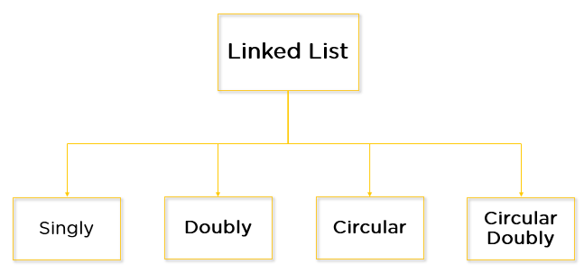
Types of linked list
Notes:
New Courses replaced with New Programmes

Slide 5
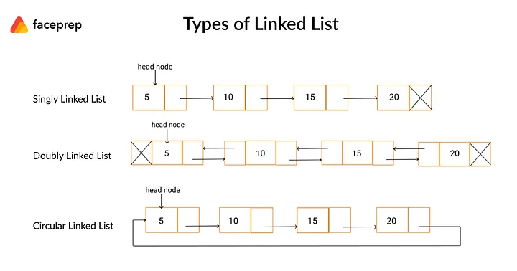
Types of linked list
Notes:
New Courses replaced with New Programmes

Slide 6
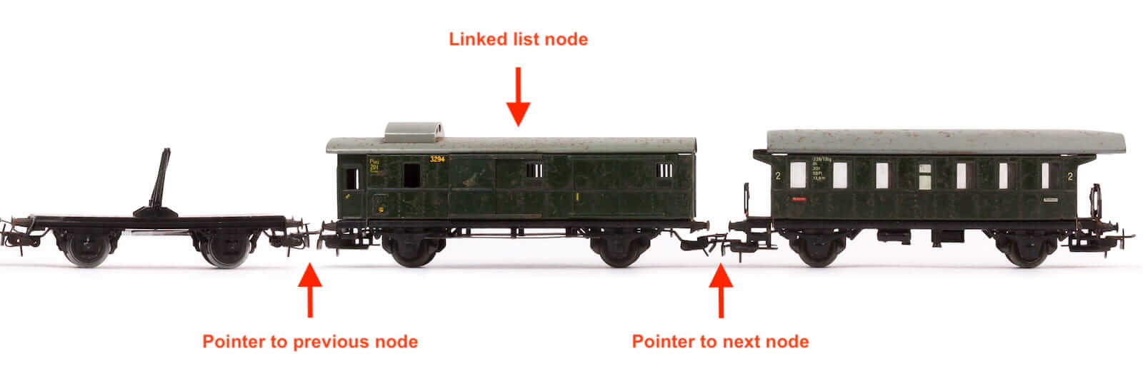
Identify
Notes:
New Courses replaced with New Programmes

Slide 7
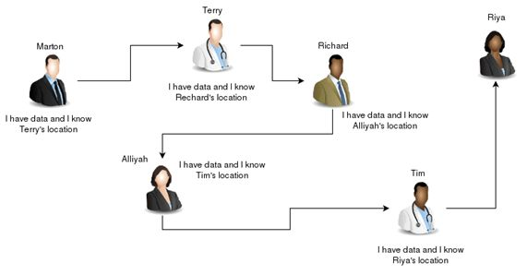
Identify type of link list
Notes:
New Courses replaced with New Programmes

Slide 8
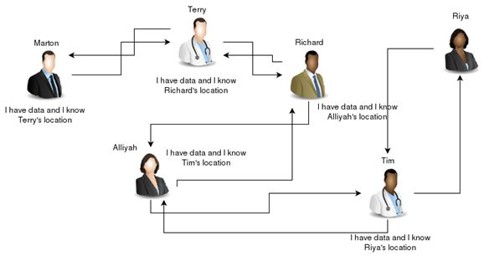
Identify type of link list
Notes:
New Courses replaced with New Programmes

Slide 9

Identify type of link list
Notes:
New Courses replaced with New Programmes

Slide 10
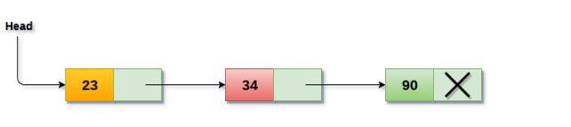
Singly linked list
Notes:
New Courses replaced with New Programmes

Slide 11
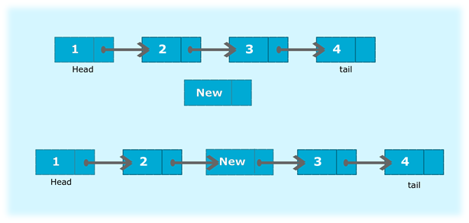
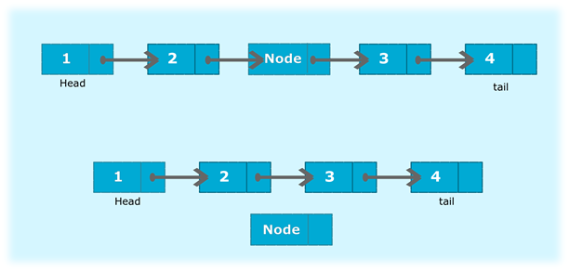
Operations on Singly Linked List
Insertion
Deletion
Notes:
New Courses replaced with New Programmes

Slide 12
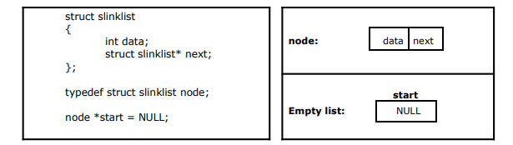
Implementation of Single Linked List
we need to create a start node, used to create and access other nodes in the linked list. The following structure definition will do
Creating a structure with one data item and a next pointer, which will be pointing to next node of the list. This is called as self-referential structure.
Initialise the start pointer to be NULL
Notes:
New Courses replaced with New Programmes

Slide 13
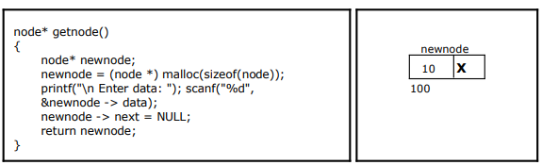
Creating a node for Single Linked List
Notes:
New Courses replaced with New Programmes

Slide 14
Singly Linked List
Data Structure | Time Complexity |  |  |  |  |  |  |  | Space Complexity
 | Average |  |  |  | Worst |  |  |  | Worst
 | Access | Search | Insertion | Deletion | Access | Search | Insertion | Deletion
Singly Linked List | θ(n) | θ(n) | θ(1) | θ(1) | O(n) | O(n) | O(1) | O(1) | O(n)
Notes:
New Courses replaced with New Programmes

Slide 15
Representation
Node Linking: Nodes are linked sequentially through pointers. Each node's pointer points to the next node in the sequence, forming the linkage.
Memory Allocation: Typically, dynamic memory allocation is used for node creation, allowing nodes to be created and destroyed as needed.
Access: Access to elements in a singly linked list starts from the head pointer. To access or manipulate data in a specific node, traversal through the list from the head pointer is necessary.
Notes:
New Courses replaced with New Programmes

Slide 16
Advantages
Efficient Insertion and Deletion: Adding or removing elements at the beginning or middle of the list is efficient, requiring only adjustments to pointers.
Dynamic Size: Singly linked lists can grow or shrink dynamically, as nodes can be added or removed without requiring contiguous memory allocation.
Flexibility: Singly linked lists have no fixed size limitations, offering flexibility in managing varying amounts of data
Notes:
New Courses replaced with New Programmes

Slide 17
Disadvantages
No Direct Access: Access to specific elements in the list requires traversal from the head pointer, making direct access inefficient.
Extra Memory Overhead: Each node in the list requires additional memory for storing pointers, leading to higher memory overhead compared to arrays.
Inefficient Reverse Traversal: Singly linked lists are inefficient for operations requiring access to nodes in reverse order, as they don't have pointers to previous nodes.
Notes:
New Courses replaced with New Programmes

Slide 18
Pseudo-code for insertion
typedef struct nd {
struct item data;
struct nd * next;
} node;
void insert(node *curr)
{
node * tmp;
tmp=(node *) malloc(sizeof(node));
tmp->next=curr->next;
curr->next=tmp;
}
Notes:
New Courses replaced with New Programmes

Slide 19
Pseudo-code for deletion
.
typedef struct nd {
struct item data;
struct nd * next;
} node;
void delete(node *curr)
{
node * tmp;
tmp=curr->next;
curr->next=tmp->next;
free(tmp);
}
Notes:
New Courses replaced with New Programmes

Slide 20
In essence ...
For insertion:
A record is created holding the new item.
The next pointer of the new record is set to link it to the item which is to follow it in the list.
The next pointer of the item which is to precede it must be modified to point to the new item.
For deletion:
The next pointer of the item immediately preceding the one to be deleted is altered, and made to point to the item following the deleted item.
Notes:
New Courses replaced with New Programmes

Slide 21
Insertion and deletion in liked list
/ Function to insert a new node.
void Linkedlist::insertNode(int data)
{
// Create the new Node.
Node* newNode = new Node(data);
// Assign to head
if (head == NULL) {
head = newNode;
return;
}
Complete code here
Notes:
New Courses replaced with New Programmes

Slide 22
Test Your self
1. As we have the memory address of Nodes can we traverse backwards in a linked list ?
a: Yes, we can.
b: No, we can’t.
2. What are the advantages of a linked list?
a: Dynamic Memory Allocation
b: They require less memory than an array to store the same data.
c: We can easily traverse back to previous elements.
d: None of the above.
Notes:
New Courses replaced with New Programmes

Slide 23
3. What is the time complexity for insertion of an element into linked list?
a: O(1)
b: O(log n)
c: O(n)
d: O(n^2)
Notes:
New Courses replaced with New Programmes

Slide 24
Quiz Answers
Answer: b
Answer :a
Answer : c
https://questions.examside.com/past-years/gate/question/pconsider-the-problem-of-reversing-a-singly-linked-list-t-gate-cse-theory-of-computation-finite-automata-and-regular-language-zpfpkf4re1g8xuff
Notes:
New Courses replaced with New Programmes

Slide 25
Review
Definition:
Singly linked list: linear structure with nodes containing data and pointers.
Components:
Nodes: data and next pointer.
Head Pointer: points to first node.
Tail Pointer: optional, points to last node.
Representation:
Nodes linked via pointers, dynamic memory allocation.
Access via head pointer, traversal for manipulation.
Notes:
New Courses replaced with New Programmes

Slide 26
Review
Advantages:
Efficient insertion/deletion.
Dynamic size, flexibility.
Disadvantages:
No direct access, traversal needed.
Higher memory overhead.
Inefficient reverse traversal.
Notes:
New Courses replaced with New Programmes

Slide 27


Notes:
New Courses replaced with New Programmes

