Slide 1

INTERDISCIPLINARY PROJECT PRESENTATION
Focus Flow-Productivity manager
By
Sarvesh S
43110832

Slide 2
AGENDA
Introduction
Abstract
Objective
System Architecture / Ideation Map
Module Implementation
Results and Discussions
Conclusion
References

Slide 3
Abstract
The Pomodoro Task Manager is a simple web-based productivity tool built using HTML, CSS, and JavaScript. It allows users to create, view, update, and delete tasks while integrating a built-in Pomodoro timer to enhance focus and time management. Each task can be tracked locally using the browser's localStorage, eliminating the need for a backend or database. The timer follows the standard Pomodoro technique - 25 minutes of focused work followed by short breaks - helping users improve concentration and productivity. The application features a clean interface, responsive layout, and real-time updates, making it an efficient and lightweight

Slide 4
Existing System
Currently, most task management and productivity tracking processes are handled manually or through separate applications. This leads to difficulty in maintaining focus, lack of synchronization between task progress and time tracking, and inefficient monitoring of productivity sessions. The Pomodoro Task Manager aims to address these issues by integrating task organization and time management into a single web-based system. Built using HTML, CSS, and JavaScript, it enables users to create and manage tasks while using a built-in Pomodoro timer to maintain consistent productivity and track work sessions effectively.

Slide 5
Proposed System
The proposed system is a web-based Pomodoro Task Manager using HTML, CSS, and JavaScript.
It lets users manage tasks and use a built-in Pomodoro timer for focused work.
Task data is saved locally, offering offline access and simple real-time tracking.

Slide 6
Advantages
Integrates task management with a Pomodoro timer for better focus.
Works offline using local storage for data saving.
Simple and responsive user interface.
Enhances productivity and time management.

Slide 7
Disadvantages
Data is lost if browser storage is cleared.
No multi-user or cloud support.
Limited to a single device.
Lacks advanced analytics or reports.

Slide 8
Hardware Requirements
• Processor: Intel i3 or above
• RAM: Minimum 2 GB
• 100 mb free space of Storage
• Internet connection
• System with browser support

Slide 9
Software Requirements
HTML-basic structure of website.
CSS-to customize the website to our liking.
JAVASCRIPT-to add functionality to the website.

Slide 10
Modules
1.FOCUS MODULE
2.SHORT BREAK MODULE
3.LONG BREAK MODULE
4.TASK MANAGING MODULE

Slide 11
Module Description
Focus Module-lets the user have a 25 min timer to work
Short break Module-lets the user take a 5 min break after the focus period
Long break Module-lets the user take a 15 min break after the focus period
Task Manager Module-lets the user add, delete and finish the tasks.

Slide 12
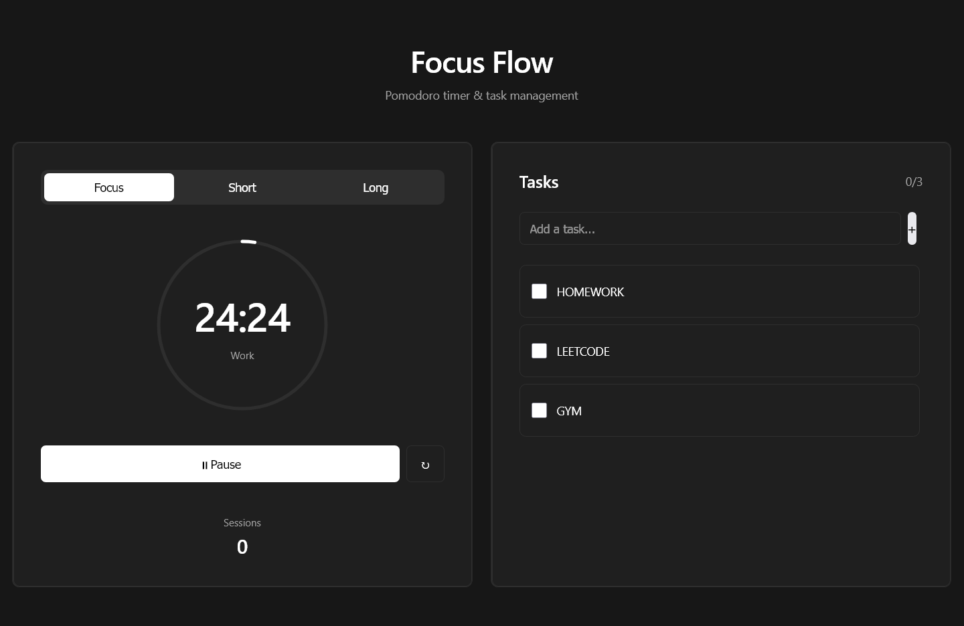
Screenshots

Slide 13
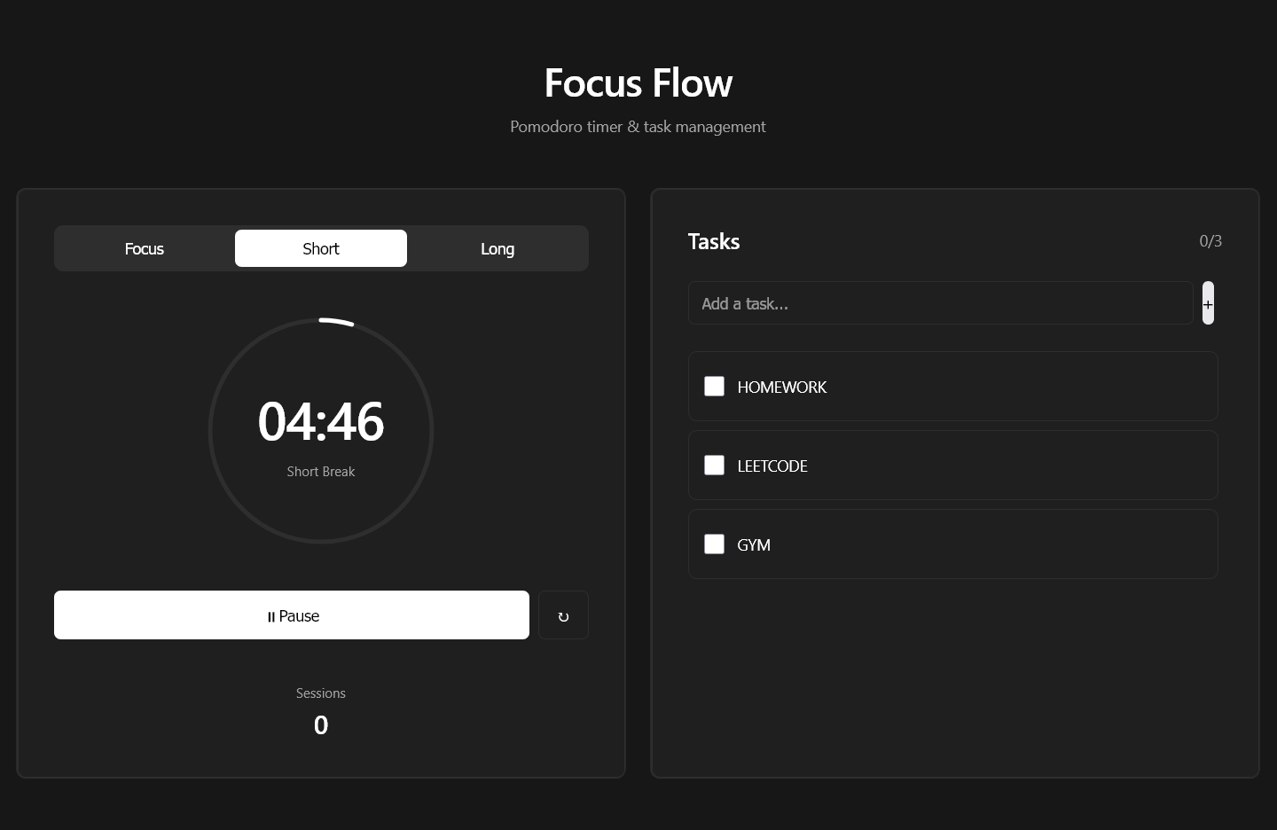
Screenshots

