Slide 1




VISUALEC
AI-Powered Vision-Based Adaptive Grid Energy Management System
Symposium Paper Presentation
MulticoreWare Annual R&D Symposium
AI
Computer Vision
IoT
Energy Optimisation
SDG: 7, 9, 11
Presenter: Sarvesh Sivasankaran Faculty Mentor: Anitha M
Rajalakshmi Engineering College
Visualec • AI + Computer Vision + IoT Energy Management

Slide 2
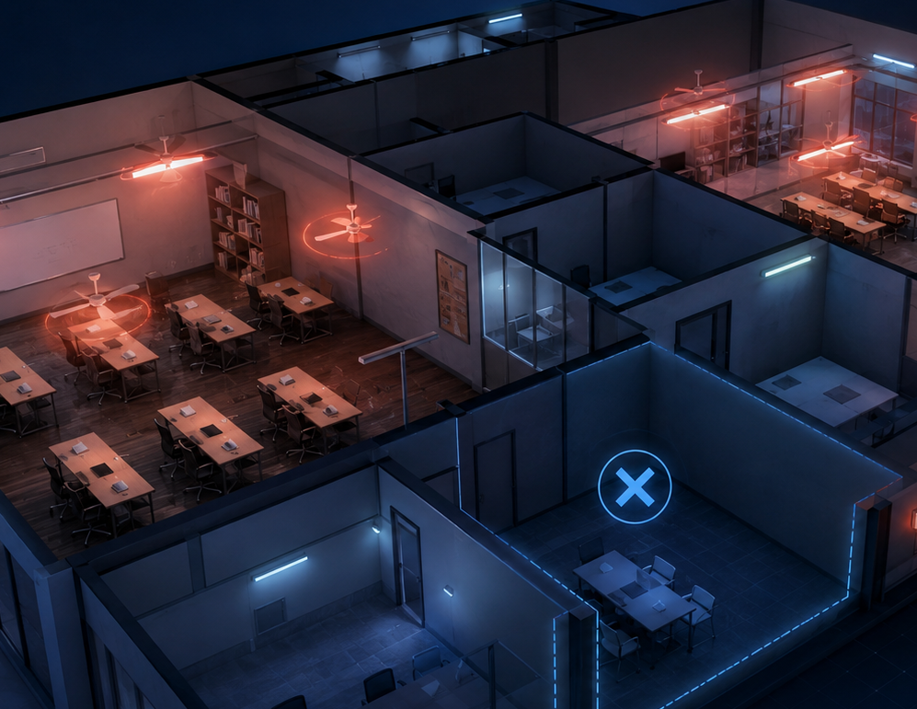
Problem Statement & Motivation
Why adaptive zone-level appliance control is needed
OBSERVED GAP
Electrical appliances often remain ON in unused areas because control is manual, schedule-based, or too coarse-grained.
• Classrooms, labs and offices have dynamic occupancy patterns.
• PIR sensors only provide basic presence detection and limited spatial understanding.
• Manual switching fails when users forget or move between sections.
• Energy control must react at zone level, not only room level.
Need
An affordable system that detects actual occupancy and controls appliances only where needed.
Visualec • AI + Computer Vision + IoT Energy Management

Slide 3
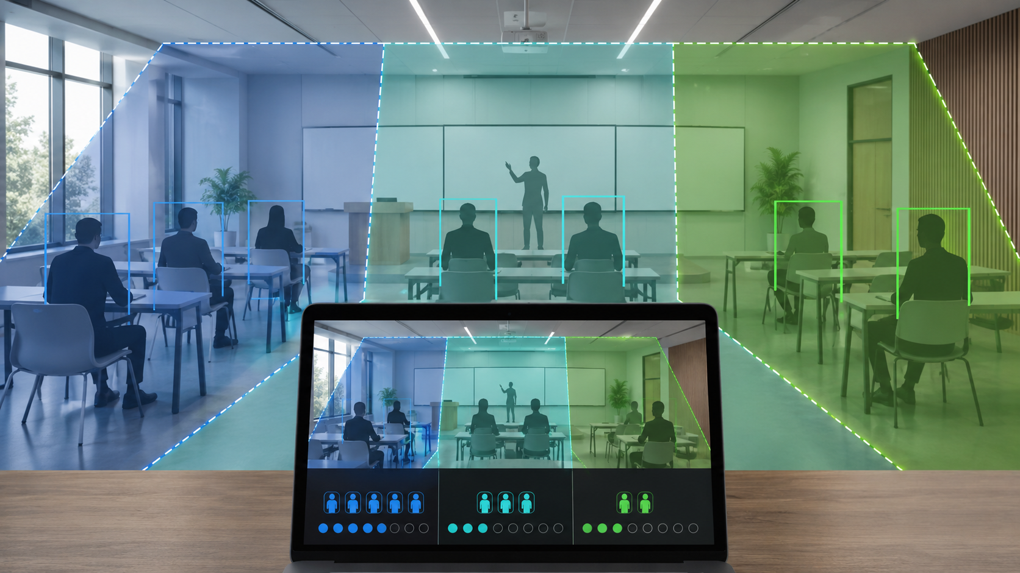
Research Objective & Contributions
Core outcomes expected from the Visualec prototype
Objective 1
Objective 2
Objective 3
Detect people from a live camera feed and map their position to room zones.
Control only zone-linked lights, fans or prototype loads using ESP32 and relays.
Monitor occupancy, relay state and estimated energy usage in real time.
Key Contributions
• Vision-based zone-level occupancy detection.
• AI-driven adaptive appliance switching logic.
• ESP32 Wi-Fi relay control layer.
• Dashboard for manual override and analytics.
• Scalable route from laptop-based MVP to edge-AI nodes.
Visualec • AI + Computer Vision + IoT Energy Management

Slide 4
Proposed Visualec System
Laptop-based AI inference with ESP32 embedded actuation
1
Laptop camera captures the room.
2
YOLO detects people in the frame.
3
Zones identify where people are located.
4
Decision engine selects appliances.
5
ESP32 receives relay commands.
6
Dashboard monitors live status.
MVP Focus
Run computer vision on the laptop; use ESP32 as a reliable relay controller.
Visualec • AI + Computer Vision + IoT Energy Management

Slide 5
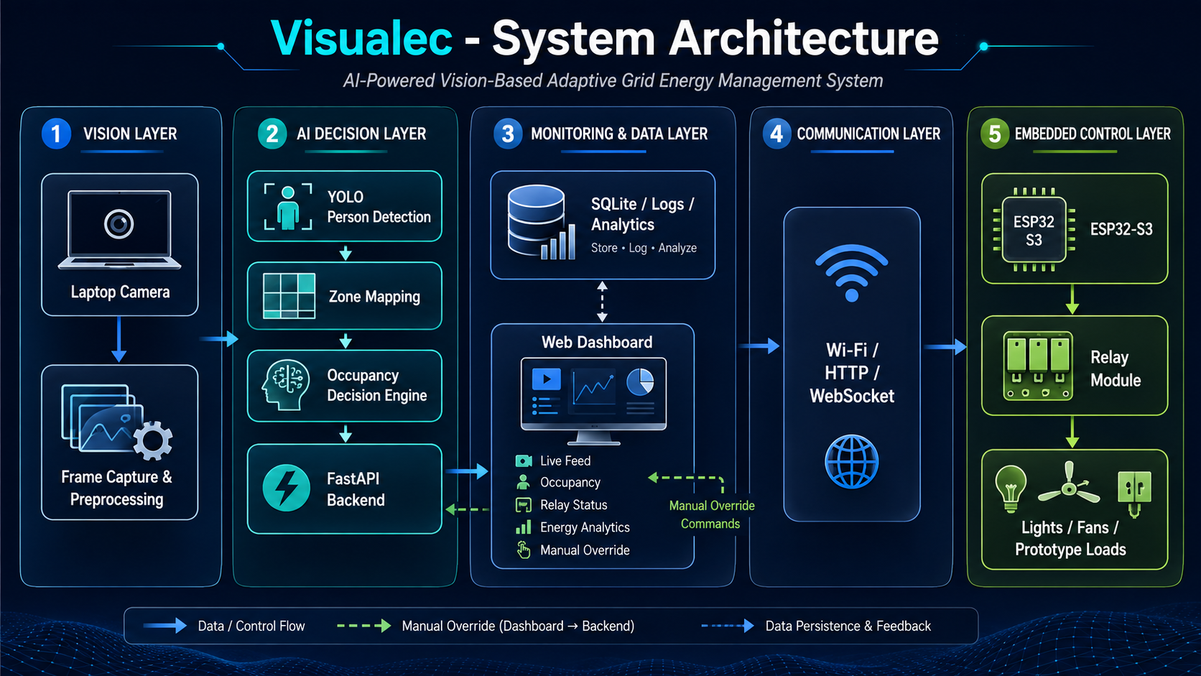
System Architecture Diagram
Vision layer → AI decision layer → communication layer → embedded control
Visualec • AI + Computer Vision + IoT Energy Management

Slide 6
Computer Vision & Zone Detection Methodology
How the system converts people detection into energy-control decisions
DETECTION METHOD
1
Capture frame using OpenCV.
2
Detect person class using lightweight YOLO.
3
Calculate bounding-box bottom-centre point.
4
Assign each person to the correct virtual zone.
5
Apply confidence threshold and filtering.
6
Use ON/OFF delays to prevent relay flickering.
Why bottom-centre?
It represents the person’s floor position better than the box centre, improving zone assignment.
Visualec • AI + Computer Vision + IoT Energy Management

Slide 7
Hardware & Software Implementation
Practical MVP setup for demonstration
HARDWARE LAYER
SOFTWARE LAYER
Prototype Components
Software Stack
• ESP32 development board
• 4-channel relay module
• Laptop webcam as vision input
• Low-voltage bulbs or prototype loads
• Regulated 5V power supply
• Python + OpenCV + YOLO for AI detection
• FastAPI backend for control logic
• React/Next.js dashboard for monitoring
• SQLite for logs and analytics
• HTTP/WebSocket for communication
Relay Mapping
ESP32 Role
Zone 1 → Relay 1
Zone 2 → Relay 2
Zone 3 → Relay 3
Receives Wi-Fi commands, validates relay IDs, switches GPIO outputs and returns acknowledgement.
Visualec • AI + Computer Vision + IoT Energy Management

Slide 8
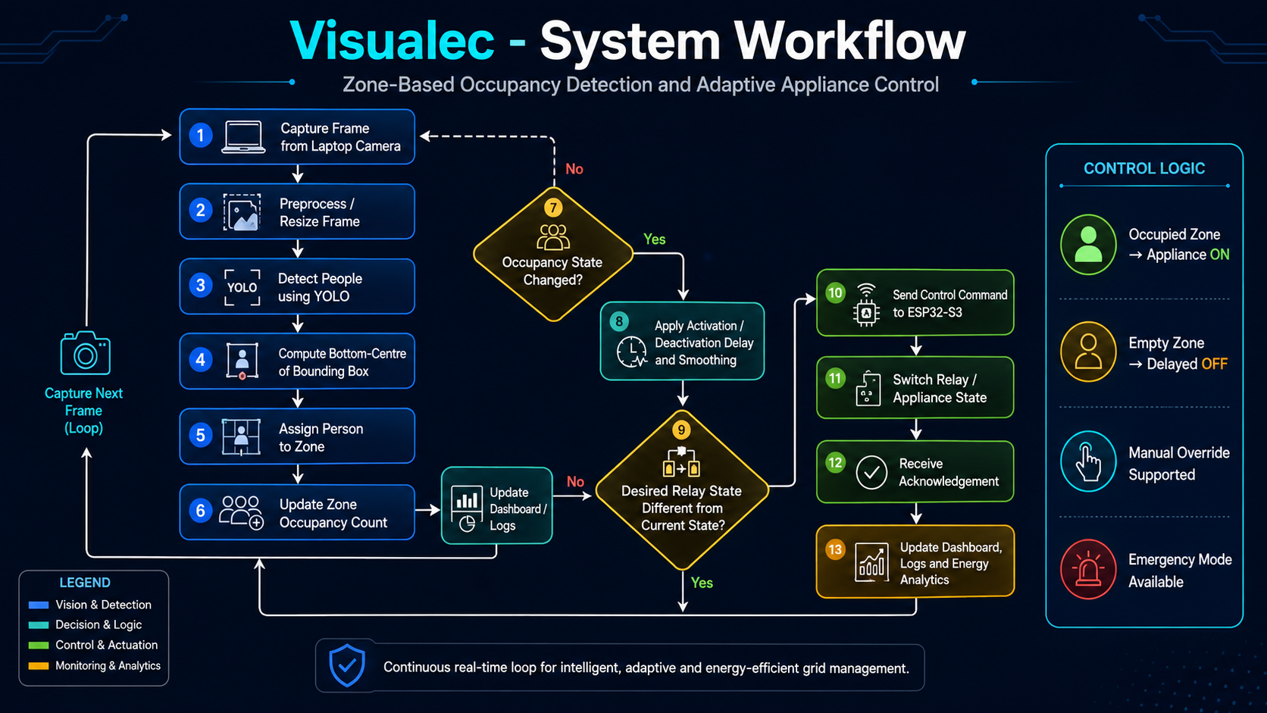
System Workflow Diagram
Continuous real-time loop for adaptive appliance control
Visualec • AI + Computer Vision + IoT Energy Management

Slide 9
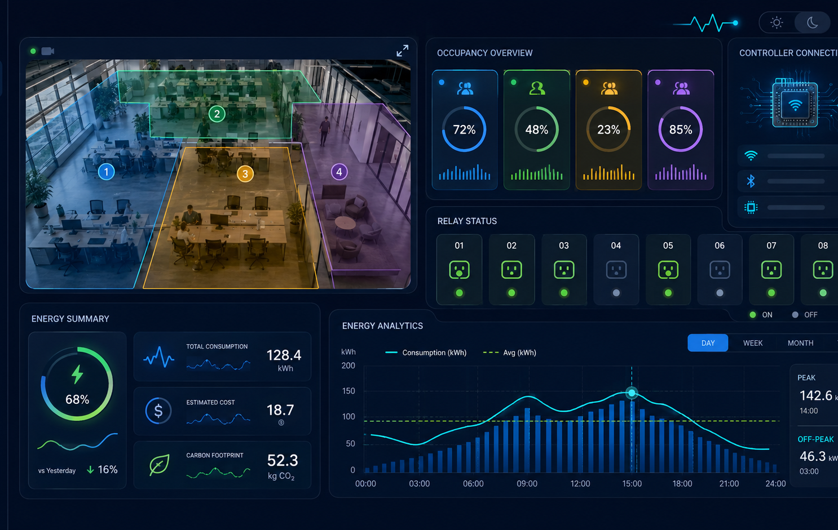
Prototype Operation & Dashboard
Real-time monitoring, override and analytics for the MVP
DASHBOARD MODULES
1
Live camera feed with zones
2
Detected people and occupancy count
3
Relay ON/OFF states
4
ESP32 connectivity
5
Automatic / manual mode
6
Energy estimate and logs
Control Modes
Automatic, manual, hybrid and emergency modes.
Visualec • AI + Computer Vision + IoT Energy Management

Slide 10
Results & Energy-Saving Evaluation
Metrics to validate performance and energy impact
EVALUATION METRICS
Traditional vs Adaptive Operation
1
Person-detection accuracy
2
Zone-assignment accuracy
4.5 kWh
3
Detection FPS
4
Relay response time
2.4 kWh
5
Occupancy-state stability
2.1 kWh
6
Estimated energy saved
Energy Formula
Baseline
All ON
Visualec
Adaptive
Saved
Energy
Energy consumed = Appliance power × Active runtime ÷ 1000
Visualec • AI + Computer Vision + IoT Energy Management

Slide 11
Limitations, Edge Deployment & Future Scope
Current boundaries and the path to scalable research deployment
Current Limitations
Future Enhancements
• Accuracy depends on camera angle and lighting.
• Occlusion affects distant-person detection.
• Laptop is required for full YOLO MVP.
• Energy values are estimates without smart metering.
• Certified safety is required for mains deployment.
• Multi-camera and multi-room support.
• Smart meter and current-sensor integration.
• Cloud analytics and long-term reports.
• Predictive energy optimisation.
• Campus-scale building-management integration.
Edge-AI Research Extension
A compressed ESP32-S3 edge node can use a quantized person-only micro-detector such as ESPDet-Pico. This is feasible for low-FPS occupancy detection, but the laptop-based system remains the stronger MVP for accurate multi-person detection and dashboard demonstration.
Visualec • AI + Computer Vision + IoT Energy Management

Slide 12
Conclusion
Visualec combines AI, computer vision and IoT to control electrical appliances according to real zone occupancy.
Smarter occupancy detection.
Adaptive appliance control.
Efficient energy utilisation.
• Reduces dependency on manual switching.
• Provides modular laptop-to-ESP32 architecture.
• Supports dashboard monitoring and analytics.
• Can scale toward distributed edge-AI nodes.
Thank You
Questions & Discussion
Visualec • AI + Computer Vision + IoT Energy Management

