Slide 1
A Cyber Triage Framework to Expedite Digital Forensic Investigation Workflows
CSE7301 University Project
Final Review
Batch Number:CSD-G40
Under the Supervision of,
Mrs.Shaik Salma Begum
Assistant Professor
School of Computer Science and Engineering
Presidency University
Roll Number | Student Name
20211CSD0185 | Sarvesh Patil
20211CSD0033 | Naveen Kumar RS
20211CSD0078 | Parashuram
20221LCSD0186 | Harish PK
Name of the Program: CSE - Data Science
Name of the HoD: Dr.Saira Banu Atham
Name of the Program Project Coordinator: Mrs. Shaik Salma Begum
Name of the School Project Coordinators: Dr. Sampath A K / Mr. Md Ziaur Rahman

Slide 2
Literature Review
Sl.No | Title / Author / Publisher | Advantages | Disadvantages
1 | Smith & Jones (2018) – Law Enforcement Vaults | Structured data storage, role-based access control | Centralized, prone to tampering, limited scalability
2 | Zhang et al. (2021) – Blockchain Evidence Framework | High data integrity (99.9%), tamper-proof ledger | Inefficient for large files, on-chain storage limitations
3 | Gupta & Sharma (2020) – Smart Contracts in Forensics | Automated access control, reduces manual errors | High complexity, possible bugs, computational overhead
4 | EU Blockchain for Forensics (2023) – Case Study | Fast cross-border evidence sharing, improved transparency | Low user adoption, regulatory alignment challenges
5 | Singh (2023) – IPFS for Evidence Storage | Scalable off-chain storage, cryptographic linkage to blockchain | External dependency, potential security vulnerabilities
6 | Brown et al. (2024) – Adoption in SMEs | Better auditability, supports industry adoption | High integration cost, steep learning curve

Slide 3
Introduction
The Cyber Triage Tool is developed to address the growing challenges in digital forensic investigations caused by the increasing volume and complexity of cybercrime. Traditional tools are often manual, slow, and vulnerable to tampering, which affects the integrity and reliability of evidence. This project introduces a blockchain-based solution that ensures tamper-proof evidence management, automates access control using smart contracts, and supports large-scale data through off-chain storage. By enhancing transparency, scalability, and interoperability, the tool empowers forensic investigators and legal professionals to work more efficiently and securely. It aims to modernize digital forensics and strengthen trust in the justice process.

Slide 4
Existing method Drawback
Data Tampering Risk Centralized systems are vulnerable to internal and external manipulation of evidence.
Manual Access Control Permission granting is slow, error-prone, and hard to scale across large teams.
Limited Scalability Traditional systems cannot efficiently handle large volumes of digital evidence.
Poor Interoperability Incompatibility between different forensic tools and jurisdictions hinders collaboration.
Lack of Real-Time Sharing Cross-border investigations are delayed due to slow, manual data transfer.

Slide 5
Objectives
Ensure data integrity using blockchain for tamper-proof evidence.
Automate access control through smart contracts.
Improve scalability with off-chain storage for large datasets.
Enable seamless interoperability with existing forensic tools.
Strengthen compliance with legal and regulatory standards.
Enhance transparency and auditability via immutable logs.
Design user-friendly interfaces for broader adoption.

Slide 6
Methodology/Modules
Step 1: Requirement Analysis → Identify functional, technical, and legal requirements.
Step 2: System Architecture Design → Design blockchain-based architecture with smart contracts and off-chain storage.
Step 3: Technology Selection → Select tools: Hyperledger, IPFS, MongoDB, React, etc.
Step 4: Prototype Development → Develop modules for evidence handling and access control.

Slide 7
Step 5: Tool Integration → Integrate with existing forensic tools (e.g., Autopsy, FTK).
Step 6: Performance Testing → Test speed and scalability on real-world datasets.
Step 7: Security Evaluation → Apply cryptographic safeguards, conduct penetration testing.
Step 8: User Acceptance Testing → Pilot run with forensic analysts, gather feedback.

Slide 8
Architecture

Slide 9
Pseudo code:
Start
Show Home Page
IF user clicks on "Login":
Go to Login Page
IF user is not registered:
Show Registration Form
IF valid details submitted:
Save user data to database
Redirect to Login Page
ELSE:
On successful login:
IF user role == "Investigator":

Slide 10
Pseudo code:
ELSE IF user role == "Admin":
Show Admin Dashboard
Admin can:
→ View All Cases
ELSE IF user role == "Legal Officer":
Show Legal Dashboard
Legal Officer can:
→ Review Evidence History
→ Verify Audit Trails
→ Approve/Reject Evidence for Court Use
ELSE:
Show Error Message: "Invalid Role"
Logout Ends Session
End

Slide 11
Hardware/software components
Software: Python, Flask, TensorFlow, PySpark, MongoDB, React
Hardware: Standard workstation with multicore CPU, 16 GB RAM, 1 TB HDD/SSD
Tools & Platforms: Apache Spark, IPFS, Hyperledger Fabric, Visual Studio Code, GitHub

Slide 12
OUTPUTS

Slide 13
OUTPUTS

Slide 14
OUTPUTS

Slide 15
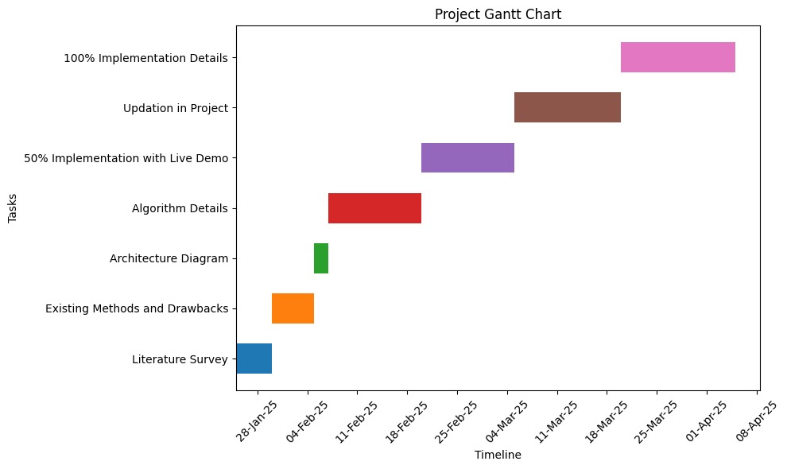
Timeline of Project

Slide 16
Expected Outcomes
Tamper‑proof evidence management via blockchain immutability
Automated, error‑free access control using smart contracts
Seamless cross‑jurisdictional evidence sharing through standard APIs
Scalable processing of large forensic datasets with off‑chain storage
Comprehensive, real‑time audit trails for every action
High system performance, supporting hundreds of gigabytes per hour
Intuitive, user‑friendly interface for investigators of all skill levels
Robust security with end‑to‑end cryptographic safeguards
Built‑in compliance with GDPR and other legal standards
Cost‑effective deployment leveraging open‑source frameworks

Slide 17
Conclusion
The Cyber Triage Tool leverages blockchain’s immutability, smart contract automation, and scalable off‑chain storage to transform digital forensic investigations. By ensuring tamper‑proof evidence logging, streamlined access control, and seamless interoperability with existing tools, it addresses critical challenges of data integrity, scalability, and regulatory compliance. Its intuitive interface and modular architecture empower investigators to work efficiently across jurisdictions, while comprehensive audit trails and cryptographic safeguards strengthen legal admissibility. As a cost‑effective, open‑source solution, the tool not only accelerates case workflows but also sets a new standard for transparency and trust in digital forensics, paving the way for future innovation and collaboration.

Slide 18
Github Link
The Github link provided should have public access permission.
Github Link:
https://github.com/Sarveshveeru1/A-Cyber-Triangle-Framework-to-expedite-Digital-Forensic-Investigation-Workflows

Slide 19
References
Smith, A. & Jones, B. (2018). “A Survey of Law Enforcement Electronic Vaults.” IEEE Journal of Digital Forensics.
Zhang, Y., Li, X. & Chen, Z. (2021). “Blockchain-Based Evidence Management Framework.” ACM Transactions on Privacy and Security.
Gupta, R. & Sharma, P. (2020). “Smart Contract‑Based Access Control in Digital Forensics.” IEEE Access.
European Union (2023). Blockchain for Forensics: Pilot Study on Cross‑border Evidence Sharing.
Singh, K. (2023). “Scalable Off‑Chain Storage for Forensic Data Using IPFS.” International Journal of Distributed Systems.
Brown, L., Patel, S. & Kumar, R. (2024). “Adoption of Blockchain in SME Forensic Practices.” Forensic Science International Reports.

Slide 20
Thank You

