Slide 1

DA 204o Data Science in Practice
Course Project Presentation
Driver Behavior Classification & Fuel Consumption Prediction
Riddhi Ranjan De(23604)
Sarveshwaran N(23585)

Slide 2
Data Science Canvas |  |  | Project: | Driver Behavior Classification & Fuel Consumption Prediction
 |  |  | Team: | Riddhi Ranjan DE Sarveshwaran N
Problem Statement |  |  |  | Execution & Evaluation |  | Data Collection & Preparation
Business Case & Value Added Analyze telematics data to detect unsafe driving and predict fuel usage. This improves fleet safety and reduces operational fuel costs. | Model Selection Use clustering and gradient-boosted models to detect aggressive driving and predict fuel use. These methods handle unlabeled, non-linear telematics data effectively. Aggressive Driving: K-Means (k=4) for pseudo-labels XGBoost Classifier for deployment Fuel Prediction: XGBoost & HistGradientBoosting Regressors. These handle non-linear behavior, large datasets, and unlabeled data. | Model Requirements Models must avoid driver leakage, handle non-linear patterns, and use scaled numeric inputs. They must generalize to unseen drivers for valid performance. | Skills Python (Pandas, NumPy, Scikit-learn). ML: clustering, boosting, evaluation metrics. Feature engineering & EDA. Domain understanding of telematics (speed, rpm, braking). Visualization (Matplotlib/Seaborn). | Model Evaluation Evaluate accuracy, F1, and ROC-AUC for aggressive driving, and MAE for fuel prediction. Real-time monitoring is required for safety alerts. | Data Storytelling The target audience needs clear visuals and actionable insights. Use simple cluster explanations and plots to highlight unsafe driving and inefficient trips. Visualize PCA, scatter plots, percentile thresholds. Provide practical insights: unsafe drivers, fuel-inefficient trips. | Data Selection & Cleansing Clustering/classification used 6 behavior features; fuel prediction used 10 engineered features. Timestamp removed, no missing data, and outliers kept as meaningful extremes. | Data Collection Dataset: Driver Behavior & Route Anomaly (DBRA24) from Kaggle. 120,000 trips × 26 features collected from telematics sensors: speed, acceleration, steering, rpm, route deviation, weather, road type. Additional data can be gathered from vehicle sensors, OBD-II, and terrain APIs. It must be accurate, time-aligned, and consistently recorded per trip.
Data Landscape You need trip-level telemetry, environmental context, and fuel data, which are already available. Additional vehicle specifications and terrain data would improve accuracy. |  | Software & Libraries Python + Jupyter Notebook Pandas, NumPy, Matplotlib, Seaborn Scikit-Learn, XGBoost, HistGradientBoosting (Optional future work: PyTorch for AE/Deep models) |  |  |  | Data Integration All data is already in a single CSV, so migration isn’t needed. It should simply be loaded into a unified Python/pandas environment for processing. | Explorative Data Analysis EDA showed meaningful outliers reflecting real extreme behaviors and clear driver-specific patterns. Descriptive statistics and distributions were created to assess data quality. Confirmed 1 trip = 1 row (no time series). Driver-level profiling identified behavioral variability. Correlation heatmaps showed weak correlations → need multi-feature modeling. Identified skewed features (rpm, acceleration variation). Percentile thresholds computed (p50–p99).

Slide 3
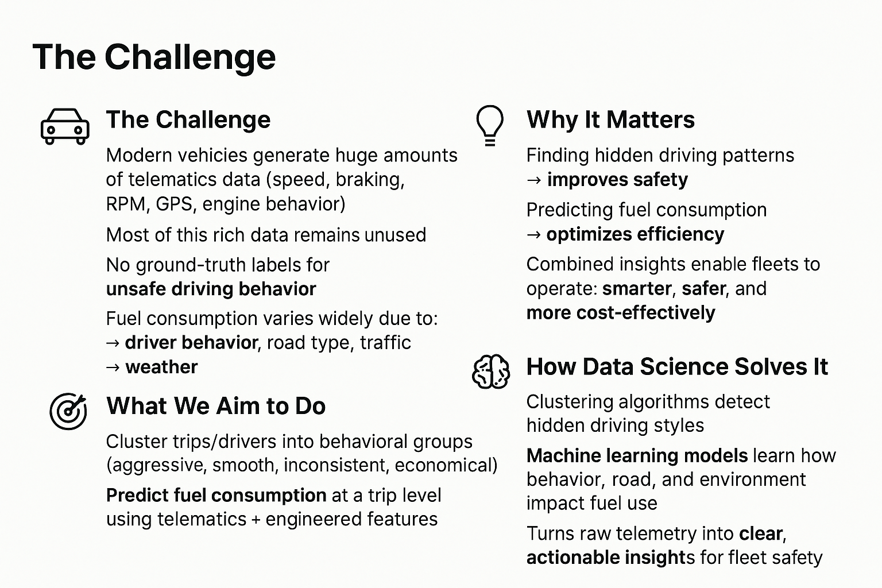
Problem Definition (Clustering + Prediction)

Slide 4




Data Collection and Preparation
Driver Behavior & Route Anomaly Dataset (DBRA24)
Dataset Overview
Sourced from Kaggle, collected from vehicles across California. Contains 120,000 trip records with 26 telemetry features capturing detailed driving behavior.
Telemetry Data Captured
Includes speed, acceleration, braking, steering angle, RPM, route deviation, anomalous events, and environmental context (weather, road type, traffic).
Data Characteristics
No missing or duplicate values, clean dataset without outliers, though class imbalance exists in anomaly labels.
Analysis Problems Addressed
Anomaly classification to detect unsafe events, fuel consumption regression to predict trip usage, and clustering to group drivers by smooth or aggressive behavior.

Slide 5
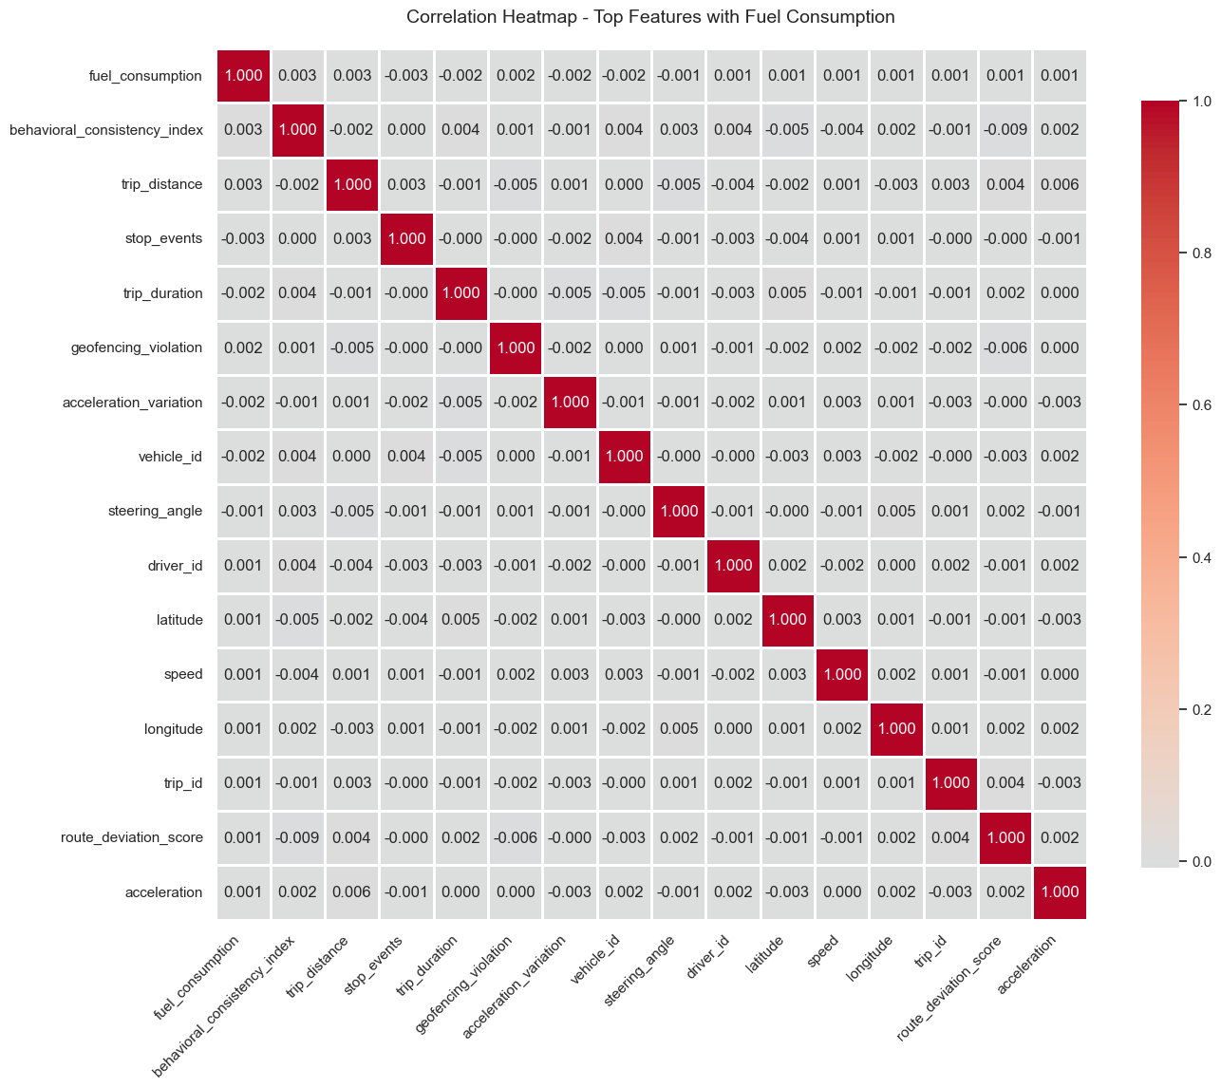
EDA for Fuel Prediction
Feature Relationships: All linear correlations with fuel are <0.01, showing no linear signal. Weak non-linear effects observed from trip distance, duration, acceleration variation, and braking events. Speed and RPM are scattered with no clear trend.
  Categorical Effects: Weather (rain/fog) slightly increases fuel use. Heavy traffic correlates with higher fuel consumption. Highways consume marginally more than rural or urban roads.
  Target Variable Behavior: Fuel consumption is highly right-skewed (0–50+ L), with mean ≈ 5.0 L and std ≈ 5.0 L. Q–Q plot confirms strong non-normality and high variability.
  Conclusions & Recommendations: Fuel shows weak linear relationships and strong noise. Linear regression performs poorly (R² ≈ 0). Nonlinear approaches—ensemble models, interaction terms, or deep learning—recommended for improved prediction.

Slide 6
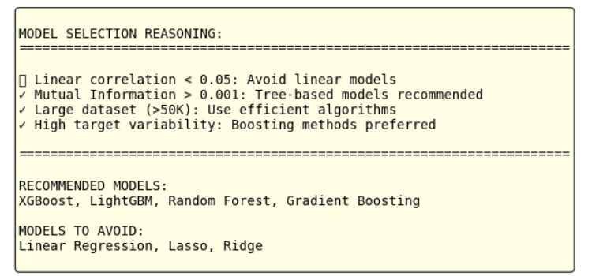
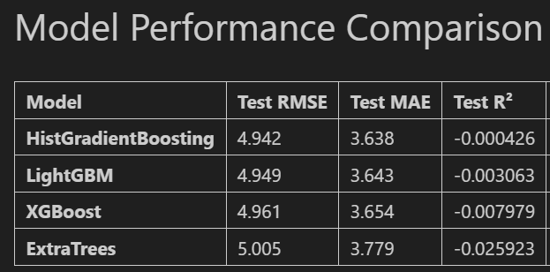
Model Selection and Model Performance
Conclusions
Model Performance
Boosting methods perform best and train efficiently
All models show near-zero R², meaning fuel is inherently hard to predict
Simple models fail due to non-linearity and high noise
Data Limitations
Very weak feature–target relationships (<0.01 correlation)
Missing key info (vehicle specs, fuel type, load, engine behavior)
Current features capture <3% variance
Next Steps
Feature engineering: Interaction terms, polynomial features, temporal features
Collect more data: Vehicle metadata, engine metrics, fuel type
Advanced modeling: Deep learning, hybrid stacking models

Slide 7
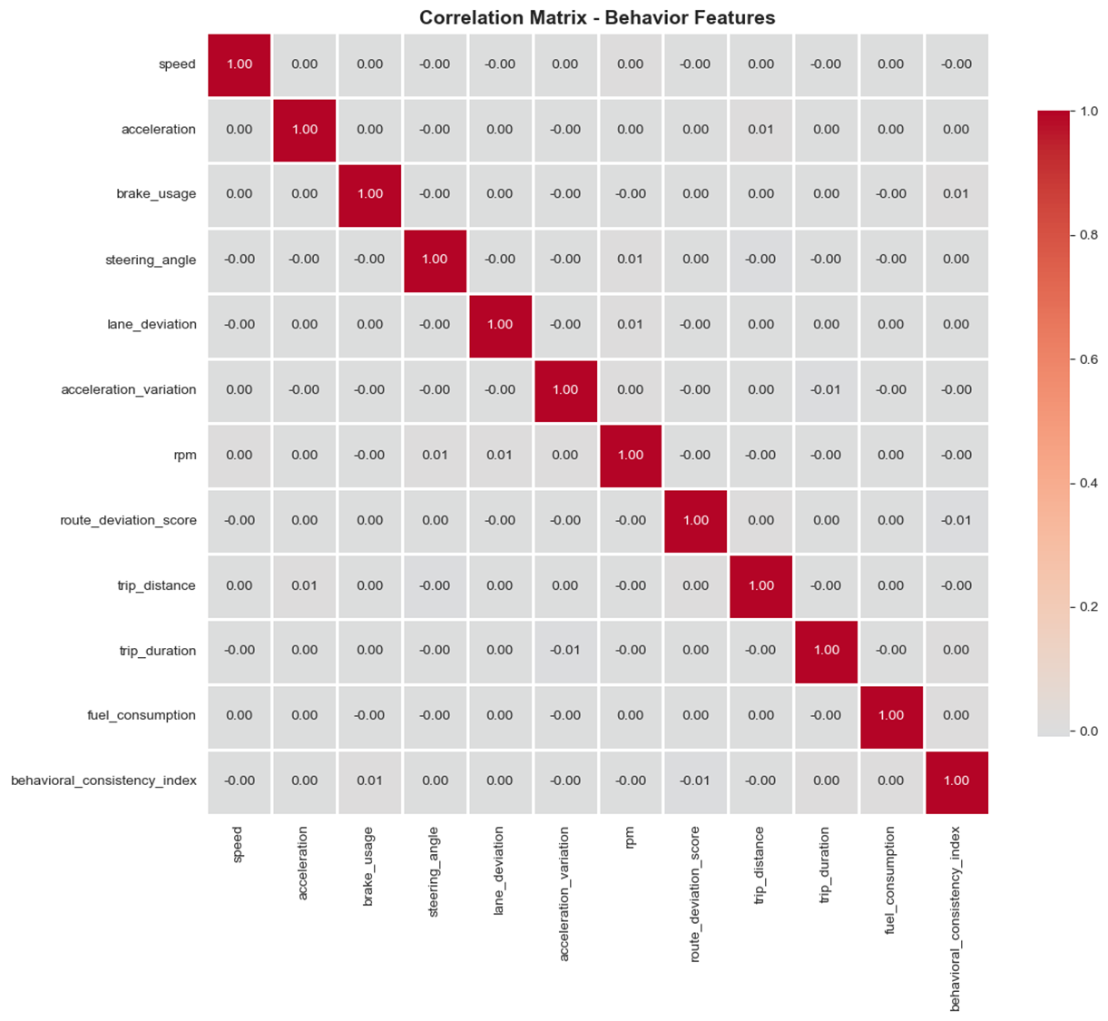
Exploratory Data Analysis for Clustering
Identifying Driver Behavior Patterns
Behavior Feature Analysis: Key telemetry variables—speed, acceleration, brake usage, steering angle, lane deviation, acceleration variation, RPM, and route deviation—capture diverse behavioral signatures. Distributions show heavy tails, especially in acceleration and braking, revealing aggressive vs. smooth driving styles.
  Correlation Insights: Pairwise correlations among behavior features are all below 0.02, indicating strong feature independence. No multicollinearity means each feature contributes distinct behavioral information, ideal for clustering methods such as K-Means and DBSCAN.
  Statistical Observations: Behavioral features exhibit high variance and distinct distributions, confirming the presence of separable driving groups and strong anomaly signals.
  Key Takeaways: Low correlation and high variability imply rich behavioral diversity. Clustering can effectively categorize risk levels and identify driving style anomalies, offering actionable insights for safety and performance optimization.

Slide 8
Driver Behavior Classification Pipeline
Data Preparation
Telemetry Dataset (120k trips)
• 26 trip-level telemetry + environmental features
• No missing values; trip-level granularity validated
Feature Selection
• 6 behavioral features chosen for clustering
(acceleration, acceleration_variation, brake_usage, rpm, lane_deviation, steering_angle)
Unsupervised Learning (Pseudo-Labeling)
K-Means Clustering
• k = 4 clusters,
StandardScaler normalization
• Domain-guided centroid initialization
Pseudo Label Generation
• Identify “Aggressive” cluster (C2)
via composite risk score
• Create binary target:
0 = Non-aggressive
1 = Aggressive
Supervised Learning
Group-Aware Train–Validation Split
• 80/20 split
Model Training (XGBoost)
• 200 estimators, depth 6
• Class weighting applied
• 6 behavioral input features
• 1 binary target
Model Evaluation
Model Validation
• Confusion matrix
• Accuracy, Precision, Recall,
F1-score
• Feature importance interpretation

Slide 9
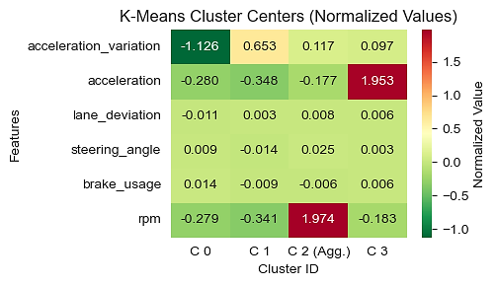
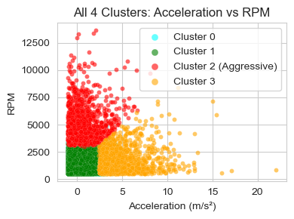
Pseudo-label generation
Goal: Automatically identify the aggressive driving cluster from K-Means outputs by scoring each cluster centroid on aggression-related features.
Feature | Weight | Meaning
rpm | 2.0 | Strongest indicator of aggressive throttle usage
acceleration_variation | 1.5 | Captures jerky / repeated bursts
acceleration | 1.5 | Measures high-intensity acceleration events
steering_angle | 1.2 | Reflects sharp turns / lane instability
brake_usage | 1.2 | Indicates hard braking or tailgating
lane_deviation | 1.0 | Tracks lateral instability under aggressive behavior
Observation: Aggressive cluster (C2) shows high RPM even under moderate acceleration.
RPM strongly signals aggressive driving because high or rapidly fluctuating RPM reflects forceful throttle input and elevated engine load¹.
Composite Risk Score = 2·rpm + 1.5·acc_variation + 1.5·acceleration + 1.2·|steering_angle| + 1.2·brake_usage + lane_deviation
Cluster with highest composite risk score = Aggressive Cluster (C2)
¹Zhang et al., IEEE T-ITS, 2018

Slide 10
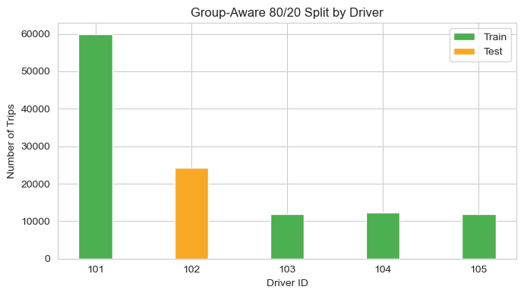
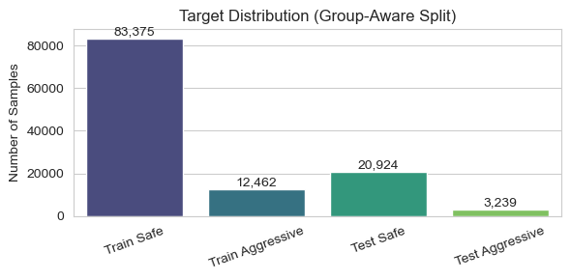
Supervised Learning
Supervised model trained on pseudo-labels using driver-aware splitting to ensure generalization to unseen drivers
Group-Aware Train–Validation Split
80/20 split
Drivers partitioned using GroupShuffleSplit
Prevents driver-level leakage
XGBoost Model Training
200 estimators, max_depth = 6
Class weighting applied for imbalanced pseudo-labels
6 behavioral input features
1 binary target (Aggressive = 1, Non-aggressive = 0)
Fast inference (<1 ms), suitable for real-time scoring
Validation F1 = 0.9904 (99.04%)

Slide 11
Performance
Aggressive vs Non-Aggressive Driving
(XGBoost Classifier)
Rank | Feature | Importance
1 | rpm | 92.3%
2 | lane_deviation | 4.3%
3 | acceleration | 2.5%
4 | steering_angle | <1%
5 | acceleration_variation | <1%
6 | brake_usage | <1%
Label | Meaning | Distribution
0 | Non-aggressive | 86.9%
1 | Aggressive | 13.1%
Confusion Matrix (Validation Set)
20869
55
Metric | Value
Accuracy | 0.997
Precision | 0.983
Recall | 0.997
F1 Score | 0.990
0
True Label
8
3231
1
0
1
Predicted Label
The model achieves >99% accuracy with extremely low false positives and false negatives, demonstrating reliable aggressive-driving classification.

Slide 12
Thank you!

