Slide 1

REAL TIME WEATHER MONITORING SYSTEM BY SARVESHWARAN V (RA2311017010006) SOHAN SIDHAARTH PRASAD(RA2311017010013) 3rd year
21EIC301P- EMBEDDED SYSTEM DESIGN
DEPARTMENT OF ELECTRONICS AND INSTRUMENTATION ENGINEERING

Slide 2
Problem Statement & Objectives
Problem Statement
Real-time, accurate, and location-specific weather data is often unavailable with conventional systems. There is a need for a low-cost IoT-based weather monitoring station that can measure temperature, humidity, pressure, rainfall, and wind to provide reliable local weather insights.
Objectives
To develop an IoT-enabled weather monitoring station using STM32 for sensor data acquisition and ESP32 for wireless communication.
This measure key weather parameters such as temperature, humidity, rainfall, and atmospheric pressure using reliable, low-cost sensors.

Slide 3
Abstract
This project presents a solar-powered weather monitoring station using an STM32 microcontroller and ESP32 module. It measures temperature, humidity, rainfall, and atmospheric pressure through dedicated sensors and displays the results on an LCD with push-button control. A solar panel with voltage regulation ensures continuous, eco-friendly operation. Data is processed locally and can be monitored remotely, making the system low-cost, efficient, and suitable for smart agriculture and environmental applications.

Slide 4
Literature Review
S.No. | Title of the Paper | Year | Journal/Conference Name | Inferences
1 | IoT Based Weather Monitoring System using ESP32 | 2021 | IEEE Conference on IoT Applications | Proposed a low-cost IoT-based system with real-time monitoring.
2 | Design of STM32 Microcontroller Based Weather Station | 2020 | International Journal of Embedded Systems | Demonstrated efficient data acquisition and processing using STM32.
3 | Wireless Weather Monitoring using ESP32 and Cloud Integration | 2022 | Springer IoT and Smart Systems | Integrated ESP32 with cloud platforms for remote monitoring.

Slide 5
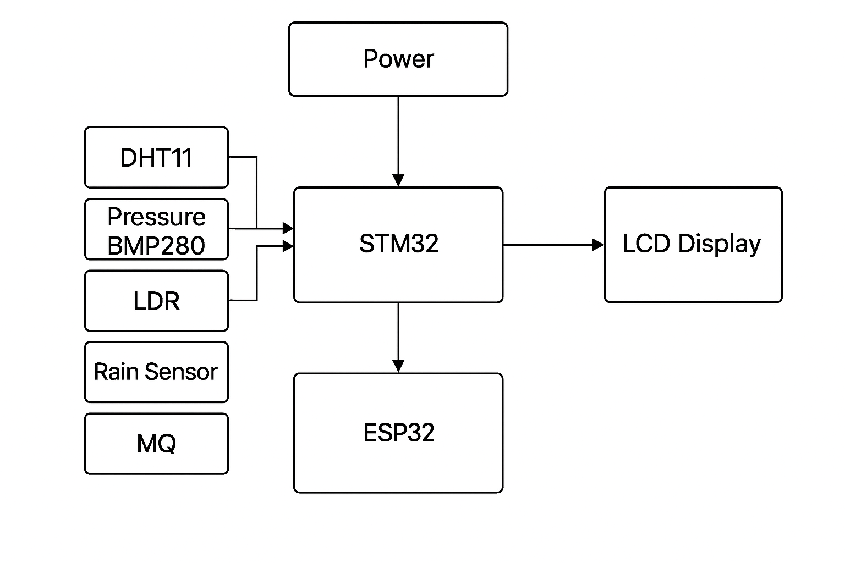
Methodology- Block Diagram

Slide 6
Algorithm
Initialize STM32, ESP32, LCD & SensorsCalibrate sensors (Temp, Humidity, Rain, Pressure)
Collect sensor data using STM32Process data (unit conversion & filtering)
Display readings on LCD (push button to switch views)
Transmit data from STM32 → ESP32 → Cloud/IoT platform
Store/log data locally or in server
Perform basic weather prediction (optional AI in ESP32)
End

Slide 7
Processor & Components Specification
Component | Specification / Details
STM32 Microcontroller | 32-bit ARM Cortex-M, 72 MHz (e.g., STM32F103C8T6), Flash: 64 KB, RAM: 20 KB
ESP32 Wi-Fi Module | Dual-core 32-bit LX6 CPU, Wi-Fi 802.11 b/g/n, Bluetooth 4.2, Operating Voltage: 3.3V
Temperature & Humidity Sensor (DHT22 / SHT31) | DHT22: Temp Range -40°C to +80°C, Accuracy: ±0.5°C, Humidity Range: 0–100%, Accuracy: ±2–5%
Barometric Pressure Sensor (BMP280 / BME280) | Pressure Range: 300–1100 hPa, Accuracy: ±1 hPa, Temp Range: -40°C to +85°C
Rain Sensor Module | Analog & Digital Output, Operating Voltage: 3.3–5V
LCD Display (16x2 / 20x4 with I2C module) | Operating Voltage: 5V, Display: Alphanumeric (2 rows × 16 characters)
Push Button | SPST, Debounced, 5V compatible
Voltage Regulator (AMS1117 / LM7805) | AMS1117-3.3: 3.3V, 1A output; LM7805: 5V, 1A output
Battery (Li-ion / Lead-acid) | 3.7V Li-ion (2000–4000 mAh) or 12V Lead-acid
Miscellaneous | PCB, Jumper Wires, Resistors, Capacitors

Slide 8
References
A. Rivera, P. Ponce, O. Mata, A. Molina, and A. Meier, “Local Weather Station Design and Development for Cost-Effective Environmental Monitoring and Real-Time Data Sharing,” Sensors, vol. 23, no. 22, 2023.
H. Chourasiya, P. Sharma, A. [et al.], “IoT-Enabled Real-Time Weather Station Using Arduino and STM32 Microcontrollers,” International Journal of Computer Techniques, vol. 12, no. 4, July–Aug. 2025.
A. F. Haque Dhrubo, S. Hasan, M. A. Qayum, “STM32-Based IoT Framework for Real-Time Environmental Monitoring and Wireless Node Synchronization,” arXiv preprint, June 2025
Z. Ohemu, J. Owolabi, H. Ali, “Real-Time Weather Forecasting Using BME280 and STM32 Microcontroller,” Asian Journal of Computer Science and Technology, vol. 14, no. 1, 2025.
Air Quality Monitoring and Alert System Using MQ135 Gas Sensor with Arduino Controller, ResearchGate (2022).
Development of an IoT-Enabled Air Pollution Monitoring and Air Quality Sensor System,” PMC, 2023.
IoT Based Weather Tracker with Data Logging Systems,” D. Samrat et al., 2024.
Air Pollution Detection Using MQ135 and ESP8266,” IJSRET, 2025
X. Shengzong and Y. Li, “Design and Implementation of Wireless Environment Monitoring and Control System,” Journal/Conference X

Slide 9
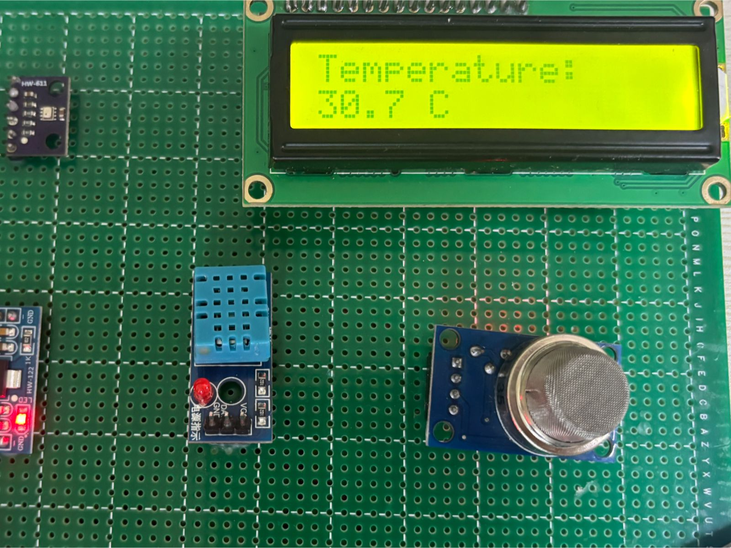
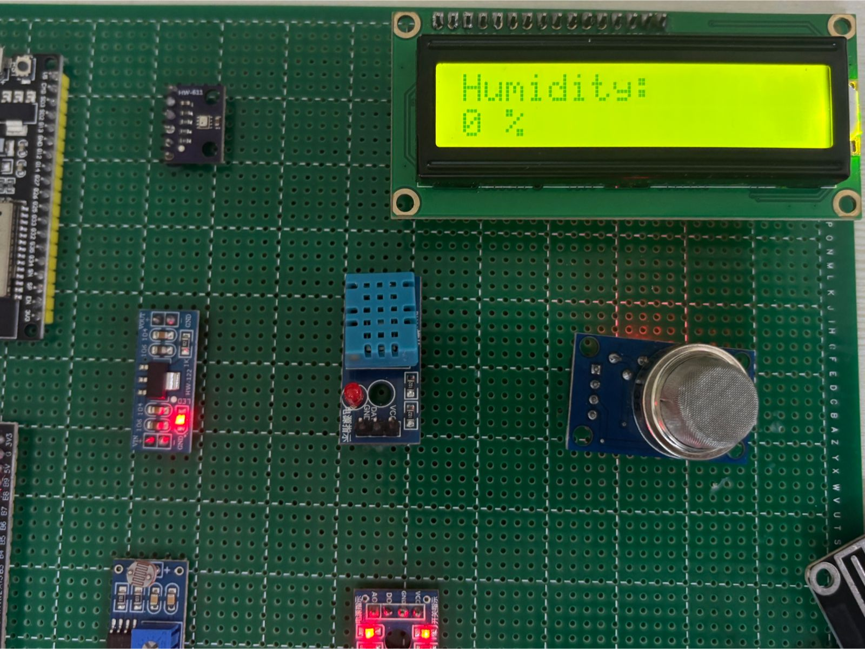
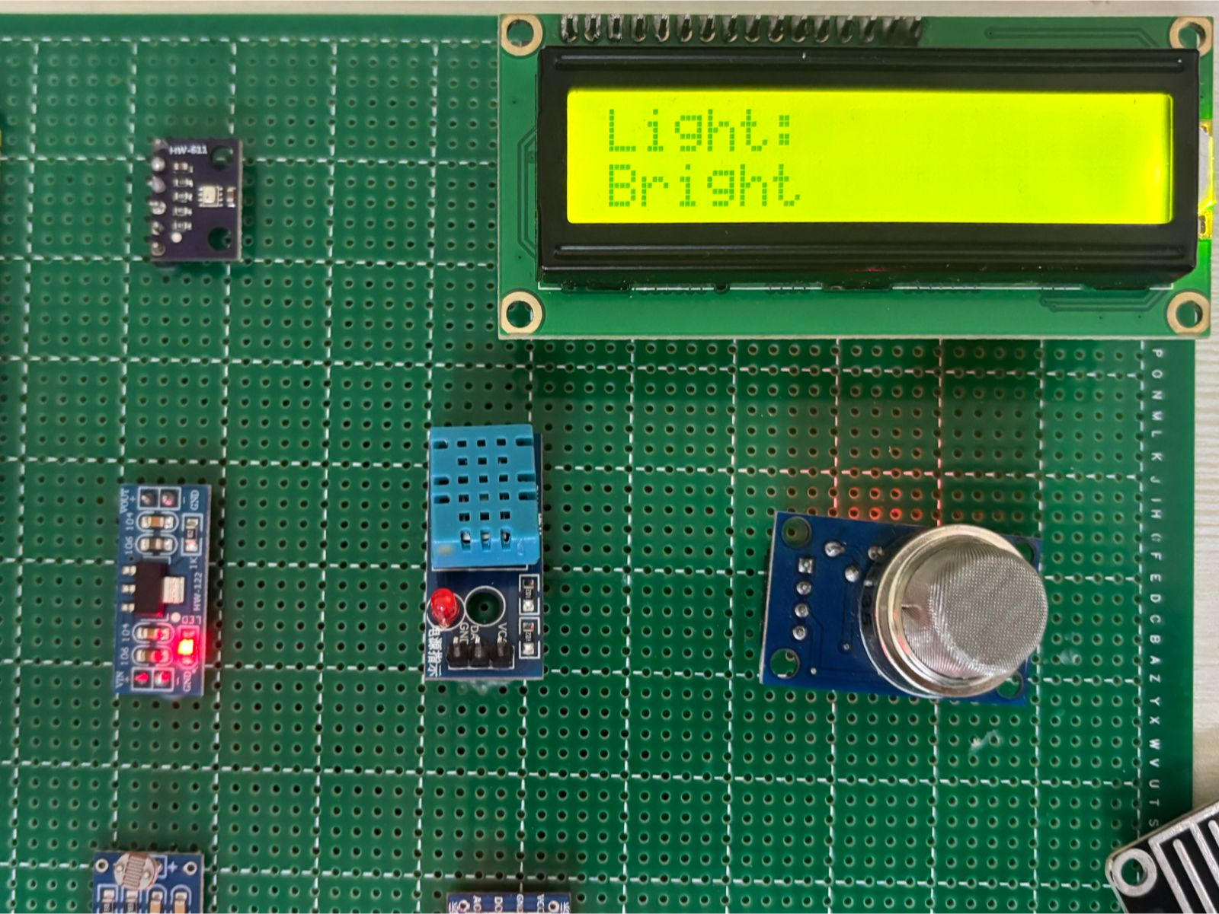
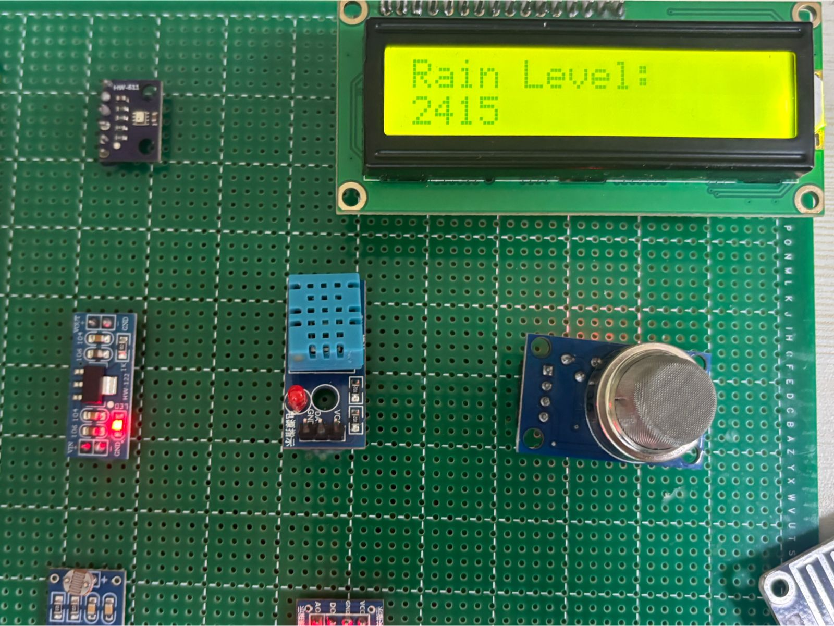
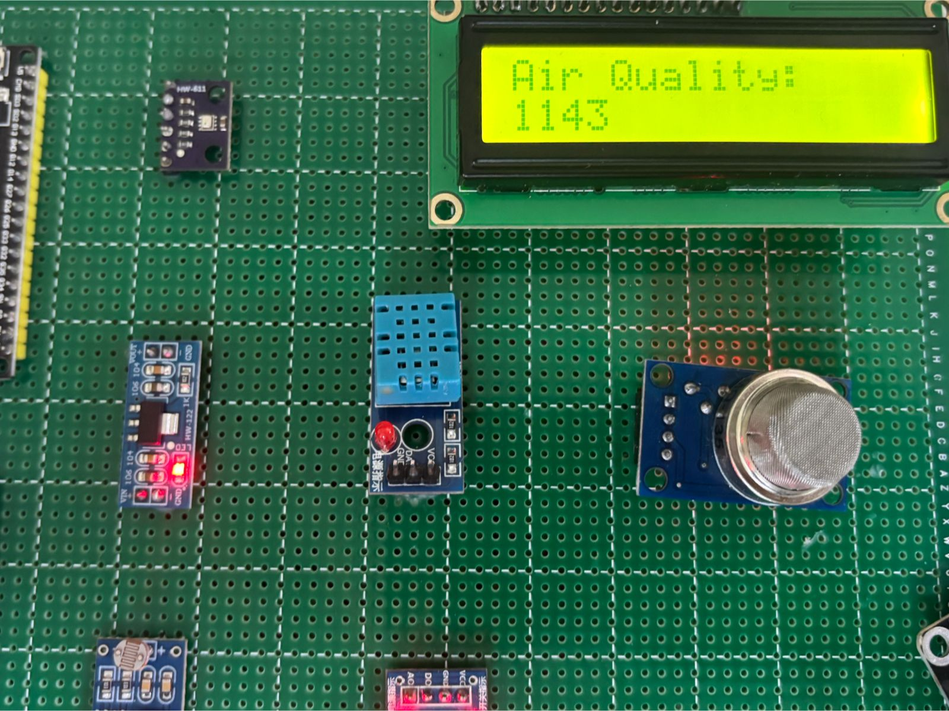
Result Images
Temperature reading
Humidity reading
LDR Sensor reading
Rain Level reading
Air Quality reading

Slide 10
Observed Readings
Parameter | Sensor Used | Typical Range | Observed Value | Unit
Temperature | BMP280 | -40 to 85 | 30.4 | °C
Humidity | DHT11 | 20–90 | 58 | %
Pressure | BMP280 | 300–1100 | 1007.2 | hPa
Air Quality | MQ135 | 0–1023 (ADC) | 324 | ADC units
Rain Level | HW-103 | 0–4000 (ADC) | 2541 (dry) | ADC units
Light Level | LDR | Digital (0/1) | Bright = 1 | —

Slide 11
Result
The weather monitoring system was successfully implemented using the STM32 microcontroller with a 16×2 I²C LCD for real-time display. The setup accurately measured temperature, humidity, pressure, air quality, rainfall, and light intensity. The BMP280 provided stable temperature and pressure readings, while the DHT11 delivered reliable humidity data. The MQ135, rain, and LDR sensors responded effectively to environmental changes. All readings were displayed clearly without flicker, confirming stable STM32 operation and efficient sensor communication. The results closely matched reference values, validating the system’s accuracy and reliability.

