Slide 1
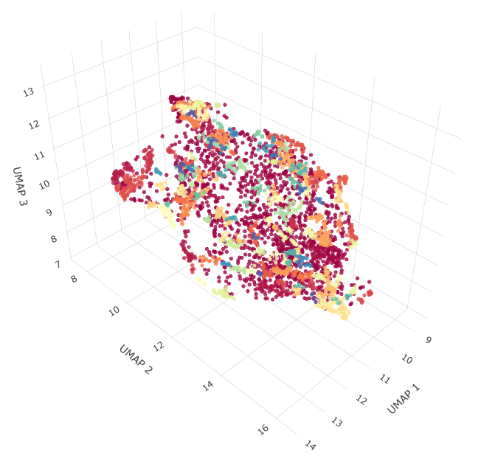
Overview of feature extraction + analysis
Pose ‘.csv’
contains coordinates of tracked body parts (keypoints) over time
Movement filtering:
Do 80% of the frames have significant keypoint displacement from the last frame?
2 min segment
(3600 frames)
yes
x, y timeseries –
centroid(x,y) per frame
no
Long-term TCN
Short-term TCN
Trained BAMS temporal convolutional layers
Discard
Z l
Z s
Z a
BAMS latent space
(feature embeddings)
64 features
64 features
128 features
1. Reduce dimensions with UMAP
2. Cluster with DBSCAN
Adapted from Azabou et al., 2023

Slide 2
Dataset
Rat: 20231127, 20231128, 20231129, 20231130
Treeshrew: 20230609, 20230613, 20230614, 20230615, 20230616

Slide 3
Use
Install the environment:
Install and open the Anaconda prompt
cd into the bams_collab folder:
cd X:\MaryBeth\BAMS\Visuomotor-Latents
Create the bams_custom environment:
conda env create -f bams_custom.yml
You will also need to have PyTorch installed
The notebook ‘get_bams_embeddings.ipynb’ contains everything you need to get the feature embeddings from a BAMS model

Slide 4
Other folder contents
bams_custom.yml
environment yml file to create the conda environment for bams
bams\
bams source code from: https://github.com/nerdslab/bams
extra_fun.py and custom_dataset_w_labels.py
Extra functions for running the notebook
data\
threshold_0.8\
dlc csv and mp4 samples for 0.8 movement thresholding
models\
bams-custom-2024-08-29-15-48-48_0.8\
0.8 movement threshold, centroid subtracted

Slide 5
Notes
The samples are chunked into 2-minute segments (ie, the complete csvs and corresponding mp4s were split into samples of 3600 frames and the ends of the complete csvs/ mp4s were discarded)
Only samples that had more than 80% movement (frame to frame) were kept as movement samples and used to train the bams model
When loading the data, a csv (video_labels) can be saved in the model folder. This tells you what order the csvs were read from the data directory, so you can later map the datapoints in the embedded space back to the csv/ mp4 space
Set create_csv = True for load_dataif you want to remake this csv

