Slide 1
UNIT - 3

Slide 2
Node MongoDB Driver
Node.js MongoDB:
Node.js can be used in database applications.
One of the most popular NoSQL database is MongoDB.
MongDB is a cross-platform, document oriented database that provides, high performance, high availability, and easy scalability.
MongoDB works on concept of collection and document.
Database:Database is a physical container for collections. Each database gets its own set of files on the file system. A single MongoDB server typically has multiple databases.
Collection:Collection is a group of MongoDB documents. It is the equivalent of an RDBMS table.
A collection exists within a single database. Collections do not enforce a schema. Documents within a collection can have different fields. Typically, all documents in a collection are of similar or related purpose.

Slide 3
Document:A document is a set of key-value pairs. Documents have dynamic schema. Dynamic schema means that documents in the same collection do not need to have the same set of fields or structure, and common fields in a collection's documents may hold different types of data.
The following table shows the relationship of RDBMS terminology with MongoDB:
RDBMS | MongoDB
Database | Database
Table | Collection
Tuple/Row | Document
column | Field
Table Join | Embedded Documents
Primary Key | Primary Key (Default key _id provided by MongoDB itself)
Database Server and Client
mysqld/Oracle | mongod
mysql/sqlplus | mongo

Slide 4
Advantages of MongoDB over RDBMS
Schema less − MongoDB is a document database in which one collection holds different documents. Number of fields, content and size of the document can differ from one document to another.
Structure of a single object is clear.
No complex joins.
Deep query-ability. MongoDB supports dynamic queries on documents using a document-based query language that's nearly as powerful as SQL.
Tuning.
Ease of scale-out − MongoDB is easy to scale.
Conversion/mapping of application objects to database objects not needed.
Uses internal memory for storing the (windowed) working set, enabling faster access of data.

Slide 5
Why Use MongoDB?
Document Oriented Storage − Data is stored in the form of JSON style documents.
Index on any attribute
Replication and high availability
Auto-Sharding
Rich queries
Fast in-place updates
Professional support by MongoDB
Where to Use MongoDB?
Big Data
Content Management and Delivery
Mobile and Social Infrastructure
User Data Management
Data Hub

Slide 6
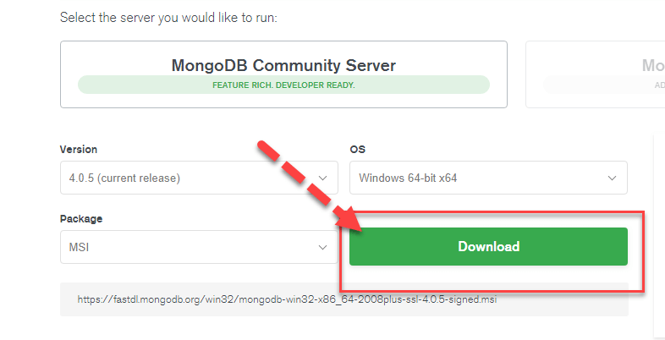
Download & Install MongoDB on Windows
Step 1) Go to link and Download MongoDB Community Server. We will install the 64-bit version for Windows.

Slide 7
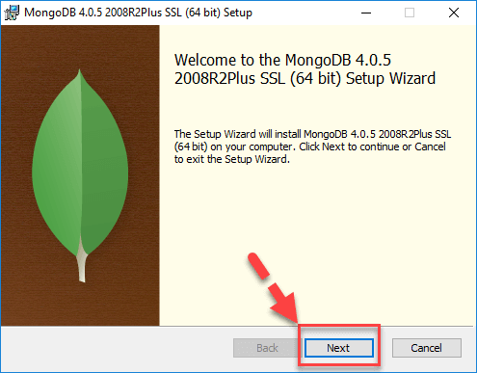
Step 2) Once download is complete open the msi file. Click Next in the start up screen.

Slide 8
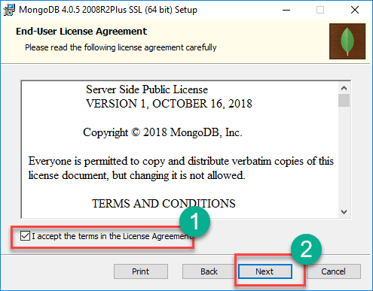
Step 3)
Accept the End-User License Agreement
Click Nest

Slide 9
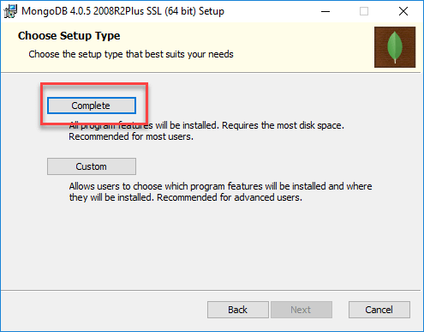
Step 4) Click on the "complete" button to install all of the components. The custom option can be used to install selective components or if you want to change the location of the installation.

Slide 10
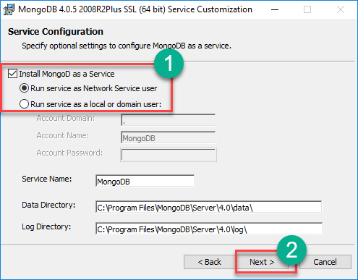
Step 5)
Select “Run service as Network Service user”. make a note of the data directory, we’ll need this later.
Click Next

Slide 11
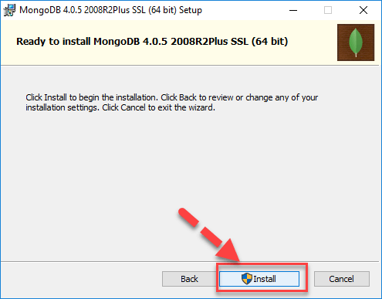
Step 6) Click on the Install button to start the installation.

Slide 12
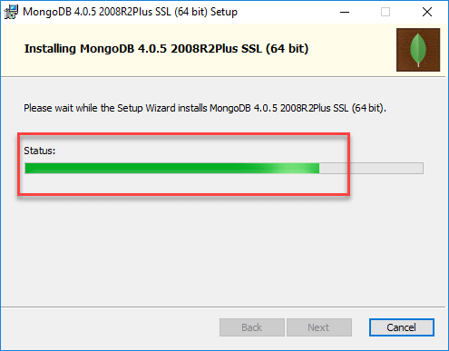
Step 7) Installation begins. Click Next once completed

Slide 13
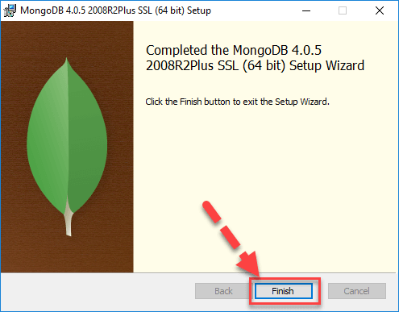
Step 8) Click on the Finish button to complete the installation.

Slide 14
MongoDB
We can download a free MongoDB database at https://www.mongodb.com.
Or get started right away with a MongoDB cloud service at https://www.mongodb.com/cloud/atlas.
Install MongoDB Driver
Let us try to access a MongoDB database with Node.js.
To download and install the official MongoDB driver, open the Command Terminal and execute the following:
Download and install mongodb package:
C:\Users\Your \npm install mongodb
Now we have downloaded and installed a mongodb database driver.
Node.js can use this module to manipulate MongoDB databases:
var mongo = require('mongodb');

Slide 15
Node.js MongoDB Create Database
Creating a Database:
To create a database in MongoDB, start by creating a MongoClient object, then specify a connection URL with the correct ip address and the name of the database we want to create.
MongoDB will create the database if it does not exist, and make a connection to it.
Example:
Create a database called "mydb":
var MongoClient = require('mongodb').MongoClient;
//Create a database named "mydb":
var url = "mongodb://localhost:27017/mydb";
MongoClient.connect(url, function(err, db) {
if (err) throw err;
console.log("Database created!");
db.close();
});

Slide 16
Node.js MongoDB Create Collection
Creating a Collection: To create a collection in MongoDB, use the createCollection() method:
Example:
Create a collection called "customers":
var MongoClient = require('mongodb').MongoClient;
var url = "mongodb://localhost:27017/";
MongoClient.connect(url, function(err, db) {
if (err) throw err;
var dbo = db.db("mydb");
//Create a collection name "customers":
dbo.createCollection("customers", function(err, res) {
if (err) throw err;
console.log("Collection created!");
db.close();
});
});

Slide 17
Data Modeling
Data modeling refers to the organization of data within a database and the links between related entities. Data in MongoDB has a flexible schema model, which means:
Documents within a single collection are not required to have the same set of fields.
A field's data type can differ between documents within a collection.
Generally, documents in a collection share a similar structure. To ensure consistency in your data model, you can create schema validation rules.

Slide 18
Use Cases
The flexible data model lets you organize your data to match your application's needs. MongoDB is a document database, meaning you can embed related data in object and array fields.
A flexible schema is useful in the following scenarios:
Your company tracks which department each employee works in. You can embed department information inside of the employee collection to return relevant information in a single query.
Your e-commerce application shows the five most recent reviews when displaying a product. You can store the recent reviews in the same collection as the product data, and store older reviews in a separate collection because the older reviews are not accessed as frequently.
Your clothing store needs to create a single-page application for a product catalog. Different products have different attributes, and therefore use different document fields. However, you can store all of the products in the same collection.

Slide 19
Schema Design: Differences between Relational and Document Databases
When you design a schema for a document database like MongoDB, there are a couple of important differences from relational databases to consider.
Relational Database Behavior
You must determine a table's schema before you insert data.
You often need to join data from several different tables to return the data needed by your application.
Document Database Behavior
Your schema can change over time as the needs of your application change.
The flexible data model lets you store data to match the way your application returns data, and avoid joins. Avoiding joins across multiple collections improves performance and reduces your deployment's workload.

Slide 20
Query and Projection
MongoDB Query is a way to get the data from the MongoDB database. MongoDB queries provide the simplicity in process of fetching data from the database, it’s similar to SQL queries in SQL Database language.
MongoDB provides the function names as db.collection_name.find() to operate query operation on database.
Syntax:
db.collection_name.find()
Example:
db.article.find()

Slide 21
Finding a single document
In MongoDB, we can find a single document using findOne() method, This method returns the first document that matches the given filter query expression.
Syntax:
db.collection_name.findOne ()
Example:
db.article.findOne()

Slide 22
Project query
This query returned the result whatever we specify in parameter using 1 and 0
1: It indicated to return the result
0: It indicates to not return the result
These parameters called Projection Parameter.
Syntax:
db. collection_name. find({< key > : < value >}, {<key> : < Projection_Parameter >})
Example:
db. article. find({author : "devil"},{title : 0}).pretty()
This query example is requesting the data which have the author as named “devil” but in the record don’t want to show the title attribute by specifying it as projection parameter 0
Query to find a record having given attribute: { author : “devil”}
Projection Parameter: {title : 0}

Slide 23
Aggregation Pipeline.
An aggregation pipeline consists of one or more stages that process documents:
Each stage performs an operation on the input documents. For example, a stage can filter documents, group documents, and calculate values.
The documents that are output from a stage are passed to the next stage.
An aggregation pipeline can return results for groups of documents. For example, return the total, average, maximum, and minimum values.
Aggregation pipelines run with the db.collection.aggregate() method do not modify documents in a collection, unless the pipeline contains a $merge or $out stage.

Slide 24
Complete Aggregation Pipeline Examples
db.orders.insertMany( [
{ _id: 0, name: "Pepperoni", size: "small", price: 19,
quantity: 10, date: ISODate( "2021-03-13T08:14:30Z" ) },
{ _id: 1, name: "Pepperoni", size: "medium", price: 20,
quantity: 20, date : ISODate( "2021-03-13T09:13:24Z" ) },
{ _id: 2, name: "Pepperoni", size: "large", price: 21,
quantity: 30, date : ISODate( "2021-03-17T09:22:12Z" ) },
{ _id: 3, name: "Cheese", size: "small", price: 12,
quantity: 15, date : ISODate( "2021-03-13T11:21:39.736Z" ) },
{ _id: 4, name: "Cheese", size: "medium", price: 13,
quantity:50, date : ISODate( "2022-01-12T21:23:13.331Z" ) },
{ _id: 5, name: "Cheese", size: "large", price: 14,
quantity: 10, date : ISODate( "2022-01-12T05:08:13Z" ) },
{ _id: 6, name: "Vegan", size: "small", price: 17,
quantity: 10, date : ISODate( "2021-01-13T05:08:13Z" ) },
{ _id: 7, name: "Vegan", size: "medium", price: 18,
quantity: 10, date : ISODate( "2021-01-13T05:10:13Z" ) }
] )

Slide 25
Calculate Total Order Quantity
The following aggregation pipeline example contains two stages and returns the total order quantity of medium size pizzas grouped by pizza name:
db.orders.aggregate( [
// Stage 1: Filter pizza order documents by pizza size
{
$match: { size: "medium" }
},
// Stage 2: Group remaining documents by pizza name and calculate total quantity
{
$group: { _id: "$name", totalQuantity: { $sum: "$quantity" } }
}
] )
The $match stage:
Filters the pizza order documents to pizzas with a size of medium.
Passes the remaining documents to the $group stage.
The $group stage:
Groups the remaining documents by pizza name.
Uses $sum to calculate the total order quantity for each pizza name. The total is stored in the totalQuantity field returned by the aggregation pipeline.
Example output:
[
{ _id: 'Cheese', totalQuantity: 50 },
{ _id: 'Vegan', totalQuantity: 10 },
{ _id: 'Pepperoni', totalQuantity: 20 }
]

Slide 26
Additional Aggregation Pipeline Stage Details
An aggregation pipeline consists of one or more stages that process documents:
A stage does not have to output one document for every input document. For example, some stages may produce new documents or filter out documents.
The same stage can appear multiple times in the pipeline with these stage exceptions: $out, $merge, and $geoNear.
To calculate averages and perform other calculations in a stage, use aggregation expressions that specify aggregation operators. You will learn more about aggregation expressions in the next section.
For all aggregation stages, see Aggregation Stages.
Aggregation Pipeline Expressions
Some aggregation pipeline stages accept an aggregation expression, which:
Specifies the transformation to apply to the current stage's input documents.
Transform the documents in memory.
Can specify aggregation expression operators to calculate values.
Can contain additional nested aggregation expressions.
Starting in MongoDB 4.4, you can use the $accumulator and $function aggregation operators to define custom aggregation expressions in JavaScript.
For all aggregation expressions, see Expression Operators.
Field Paths
Aggregation expressions use field path to access fields in the input documents. To specify a field path, prefix the field name or the dotted field name (if the field is in the embedded document) with a dollar sign $. For example, "$user" to specify the field path for the user field or "$user.name" to specify the field path to "user.name" field.
"$<field>" is equivalent to "$$CURRENT.<field>" where the CURRENT is a system variable that defaults to the root of the current object, unless stated otherwise in specific stages.

Slide 27
Run an Aggregation Pipeline
To run an aggregation pipeline, use:
db.collection.aggregate() or
aggregate

