Slide 1
ATAL TINKERING LAB

Slide 2
What is ATL ?

Slide 3
Learn ?

Slide 4
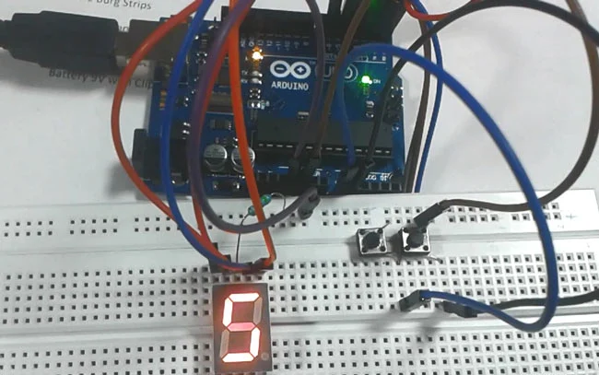
Digital Dice.

Slide 5
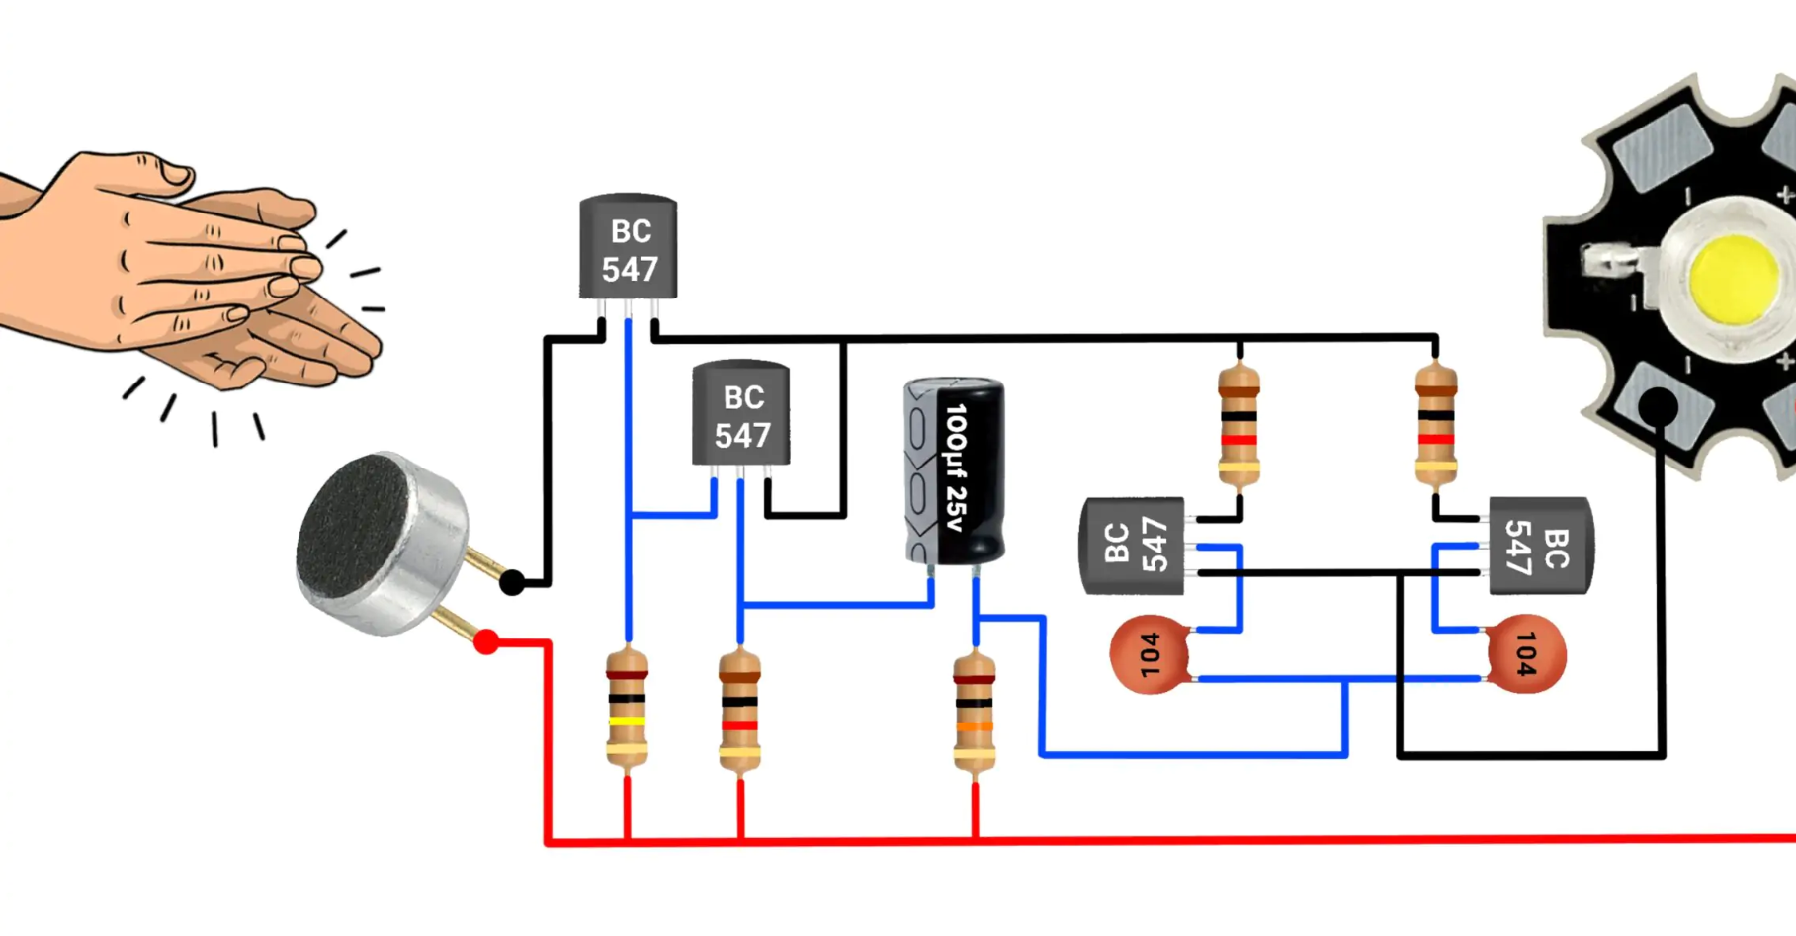
Clap Switch.

Slide 6
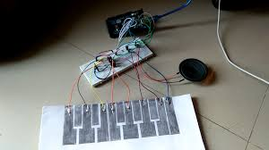
Virtual Piano.

Slide 7
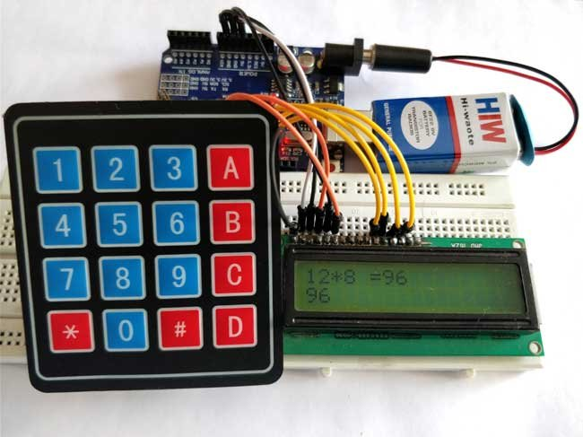
Calculator.

Slide 8
If you could invent?

Slide 9
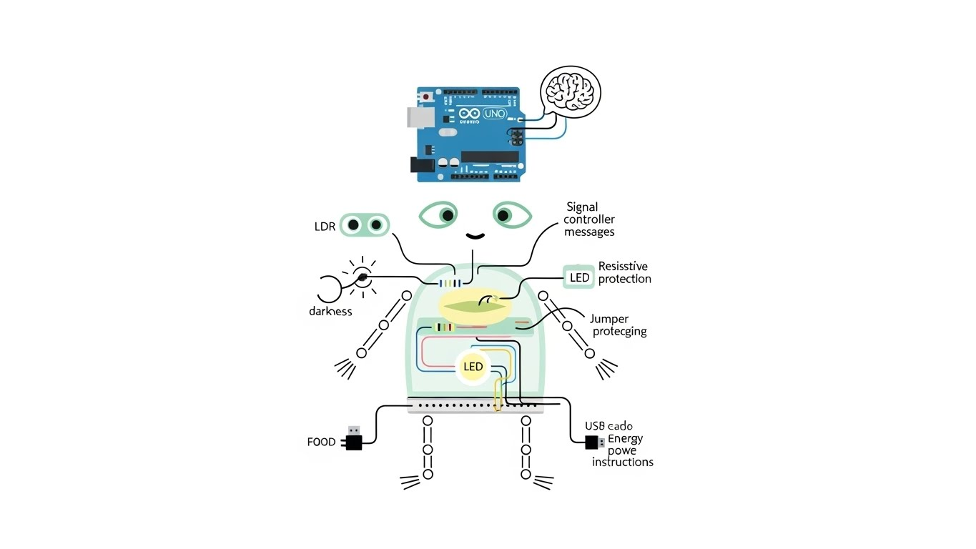

Slide 10
