Slide 1
Workload-Driven Automated Index
Recommendation Using Machine Learning
Sayem Sarwar · Majharul Islam Shanto
Department of Computer Science, Troy University

Slide 2
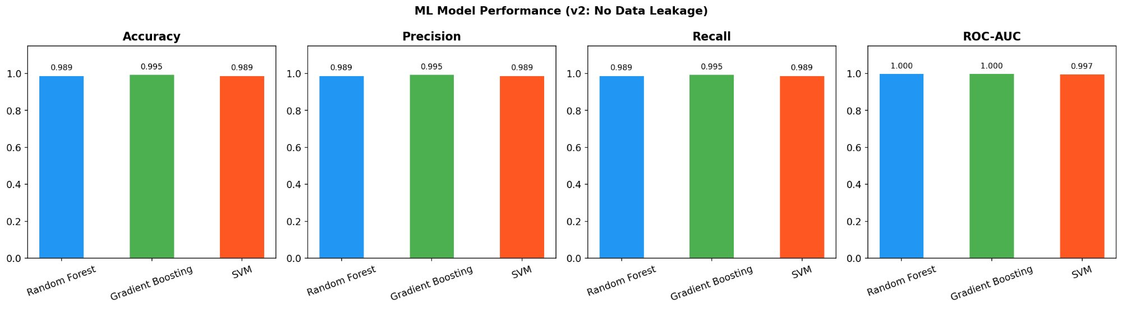
OVERVIEW
Key Results at a Glance
911 queries · 30 EXPLAIN features · No DBA input · No runtime leakage
99.45%
1.37×
2.59×
558.6×
GB Accuracy
Overall Speedup
Avg Per-Query Speedup
Best Single Query
AGG_Q029: 101.89ms → 0.18ms | 22.1% of queries improved | 25 indexes applied automatically

Slide 3
MOTIVATION
The Problem: Index Selection is Hard
The Challenge
Existing Tools Fall Short
Too few indexes
→ Full table scans → Very slow queries
Too many indexes
→ Slow inserts and updates
Manual selection
→ Needs expert DBA knowledge
→ Takes days or weeks
→ Reactive, not proactive
AutoAdmin (Microsoft)
→ Requires DBA-provided candidate sets
→ SQL Server cost model only
DB2 Design Advisor (IBM)
→ Requires DB2-specific cost model
→ DBA must supply column candidates
Our System
→ No DBA · No cost model · Automatic!

Slide 4
RESEARCH QUESTIONS & CONTRIBUTIONS
Research Questions & Contributions
RQ1
Key Contributions
Can EXPLAIN features alone predict index need without runtime data?
1. 911-query TPC-H workload (vs. standard 22 queries)
2. 30 leakage-free EXPLAIN features — no runtime used
3. ML vs. 3 non-ML baselines + full ablation study
4. Fully automated pipeline — no DBA, no candidate set
5. 1.37× overall speedup validated end-to-end
RQ2
Do ML-guided indexes yield measurable speedups on TPC-H?
RQ3
How does improvement vary across query complexity types?

Slide 5
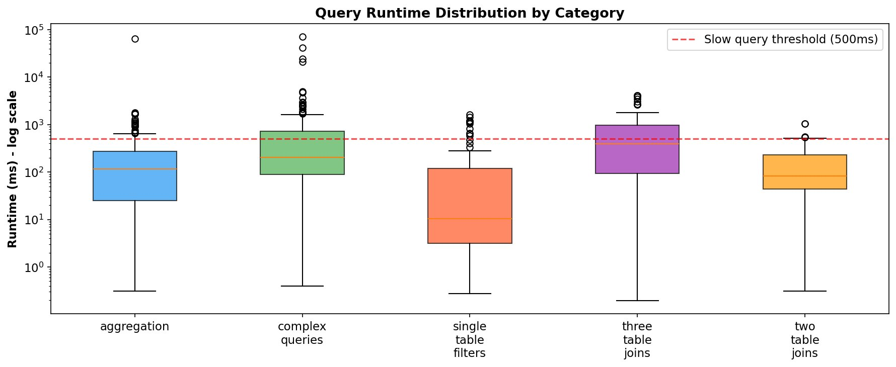
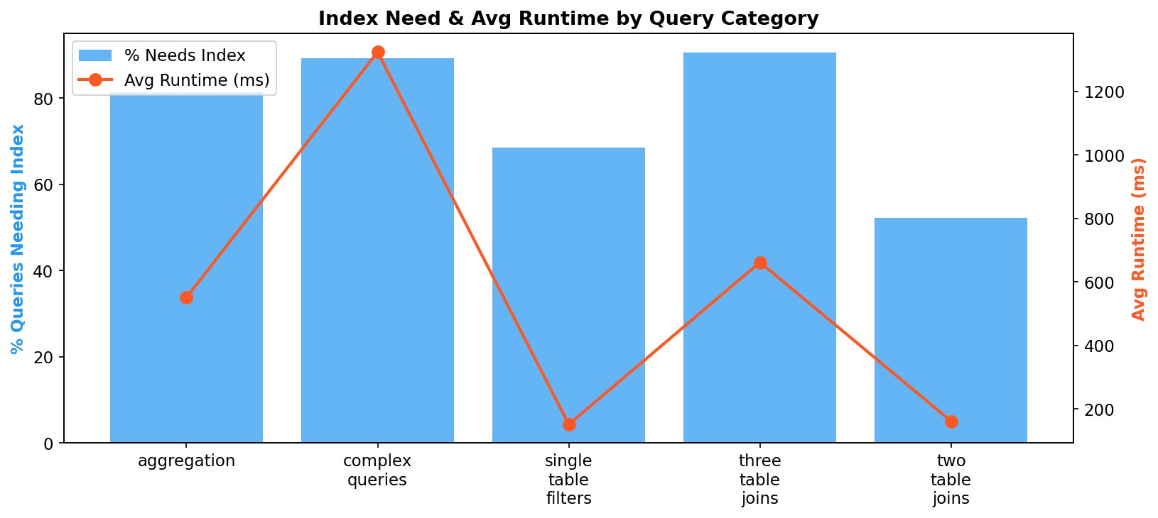
METHODOLOGY — WORKLOAD DESIGN
TPC-H Workload Design
MySQL 8.0.40 · TPC-H SF-1 (1GB) · Apple M-series 16GB RAM · 8 tables · 1.59M rows
Category | Queries | Avg Runtime | % Needs Index | Key Insight
Single-Table Filters | 111 | 151 ms | 69% | Moderate need
Two-Table Joins | 200 | 161 ms | 52% | Lowest index need
Three-Table Joins | 200 | 662 ms | 90% | High index need
Aggregation | 200 | 551 ms | 81% | Best: 4.16×
Complex Queries | 200 | 1,323 ms | 89% | High index need
TOTAL | 911 | 607 ms | 76.5% | 906 successful
911
906
905
76.5%
queries designed
successfully ran
compared before/after
labeled needs index

Slide 6
METHODOLOGY — FEATURE EXTRACTION
30 Leakage-Free EXPLAIN Features
All features from MySQL EXPLAIN only. Runtime deliberately excluded to prevent data leakage.
Join Type
Index Coverage ★
Row Estimates
Plan Flags
Query Structure
· max_join_type_score (0=best, 11=ALL=worst)
· index_coverage_ratio
· total_rows_examined
· has_filesort
· num_tables
· has_full_scan
· num_indexes_used
· max_rows_examined
· has_temp_table
· has_subquery
· full_scan_table_count
· has_no_index
· log_rows_examined
· has_using_index
· has_union
· has_index_scan, has_range_scan
· avg_possible_keys
· rows_per_table
· has_using_where
· num_select_types
★ Index Coverage is the MOST CRITICAL group — ablation study confirms largest F1 drop when removed

Slide 7
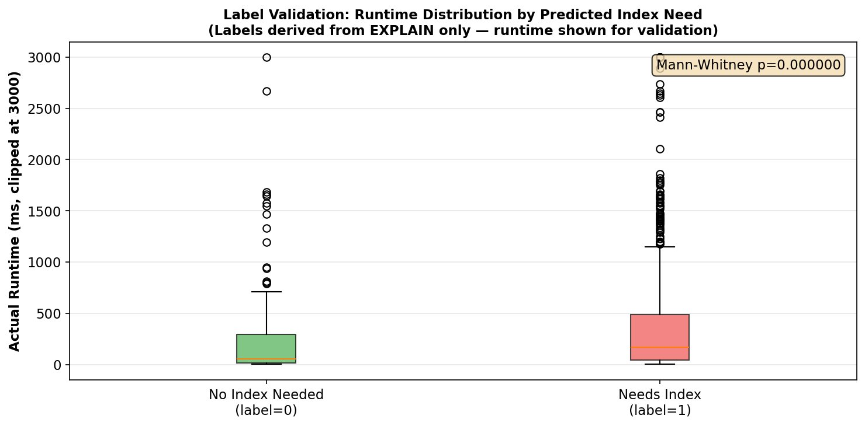
METHODOLOGY — LABEL GENERATION
Label Generation & Statistical Validation
Labels derived ONLY from EXPLAIN signals — never from runtime (prevents leakage)
(a)
Full table scan detected (type=ALL in EXPLAIN)
(b)
No index used AND rows > 60th percentile threshold
(c)
filesort OR temp table detected with high row estimates
(d)
Multi-table join with index coverage ratio < 0.5
693 / 906 queries labeled needs_index=1 (76.5%)
Avg runtime: 726.6ms (needs index) vs 226.0ms (no index) = 3.22× difference
Mann-Whitney U = 93,225 p < 0.001 → labels are statistically valid ✓

Slide 8
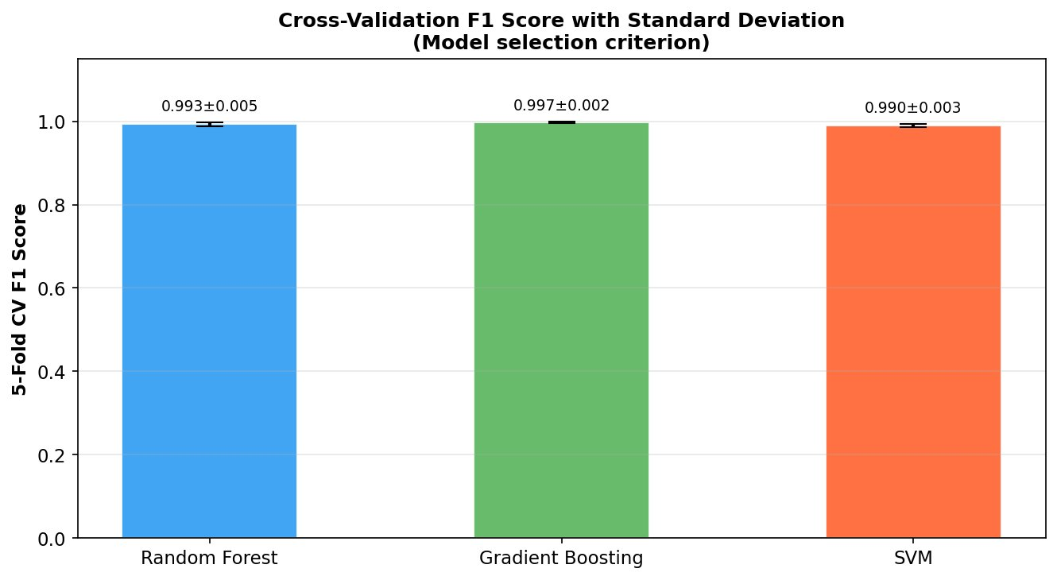
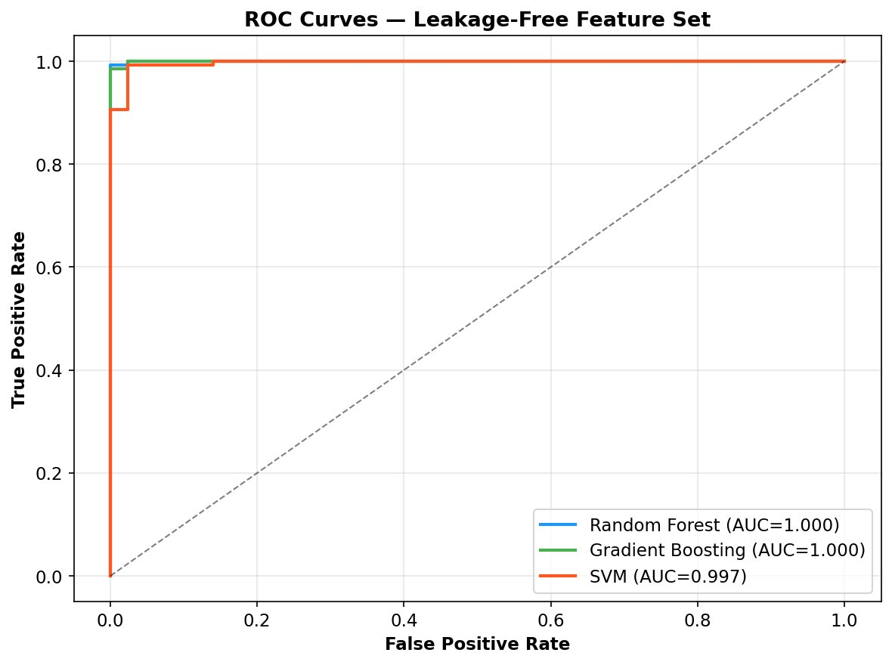
ML EVALUATION — MODEL PERFORMANCE
ML Model Performance
80/20 stratified split · 5-fold CV · 8% Gaussian noise on row features · Seeds fixed at 42
Why Gradient Boosting?
0.9973
Highest CV F1 (±0.0022)
1
Only 1 misclassification
p=0.036
Beats SVM (t-test)
1.000
ROC-AUC = perfect

Slide 9
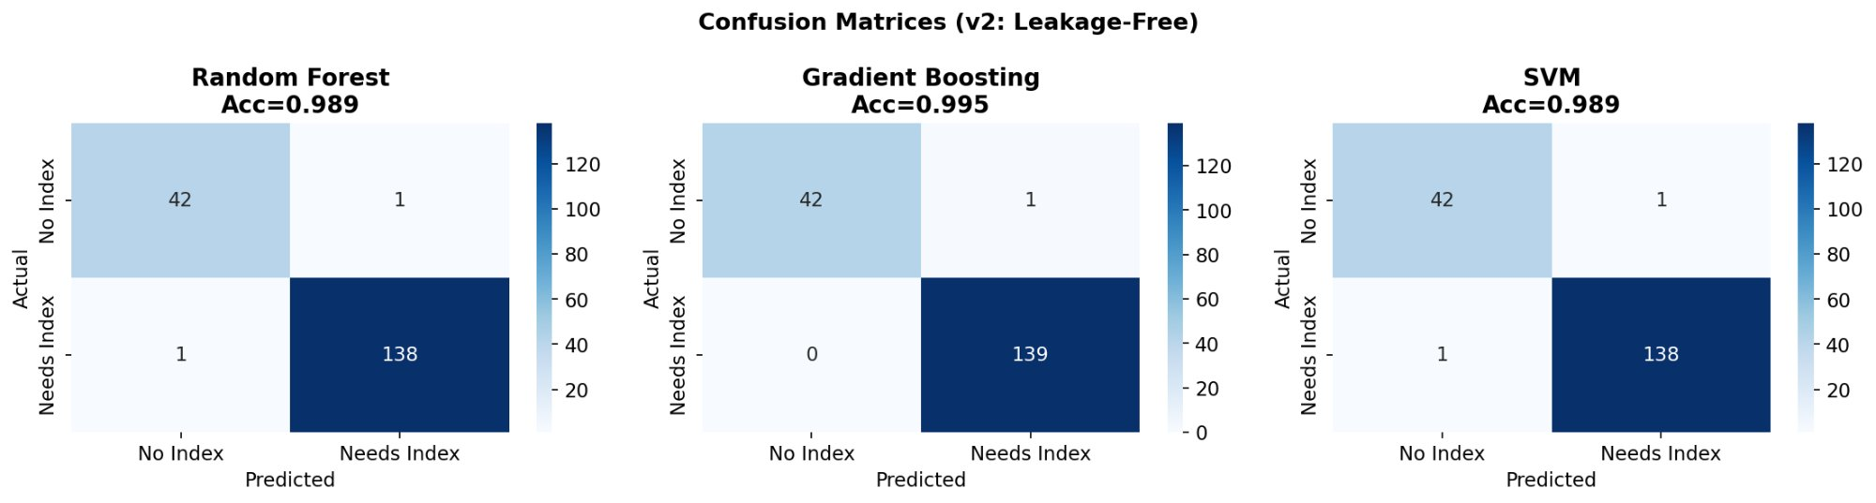
ML EVALUATION — CONFUSION MATRICES & ROC
Confusion Matrices — All Three Models
Random Forest
Gradient Boosting ✓ SELECTED
SVM
2 misclassifications
42 TN · 138 TP · 1 FP · 2 FN
Only 1 misclassification!
42 TN · 139 TP · 1 FP · 0 FN
2 misclassifications
40 TN · 138 TP · 1 FP · 3 FN

Slide 10
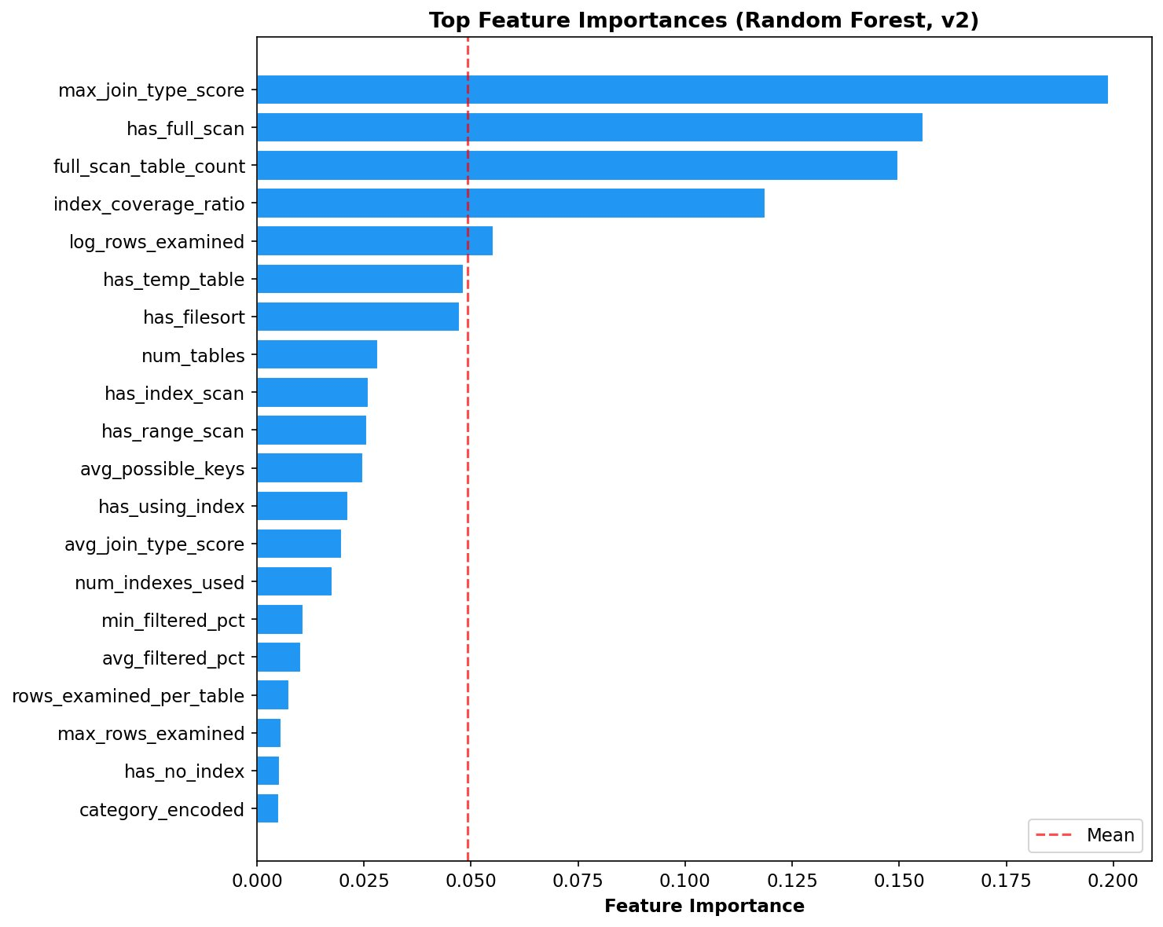
ML EVALUATION — FEATURE IMPORTANCE
Feature Importance Analysis
Top Features Tell the Story
~20%
max_join_type_score
Worst join access type
(0=const, 11=ALL=full scan)
~15%
has_full_scan
Direct full scan indicator
Strongest single signal
~15%
full_scan_table_count
How many tables full scan
More = worse
~11%
index_coverage_ratio
Fraction of tables using
an index (0=none, 1=all)
~6%
log_rows_examined
Log of total rows checked
High = slow query
All top features are structural EXPLAIN properties — no runtime involved ✓

Slide 11
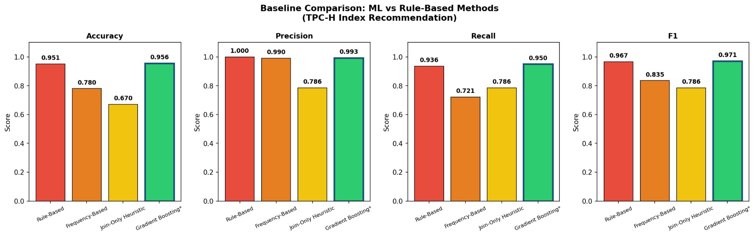
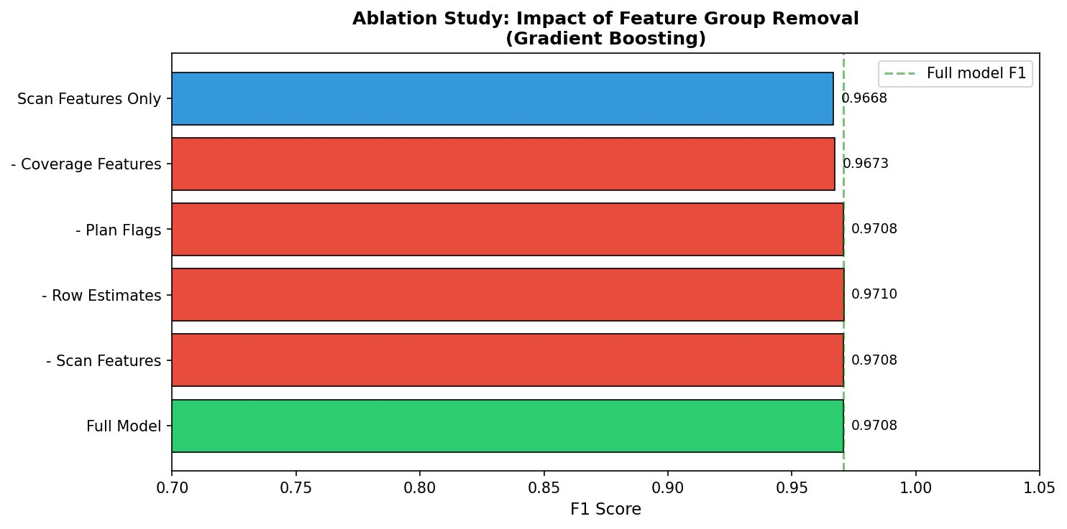
BASELINE COMPARISON & ABLATION
Baseline Comparison & Ablation Study
Why ML Beats Rules
Join-Only
F1: 0.786
FN:30
Frequency
F1: 0.835
FN:39
Rule-Based
F1: 0.967
FN:9
GB (Ours)
F1: 0.971
FN:7
GB has fewest false negatives (7 vs 9)
→ catches more index-needing queries
★ Ablation: Removing Index Coverage features
causes the LARGEST F1 drop (0.0035)

Slide 12
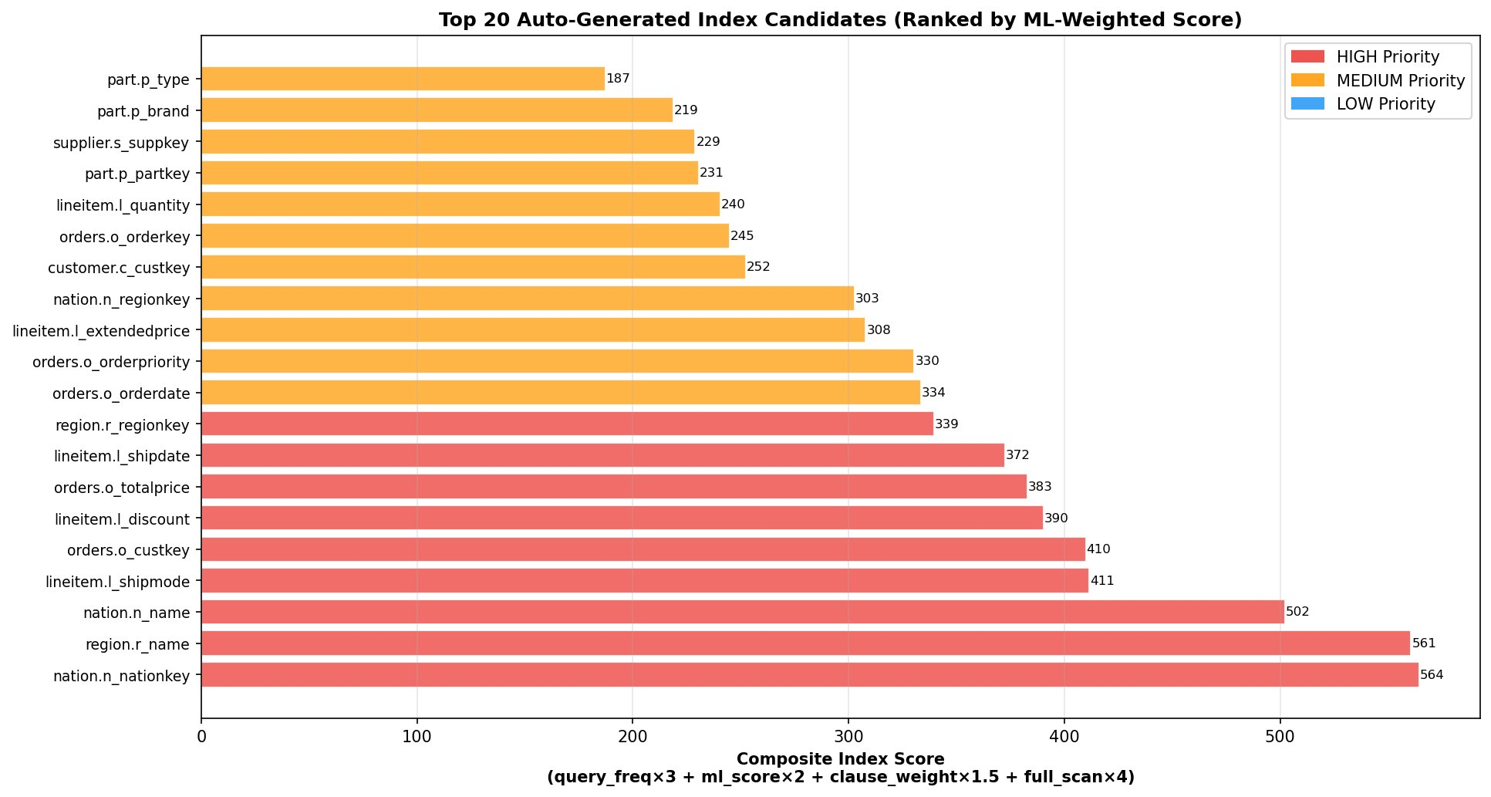
AUTOMATED INDEX PIPELINE
Automated Index Generation Pipeline
1
2
3
4
5
6
Parse SQL
→
Run EXPLAIN
→
ML Scoring
→
Comp. Score
→
Rank & Tier
→
Apply
Extract WHERE/
JOIN/GROUP BY
Detect full
scans & features
GB predicts
index need
freq×3 + ML×2
+clause×1.5
+scans×4
Assign HIGH/
MEDIUM/LOW
Create indexes
automatically
6,311
50
20
~26 min
col refs extracted
unique candidates
new indexes applied
pipeline overhead

Slide 13
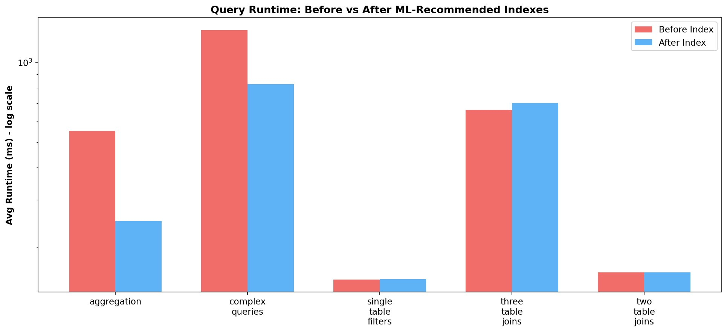
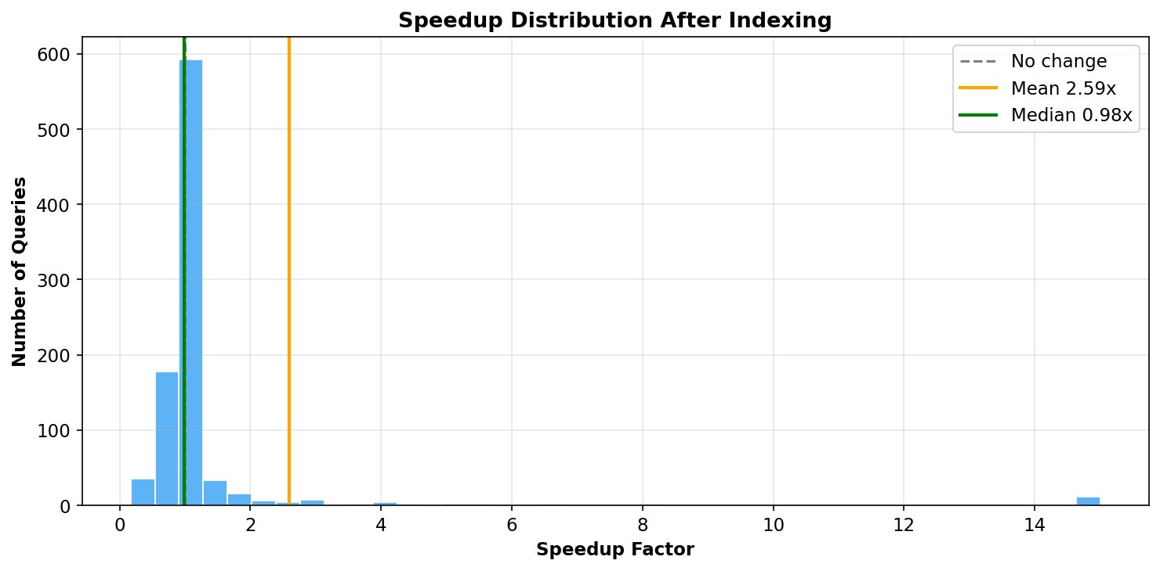
RESULTS — BEFORE VS. AFTER
Before vs. After Performance (905 Queries)
BEFORE
AFTER
22.1% Improved (>5% faster)
550,091 ms
→ 1.37× →
401,731 ms
74.9% Unchanged (±5%)
9.2 minutes total
6.7 minutes total
3.0% Slightly degraded
No query regressed more than 1.5× · All degraded queries remained below 900ms

Slide 14
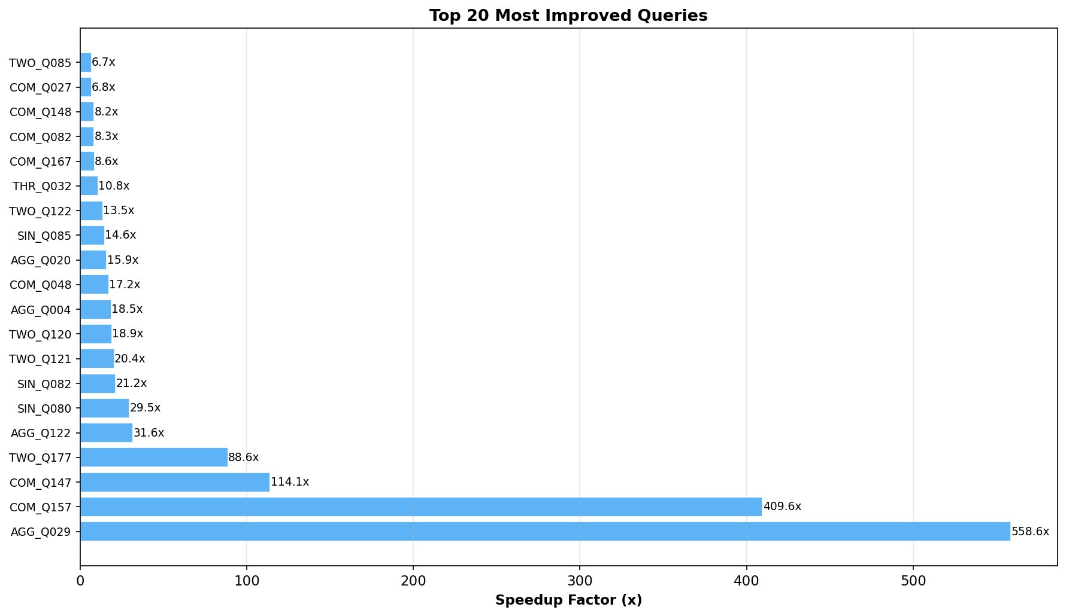
RESULTS — TOP IMPROVEMENTS & CASE STUDIES
Top Query Improvements & Case Studies
AGG_Q029 558.6×
101.89ms → 0.18ms
lineitem full scan (600K rows) → after indexing l_shipdate: only ~1,200 rows scanned.
COM_Q157 409.6×
41,188ms → 100.55ms
Repeated full scans on orders (150K rows) in subquery → after indexing o_custkey: index lookups.
TWO_Q177 88.6×
28.99ms → 0.33ms
Two-table join with o_totalprice filter → full scans on both tables → after indexing: direct lookup.
Per-Category: Aggregation 4.16× · Complex 3.85× · Single-Table 1.62× · Two-Table 1.76× · Three-Table 1.18×

Slide 15
Conclusion & Future Work
CV F1
0.9973
Gradient Boosting on 30 leakage-free EXPLAIN features
Beats
3/3
Outperforms all non-ML baselines with fewest false negatives (7 vs 9)
Ablat.
★
Index Coverage features are the most critical group
Speed
1.37×
Overall speedup · 2.59× avg · up to 558.6× individual improvement
Auto
34
Indexes generated and applied automatically — zero DBA input
Future Work
SF-10/SF-100 evaluation · Composite multi-column indexes · PostgreSQL & SQL Server validation · Online RL adaptive tuning
Thank you! Questions welcome · ssarwar@troy.edu · Department of CS, Troy University

