Slide 1
DeepPulmoMultiNetWeb: Web-Based Deep Multinet Approach for Pneumonia Detection in Chest X-rays
Pneumonia Detection

Slide 2






Presented By
Supervised By
Md. Emran Hossain (17)
Ashikul Islam (30)
Md. Tahzib-Ul-Islam Assistant professor Department Of CSE Dhaka International University
Mashruba Zaman(33)
Sarwar Alam (42)
Ashik Ahmed (51)
D-58, Dept. of CSE

Slide 3
Introduction
Main Contribution of our work
Data Resource
Workflow
Preprocessing
Applied Models
Multinet
Result Analysis
Related Works
Web Interface
CONTENTS

Slide 4
Introduction
Pneumonia is a leading cause of death worldwide, especially among the children under 5. It affects million yearly, with a significant burden in developing countries.
Chest X-rays are widely used for diagnosis, but their interpretation depends on expertise and can be subjective, leading to delays and misdiagnoses.
Deep learning has shown promise in medical image analysis tasks, including pneumonia detection.
Developing automated, objective and accurate deep learning models can:
Improve diagnostic accuracy and speed.
Reduce reliance on specialist expertise.
Potentially increase access to accurate diagnosis in resource-limited settings.

Slide 5




Contribution
This deep learning project holds immense potential to revolutionize the field of medical diagnostics, particularly in the realm of pneumonia detection from chest X-rays.
The primary beneficiaries of this project include:
Patient Benefits
Early Detection and Treatment
Provide Better Resource
Healthcare Providers

Slide 6
Data Resource
In the system we developed, we fed chest x-ray images to train the models and evaluated the accuracy using some chest x-ray images. These images are collected from Kaggle.
Normal
1583
Train
4684
Total Images
5856
Pneumonia
4273
Test
1172

Slide 7
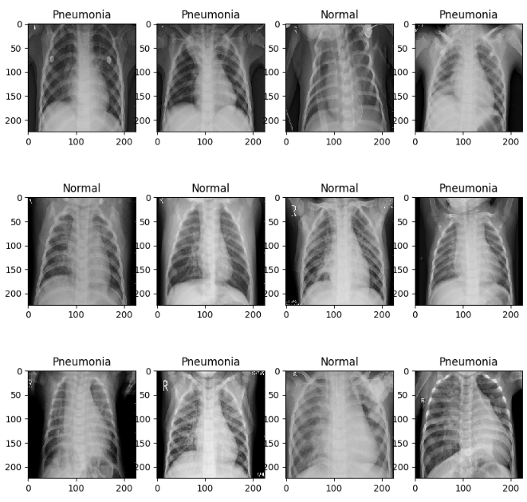
Data

Slide 8
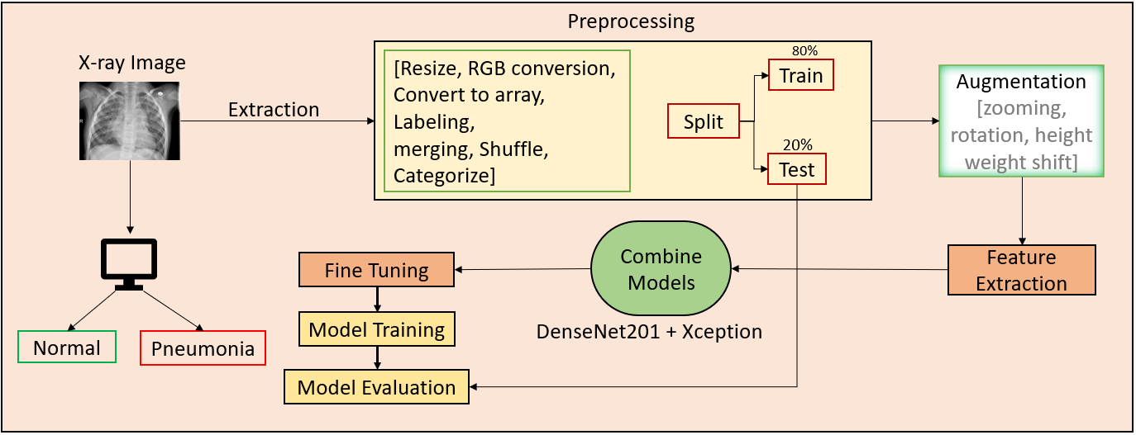
workflow

Slide 9
Preprocessing
Convert to array
I
Convert the jpeg file to array format using the NumPy library.
II
Resize
Resize all the images into same dimension; 224 × 224.
III
Greyscale to RGB
Convert the 1 channel greyscale images into 3 channel RGB format.
IV
Labeling
Create label for the images; 0 for normal & 1 pneumonia.
Merging
V
Merging the data variables with their corresponding label variables.
VI
Shuffling
Shuffle the training datasets to acquire better learning performance.
VII
Categorize
Categorize into 2 channel output for binary classification.

Slide 10
Augmentation
We applied augmentation in our training set
Train
4684
augmentation
Train
32788
The augmentation was done according these seven factor:
rotation_range=90,
width_shift_range=0.2,
height_shift_range=0.2,
shear_range=0.2,
zoom_range=0.2,
horizontal_flip=True,
fill_mode='nearest'

Slide 11
Applied Models
MobileNet
VGG16
VGG19
Xception
DenseNet201
RestNet50
NasNetMobile

Slide 12
Multinet
DenseNet201
Accuracy: 96%
Xception
Accuracy: 96%
DeepPulmoMultiNet
Accuracy: 98%

Slide 13
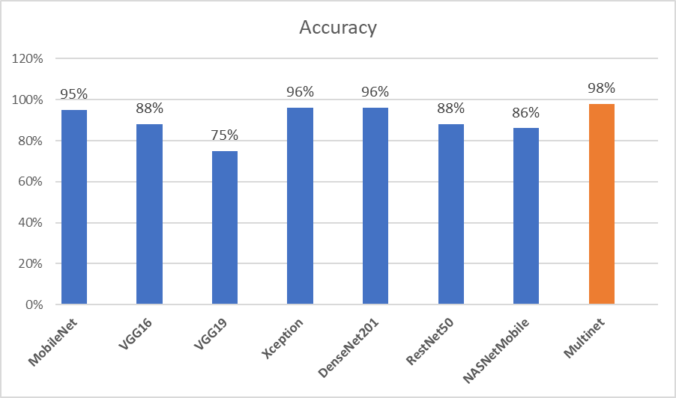
Result Analysis
The comparison bar chart is showing the accuracy between all the models and the Multinet model that we have developed.

Slide 14
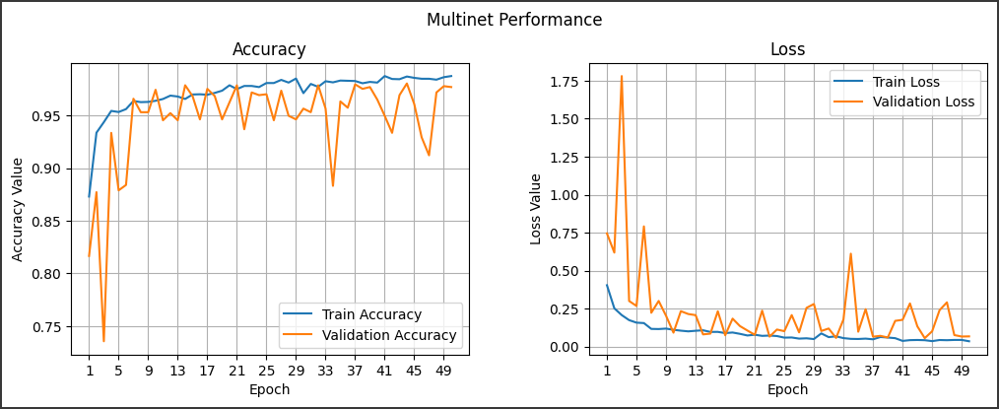
The graph of epoch vs accuracy & epoch vs loss

Slide 15
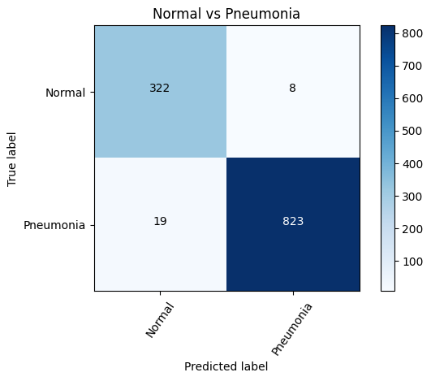
The confusion matrix of Multinet

Slide 16
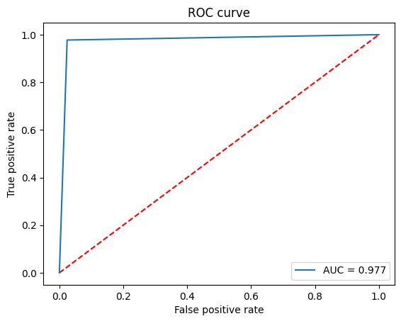
The ROC curve of Multinet

Slide 17
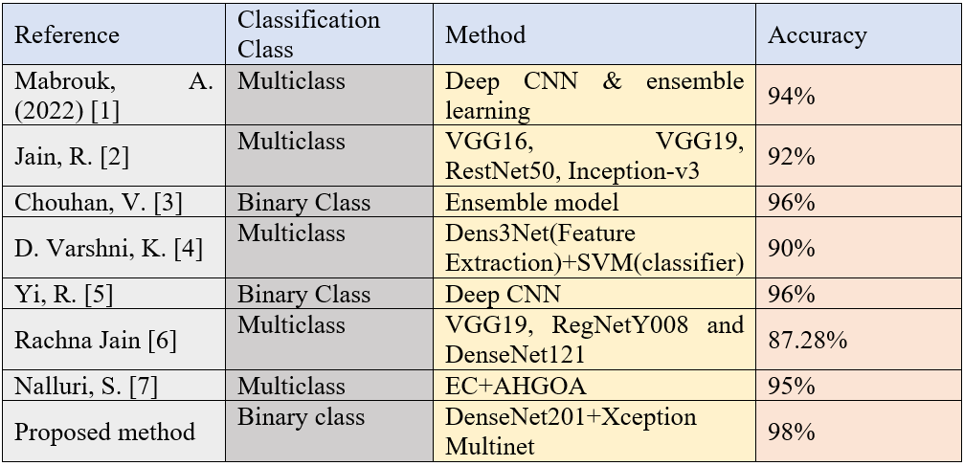
Related Work
The comparison with related works.

Slide 18
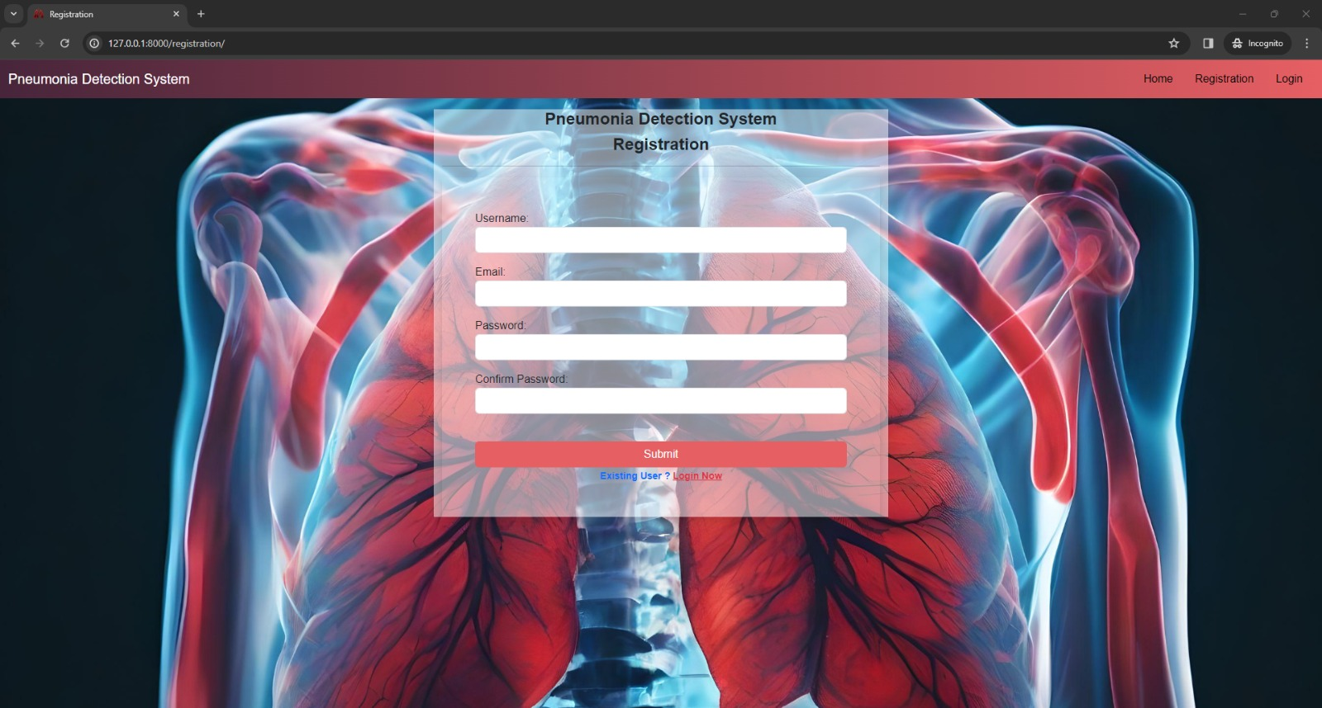
Web Interface

Slide 19
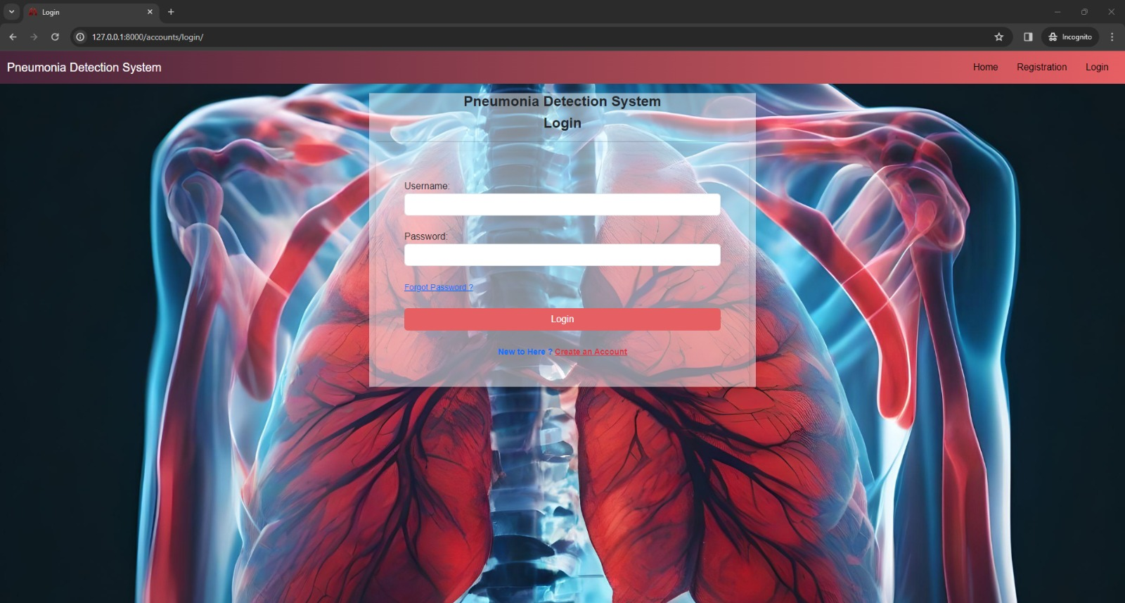

Slide 20
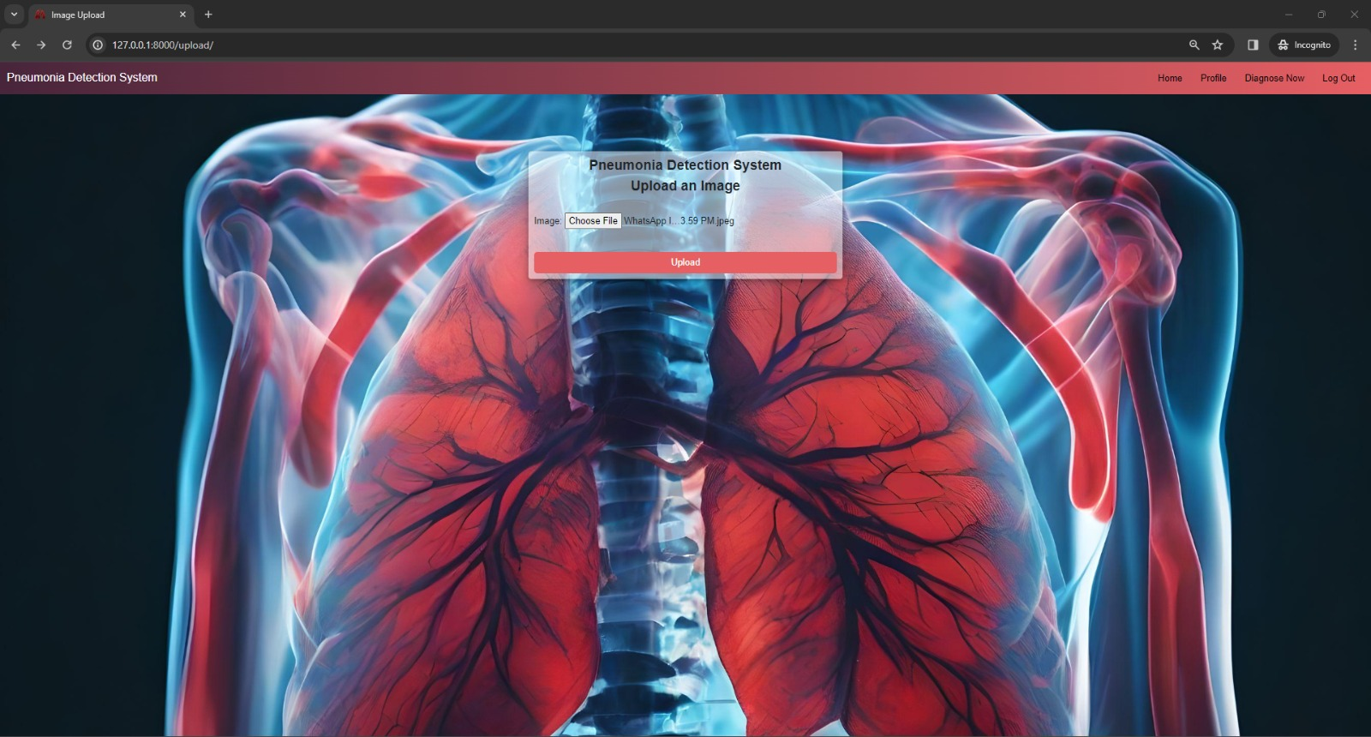

Slide 21
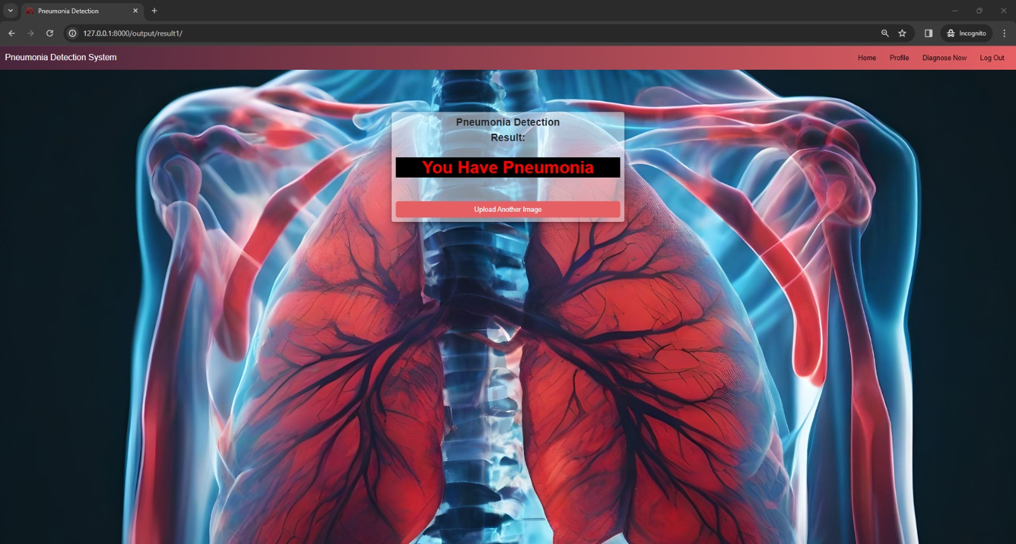

Slide 22
REFERENCES
Mabrouk, A., Díaz Redondo, R.P., Dahou, A., Abd Elaziz, M. and Kayed, M., 2022. Pneumonia detection on chest X-ray images using ensemble of deep convolutional neural networks. Applied Sciences, 12(13), p.6448.
Jain, R., Nagrath, P., Kataria, G., Kaushik, V.S. and Hemanth, D.J., 2020. Pneumonia detection in chest X-ray images using convolutional neural networks and transfer learning. Measurement, 165, p.108046.
Chouhan, V., Singh, S.K., Khamparia, A., Gupta, D., Tiwari, P., Moreira, C., Damaševičius, R. and De Albuquerque, V.H.C., 2020. A novel transfer learning based approach for pneumonia detection in chest X-ray images. Applied Sciences, 10(2), p.559.
D. Varshni, K. Thakral, L. Agarwal, R. Nijhawan and A. Mittal, "Pneumonia Detection Using CNN based Feature Extraction," 2019 IEEE International Conference on Electrical, Computer and Communication Technologies (ICECCT), Coimbatore, India, 2019, pp. 1-7, doi: 10.1109/ICECCT.2019.8869364.
Yi, R., Tang, L., Tian, Y. et al. Identification and classification of pneumonia disease using a deep learning-based intelligent computational framework. Neural Comput & Applic 35, 14473–14486 (2023). https://doi.org/10.1007/s00521-021-06102-7
Rachna Jain, Preeti Nagrath, Gaurav Kataria, V. Sirish Kaushik, D. Jude Hemanth, Pneumonia detection in chest X-ray images using convolutional neural networks and transfer learning, Nalluri, S. and Sasikala, R., 2024. Pneumonia screening on chest X-rays with optimized ensemble model. Expert Systems with Applications, 242, p.122705.

Slide 23
THANK YOU

