Slide 1
Slips of everyday action
JISHA, SARZILA SAHRIN
20-42526-1
HCI, SECTION: [B]
DEPT. OF CSE
AMERICAN INTERNATION
UNIVERSITY – BANGLADESH

Slide 2
What are Slips ?
Slips are human errors, that happened in our daily life actions.
Slips result from automatic human behavior.
Slips are cognitive errors.
Slips are always small things.
Slips are misplaced actions.
Slips are the wrong thing moved.
Slips are like a desired action undone.
Slips are relatively easy to discover by simple observation and monitoring.
Slips have no human control.
Slips can be connected with both short-term memory and long-term memory, depending on the type of slip and the nature of the action being performed.

Slide 3
Type of Slips ?
Capture Errors
Description Errors
Data-driven Errors
Associative Activation Errors
Loss-of-activation Errors
Mode Errors

Slide 4
5 (five) Slips occurred OR I experienced in MY LIFE

Slide 5

Slip no – 01 : Capture Error
One day, I decided to have iftar with my friends in this Ramadan. So we went to a local restaurant and bought some iftar items that cost 330 taka. I gave the shopkeeper 340 taka and told him to return 10 taka. However, he took the money from my hand and offered us 350 taka in return, including the money we gave him. We realized that the shopkeeper was under pressure due to the iftar time. We noticed there was a huge crowd in his restaurant and the iftar time was closer. So he might be distracted by that crowd. We returned the extra money to him. It was a capture error by the shopkeeper.

Slide 6

Slip no – 02 : Description Error
This example is taken from a drama. One day, a girl saw some white powder on the table and assumed it was baking powder and without checking it, she filled it in the baking powder box. That afternoon, she proceeded to bake a cake with that powder. Later, when her husband tried to cut the cake, it exploded. It turns out that the white powder she had used was actually gunpowder, which she had mistakenly taken for baking powder due to its visual similarity. So, this is a description error by the girl due to the visual similarity of baking powder and gun powder.

Slide 7
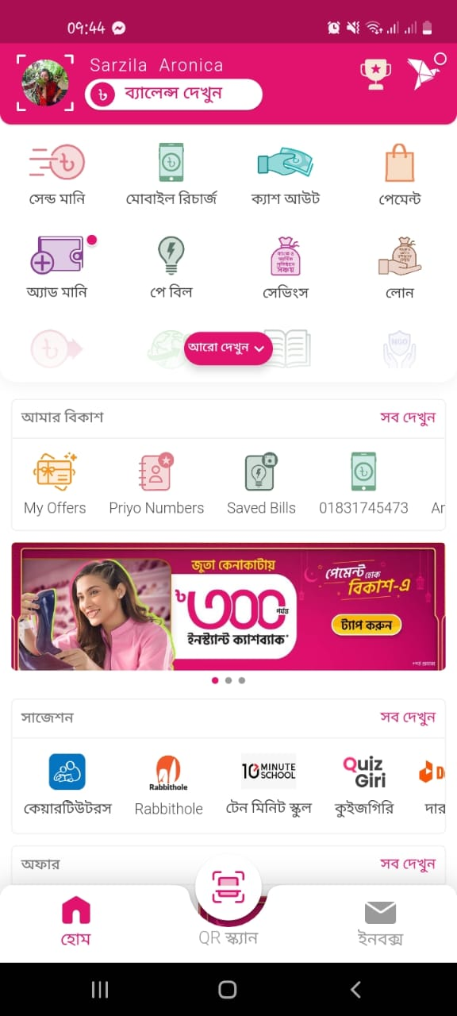
Slip no – 03 : Data Driven Error
Eid means joy, Eid means happiness. Now-a-days, it became a trend to send the salami on bKash. Like everyone, I also loved to send salami to my friends and dear ones. This Eid, I wanted to enter into the “send money” feature but I ended up entering the “mobile recharge” feature in some cases. Because I used to do mobile recharge using bKash usually and so it became a piece of static information in my memory. That’s why I swapped between these two features mostly. So, this is a data-driven error by me.

Slide 8

Slip no – 04: Associative Activation Error
Last month, I visited one of my cousin’s house. He works in the bKash customer care service. We were gossiping with each other. Suddenly his phone rang. He received the call and instantly started saying “Hello, Sir! Good evening. This is Atiq from bKash. How may I assist you?” instead of saying the normal “Hello”. I and my other cousins were shocked at first, then we burst into laughter. The call actually came from my aunt. But as vaia is habituated to attending customer calls frequently, this became a daily routine or habit for him and so this associative activation error occurred by him. When his phone rang, his short-term memory failed to register that the call was not from a customer and he automatically responded with the scripted greeting. This slip highlights the possible inaccuracies in the processing of short-term memory.

Slide 9
Slip no – 05 : Loss-of-activation Errors & Mode Error
My mother had a tendency to forget things easily, which often led to errors in her daily life. For example, she put milk on the stove and continued her other work. But most of the time, she forgot to switch off the stove and so the milk got burnt. So, this is a loss-of-activation error by my mother. Another example is, my mother washed plates and cut watermelons on a random day. After that, instead of keeping these washed plates on the rack, she put the plates into the fridge. So, this is a mode error that occurred by my mother. Mental pressure and sleepless nights damaged her brain and made her more related with short time memory loss in form of these slips.

Slide 10
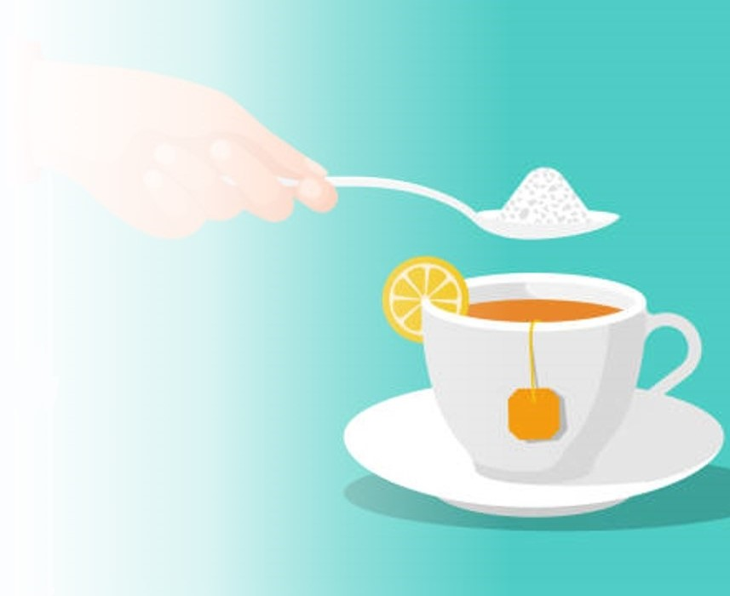
THANK YOU
Salt

