Slide 1


CODE OF ETHICS
GROUP NO : 01

Slide 2

GROUP MEMBERS
NAME | ID
JISHA, SARZILA SAHRIN | 20-42526-1
BARI, SAMIHATUL | 20-42018-1
AKTER, TAMANNA | 20-42410-1
AKTHER, SUMI | 20-43154-1

Slide 3
ABOUT OUR STARTUP
OBJECTIVES:
To prevent self-harms
To reduce mental health issues
To monitor mental condition 24/7
To detect depressed person
To provide services related to treatment and therapy
To give mental support & counseling
Methodology: Sentiment Analysis.

Slide 4
HOW IT WORKS
Download "Healing" app & install it in your phone.
It will record your IP address while installing.
This app will monitor your activities, such as messages, posts on social media, comments, reactions on post, search engine etc and detect some particular words like "feeling low", “kill", “die", "cry", "depression", "poison" and based on these information, it will detect your mental condition and if you're not okay, it will take necessary steps to make you feel better.
This app can track your location so that if you're somehow thinking about self-harm, it will inform and the rescue team will come to stop you.

Slide 5
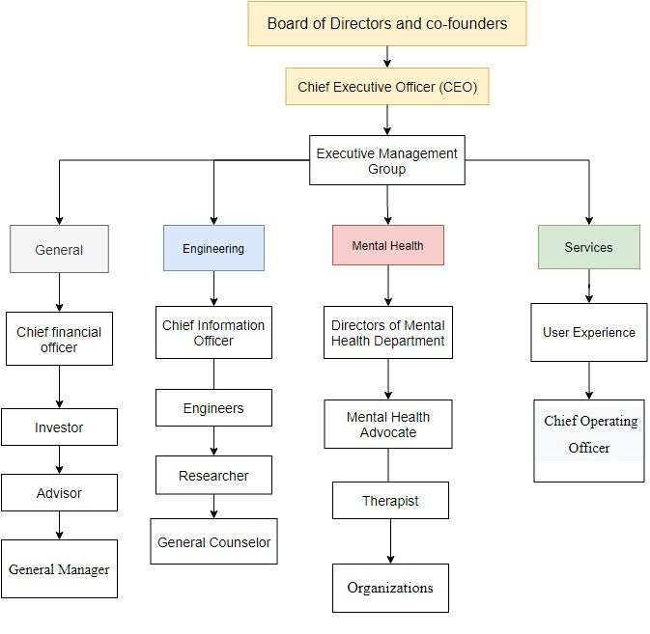
ORGANIZATIONAL
HIERARCHY

Slide 6
CODE OF ETHICS
To hold paramount, the safety, health, and welfare of the public, to strive to comply with ethical design and sustainable development practices, to protect the privacy of others, and to disclose promptly factors that might endanger the public or the environment
Engineers shall perform services only in the area of their competence.
2.1 Engineers shall undertake assignments only when qualified by education or experience in the specific technical fields involved.
2.2 Engineers shall not affix their signatures to any plans or documents dealing with subjects matter in which they lack competence, nor to any plan or document not prepared under their direction and control.
2.3 Engineers may accept assignments and assume responsibility for coordination of an entire project and sign and seal the engineering documents for the entire project, provided that each technical segment is signed and sealed only by the qualified engineers who prepared the segment.

Slide 7
CODE OF ETHICS
To avoid real or perceived conflicts of interest whenever possible, and to disclose them to affected parties when they do exist.
To avoid unlawful conduct in professional activities, and to reject bribery in all its forms.
To seek, accept, and offer honest criticism of technical work, to acknowledge and correct errors, to be honest, and realistic in stating claims or estimates based on available data, and to credit properly the contributions of others.
To treat all persons fairly and with respect, and to not engage in discrimination based on characteristics such as race, religion, gender, disability, age, national origin, sexual orientation, gender identity, or gender expression.
To avoid injuring others, their property, reputation, or employment by false or malicious actions, rumors, or any other verbal or physical abuses.

Slide 8
CODE OF ETHICS
Engineers, before undertaking work for others in connection with which the engineer may make improvements, plans, designs, inventions, or other records that may justify copyrights or patents, should enter into a positive agreement regarding ownership. They shall continue their professional development throughout their careers and should keep current in their specialty fields by engaging in professional practice, participating in continuing education courses, reading in the technical literature, and attending professional meetings and seminars.
Engineers shall support colleagues and co-workers in following this code of ethics, to strive to ensure the code is upheld, and to not retaliate against individuals reporting a violation.
Engineers shall not attempt to obtain employment or advancement or professional engagement by untruthfully criticizing other engineers, or by other improper or questionable methods.

Slide 9
THANK YOU!

