Slide 1

AMERICAN INTERNATIONAL UNIVERSITY- BANGLADESH
Faculty of Science and Technology
Presentation
MACHINE LEARNING (Sec : B)
Course Teacher : DR. M M MANJURUL ISLAM

Slide 2
◻ Title Of Presentation
Finding out the causes of drug addiction tendency among Bangladeshi students from Kaggle Dataset using Naïve Bayes and Decision Tree for More Accurate Prediction in Future

Slide 3
◻ Meet Our Team
Group-ML Alphas
Tanha Reja [ID- 19-40151-1]
Ruksat Khan Shayoni [ID- 20-41922-1]
Sarzila Sahrin Jisha [ID- 20-42526-1]
S M Asif Hossain [ID- 21-44421-1]

Slide 4
◻ Outline
Introduction
State-of-the-arts
Proposed Solution
Details of Proposal
Comparative Analysis
Decision Making
References

Slide 5
◻ Introduction
PROBLEM DEFINIATION:
Identified Factors -> Experimental curiosity, Peer pressure, Poor socio-economic condition
But could be more factors
Less Awareness
SOLUTION:
Naïve Bayes and Decision Tree
Comparing Models
Evaluating Models
Finding More Factors

Slide 6
◻ State-of-the-arts
Research Works | Year | Data Classification Techniques | No. of Datasets
S. D. Jadhav, H. P. Channe | 2016 | K-NN, Naive Bayes and Decision Tree | 3
I. A. A. Amra, A. Y. A. Maghari | 2017 | K-NN and Naïve Bayesian | 1
Arif, M. A. I., Sany, S. I., Sharmin, F., Rahman, M. S., & Habib, M. T. | 2021 | k-NN, SVM, Logistic Regression, Naive Bayes, CART, AdaBoost, Random forest, MLP, GBM | 1

Slide 7
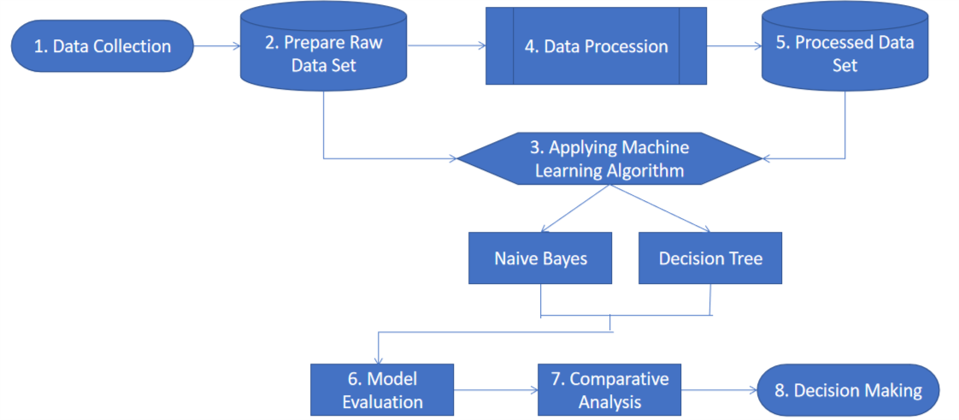
◻ Proposed Solution
Data Collection
Manually Preparing Raw Dataset
Apply ML Algorithms Without Preprocessing & Evaluation
Preprocessing Data
Apply ML Algorithms After Preprocessing Data & Evaluation
ML Model Evaluation
Comparatve Analysis
Decision Making

Slide 8
1. Data Collection
The Dataset Link:
https://www.kaggle.com/datasets/protikmostafa/drug-addiction-in-bangladesh-reasons?resource=download
Microsoft Excel version (CSV -> Comma-separated values Format)
More than 200 instances
Factors, Lifestyles which may or may not lead them to drug addiction

Slide 9
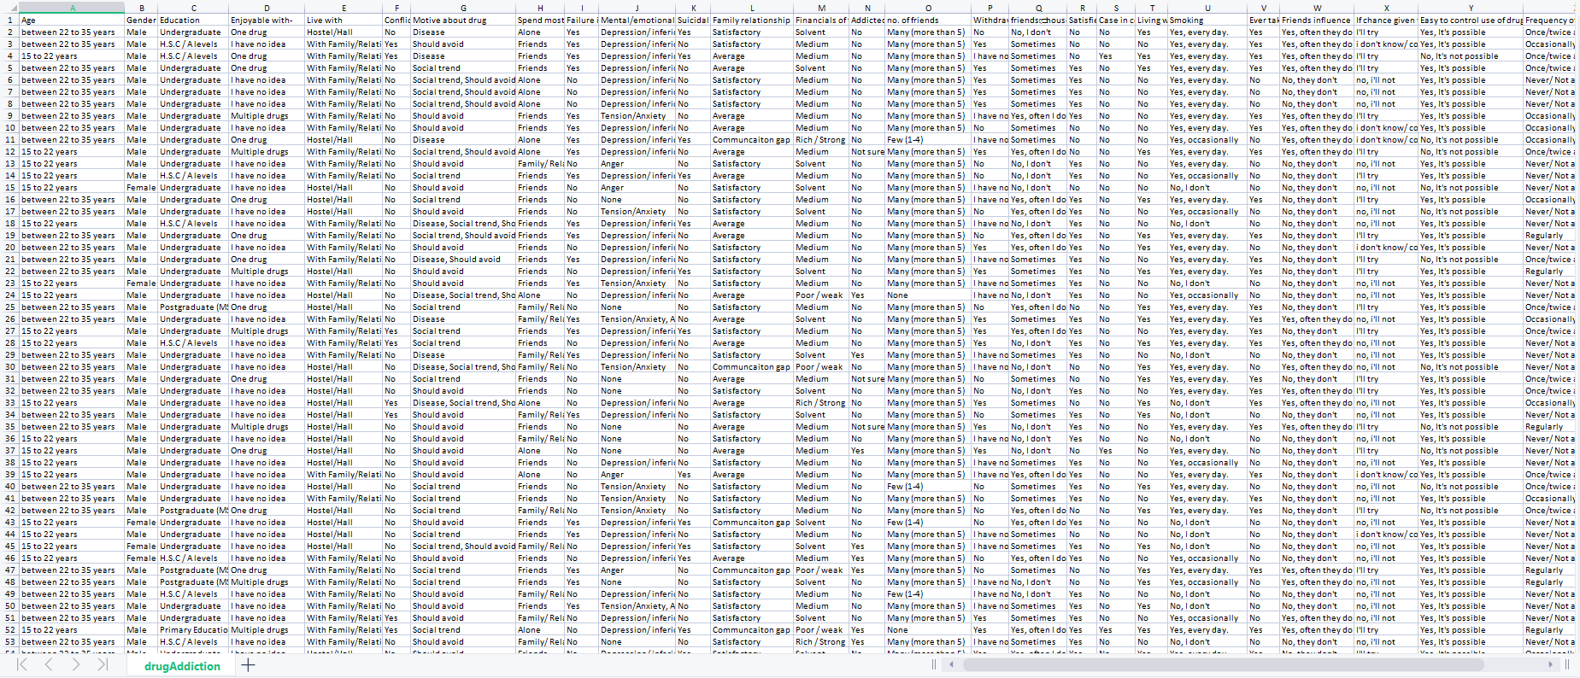
1. Snapshot Of Initial Dataset
Initial Dataset -> 211 Instances, 26 Attributes, Nominal Data Type, Supervised Dataset, 4 Class

Slide 10
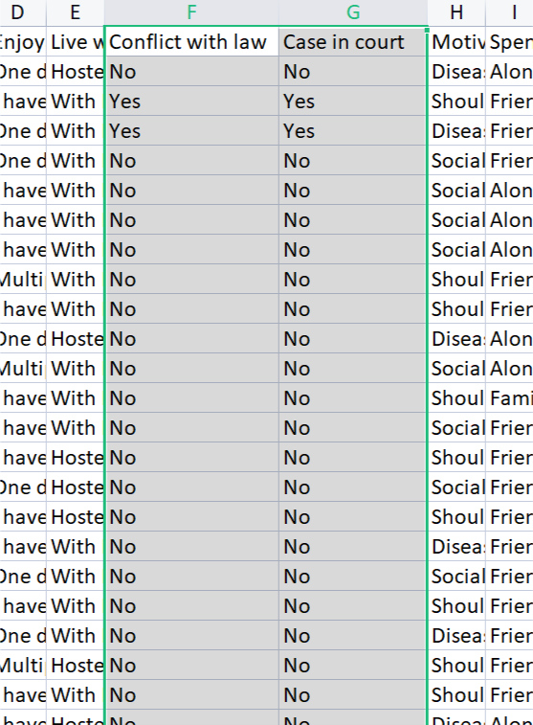
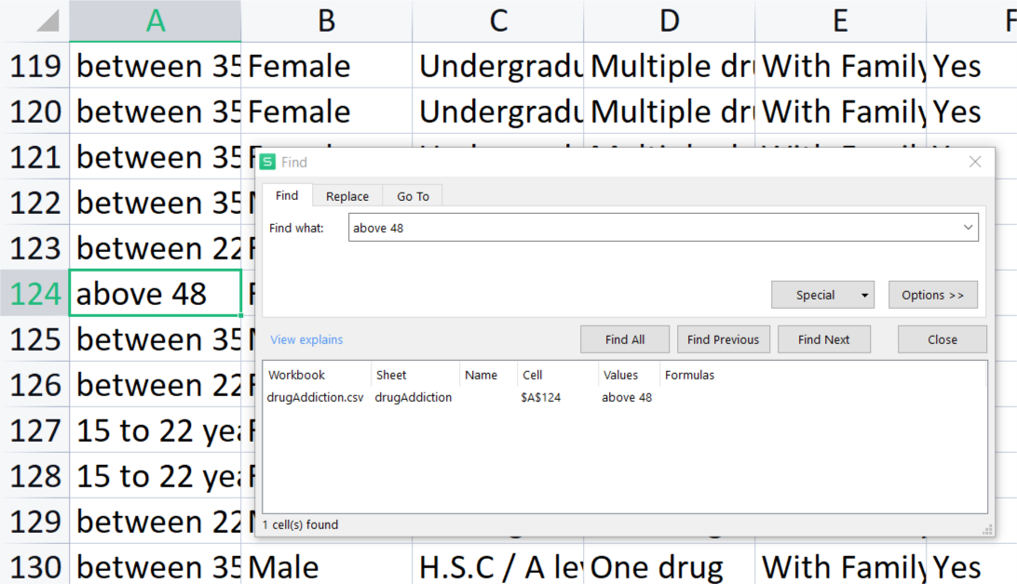
1. Problems In Initial Dataset
Contains Outliers -> Only one ‘above 48’ value in Age Attributes
Similar Attributes -> Conflict With Law, Case In Court
Missing Values

Slide 11
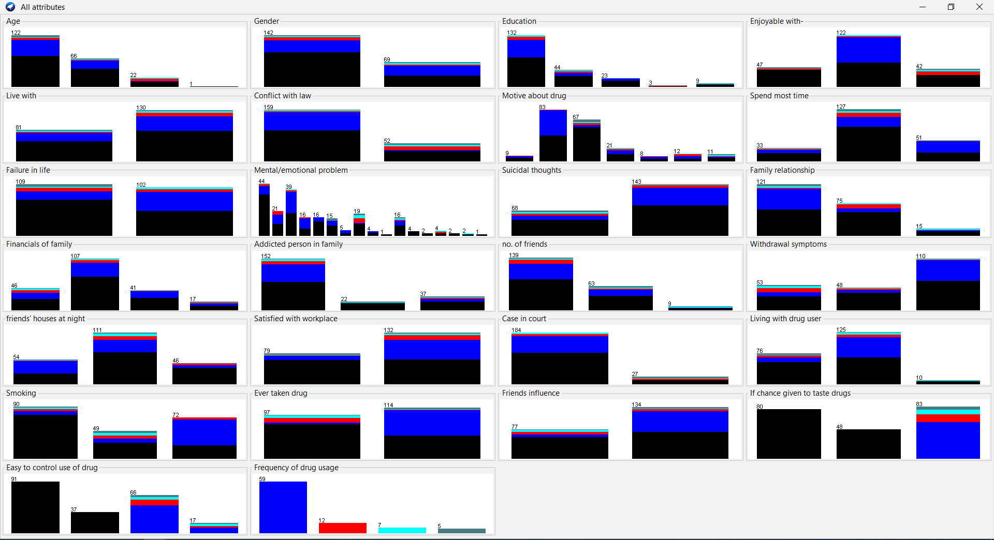
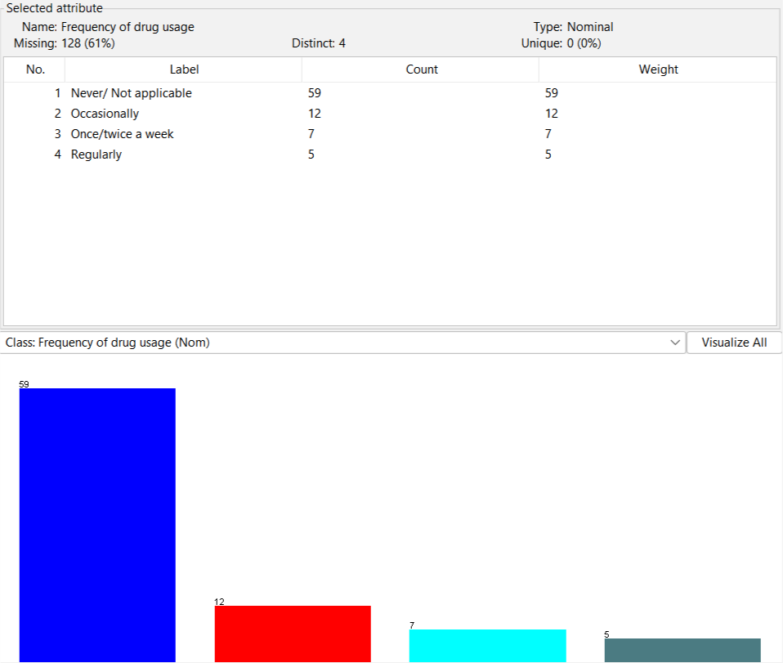
1. Visualization Of Initial Dataset

Slide 12
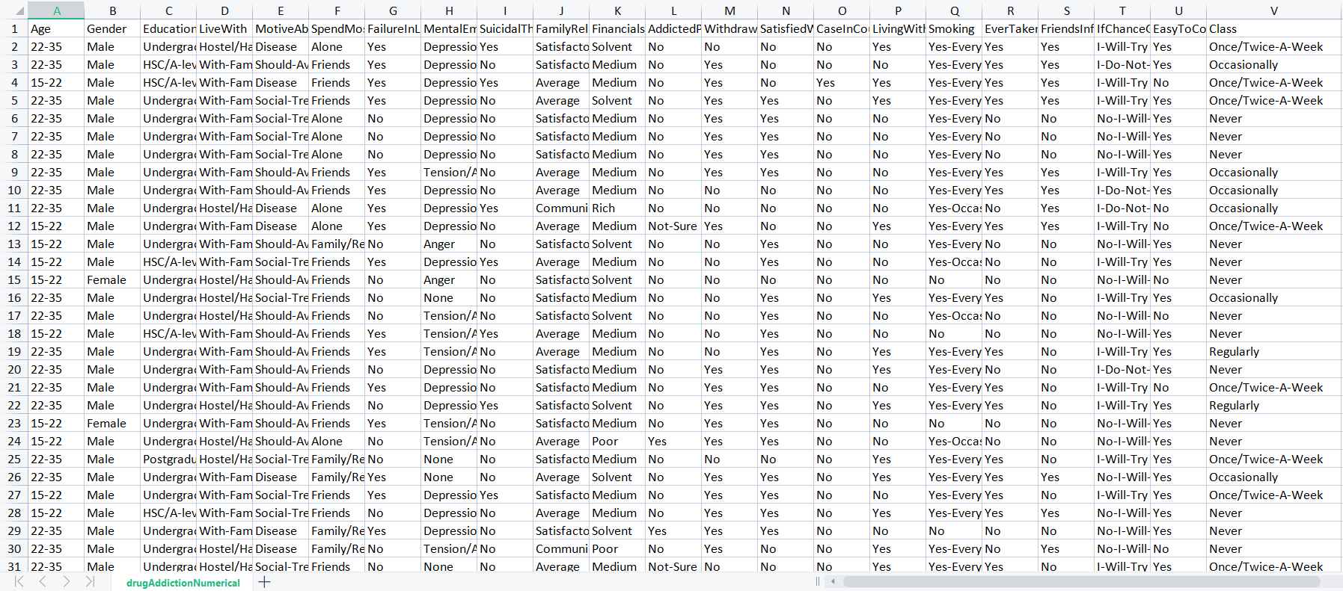
2. Prepare Raw Dataset
Manually Preparing Raw Dataset (Discarding Outliers, Editing values so that it is easily readable by models, Discarding repeated attributes, No missing values)
Finished Dataset -> 211 Instances, 22 Attributes
ARFF(Attribute-Relation File Format) File Creation

Slide 13
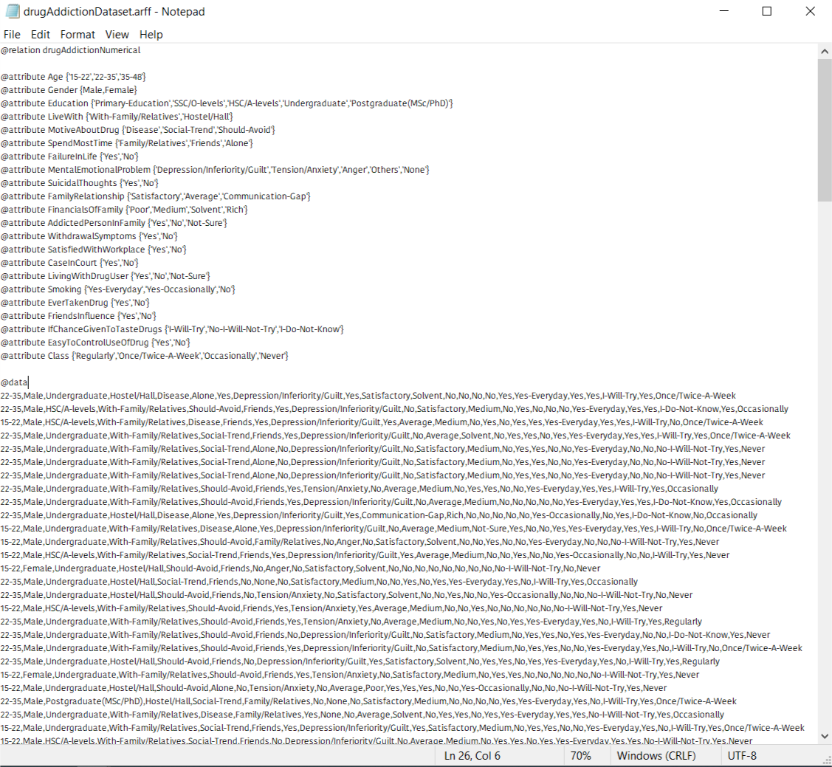
2. ARFF File For ML Model Creation

Slide 14
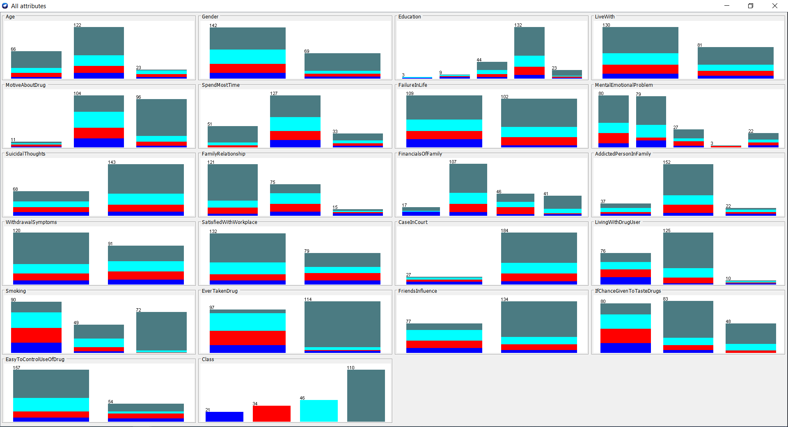
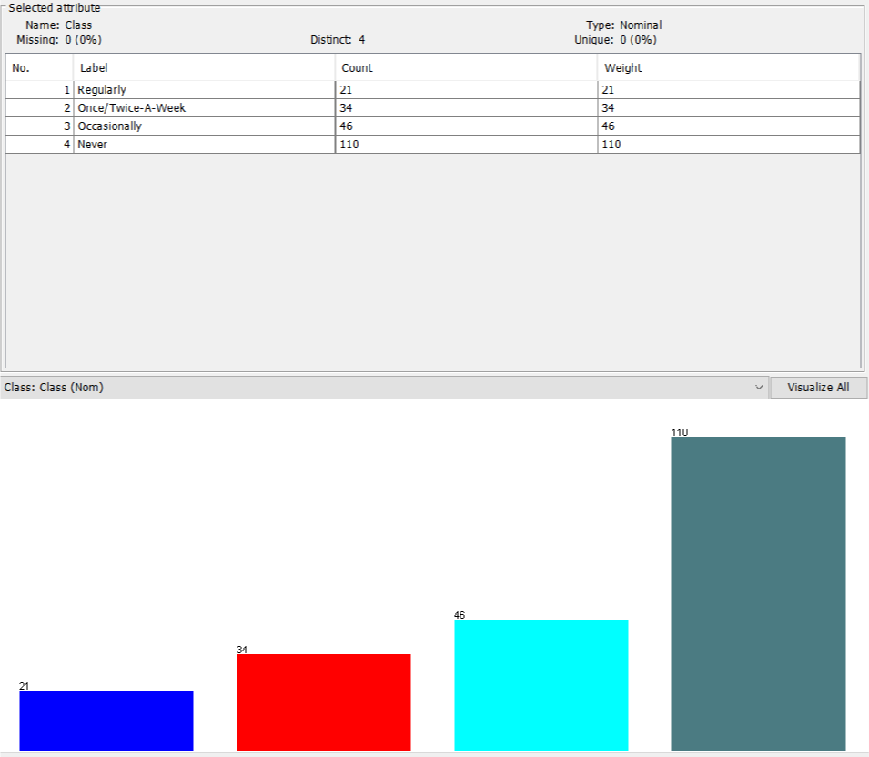
2. Visualization Of Finished Dataset

Slide 15
3. Applying Machine Learning Algorithm To Create Predictive Models In Tool
Model:1 -> Naïve Bayes:
It’s a statistical classifier that performs probabilistic prediction, such as- it predicts class membership probabilities.
Model:2 -> Decision Tree:
Decision tree algorithm is a data mining induction techniques that recursively partitions a dataset of records using depth-first greedy approach or breadth-first approach until all the data items belong to a particular class.
Tool Used For Model Building:
Weka version 3.8.6

Slide 16
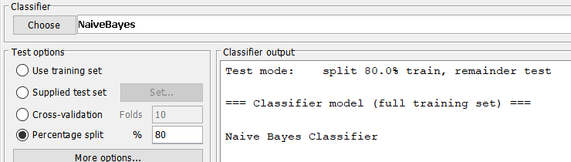
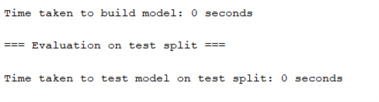
3.1 Applying Naive Bayes Classifier Algorithm Before Preprocessing Dataset
80% Training Set, 20% Testing Set
Time Taken To Build Naive Bayes Model -> 0 Sec

Slide 17
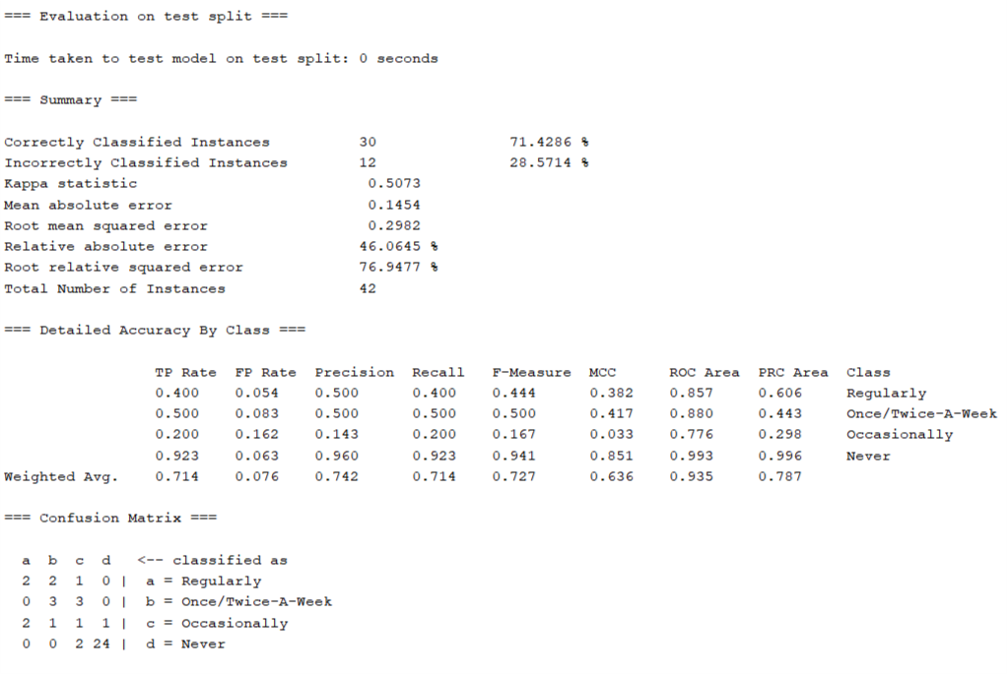
3.1 Evaluation Of Naive Bayes Classifier Model
Correctly Classified 30 out of 42 Instances
Accuracy - > 71.4286%
Kappa -> 0.5073
MAE -> 0.1454
RMSE -> 0.2982
RAE -> 46.0645%
RRSE -> 76.9477%
Recall -> 0.714
Precision -> 0.742
F-Measure -> 0.727

Slide 18
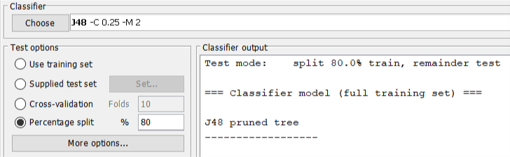
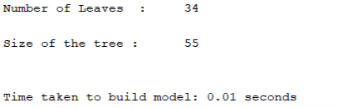
3.2 Applying Decision Tree Algorithm Before Preprocessing Dataset
80% Training Set, 20% Testing Set
Time Taken To Build Decision Tree Model -> 0.1 Sec
No of Leaf Nodes -> 34
Size of Tree -> 55

Slide 19
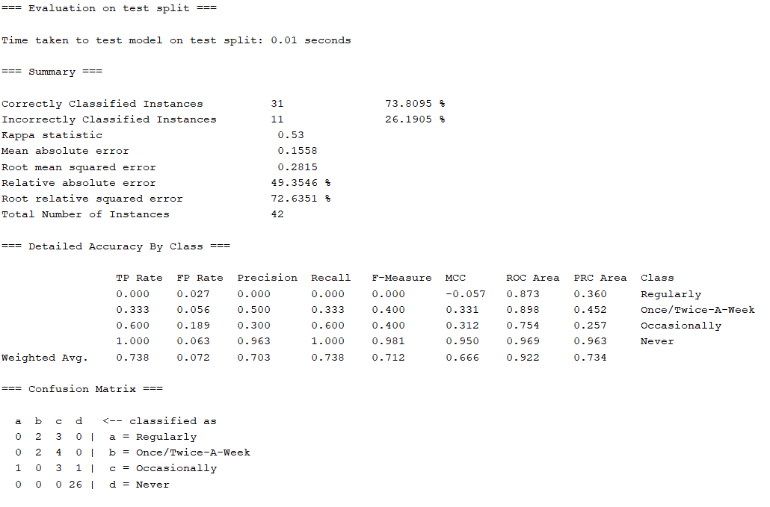
3.2 Evaluation Of Decision Tree Model
Correctly Classified 31 out of 42 Instances
Accuracy - > 73.8095%
Kappa -> 0.53
MAE -> 0.1558
RMSE -> 0.2815
RAE -> 49.3546%
RRSE -> 72.6351%
Recall -> 0.738
Precision -> 0.703
F-Measure -> 0.712

Slide 20
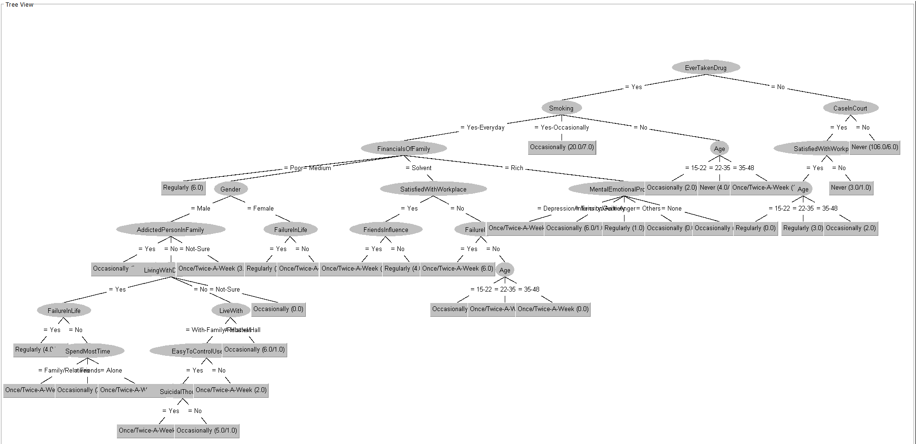
3.2 Decision Tree Created By Model

Slide 21
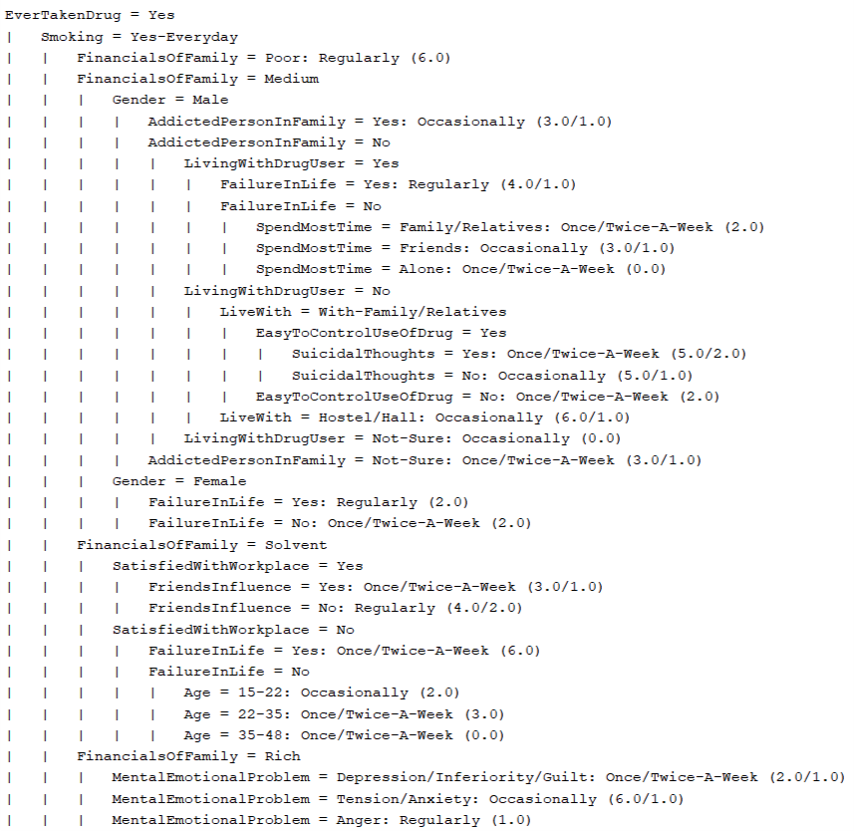
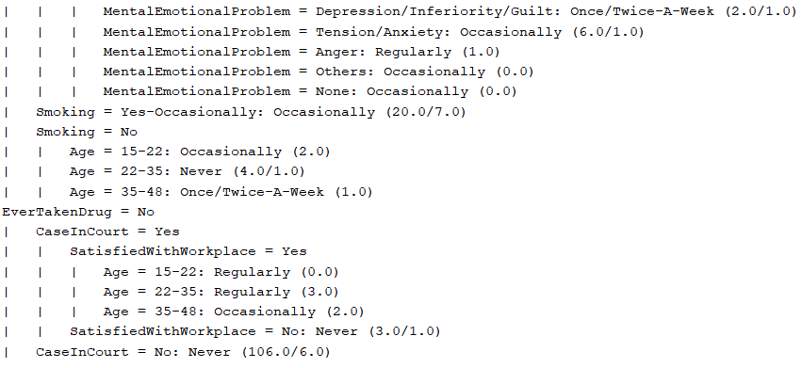
3.2 Decision Tree (Alternative Representation)

Slide 22
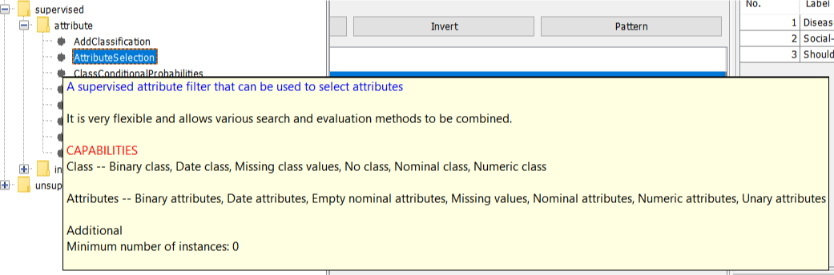
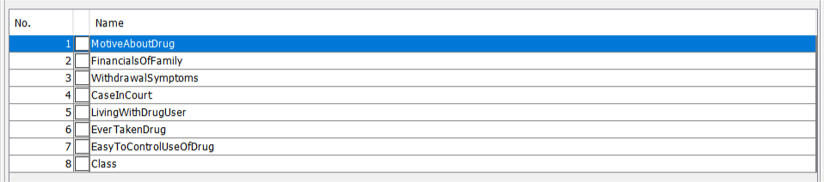
4. Preprocessing Dataset
Attribute Selection Method
Allows various search & evaluating methods to be combined
After Preprocessing Attribute No -> 8
Initial Attribute No -> 22

Slide 23
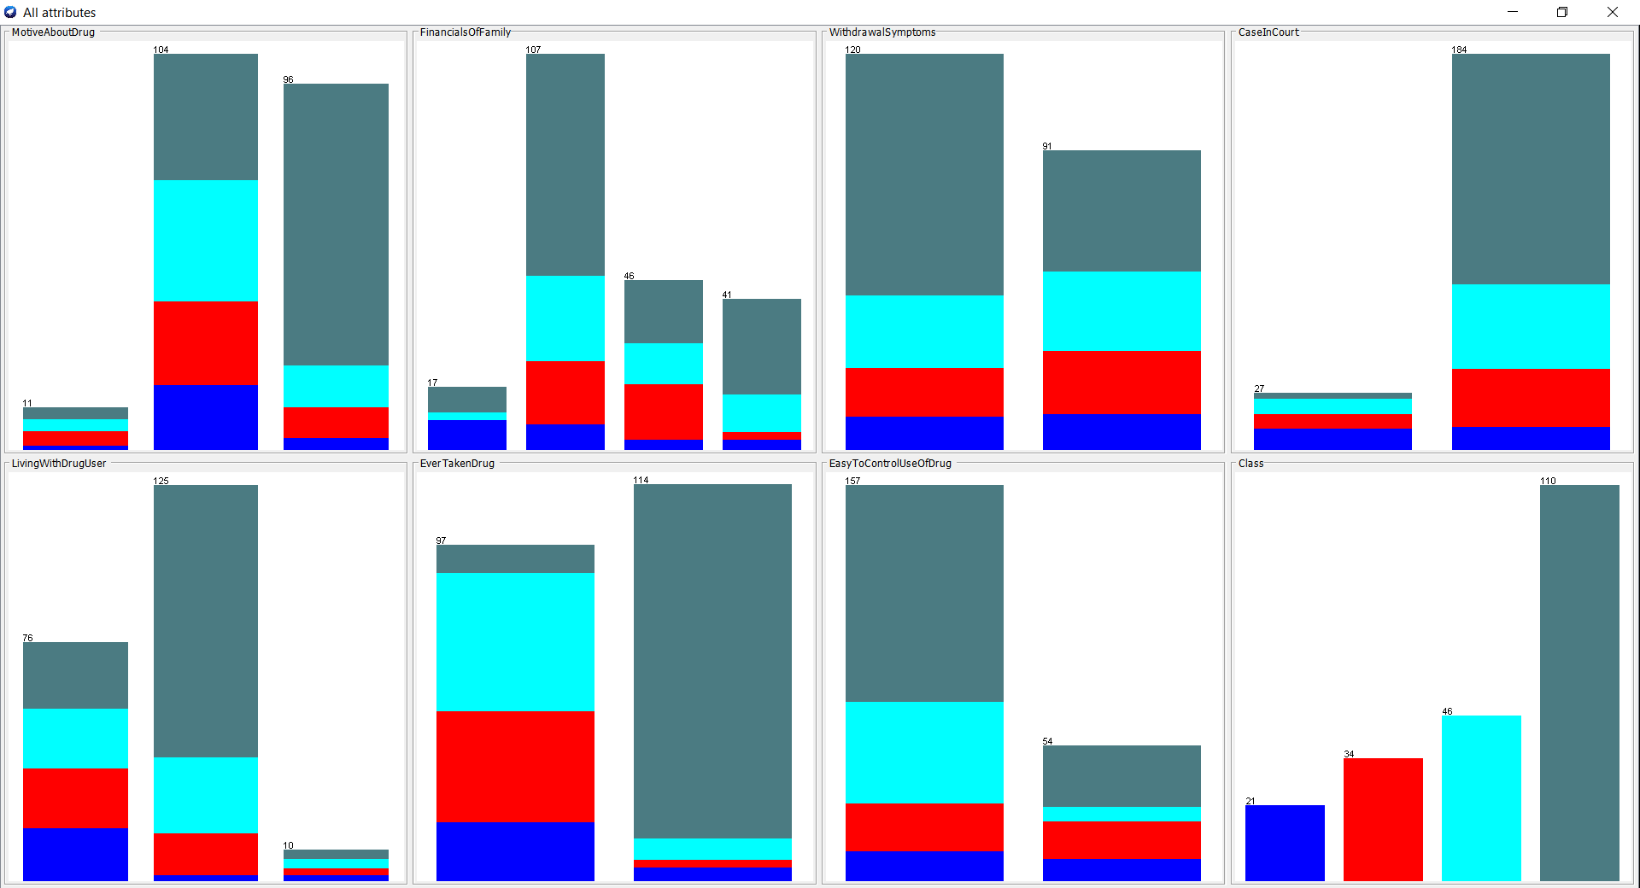
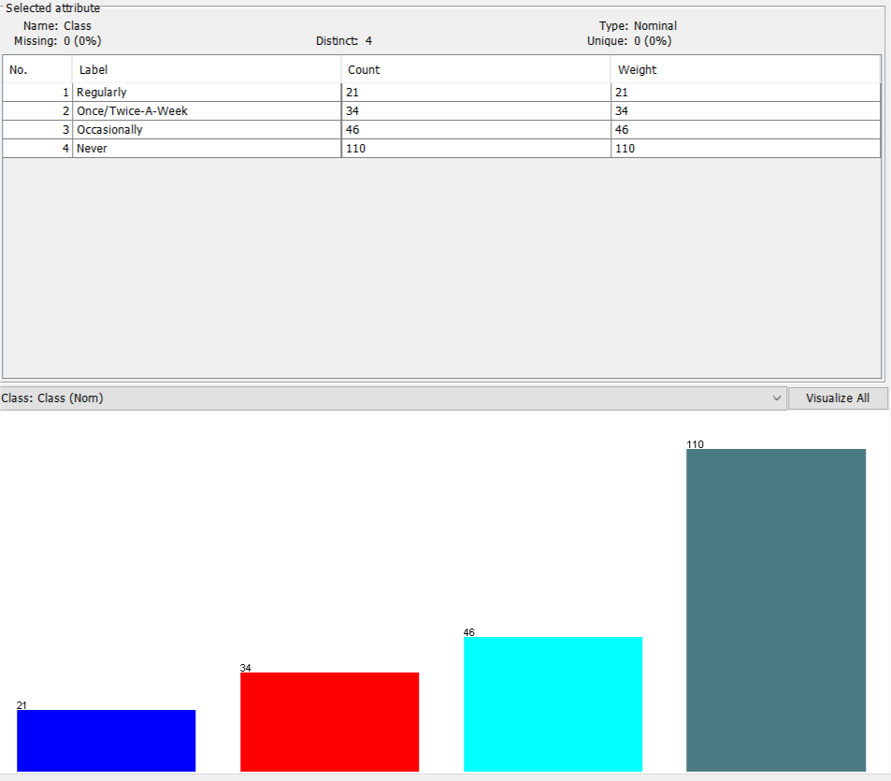
4. Visualization Of Finished Dataset

Slide 24
5.1 Applying Naive Bayes Classifier Algorithm After Preprocessing Dataset
80% Training Set, 20% Testing Set
Time Taken To Build Naive Bayes Model -> 0 Sec

Slide 25
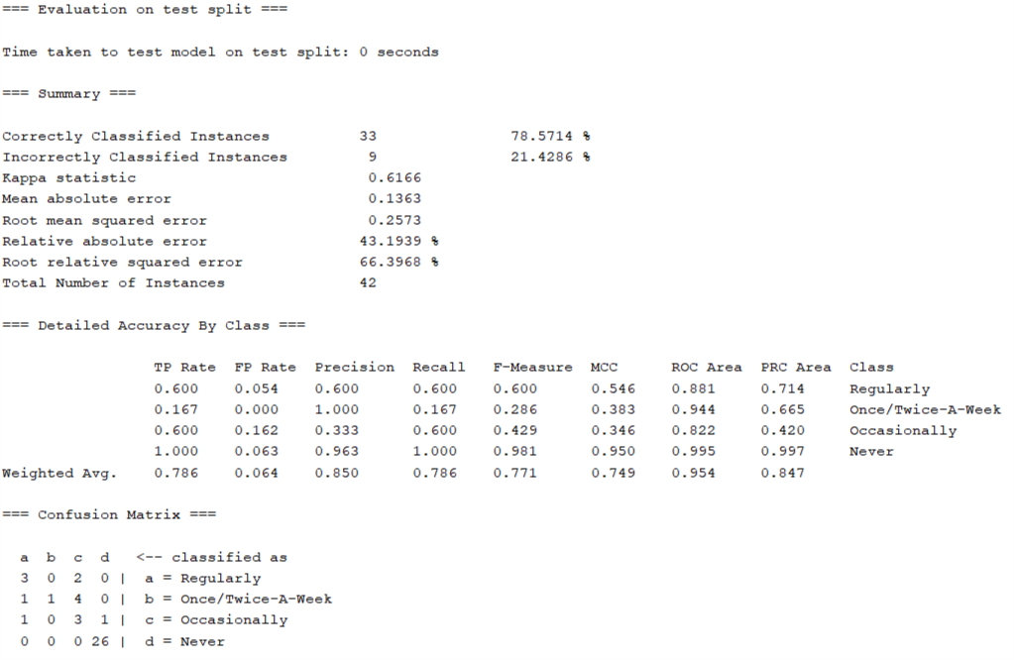
5.1 Evaluation Of Naive Bayes Model
Correctly Classified 33 out of 42 Instances
Accuracy - > 78.5714%
Kappa -> 0.6166
MAE -> 0.1363
RMSE -> 0.2573
RAE -> 43.1939%
RRSE -> 66.3968%
Recall -> 0.786
Precision -> 0.850
F-Measure -> 0.771

Slide 26
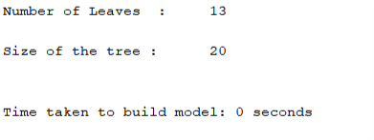
5.2 Applying Decision Tree Algorithm After Preprocessing Dataset
80% Training Set, 20% Testing Set
Time Taken To Build Decision Tree Model -> 0 Sec
No of Leaf Nodes -> 13
Size of Tree -> 20

Slide 27
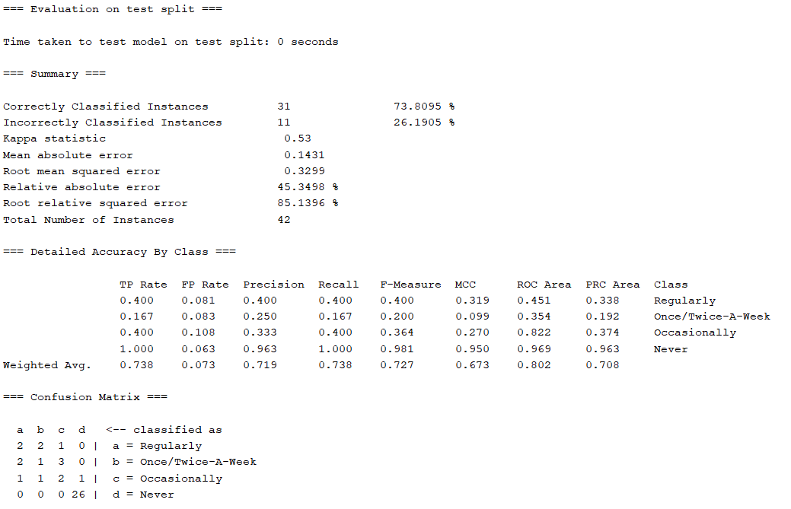
5.2 Evaluation Of Decision Tree Model
Correctly Classified 31 out of 42 Instances
Accuracy - > 73.8095%
Kappa -> 0.53
MAE -> 0.1431
RMSE -> 0.3299
RAE -> 45.3498%
RRSE -> 85.1396%
Recall -> 0.738
Precision -> 0.719
F-Measure -> 0.727

Slide 28
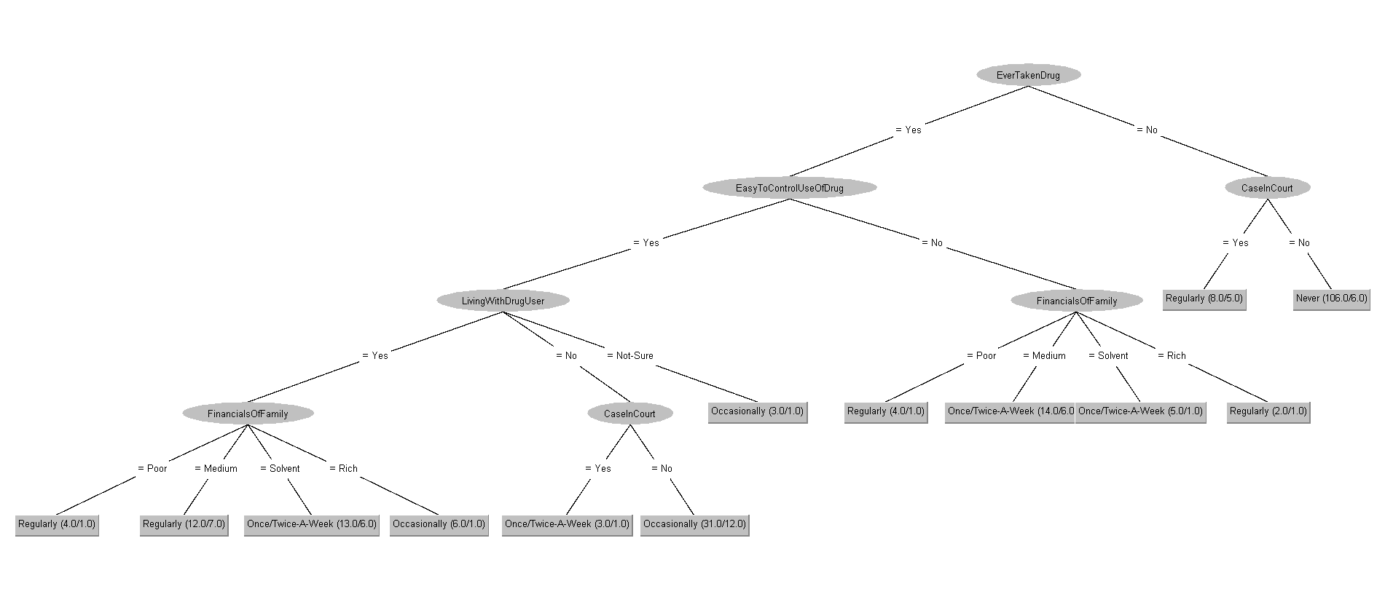
5.2 Decision Tree Created By Model

Slide 29
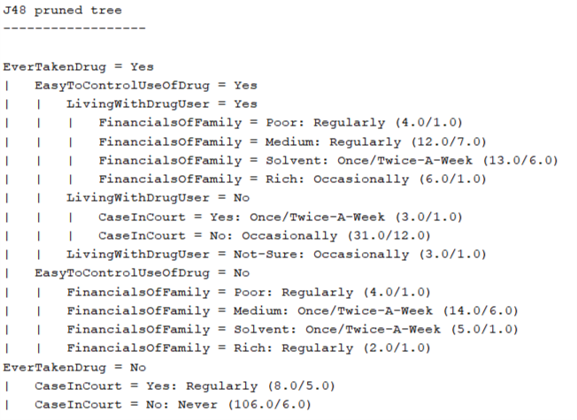
5.2 Decision Tree (Alternative Representation)

Slide 30
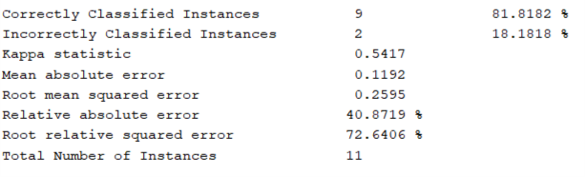
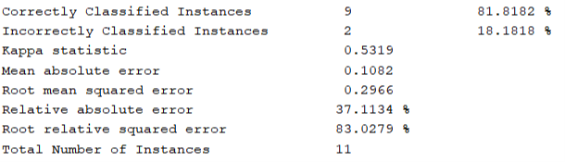
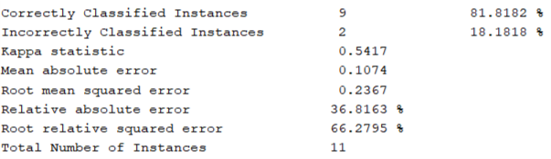
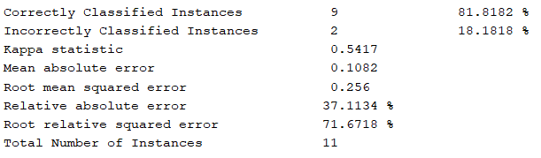
5.3 Extra
When Training Set 95% & Test Set 5%
NB Before Preprocess DT Before Preprocess
NB After Preprocess DT After Preprocess

Slide 31
6. Evaluation Metrics
Kappa Statistics -> Basically tells how much better classifier is performing, ranges from 0 to 1, 1 being best.
Mean Absolute Error -> The measure of how far the predictions are from the actual output. Closer to 0 is better.
Root Mean Squared Error -> Similar to MAE but penalizes the error terms more. Closer to 0 is better.
Relative Absolute Error -> Measures the performance of a predictive model and is expressed in terms of a ratio, ranges from 0 to 1. Closer to 0 is better.
Root Relative Squared Error -> A basic metric that gives a first indication of how well model performance. Closer to 0 is better.
Accuracy -> Indicates how many times the ML model was correct overall. The more the better.
Recall -> Indicates how many times the model was able to detect a specific category.
Precision -> Indicatees how good the model is at predicting a specific category.
F1 -> Harmonic Mean Of P&R
Recall, Precision, F1 -> Closer to 1 is better.

Slide 32
6.1 Evaluating Models (Naive Bayes)
Before Pre-Processing
Accuracy - > 71.4286%
Kappa -> 0.5073
MAE -> 0.1454
RMSE -> 0.2982
RAE -> 46.0645%
RRSE -> 76.9477%
Recall -> 0.714
Precision -> 0.742
F-Measure -> 0.727
After Pre-Processing
Accuracy - > 78.5714% ; Improved
Kappa -> 0.6166 ; Improved
MAE -> 0.1363 ; Improved
RMSE -> 0.2573 ; Improved
RAE -> 43.1939% ; Improved
RRSE -> 66.3968% ; Improved
Recall -> 0.786 ; Improved
Precision -> 0.850 ; Improved
F-Measure -> 0.771 ; Improved

Slide 33
6.2 Evaluating Models (Decision Tree)
Before Pre-Processing
Accuracy - > 73.8095%
Kappa -> 0.53
MAE -> 0.1558
RMSE -> 0.2815
RAE -> 49.3546%
RRSE -> 72.6351%
Recall -> 0.738
Precision -> 0.703
F-Measure -> 0.712
After Pre-Processing
Accuracy - > 73.8095% ; Same As Before
Kappa -> 0.53 ; Same As Before
MAE -> 0.1431 ; Improved
RMSE -> 0.3299 ; Did Not Improve
RAE -> 45.3498% ; Improved
RRSE -> 85.1396% ; ; Did Not Improve
Recall -> 0.738 ; Same As Before
Precision -> 0.719 ; Improved
F-Measure -> 0.727 ; Improved

Slide 34
7. Comparative Analysis
 | Naive Bayes | Decision Tree
Training Time | Faster than DT in computational time for training | Slower than NB
Accuracy | Before Preprocessing -> 71.4286% After Preprocessing -> 78.5714% Higher accuracy than DT for our dataset | Before Preprocessing -> 73.8095% After Preprocessing -> 73.8095% Lower accuracy than NB for our dataset
Evaluation Metrics | Higher Kappa Statistics than DT Lower MAE, RMSE, RAE, RRSE than DT Higher Recall,Precision, F-Measure than DT | Lower Kappa Statistics than NB Higher MAE, RMSE, RAE, RRSE than NB Lower Recall,Precision, F-Measure than NB
Kappa -> 0.5073 MAE -> 0.1454 RMSE -> 0.2982 RAE -> 46.0645% RRSE -> 76.9477% Recall -> 0.714 Precision -> 0.742 F-Measure -> 0.727 | Kappa -> 0.6166 ; Improved MAE -> 0.1363 ; Improved RMSE -> 0.2573 ; Improved RAE -> 43.1939% ; Improved RRSE -> 66.3968% ; Improved Recall -> 0.786 ; Improved Precision -> 0.850 ; Improved F-Measure -> 0.771 ; Improved
Kappa -> 0.53 MAE -> 0.1558 RMSE -> 0.2815 RAE -> 49.3546% RRSE -> 72.6351% Recall -> 0.738 Precision -> 0.703 F-Measure -> 0.712 | Kappa -> 0.53 ; Same As Before MAE -> 0.1431 ; Improved RMSE -> 0.3299 ; Did Not Improve RAE -> 45.3498% ; Improved RRSE -> 85.1396% ; ; Did Not Improve Recall -> 0.738 ; Same As Before Precision -> 0.719 ; Improved F-Measure -> 0.727 ; Improved

Slide 35
8. Decision Making
More Data
Better Performance -> Naive Bayes
More Tendency | Less Tendency
Age : 22-35 Male Undergraduate Students Social Trend Bad Relation With Family Failure In Life Depression/Inferiority/Guilt/Tension Suicidal Thoughts Addicted Person In Family or Lives With An Addicted Person Case In Court Smoker Bad Friend Influence Said yes when got asked if they’ll ever take drug if got chance Less Control Over Drug Usage | Lives with Family/Relatives & Good Family Bonding Medium Financial Status Satisfied With Workplace No Addicted Person In Family Good Friends Said no when got asked if they’ll ever take drug if got chance Does Not Smoke More Self Control

Slide 36
◻ References
S. D. Jadhav, H. P. Channe, “Comparative Study of K-NN, Naive Bayes and Decision Tree Classification Techniques.” International Journal of Science and Research (IJSR) ISSN (Online): 2319-7064. Paper ID: NOV153131. Volume 5 Issue 1, January 2016
I. A. A. Amra, A. Y. A. Maghari, “Students Performance Prediction Using KNN and Naïve Bayesian.” 8th International Conference on Information Technology (ICIT). DOI: 10.1109/ICITECH.2017.8079967. May 2017
Arif, M. A. I., Sany, S. I., Sharmin, F., Rahman, M. S., & Habib, M. T. “Prediction of addiction to drugs and alcohol using machine learning: A case study on Bangladeshi population.” International Journal of Electrical and Computer Engineering, Vol. 11, No. 5. October 2021

