Slide 1
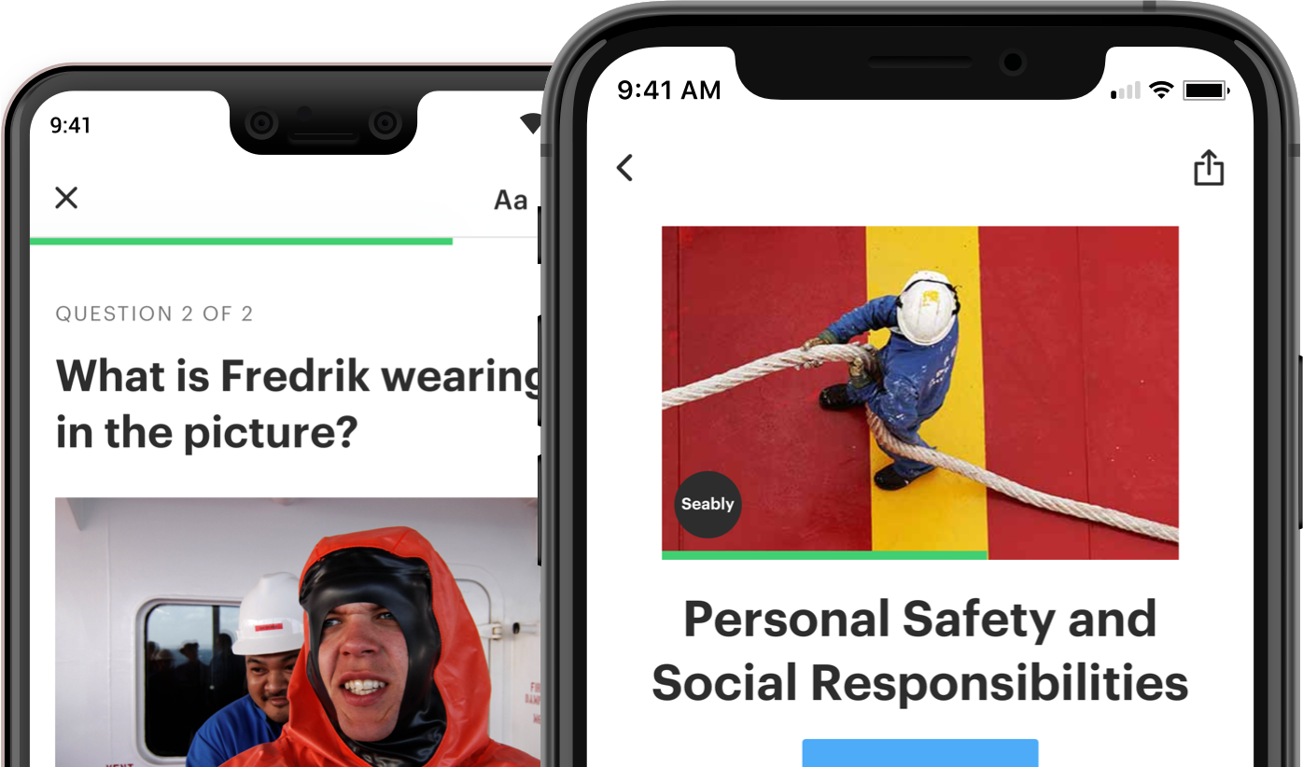

Slide 2


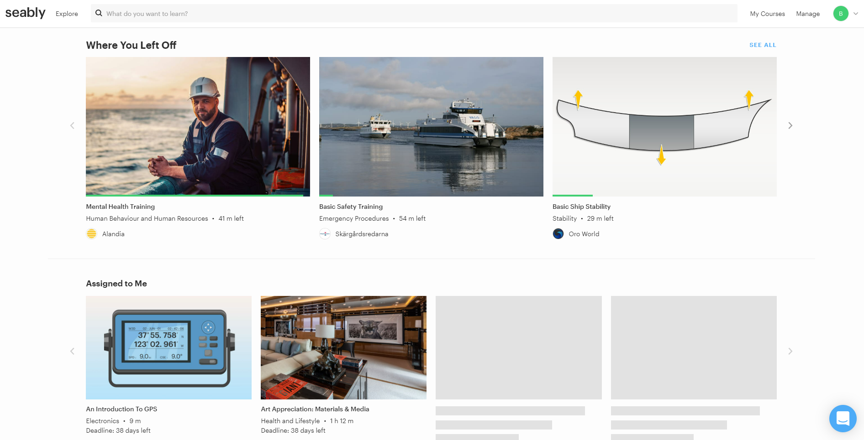

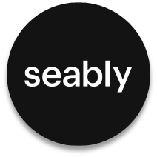
What Is Seably ?
Seably is an online maritime learning platform where the content is being built up from various sources, providing a rich source of training material.
Seably has replaced Videotel On Demand (VOD) across all Synergy ships as a new learning platform. Seably is more seafarer-friendly in terms of convenience and use. It empowers the seafarers to complete the training at their own pace, in their own convenient time using their own chosen device.

Slide 3
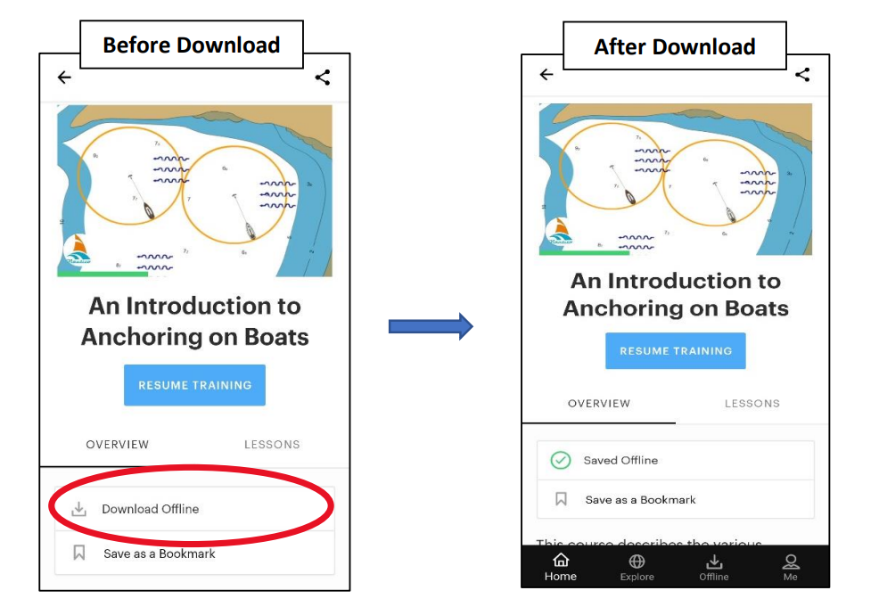
Key features of Seably
Unlimited Access to All Courses.
Synergy employees will have unlimited access to company-owned content, as well as over 270 courses developed by industry specialists covering a wide range of topics and skills, including specialized wellness programs, designed and created by health experts with the mariner in mind.
Learn Anywhere Onshore or at Sea
The Seably platform can be accessed online and offline, at any time on land or at sea using apps, PCs and mobile devices.
You can download courses to a device and complete the training without an internet connection, bring courses out to sea with our iOS and Android apps. Works on both phones and tablets.
Be wherever you learn the best.

Slide 4
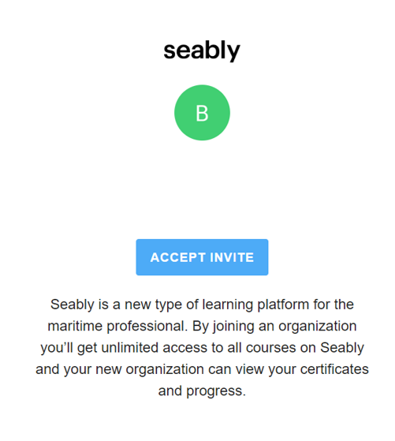
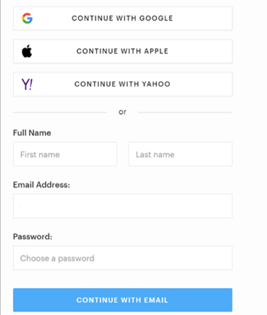
How do I get access to Seably ?
Step 1:
We have sent an invite link to each seafarer to their email address that is registered with Synergy. Once you open the mail, click ‘Accept Invite’.
On Clicking ‘Accept Invite’ it will take you to Seably platform and will ask you to setup a password
Step 2 :
Use ‘Email Address’ option and use the Email address you received the invite link to set up your password.
Note: Setup your password and save it securely to prevent unauthorized access.

Slide 5
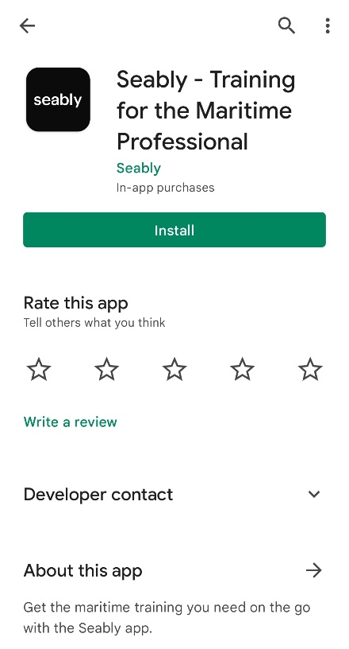
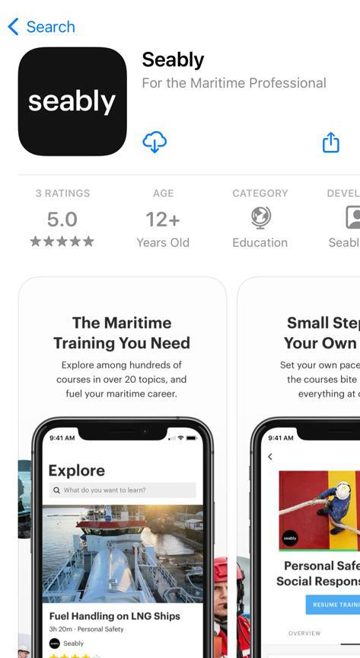
Step 3:
Download Seably App from Play store (Android) or App Store (iOS) in your personal device (Mobile/Tab/iPad) and login using your credentials.
Android
iOS

Slide 6
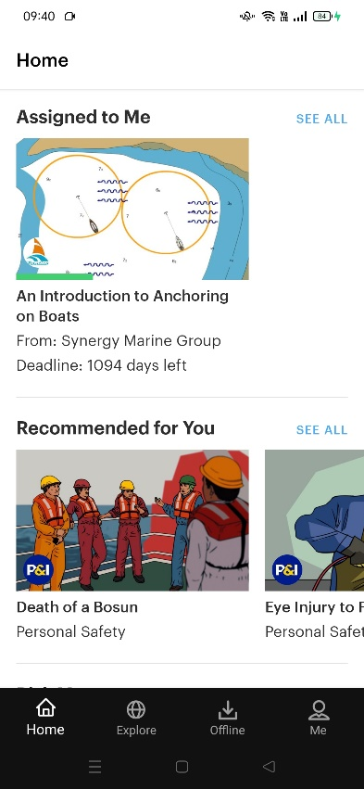
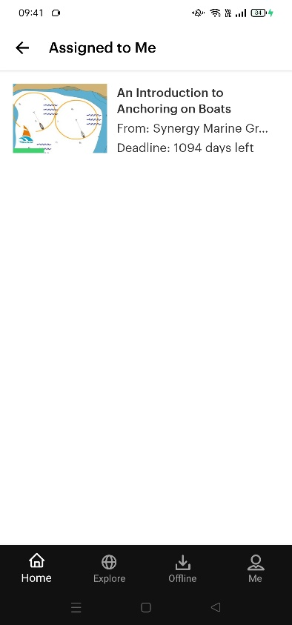
How to know my Assigned Courses ?
Step 1:
After logging into the Seably Platform, you can go to ‘My Course’ to see the courses assigned
Click ‘See All’ where you will find all the courses assigned to you and the deadline to complete the course.
Note:
It is advised to download the courses assigned to you while you have access to internet before onboarding the vessel. This will enable offline access of the course material.

Slide 7
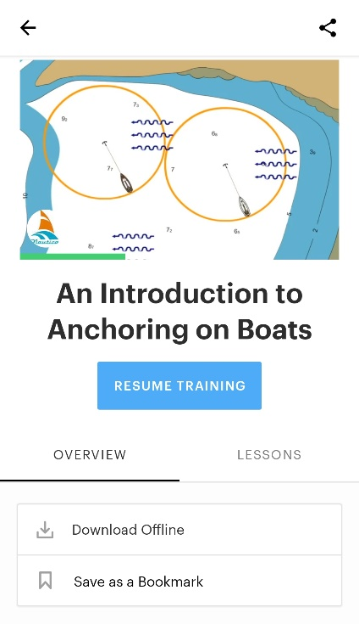
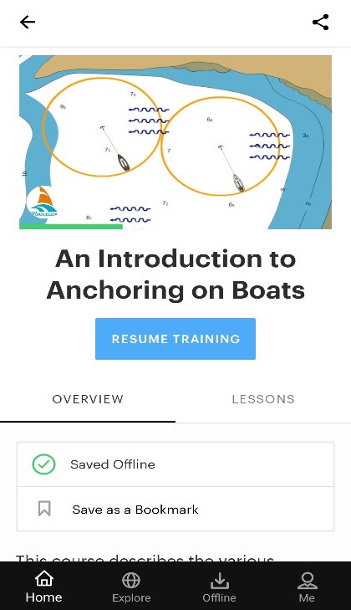
How to download the Courses ?
Step 1:
Click on a Course you wish to download.
Upon clicking the course, you will find ‘Download Offline’ option which when clicked, will download the course to your dashboard
Before Download
After Download
Step 2:
You can find the downloaded course in the ‘Offline’ section of your dashboard. .
Note:
Kindly note that Downloading courses to access it offline can only be done via App and not through website.

Slide 8
How do I get my Certificates?
Upon completing the course, the course completion certificate will be sent to the registered email address and will also be accessible in Seably. Your progress will also be monitored by office personnel.
Most of the courses have a validity of 2 years. Some courses have 3 years validity and very few have a lifelong validity to it.
Note:
Kindly fill the form in the chat box if you haven’t received Seably invite. You will receive the invite link by a week after the form is submitted.
You may contact seably@synergyship.com or contact chatbot in Seably website/app in case of any queries.

Slide 9
Team Synergy and Seably wish you a very happy learning.
Thank You For Giving Your Valuable Time.

