Slide 1
BUSTRACK

Slide 2
The application
General presentation
The average person using the bus spends on average 5 minutes in the buss stop. It might not sound that bad, but in winter you sure will be freezing by the time you get on the bus. By using the BussTrack application the user is prompted when it needs to leave home to reach the bus with no waiting time. The app is map based so you can see all busses going through your city live. You can also check for routes in case you don’t know which bus to get.
App functionalities
Standard User can check routes
Standard User can see busses on map
Standard User can check bus stop information
Admin can create a standard user account
Admin can create a driver account
Admin can add, edit buss stops, routes and busses
Driver can set up the buss for the day
Driver can passively pass data related to the buss

Slide 3

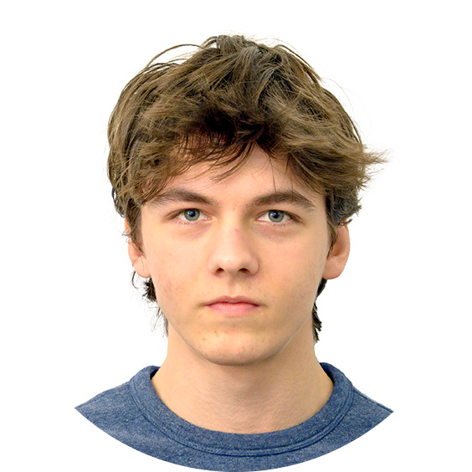
TEAM PRESENTATION
Andrei Sas-Miresan Developer
Working on the interface
Alexandru Pop Developer
Working with data

Slide 4
ROADMAP
Realised how much time we spent at a bus stop
Transformed it into a map based application
Working on making the app more precise and interactive
1
3
5
2
4
6
Came up with a not so friendly but usefull application
Our first launch on play store
Releasing it on iOS

Slide 5


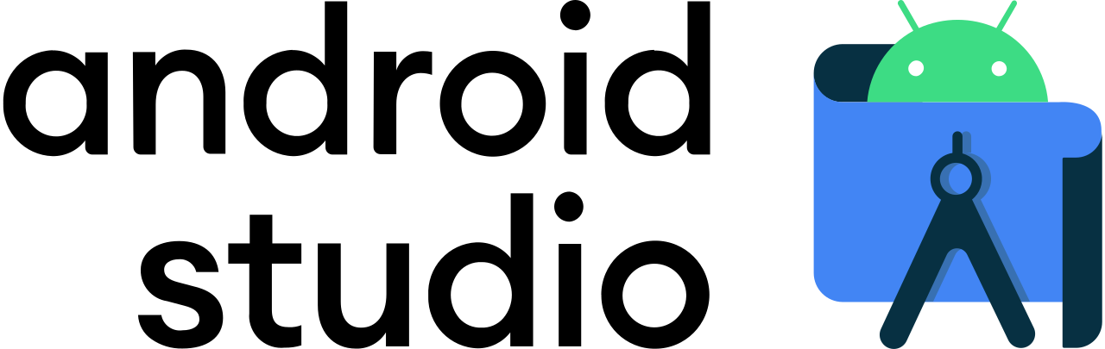
IT Technology
We use the platform to host the server for the exchange of informations between the database and the phones locations
We use the MySQL program to create and organize the database of the busses, routs and stations.
We use the android studio program to create our app for easier access to the maps APIs

Slide 6
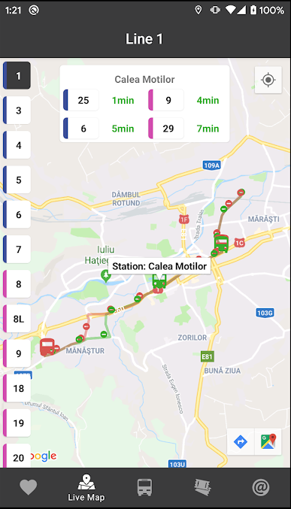
USER INTERFACE
(looking for the busses at the selected station)

Slide 7
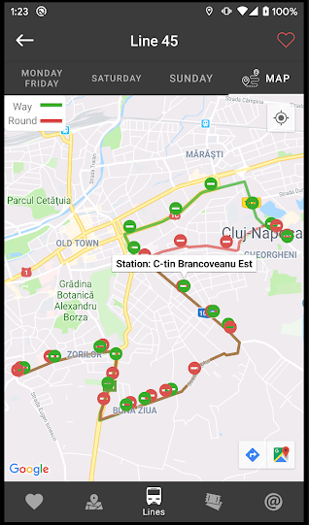
USER INTERFACE
(looking for possible routes from a station)

Slide 8
Portability & Competition
Our BussTrack application is portable. It is a mobile application which currently runs on all android devices, whether it’s a phone, tablet or virtual machine.
All data is hosted on 24/7 running servers and so its always accessible from any device.
We are looking to expand our application for iOS lovers in the future but it will not be so soon as we focus on delivering quality first and then go wide.
The only competing software on the market is Bus Cluj-Napoca found in the Play Store, an app which crashes and it is out of service since 31th of October.

Slide 9
DESIGN OF THE APP
1

Slide 10
USE CASES
2

Slide 11
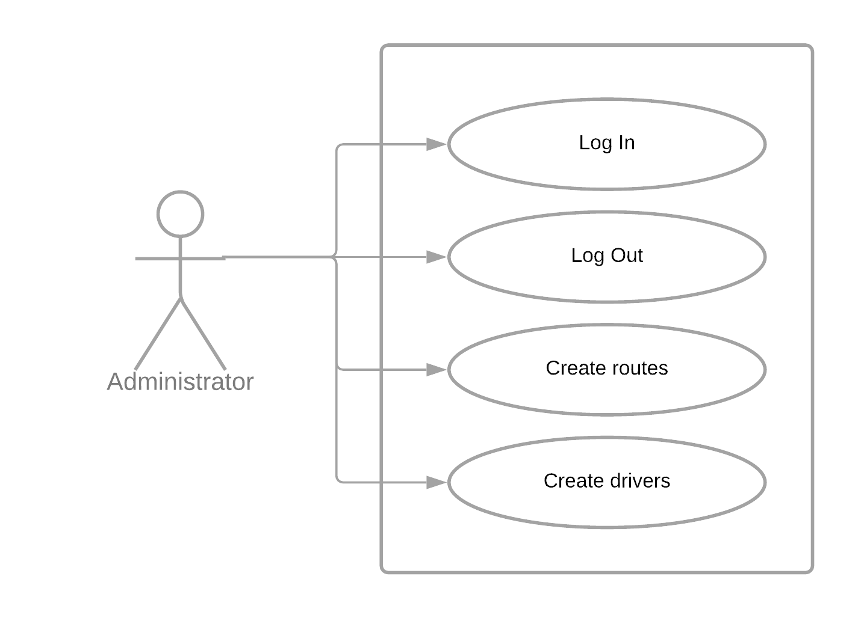
User administrator
Description:
This actor is the person who administrates the backend data of the app and the accounts of the other user types.

Slide 12
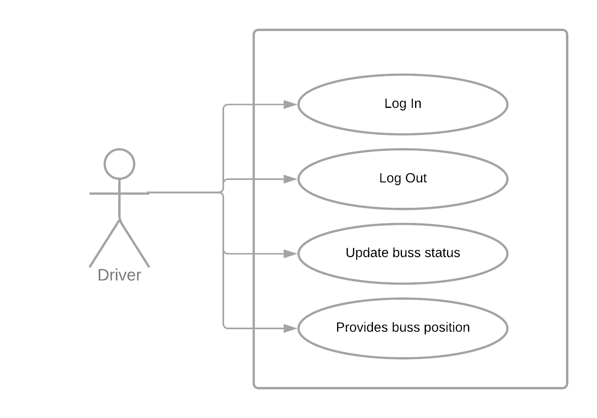
User driver
Description:
This actor is the person who drives one of the busses. The Driver is the one responsible to set the line it drives every day and to update the status of the buss. The Driver is used to determine the location of the buss also.

Slide 13
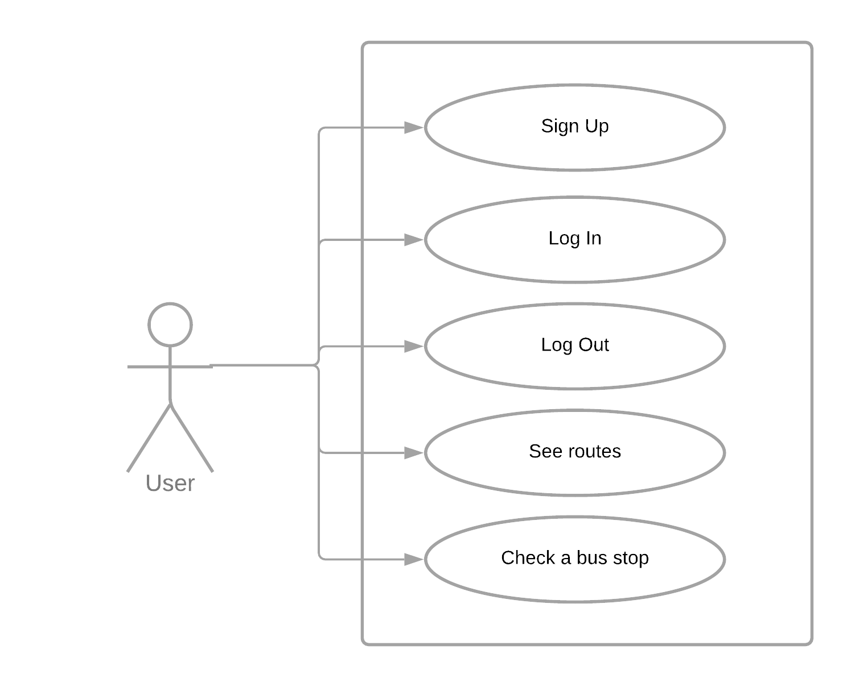
User normal user
Description:
This actor is the person who mainly uses the app with personal intentions.

Slide 14
ARCHITECTURE DIAGRAMS
2

Slide 15
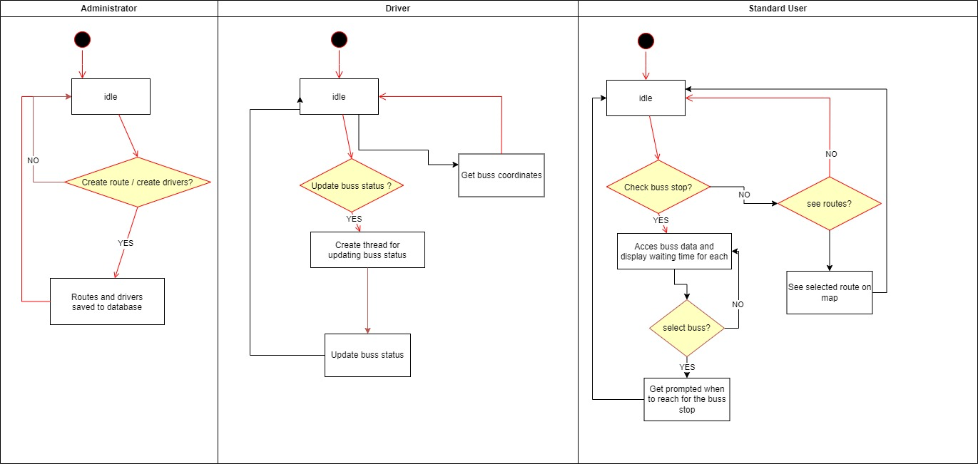
Activity diagram

Slide 16
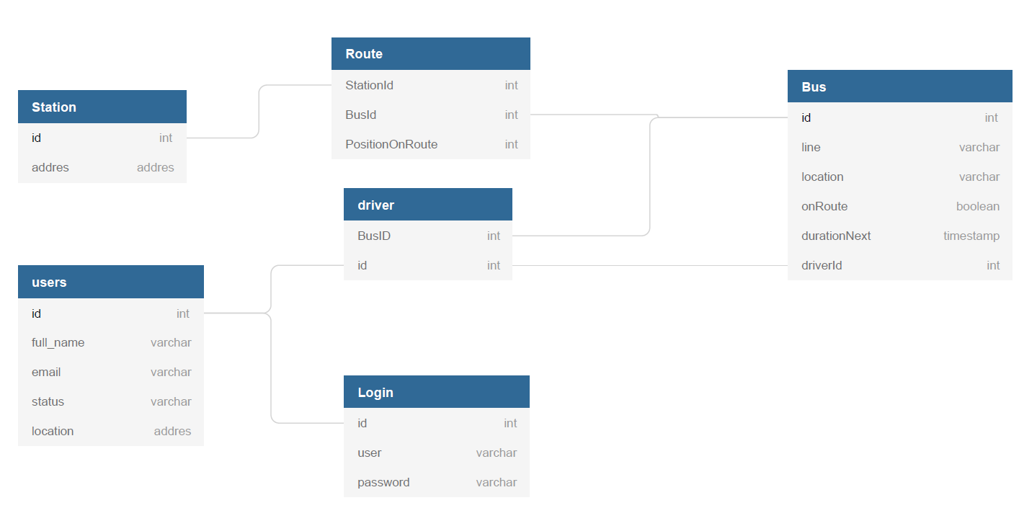
Database diagram

Slide 17
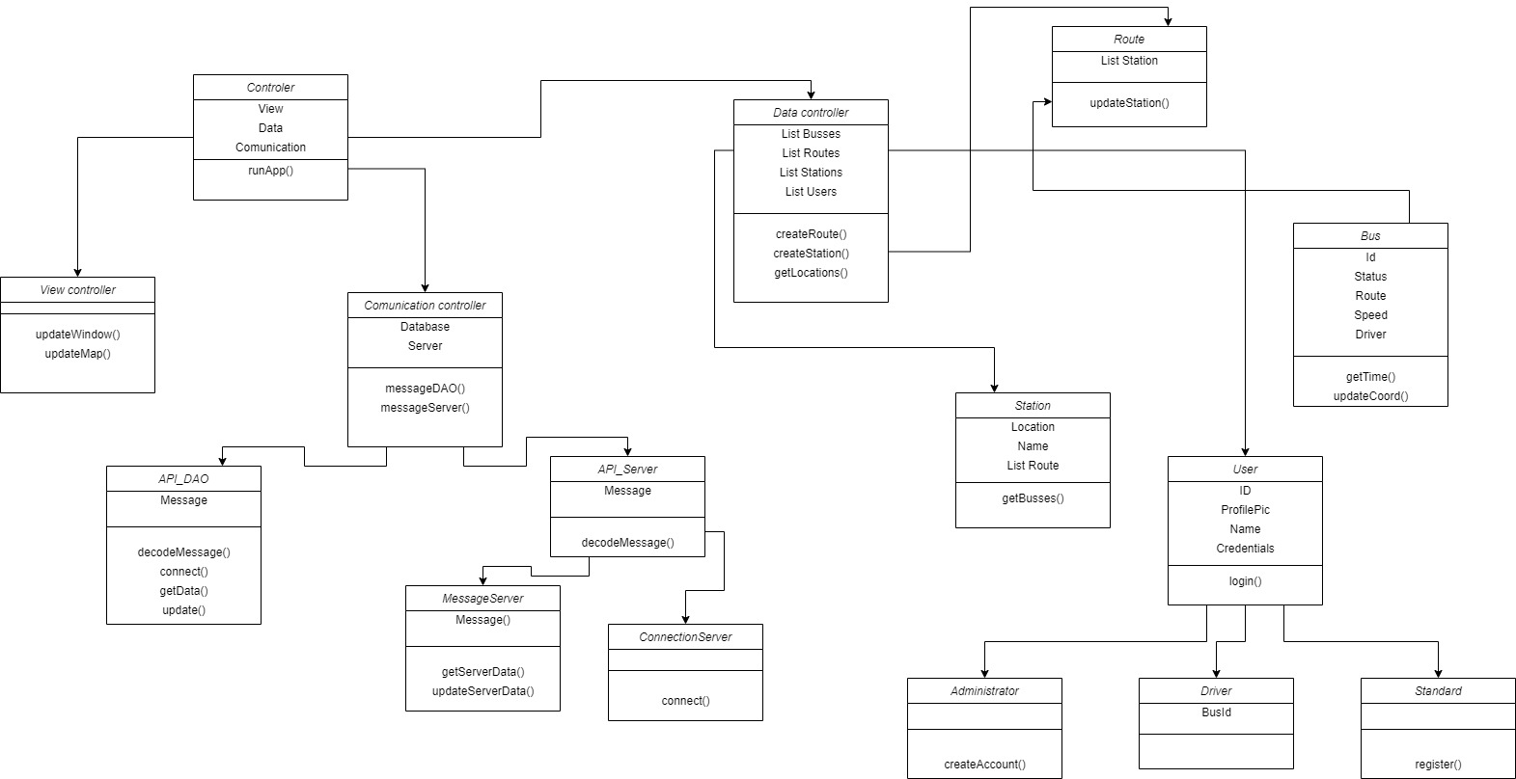
Class diagram

Slide 18
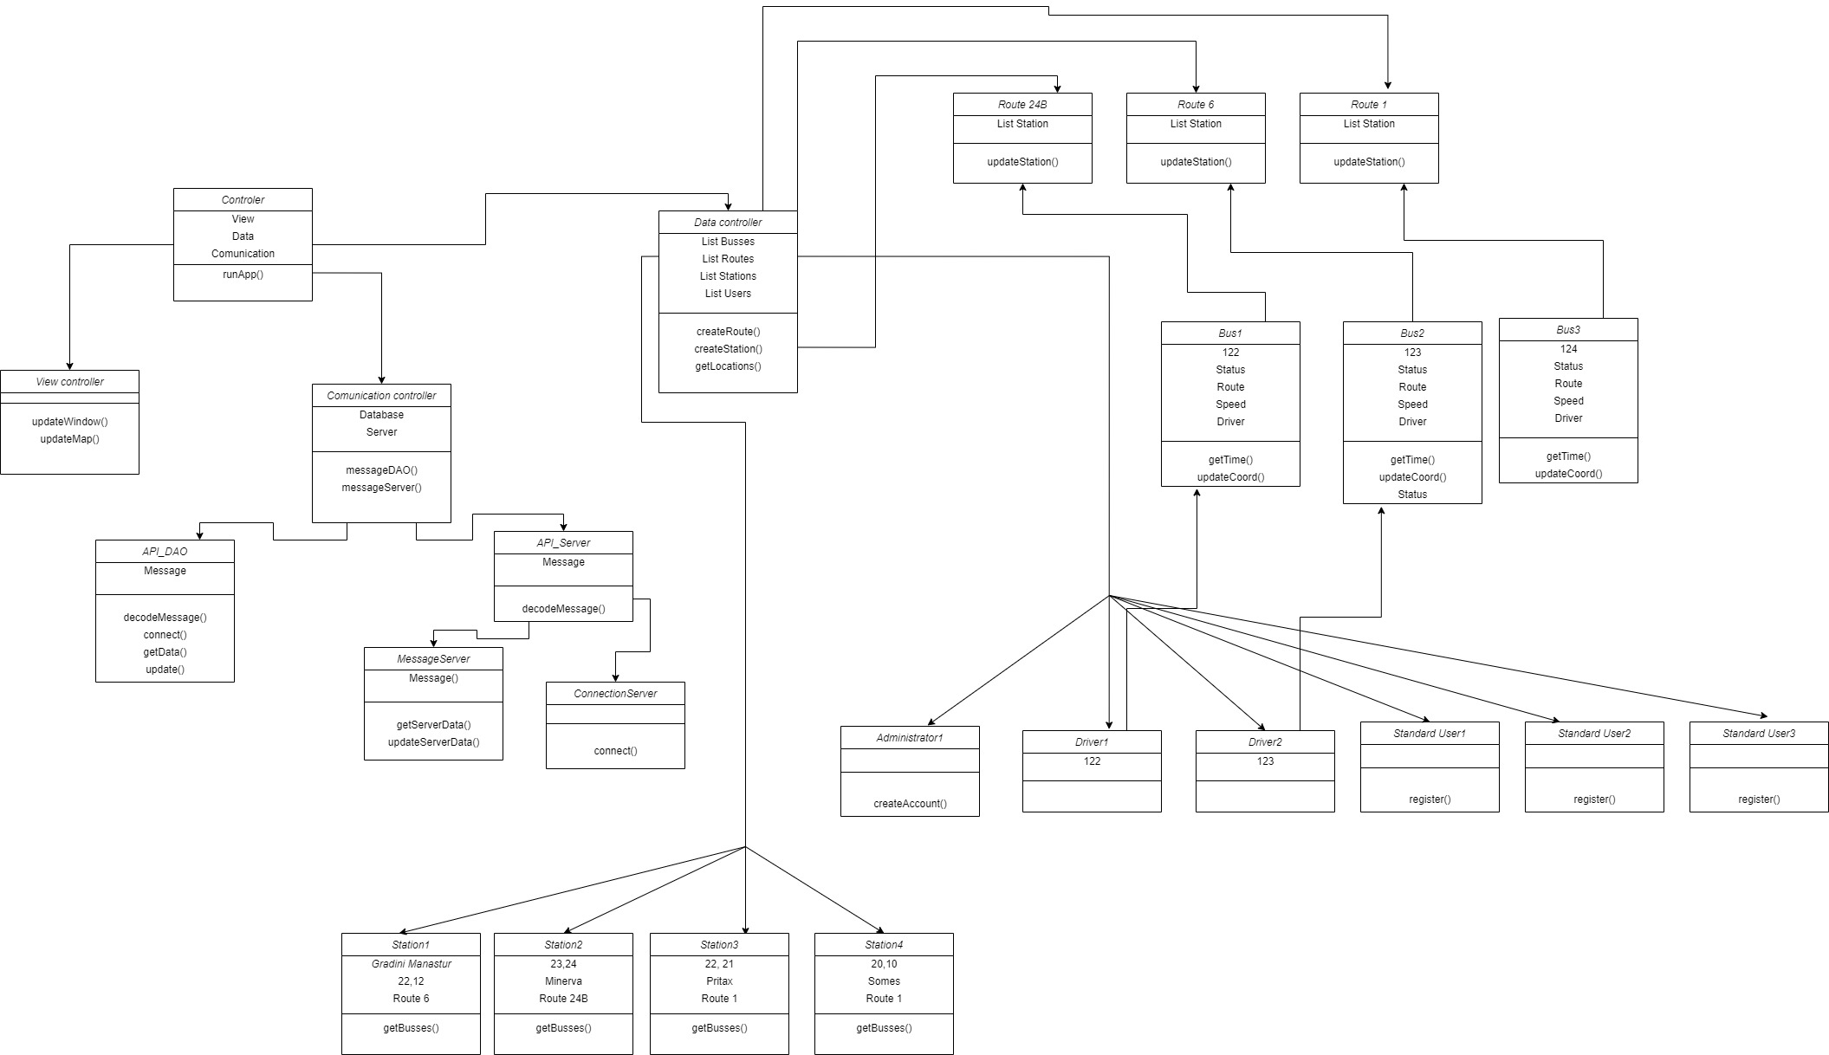
Object diagram

Slide 19
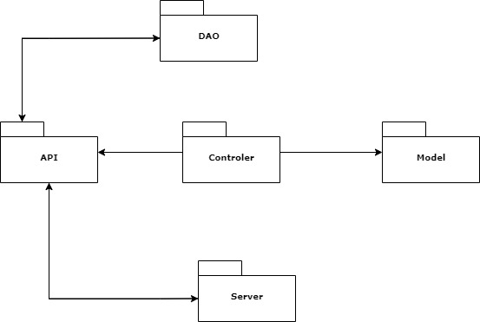
Package diagram

Slide 20
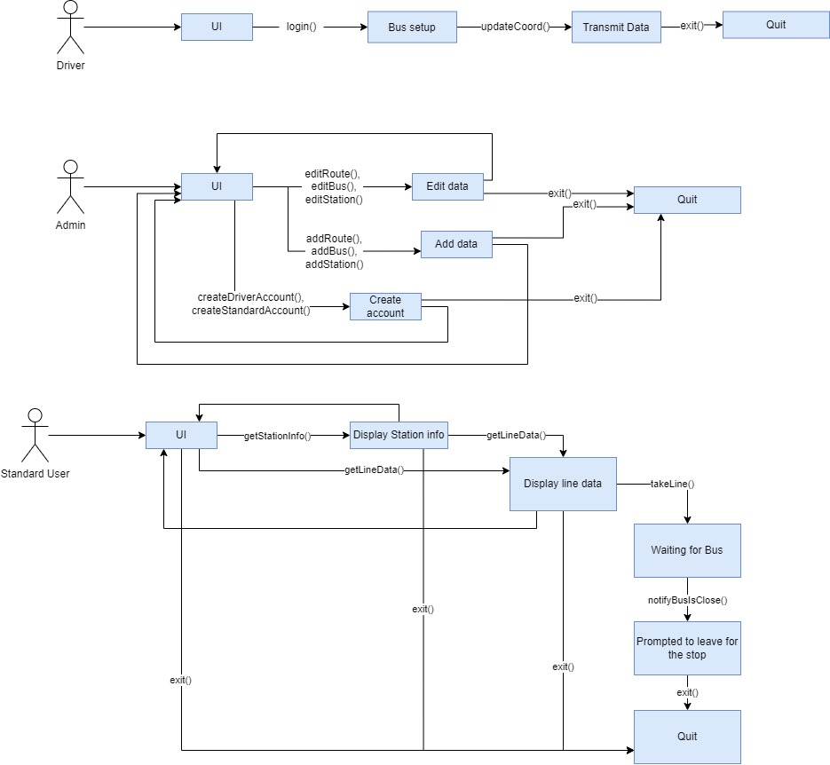
Communication diagram

Slide 21
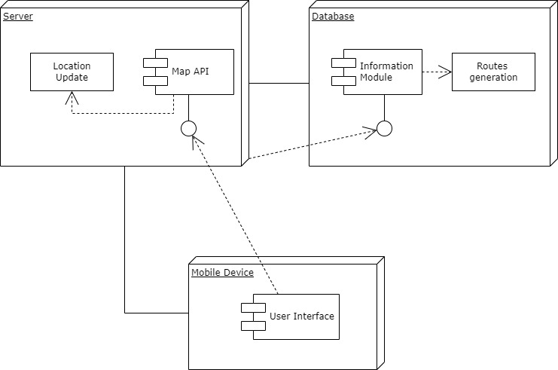
Deployment diagram

Slide 22
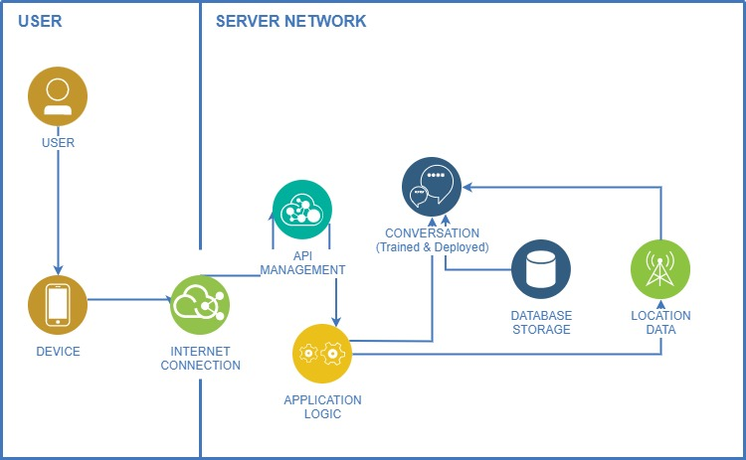
System architecture diagram

Slide 23
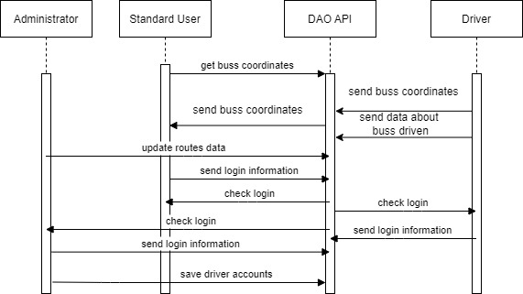
Sequence diagram

Slide 24
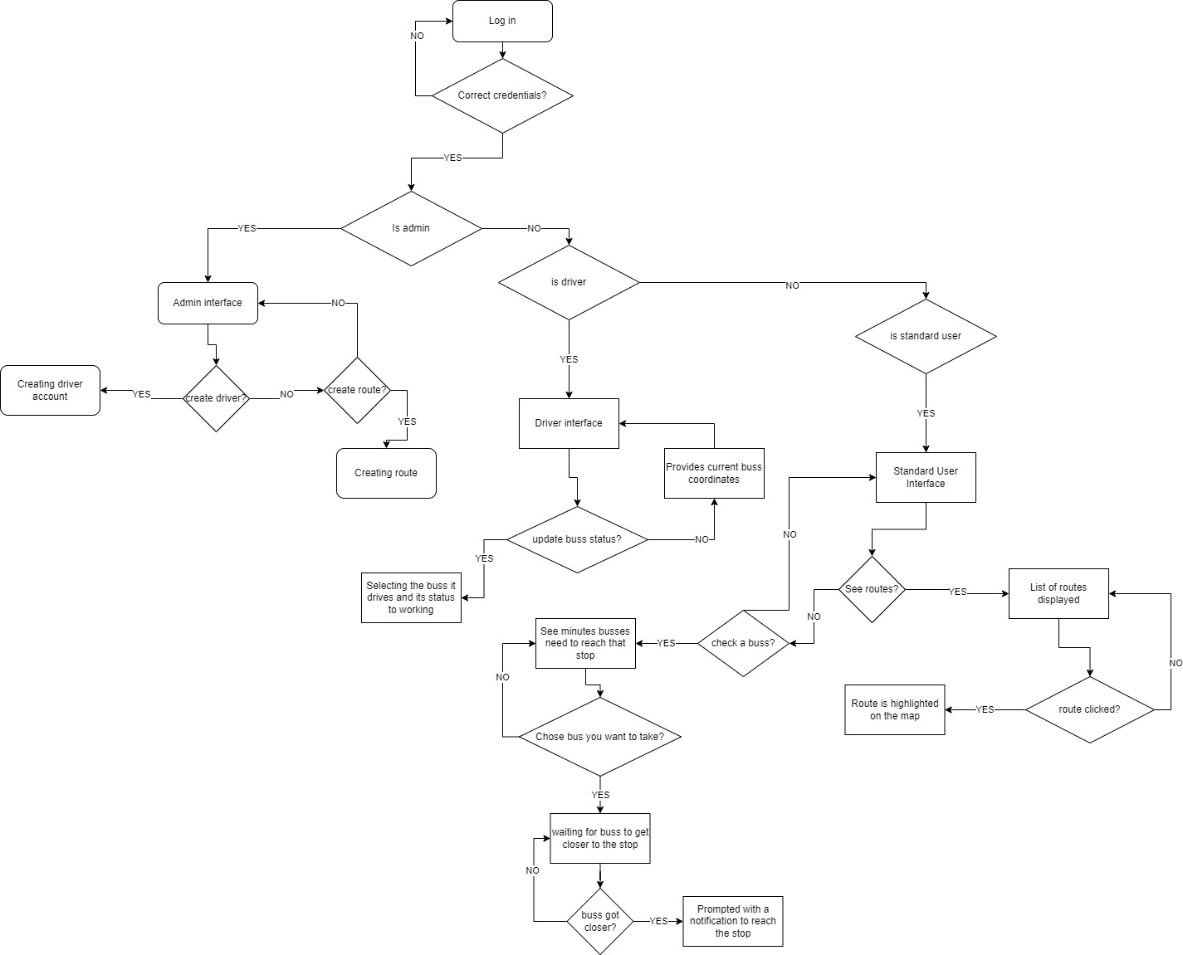
Flowchart diagram

Slide 25
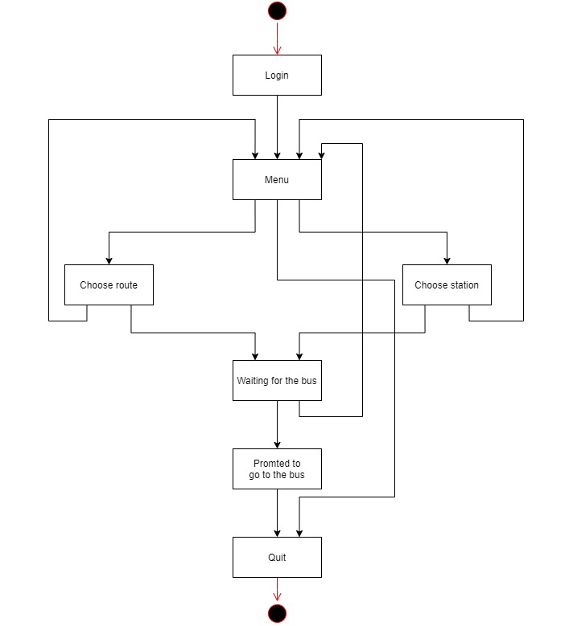
State transition diagram
Standard user

Slide 26
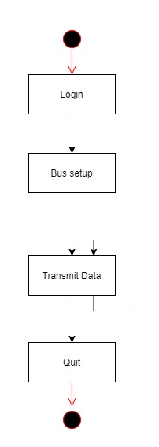
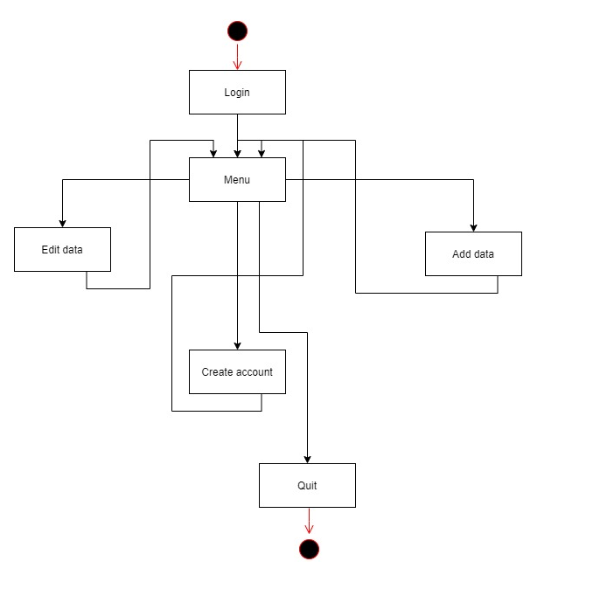
State transition diagram
Admin
Driver

Slide 27
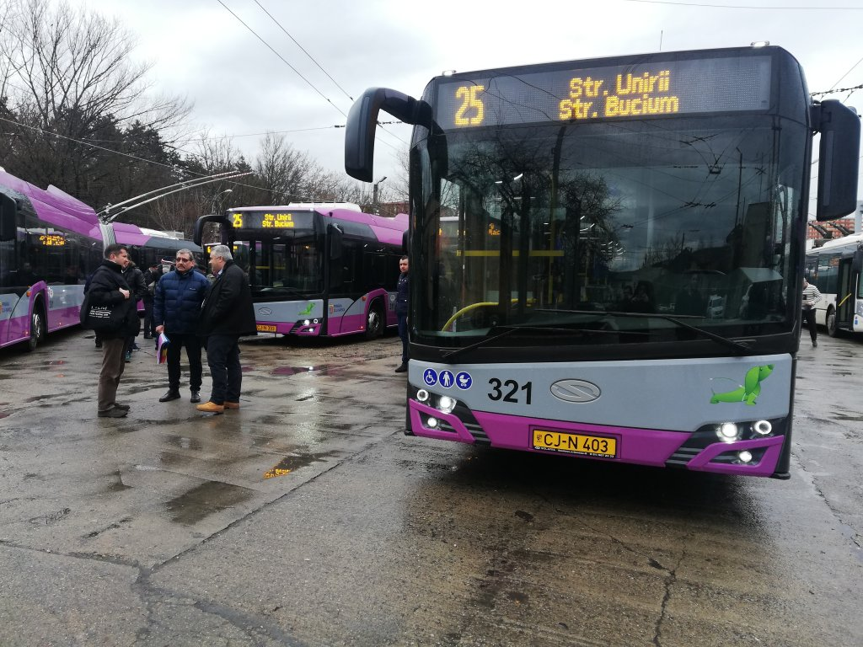
CREDITS
Special thanks to all the people in the CTP community for being receptive to our ideas and using and supporting our application.
We couldn’t do it without you!

