Slide 1
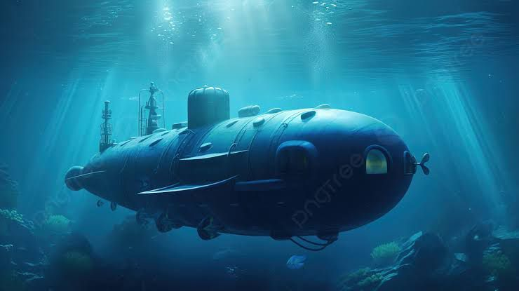
Sonar Rock And Mine Prediction

Slide 2
Introduction :
Sonar Rock and Mine Prediction: A Deep Dive
Sonar rock and mine prediction is a critical application of machine learning, particularly in naval and underwater operations. It involves using sonar data to accurately classify underwater objects as either rocks or mines. This technology is essential for ensuring the safety of naval vessels and underwater operations.

Slide 3
How Does It Work?
Data Acquisition:
Sonar systems emit sound waves and record the echoes reflected from underwater objects.
These echoes are captured and converted into numerical data, often represented as a series of numbers.
Data Preprocessing:
The raw sonar data is cleaned and preprocessed to remove noise and inconsistencies.
Feature extraction techniques are applied to extract relevant information from the data, such as frequency, amplitude, and phase.

Slide 4
Model Selection and Training:
A suitable machine learning algorithm is chosen, such as:
Logistic Regression: A simple yet effective algorithm for binary classification.
Support Vector Machines (SVM): Powerful for high-dimensional data and nonlinear decision boundaries.
Neural Networks: Flexible models capable of learning complex patterns.
Random Forest: Ensemble learning technique that combines multiple decision trees.
The selected model is trained on a labeled dataset, where each data point is associated with a correct label (rock or mine).
Model Evaluation:
The trained model is evaluated on a separate test dataset to assess its accuracy and performance.
Metrics like accuracy, precision, recall, and F1-score are used to evaluate the model's effectiveness.

Slide 5
Deployment :
The trained model is integrated into sonar systems to provide real-time predictions.
The system can alert operators to potential threats, allowing them to take appropriate actions.

Slide 6
Challenges and Future Directions
Data Quality:
The quality of sonar data can be affected by factors like noise, interference, and environmental conditions.
Feature Engineering:
Extracting meaningful features from sonar data is crucial for accurate predictions.
Model Complexity:
Balancing model complexity with computational efficiency is essential for real-time applications.
Adversarial Attacks: Protecting models from malicious attacks that can degrade their performance is a growing concern.

Slide 7
Future research directions include:
Advanced Deep Learning Techniques:
Exploring the use of deep neural networks, such as convolutional neural networks (CNNs) and recurrent neural networks (RNNs), for more accurate predictions.
Transfer Learning:
Leveraging pre-trained models to improve performance with limited data.
Explainable AI: Developing techniques to understand the decision-making process of machine learning models, enhancing trust and transparency.
By addressing these challenges and exploring innovative approaches, sonar rock and mine prediction can continue to advance, improving the safety and efficiency of underwater operations.

Slide 8
THANK YOU
Prepared By:
Mostafa Maysara Mostafa
Abdelrahman Elhussiney Mahmoud
Assem Muhammed Abdelbaqy
Hossam Elden Hatem Mahmoud
Muhammed Mohsen Muhammed
https://colab.research.google.com/drive/10qDiidvdByF_I9UQZ_w2VtQHeXT7AZXC

