Slide 1
SasFit models integration
www.europeanspallationsource.se
15 October 2016

Slide 2

SINE2020 goals
Code modularization
New API
New GUI
Optimization of algorithms for real time analysis
Extension with SASFit models

Slide 3
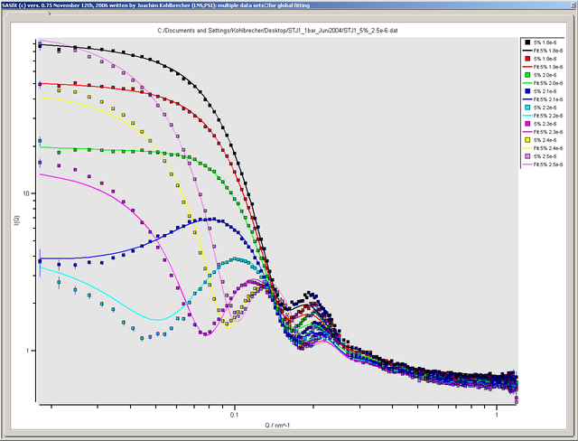

SasFit - software package for fitting small-angle scattering curves
Written to fulfill the needs at the SANS facility at PSI
Calculates integral structural parameters like radius of gyration, scattering invariant, Porod constant
Fits scattering data with form and structure factors
Simultaneously fits several scattering curves with a set of global parameters
Numerical routines written in C whereas the menu interface in Tcl/Tk
Joachim Kohlbrecher

Slide 4
SasFit Models Integration Pipeline
SasFit Models
Conversion Script
SasModels *.c *.py files
Code beautifier
TEST + COMPARISON
ComparisonWebpage

Slide 5
Conversion script
Extracts code from SasFit plugin models
Reads in model and parameters description
Reads in parameters defaults
Outputs *.c and *.py files
Creates description, parameters table, demo section, etc.
Converts to SasModels functions (Iq, Iqxy, form_volume)
Replaces internal functions (GSL)
SasFit Models
Conversion Script
SasModels *.c *.py files
Code beautifier
TEST + COMPARISON
ComparisonWebpage

Slide 6
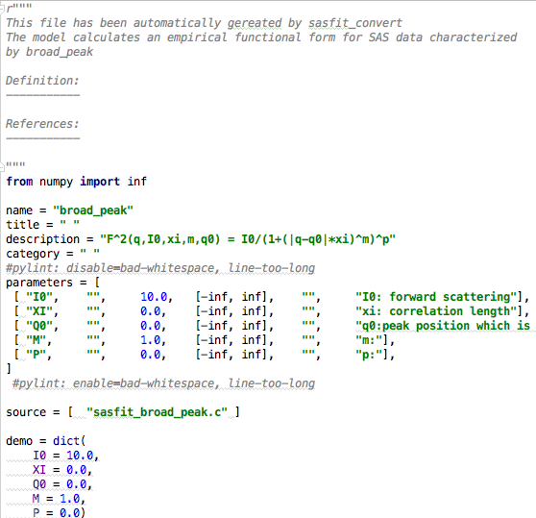
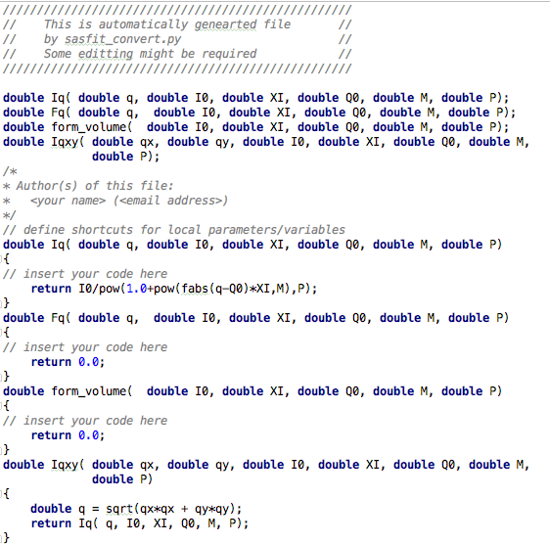
Conversion script
Python file
C file
Documentation needs to be
added manually
Unit tests needs to be
added manually

Slide 7
Code Beautifier
The raw c code after conversion is rather ugly
Astyle – a command line tool for code beautification
Line splitting
Indentation
SasFit Models
Conversion Script
SasModels *.c *.py files
Code beautifier
TEST + COMPARISON
ComparisonWebpage

Slide 8
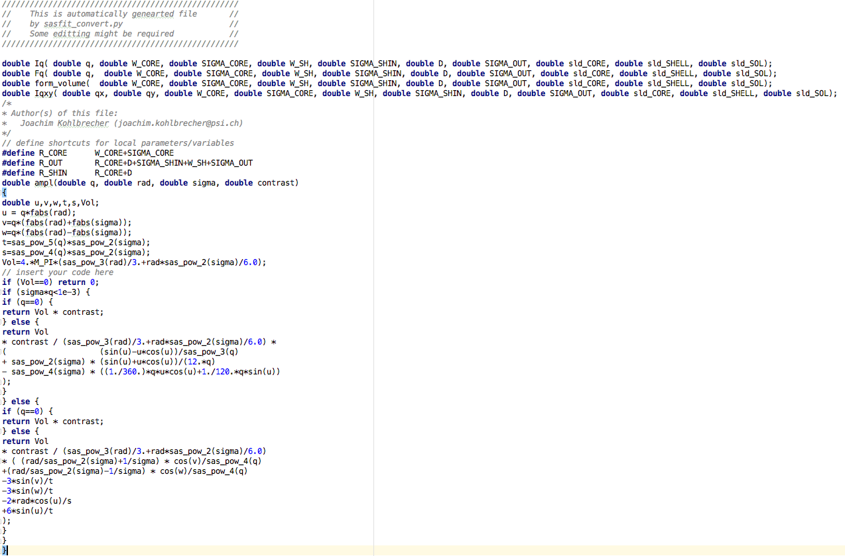
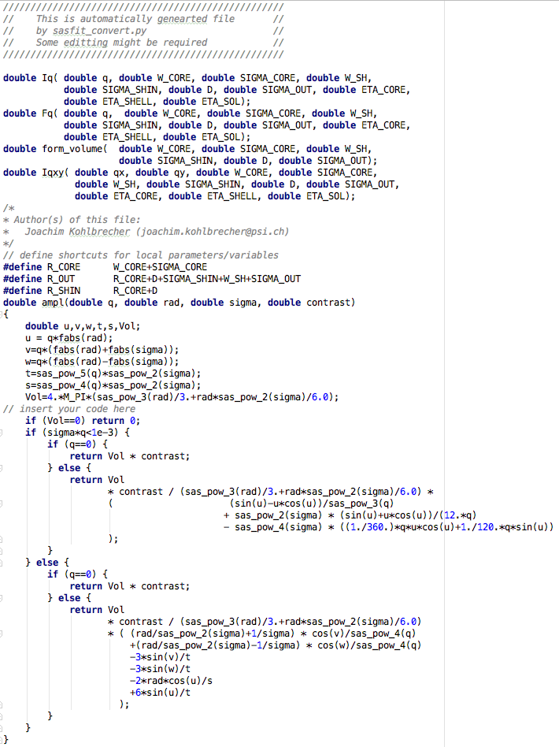
Code Beautifier
Before
After

Slide 9
Model tests and comparison
Compilation test on CPU and GPU
For non-overlapping model CPU/GPU comparison
For overlapping models extended version of sascomp script (-sasfit= )
Reasonable parameters for SasFit models have to be provided
Unit test have to be added manually
SasFit Models
Conversion Script
SasModels *.c *.py files
Code beautifier
TEST + COMPARISON
ComparisonWebpage

Slide 10
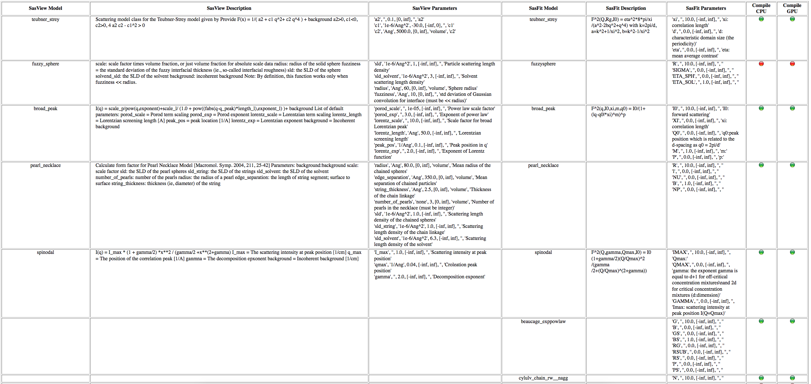
Webpage of (non)overlapping models

Slide 11
Results
For 129 models 57 have been converted 29 of which compiled (both CPU and GPU)
5 overlapping with SasView models (based on their names)
SasFit Models
Conversion Script
SasModels *.c *.py files
Code beautifier
TEST + COMPARISON
ComparisonWebpage

Slide 12
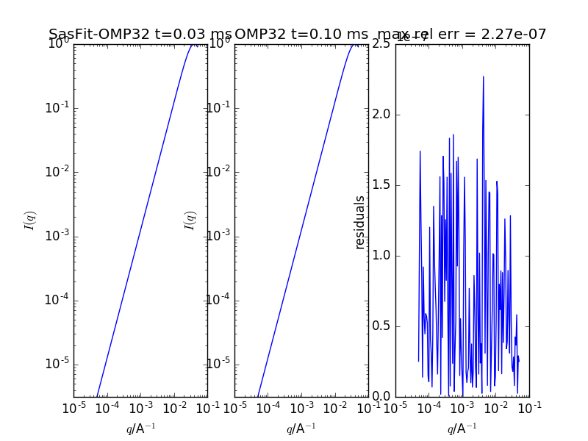
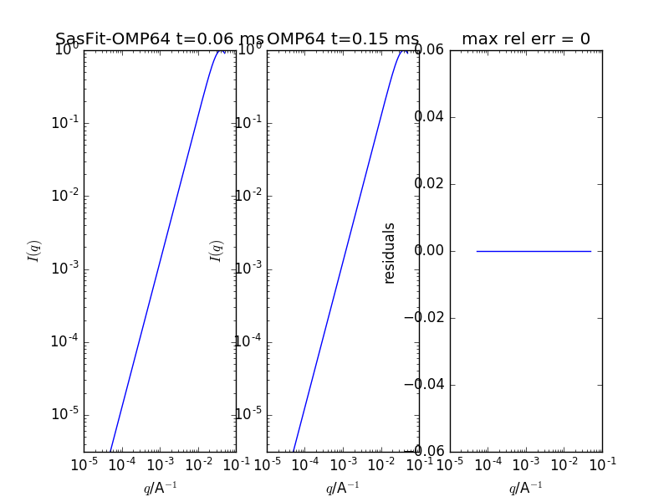
Results – Spinodal Model
I(q) = I_max * (1 + gamma/2) *x**2 / (gamma/2 +x**(2+gamma)
x = q/qmax
I_max - Scattering intensity at peak position qmax - Corleation peak position gamma - Decomposition exponent
Single Precision (CPU)
Double Precision (CPU)

Slide 13
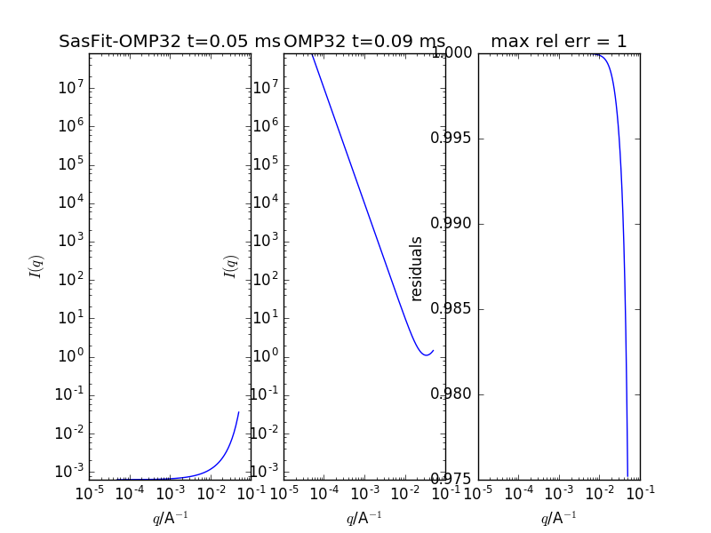
Results – BroadPeak Model
SasView I(q) = I_{p}/q^{p}+I_{L} /(1 +(|q-q₀|x_{i})^{m})
Sasfit I(q) = I_{L}/((1+|q-q₀|x_{i})^{m})^{p}
I_{p} - Power law scale factor p - Exponent of power law I_{L} - Scale factor for broad Lorentzian peak x_{i} - Lorentzian screening length q₀ - Peak position in q m - Exponent of Lorentz function

Slide 14
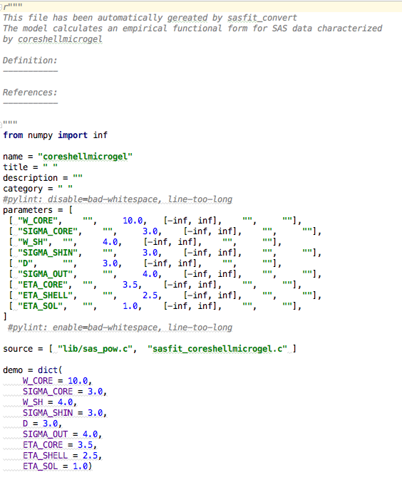
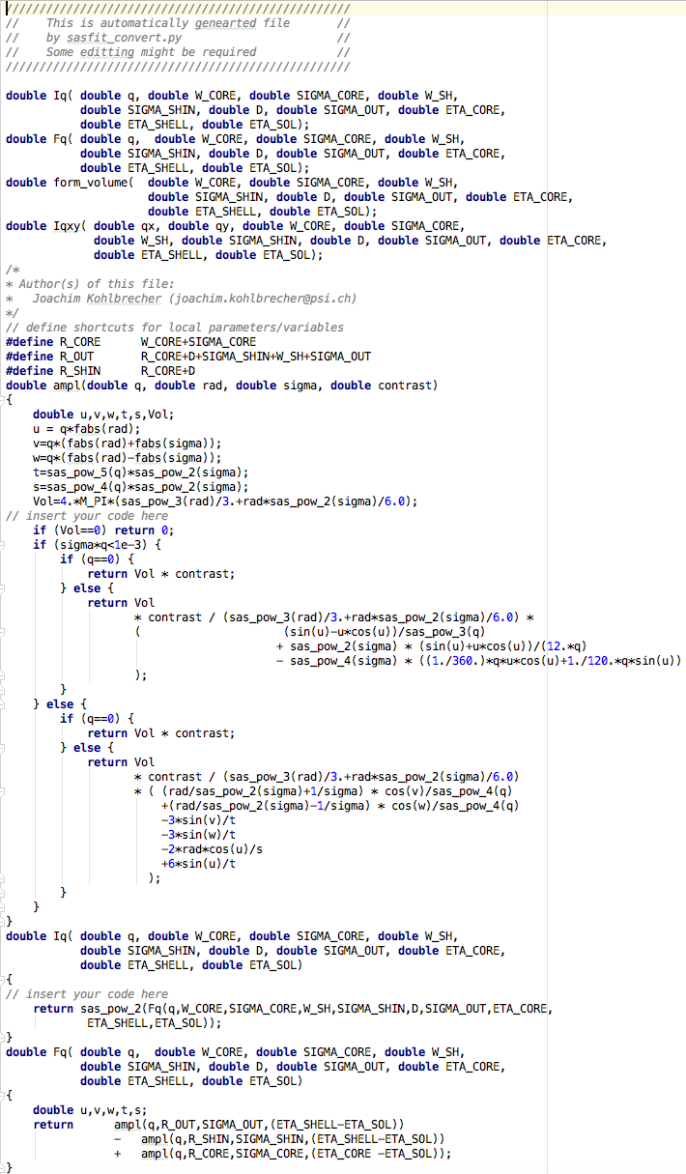
Results – CoreShellMicrogel
Calculates the scattering from spherical particles with a parabolic ”fuzzy” interface.
Python file
C file

Slide 15
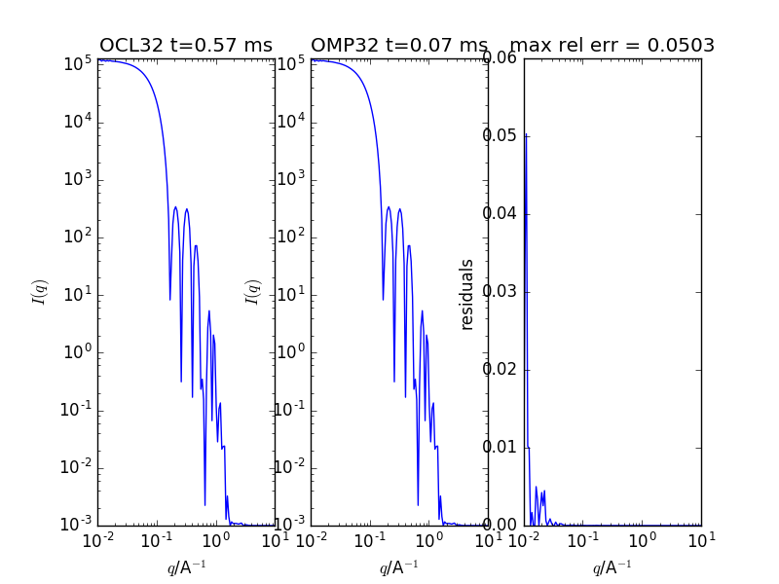
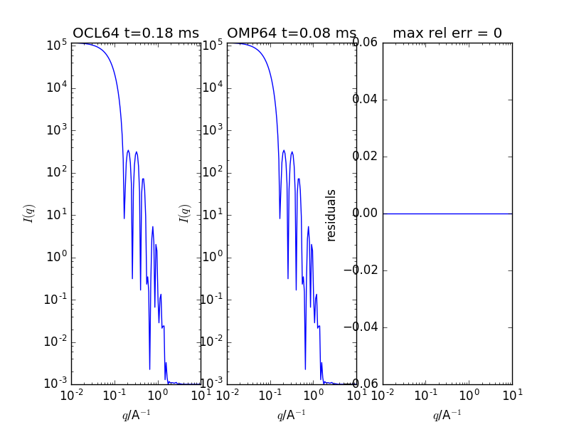
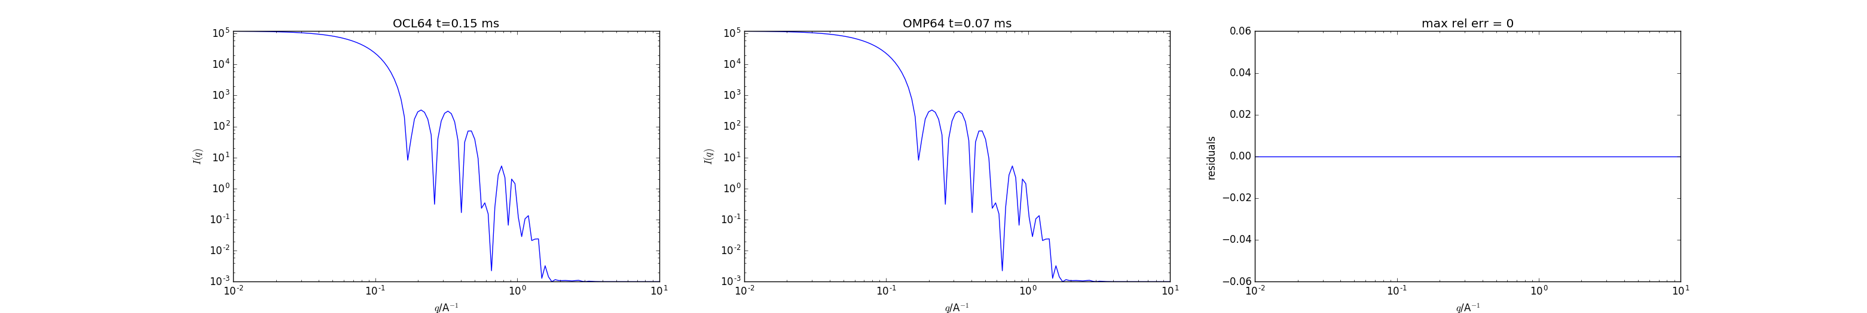
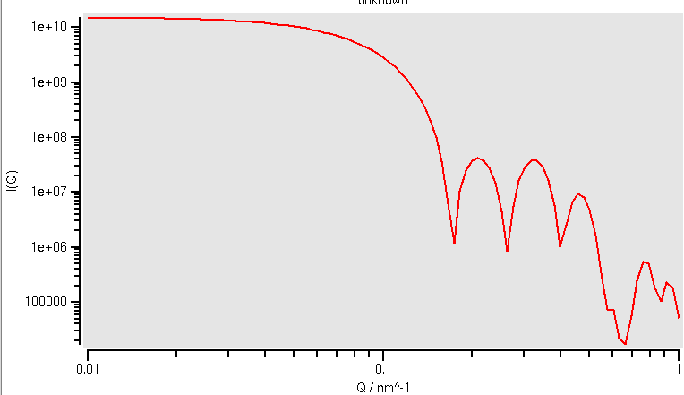
Results – CoreShellMicrogel
Single Precision
Double Precision
SasModels
SasFit

Slide 16
Open Issues
External Libraries (GSL and/or SasFit_common)
Model Libraries/Distribution
Reasonable parameters and unit tests
Ornstein-Zernike calculator
Testing and comparison with the original SasFit models

Slide 17
External Libraries Scenario 1: No external Libraries
Advantages | Disadvantages
Full control and test coverage Runs on CPU and GPU Single and double precision Straightforward distribution (no licensing issues) | Lot of work Doesn’t solve general problem of compiling with external libraries

Slide 18
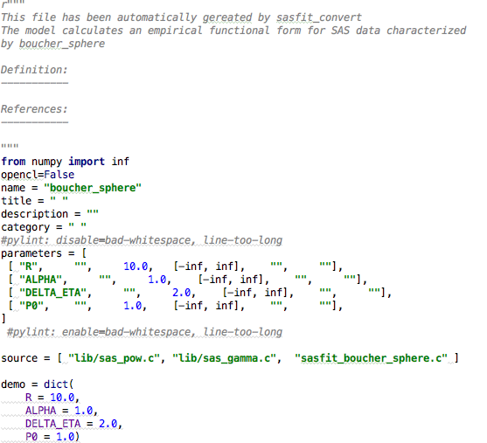
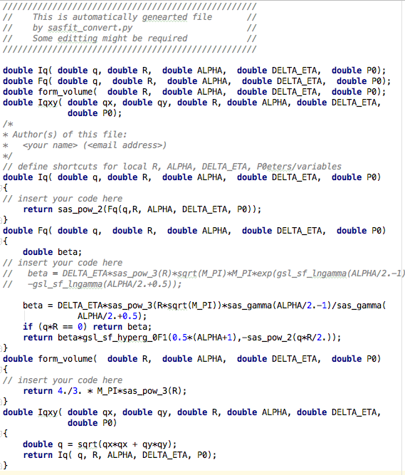
External Libraries Scenario 2: GSL
Advantages | Disadvantages
Solving “general” user case Access to numerous mathematical functions Relatively simple to implement in sasmodels | Runs on CPU only (most likely) GPL license Shipping libraries

Slide 19
External Libraries Scenario 3: SasFit_common
Advantages | Disadvantages
Using SasFit as external library Synced with current and future SasFit Relatively small modification in SasView/Sasmodels code | Very limited control Shipping rather impossible Difficult to compile (platform dependence) GPL license Runs on CPU only Doesn’t solve general problem of compiling with external libraries

Slide 20
SasFit Model Distribution
Automatically converted GPL models still hold GPL license.
Shipped separately and run upon license agreement
SasModels Markteplace?

Slide 21
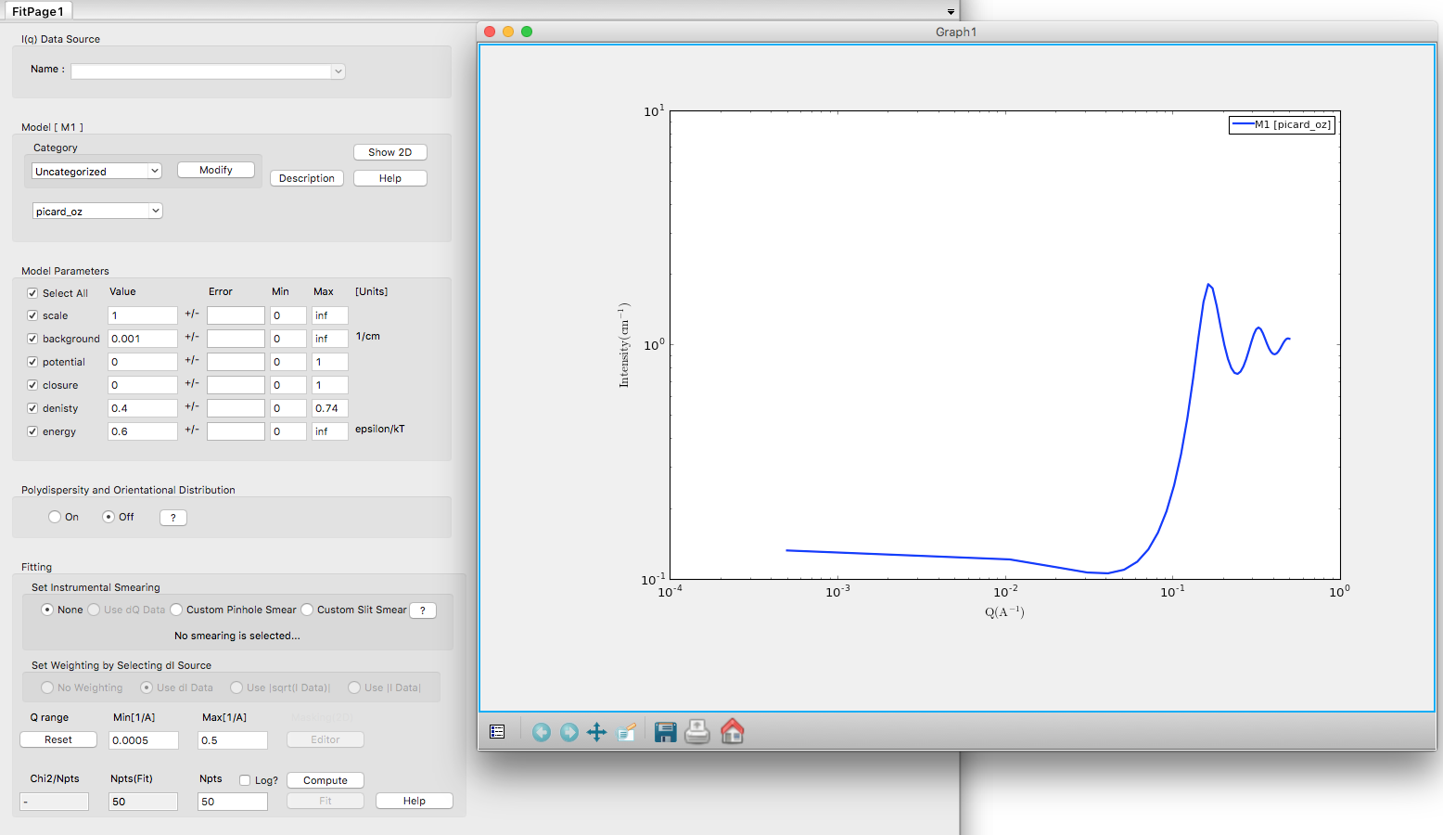
Picard OZ solver
Crude python implementation – takes 2min to compute

Slide 22
Open Issues
External Libraries (GSL or SasFit_common)
Model Libraries/Distribution
Reasonable parameters and unit tests
Ornstein-Zernike calculator
Testing and comparison with the original SasFit models

Slide 23
Conclusions
SasFit model functions to large extent can be automatically converted to SasModels
Available conversion framework that can be used internally at ESS and by our collaborators at PSI
Works on the newly added model (SESANS)
Even if successfully converted, reasonable parameters, unit tests and full model description may need to be added manually

Slide 24
GSL or users external libraries (based on the correspondence with Paul Kienzle)
Single and Double precision versions needed
opencl=False will have to be passed when linking to non-OpenCL code
Precompiled libraries can be supplied for Mac and Windows version
Building the external library as part of building the model may be needed for users contributed software
GSL is GPL that we try to avoid in SasModels, however license=gpl can be introduced to decide if BSD or GPL versions should be built

Slide 25

SasFit intensity calculation
In the monodisperse approximation the intensity is calculated as:
where F(Q,R) – form factors
S(Q) – structure factors
The other possibility involves the local monodisperse approximation:
Where N(r) is a parameter distribution function
Eventually decoupling approach can be applied
< F >²= < F >< F* >- form factor amplitudes including complex conjugate

