Slide 1


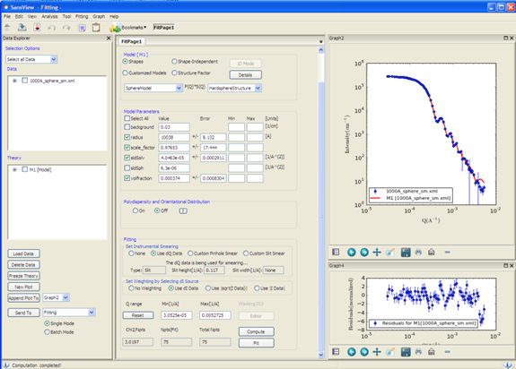
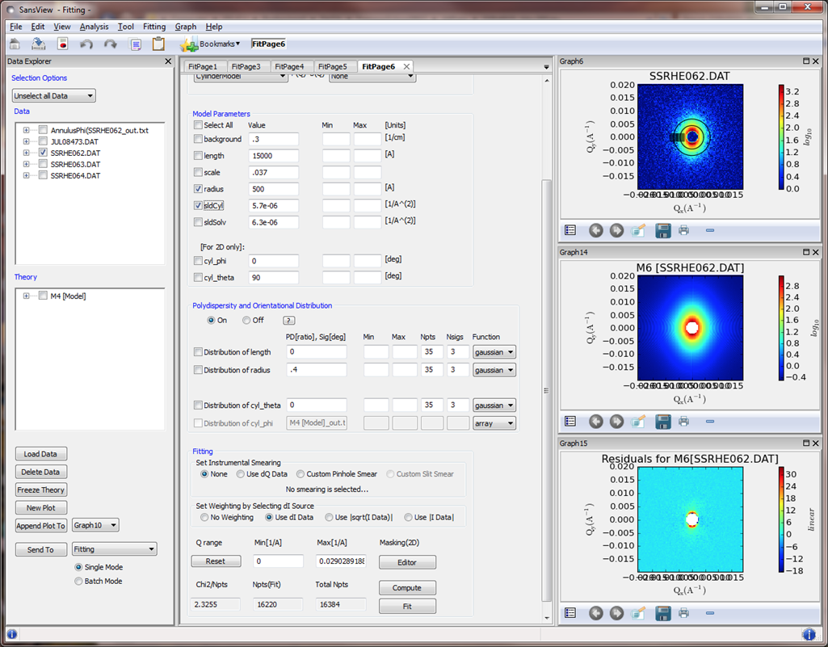
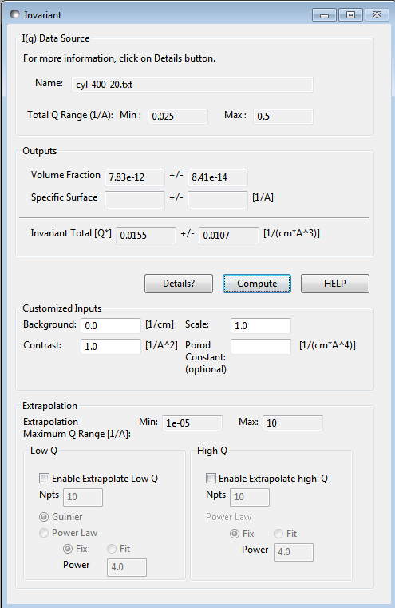
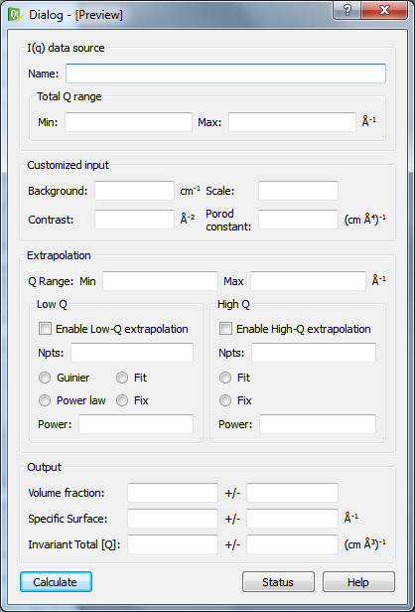
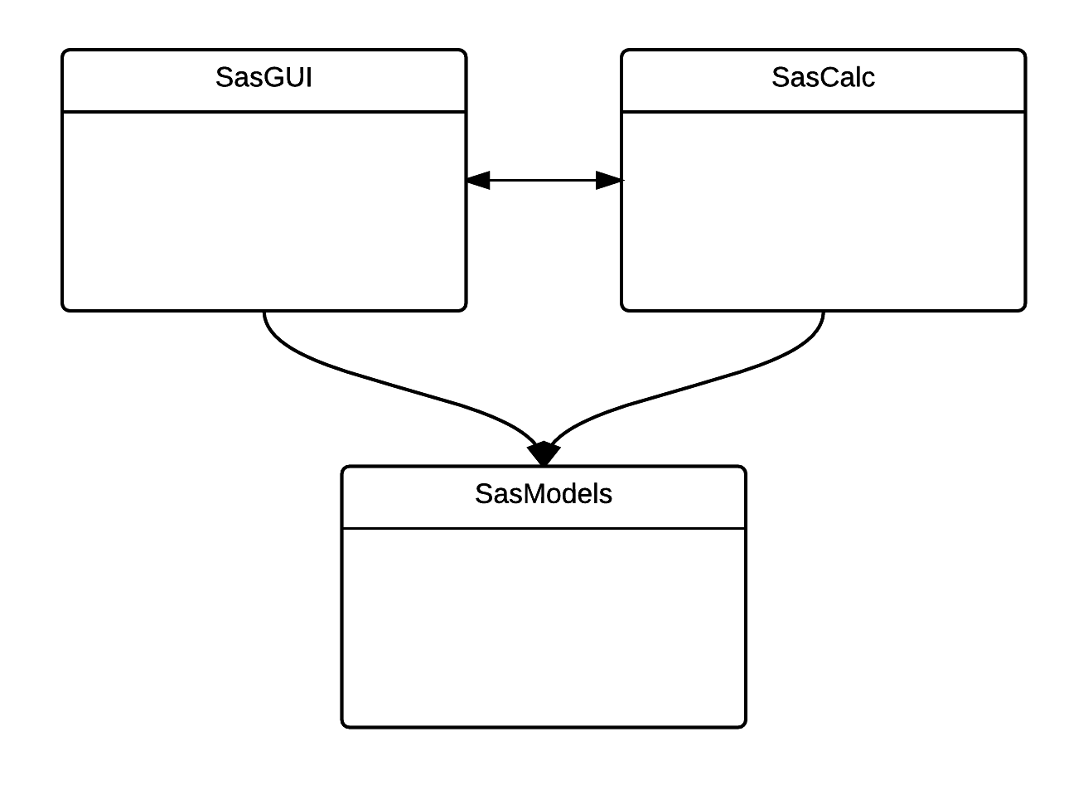
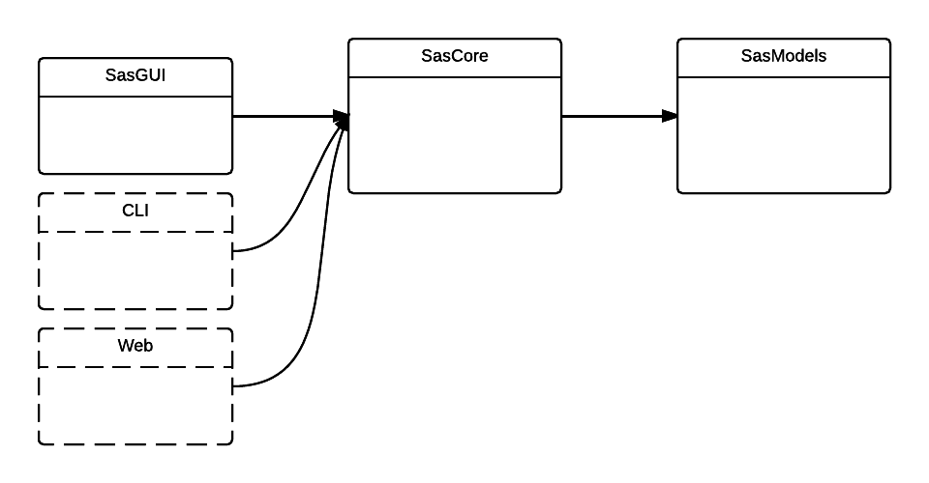
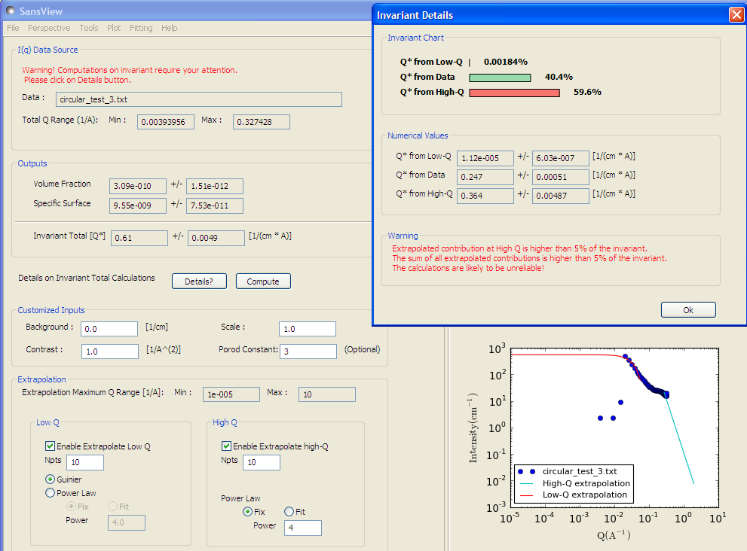
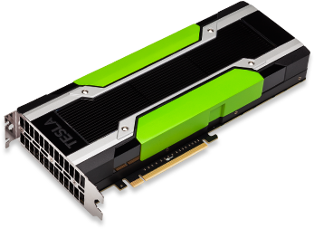
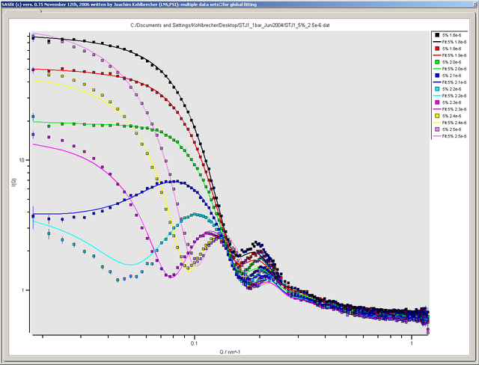
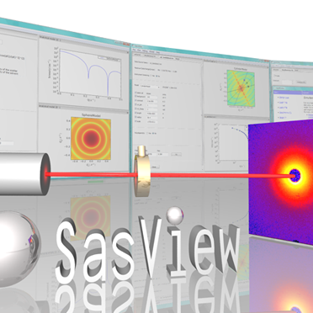
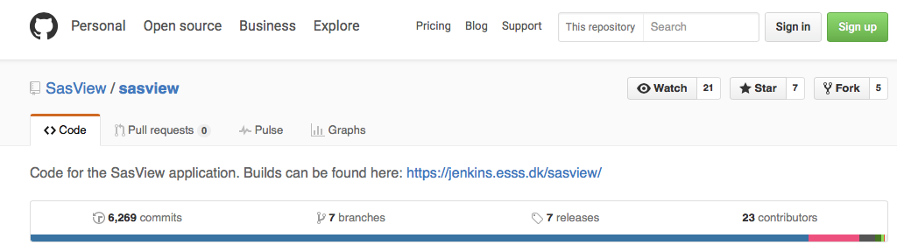
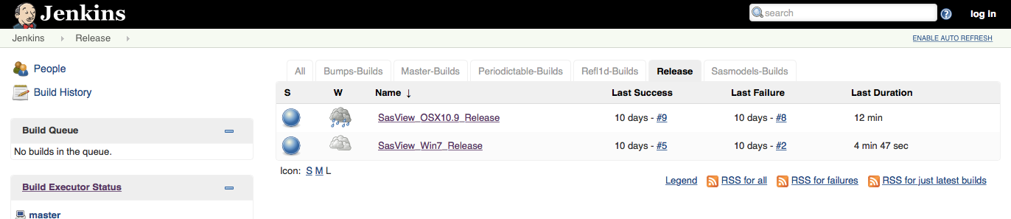
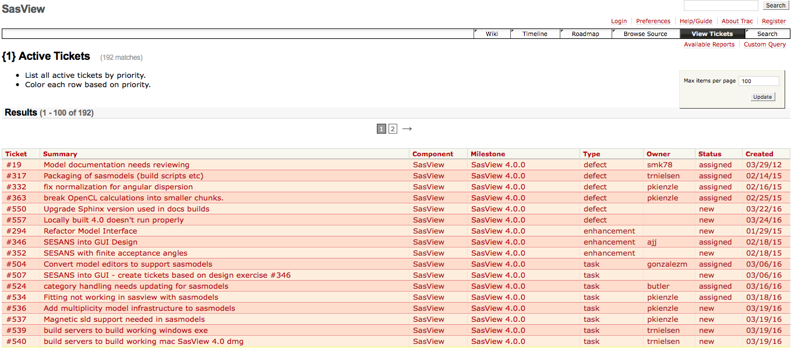
ESS View on SasView
Small Angle Scattering data analysis within the SINE2020 project
Wojciech Potrzebowski¹, Piotr Rozyczko¹, Torben Nielsen¹, Andrew Jackson^{2,3} and Thomas Holm Rod¹
¹European Spallation Source ERIC, Data Management and Software Center, Ole Maaløesvej 3, 2200 Copenhagen N, Denmark
²European Spallation Source ERIC, Tunavägen 24, 223 63 Lund, Sweden
³Physical Chemistry, Lund University, Naturvetarvägen 14, 221 00, Lund, Sweden
SasView is a well-established open source, collaboratively developed software for the analysis and the modeling of small angle scattering (SAS) data. The core functionality of SasView includes the fitting of model functions, pair-distance distribution function inversion and model-independent analysis. SasView provides a large collection of form and structure factors and with the recently introduced modularization allows for easy incorporation of user-defined models.
The European Spallation Source (ESS) has during the last years taken an active role in supporting SasView with the aim of providing it for ESS users from the start of operation.
To increase this effort and as part of the EU funded Horizon2020 project - SINE2020, ESS also employs two full time SasView developers. The aim of the project is to deliver inter-operable versatile, robust, reliable, maintainable and sustainable data analysis software that can be used by all the involved neutron scattering facilities (i.e. ESS, ILL, ISIS, LLB, MLZ, and PSI).
Here we present, how the SINE2020 project enables the development of new features, code refactoring, GUI re-design and optimization for faster analysis methods by use of GPUs. We also discuss an anticipated outcome of the project, which is a better user experience and make SasView a potential tool for live analysis of SAS data.
SasView 4.0
SasView has been actively developed for almost a decade. The core functionalities of the current version 4.0 include: fitting of models functions pair-distance distribution function calculations and model independent analysis
ESS support for SasView
The European Spallation Source (ESS) during the last years has taken an active role in supporting SasView with the aim of providing it for ESS users from the start of operation. This involves hosting computational infrastructure and providing manpower through external funding. From the beginning of 2016 the ESS efforts on SasView are supported by EU funded project – SINE2020. The funding allowed for hiring two full-time developers and enables systematic code development and maintenance.
Fitting of Model Functions
An extensive library of form and structure factors representing various particle shapes and interactions is available from SasView.
The fitting module:
handles 1D and 2D data,
provides an access to built-in polydispersity function
allows for simultaneous and batch fitting.
takes an advantage of Bayesian statistics
SINE2020 actions
The main SasView goals within SINE2020 project involves: 1) development of new GUI and API, 2) code modularization and optimization, 3) incorporation of model functions from SasFit program.
As of version 4.0 the process of implementing new models is hugely simplified
The newly developed infrastructure provides the ability for users to add SasView discoverable models implemented either in C or python
The new models library also incorporates the calculation of SESANS (Spin-Echo SANS) curves from SANS models as well as native SESANS models
New GUI
The new version of GUI will take an advantage of a well-established Qt framework, which provides:
platform consistency
professional and mature technology,
long term maintainability,
ease of development (Qt designer),
clean separation of UI and code,
implemented in other software data reduction and analysis supported by ESS (e.g. Mantid [2]).
P(r) inversion
Pair distance distribution function is related to the frequency of observing certain distances r within the particle.
SasView calculates a real-space pair-distance distribution function using Moore’s derivation [1]
The method allows for estimation of background and regularization constant
The exploration of the maximum dimension (Dmax) with the respect to χ² can be performed
Currently Proposed
New API
The developments for a new API will involve:
enabling an access to SasModels, either directly or through SasCalc module,
facilitate the exclusive access to SasCalc from SasGUI
enable CLI access to all the SasCalc functionality and models.
Model-independent analysis
The model-independent analysis involves the calculation of the scattering invariant:
Based on scattering invariant the volume fraction can be calculated:
and similarly the surface are can be determined:
Code Optimization
Beginning from version 4.0, SasView supports calculations on Graphical Processing Units (GPU). It has already bean demonstrated that it considerably speeds up fitting of model functions. However there are still functionalities that are suboptimal. Therefore actions will be taken to optimize such bottlenecks in code.
www.nvidia.com
SasView
SasFit
SasFit models integration
One of the goals in SINE2020 project also involves an extension of SasView model function library with SasFit functions [3]. SasFit is a program that has been developed to fulfill the needs at the small angle neutron scattering facility at PSI. SasFit contains a large library of form and structure factors that would clearly expand fitting repertoire of SasView. With the newly introduced modularization SasFit models will be incorporated into SasModels library.
Modularization and GPU implementation
In recent SasView developments, efforts have been made to separate model functions library from GUI and calculation module. Such a separation allows for easier addition of models, better code testing and maintenance as well as opens up for easier future development. Another recent development involves implementation on Graphical Processing Units (GPU), which allows for faster calculations of complex model functions (10 to 100 times faster).
SasView Development Workflow
The developer team currently hails from 6 neutron scattering facilities (ESS, ILL, ISIS, LLB, MLZ, and PSI). The project is lead by a management team and as of 2016 there are ~25 contributors.
Live Data Analysis
The proposed in SINE2020 improvements for SasView should lead to a better user experience as well as enable performing live analysis of the neutron scattering data. With this respect LiNDA (Live Neutron Data Analysis) project has been imitated. The main aim of the project is to enable users to perform full data analysis during an experimental run, oppose to a typical situation when analysis is performed after experiment completion.
Given the dynamic nature of the project the development workflow has been implemented, which includes:
code hosting at github,
tracking issue system with Trac
Jenkins-based build system.
biweekly video conferences
bianual code camps.
However the user support involves:
build-in and web-based documentation
tutorials
user oriented workshops (will be held in the future)
Simulated Data Example
As a proof of concept live data analysis has been performed on simulated neutron scattering data.
The simulated data was generated with McStas program [4] and reduced using Mantid.
The modeling was performed with the current version of SasView and different optimizers were explored.
The case of fitting spherical nanoparticle with varying radius size have been investigated.
Acknowledgments and References
This project has received funding from the European Union’s Horizon 2020 research and innovation programme under grant agreement No 654000. We would also like to thank all members of SasView community for a kind support and a fruitful collaboration.
[1] Moore J. Appl. Cryst., 13 (1980) 168-175
[2] O. Arnold, et al., Nucl. Instr. Meth. Phys. Res. Sec. A, Vol. 764, 2014, Pages 156-166,
[3] Breßler I, et al. J.Appl. Cryst. 2015 Sep 20;48(Pt 5):1587-1598. eCollection 2015.
[4] Willendrup P.K. et al. Nucl. Instr. Meth. Phys. Res. Sec. A, Vol. 634, 2011, Pages S150–S155

