Slide 1

A Toolkit for Small-Angle Scattering Data Analysis

Slide 2
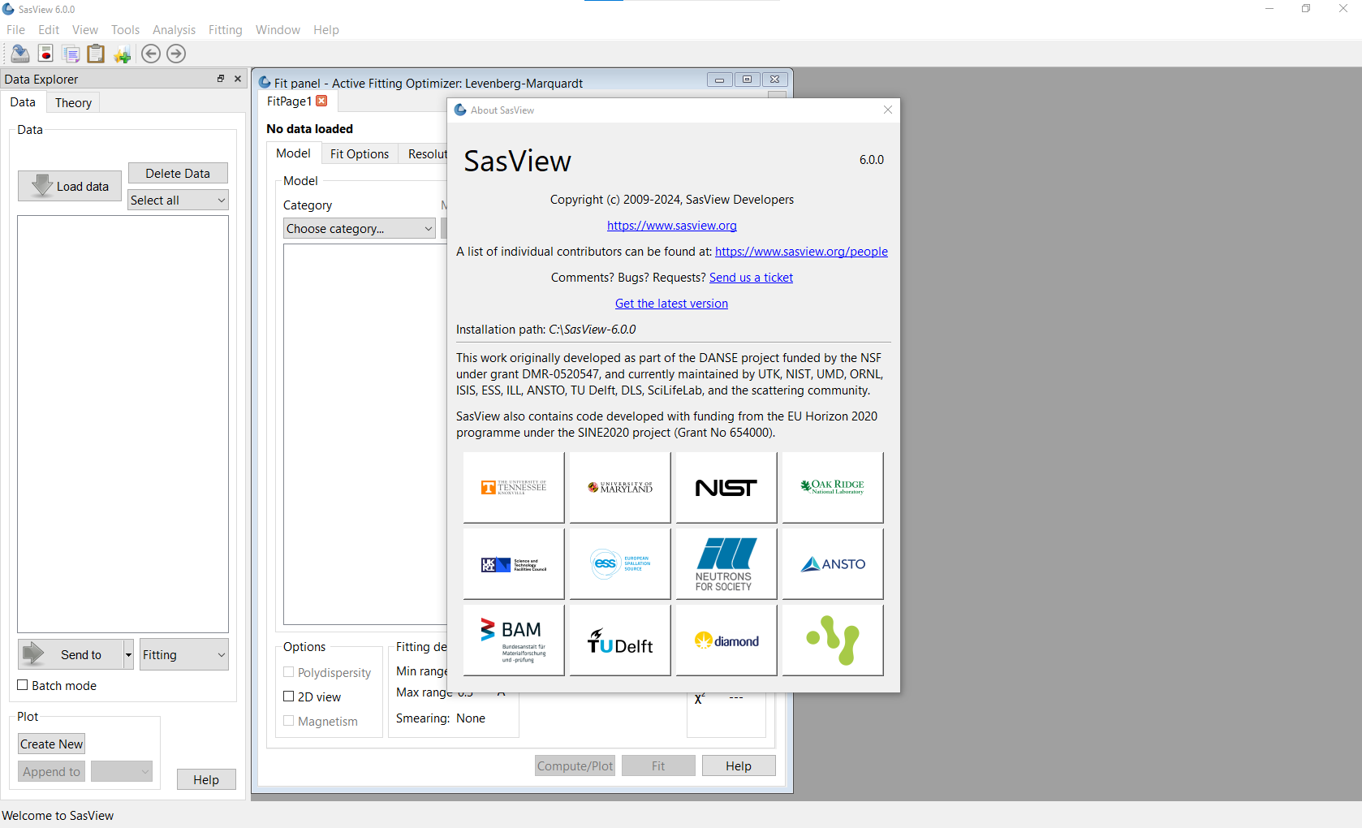
Before we start…

Slide 3
The plan…
Paul Butler Overview (15 min)
Steve King Basic Features (45 min)
1D Fitting
P(Q)
P(Q)×S(Q)
with polydispersity
with resolution smearing
Correlation Functions
Distance Distributions
Annika Stellhorn Magnetic Analysis (10 min)
Elizabeth Kelley Using the Command Line (10 min)
Paul Butler Model Writing (35 min)

Slide 4



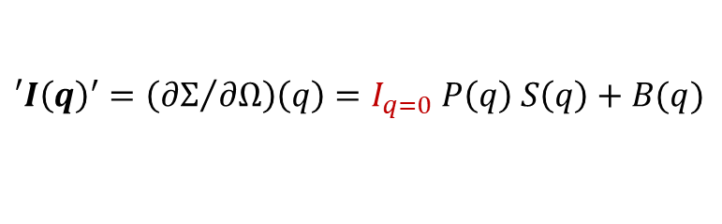
Model-Fitting
, , etc…
$$′I{\left(q\right)}^{′}=\left({∂Σ}/{∂Ω}\right)\left(q\right)=I_{q=0} P\left(q\right) S\left(q\right)+B(q)$$
$$=Λ N V^{2} {\left(ρ−ρ_{matrix}\right)}^{2} P\left(q\right) S\left(q\right)+B(q)$$
$$=Λ φ V{ \left(ρ−ρ_{matrix}\right)}^{2} P\left(q\right) S\left(q\right)+B(q)$$
SasView offers:
~90 P(q)
4 S(q)
But you can add more!
Form Factor
Structure Factor
Method:
choose a P(q) & S(q) if required
choose a set of starting parameters
compute I(q)
compare the model calculation (theory) with the experimental data
adjust some parameters
iterate until an acceptable solution is found (hopefully…)

Slide 5

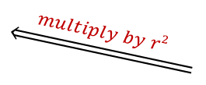






The ‘Magic Square’
Real-space
Reciprocal-space
ρ(r)
scattering length density
F(q)
scattering amplitude
$$\underset{⇔}{ Fourier Transform }$$
$$\underset{⇐}{ auto−correlation }$$
$$\underset{⇒}{magnitude squared}$$
loss of phase information
P(r)
distance distribution
$$\underset{⇐}{ multiply by r2 }$$
z(r)
chord distribution
Γ(r)
correlation function
I(q)
scattering intensity
$$\underset{⇔}{Laplace Transform}$$
$$\underset{⇔}{ Fourier Transform }$$
G(δ)
SESANS function
$$\underset{⇔}{ Hankel Transform }$$
After Stribeck, (2007) & others

Slide 6



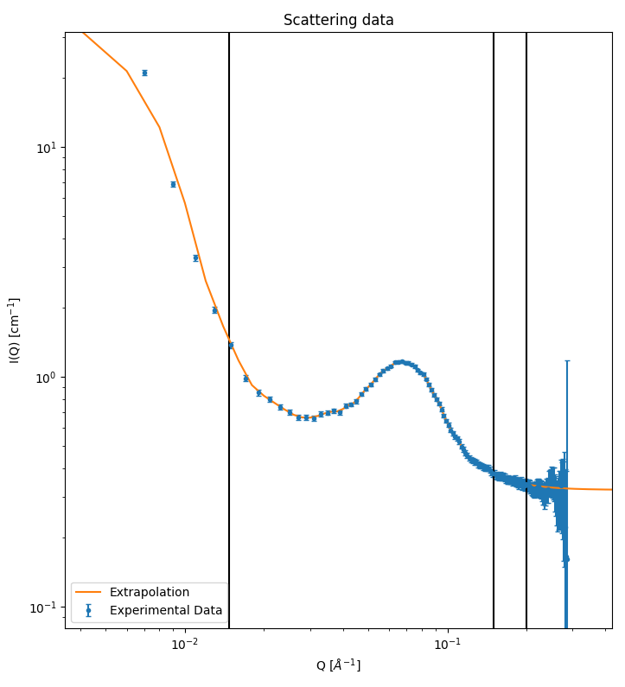
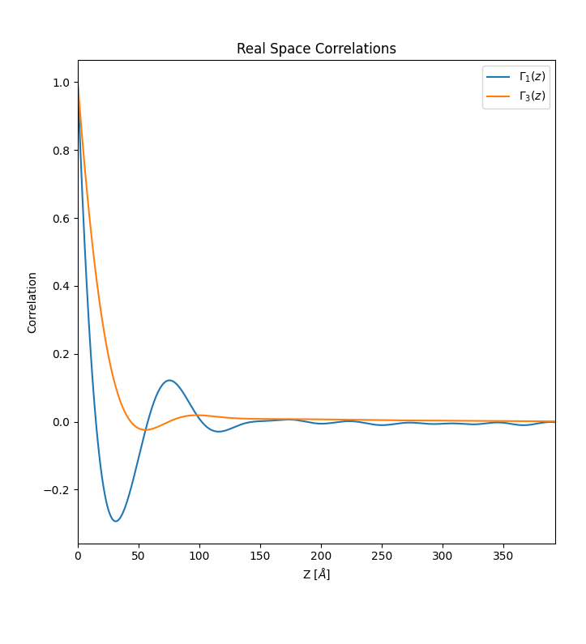
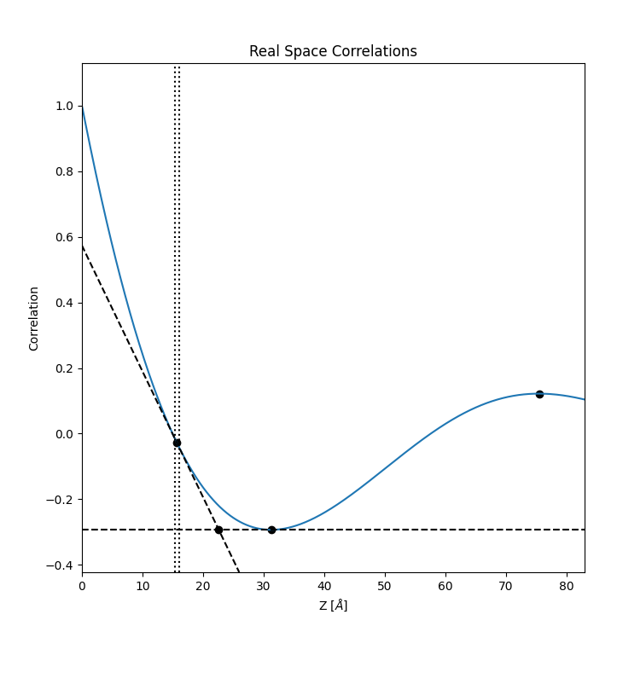
Real-Space Methods (1)
Correlation Function, Γ (r)
describes spatial inhomogeneity in SLD in the sample
in essence, the probability that rods of different lengths moving through the sample have equal SLD at either end
1D: 3D:
3D:
I(q)
Γ₁(r) & Γ₃(r)
extraction of lamellar parameters
Rieger, (2002)
SasView computes Γ₁(r) & Γ₃(r) + IDF

Slide 7




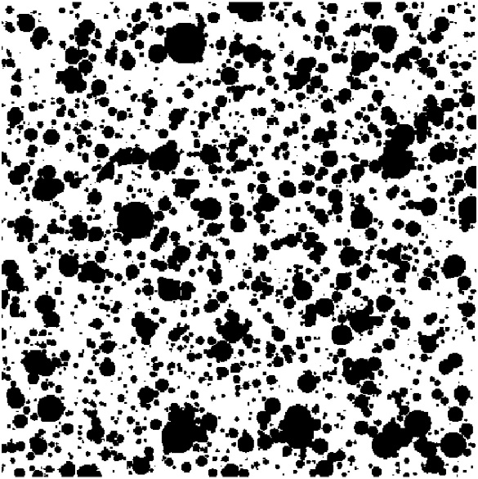



Real-Space Methods (2)
few analytical expressions for Γ (r)
homogeneous sphere:
(radius, R) where 0 ≤ (r/R ) ≤ 2
see Glatter & Kratky, (1982)
randomly-distributed 2-phase system: Debye & Bueche, (1949)
(single correlation length, ξ ) Debye, Anderson & Brumberger (1957)
randomly-distributed 2-phase system: Debye, Anderson &
(dual correlation lengths, ξ & Ξ ) Brumberger (1957)
Moritani et al, (1970)

Slide 8
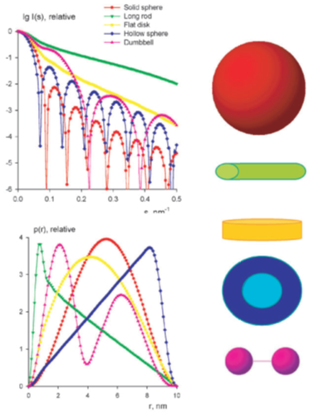
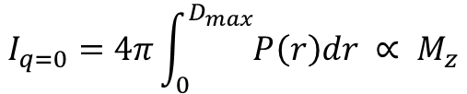
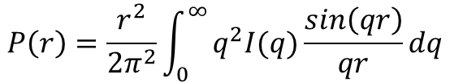
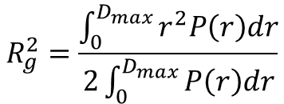
Real-Space Methods (3)
(Pair) Distance Distribution Function, P(r)
in essence, a histogram of pair-wise distances between atoms in the scatterer
solve set of basis functions by Indirect Fourier Transformation (IFT)
Glatter, (1977); Moore, (1980); Hansen & Pedersen, (1991)
SasView implements the Moore method
$$P\left(r\right)=\frac{r^{2}}{2π^{2}}\int_{0}^{∞}{q^{2}I(q)\frac{sin\left(qr\right)}{qr}dq}$$
$$I_{q=0}=4π\int_{0}^{D_{max}}{P\left(r\right)dr ∝ M_{z}}$$
$$R_{g}^{2}=\frac{\int_{0}^{D_{max}}{r^{2}P\left(r\right)dr}}{2\int_{0}^{D_{max}}{P\left(r\right)dr}}$$
Other implementations:
GIFT (from Glatter); GNOM (in ATSAS Suite); BIFT (in BioXTAS RAW)
D_{max}
Svergun & Koch, (2003)

Slide 10
The master plan…
Overview of features and new in 6.0 (10-15 min) PAUL
Slides general overview of layout and where to find things … ethos of project? Points of contact at facilities, contributor list, contacts at SAS2024. Put stickers on “badges”
Maybe preview of future features to come (beyond 6.0)
Where to find help
Overview of using basic features (45 min) STEVE
1d fit simple (polymer Gaussian coil)
1d with structure factor (SDS data)
Fit with polydispersity
Impact of resolution smearing
Correlation function
P(R) of protein – Apoferritin .. and maybe sphere and rod?
BONUS if time permits
add/multiply used in response to question
10 min coffee
Note on magnetic/pol beam stuff 10 min ANNIKA
Brief look at CLI (quick demo of Caitlyn Wolf stuff?) (10 min) LIZ
Model writing (35 min) PAUL
Different API ( add/multiply and reparam)
Use sphere and have equations ready on on board – also in back .. how about a handout. Could point to tutorials and send pdf handout
Step through
Easy editor and “hand write” all equations including bessel NO polydisperse parameters
Use scipy functions
Use library functions
Make polydisperse → point out the need to move 1/V out of the equation and use form_volume. Difference between z average (volume average) and number average
Make possible to use structure factor
Move to C
Add beta approximation (have_fq=true)
What if it IS a structure factor?

