Slide 1
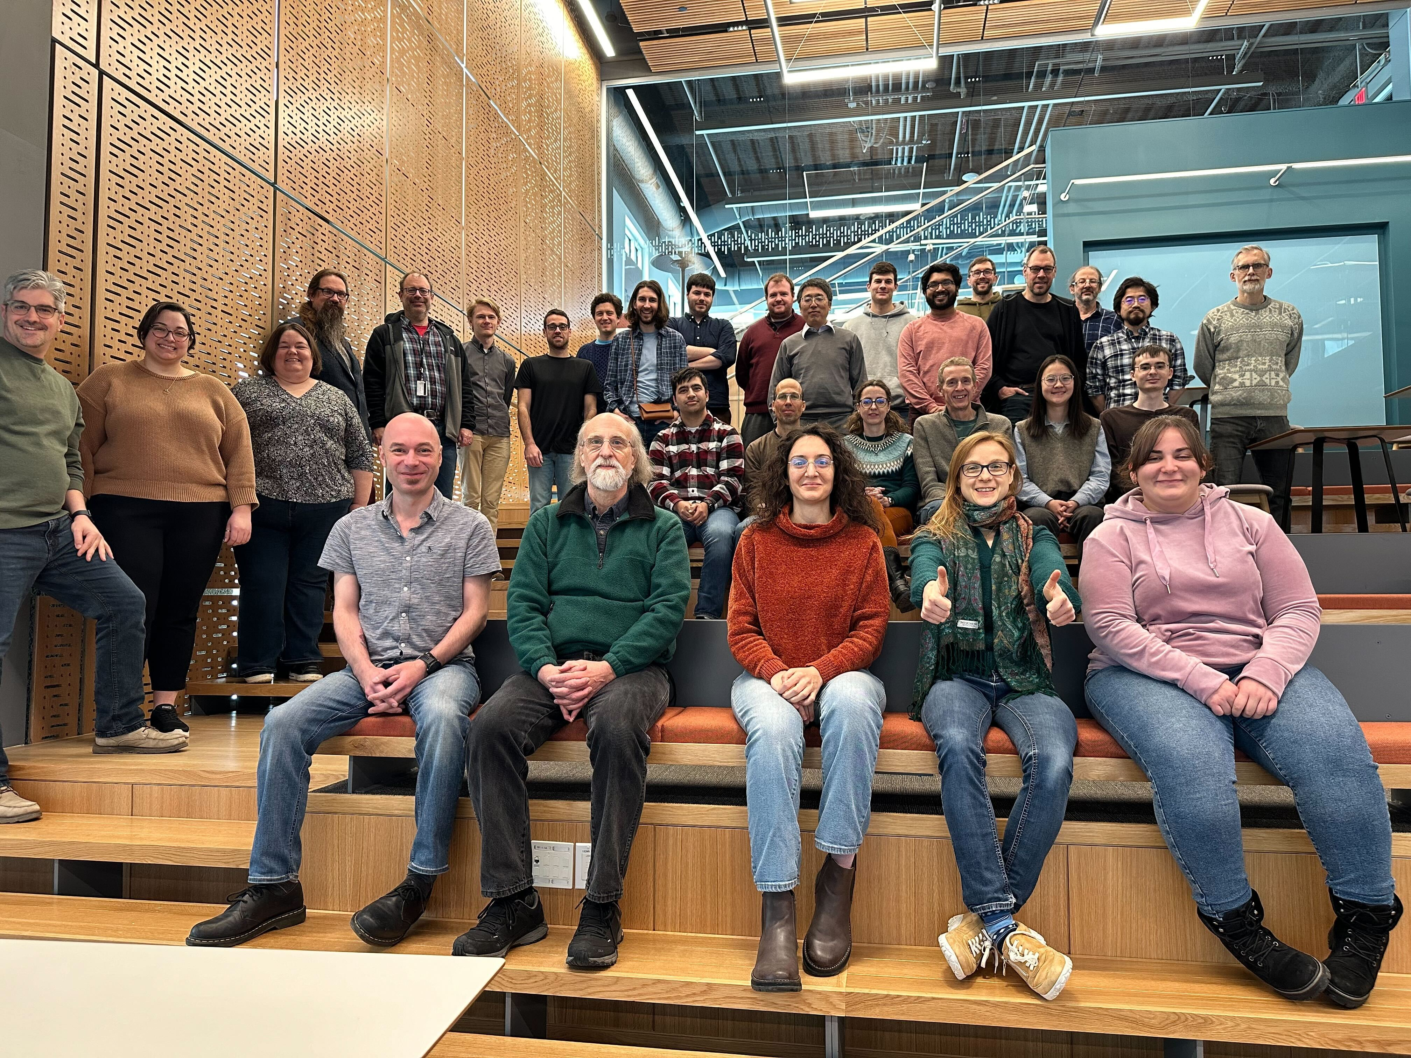
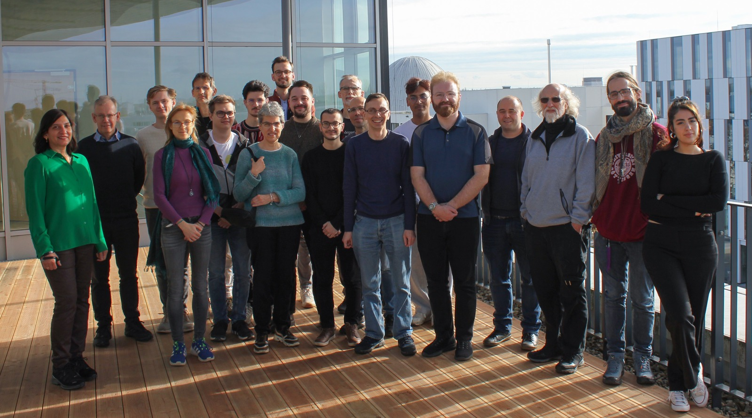
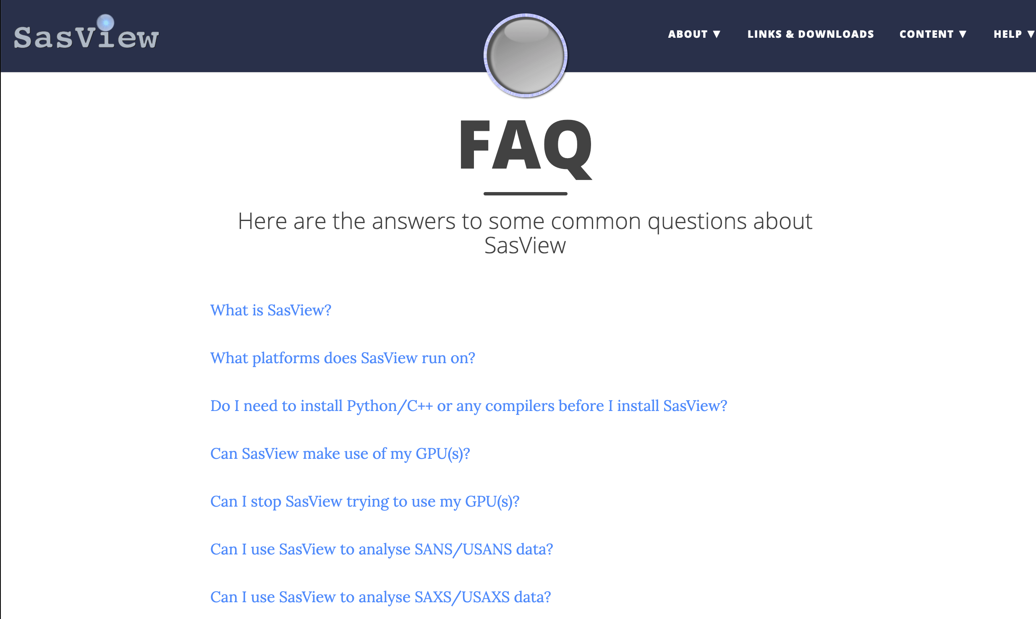
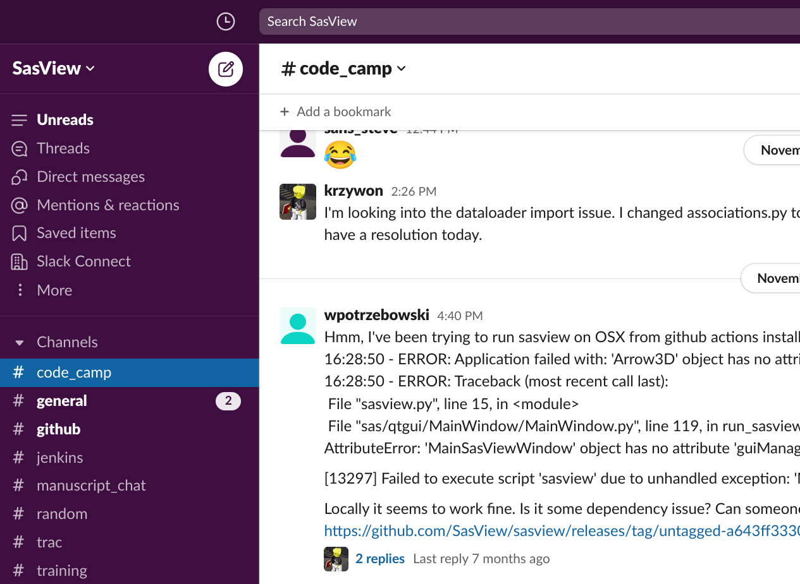
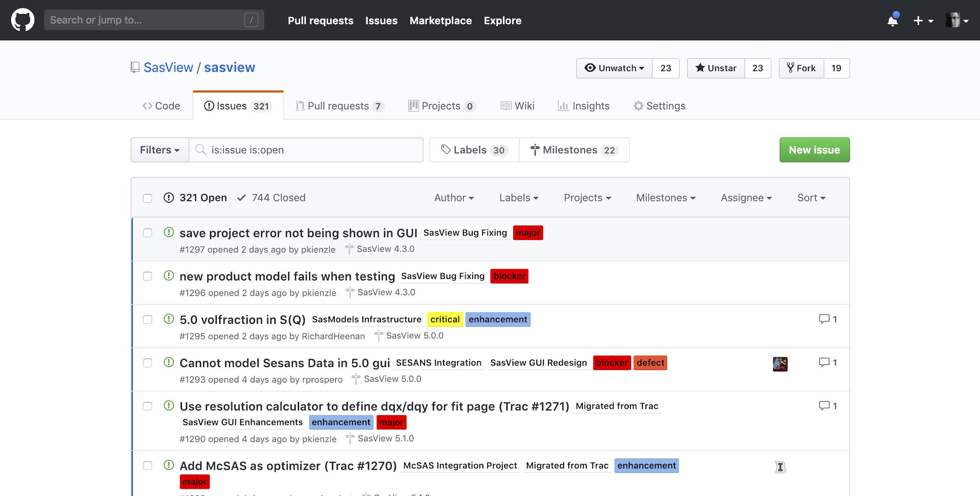
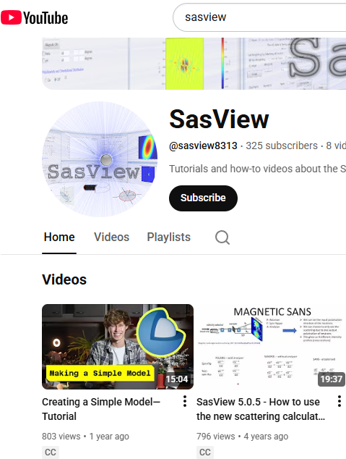
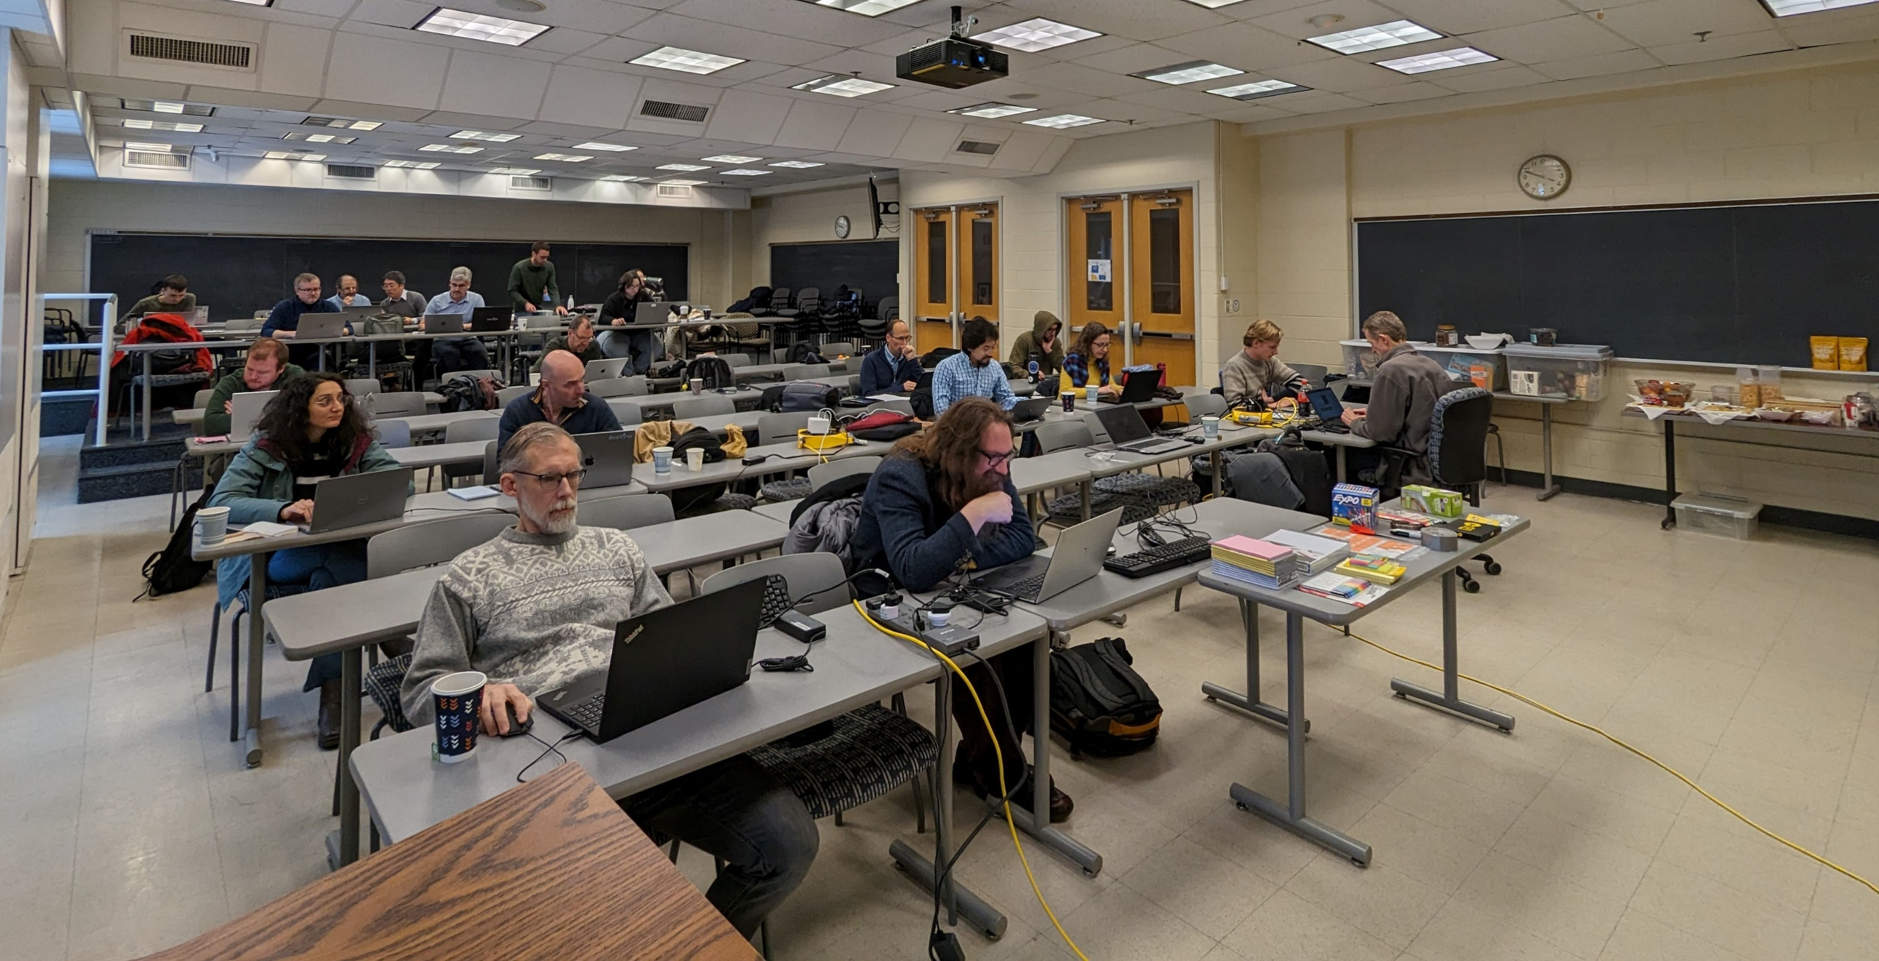
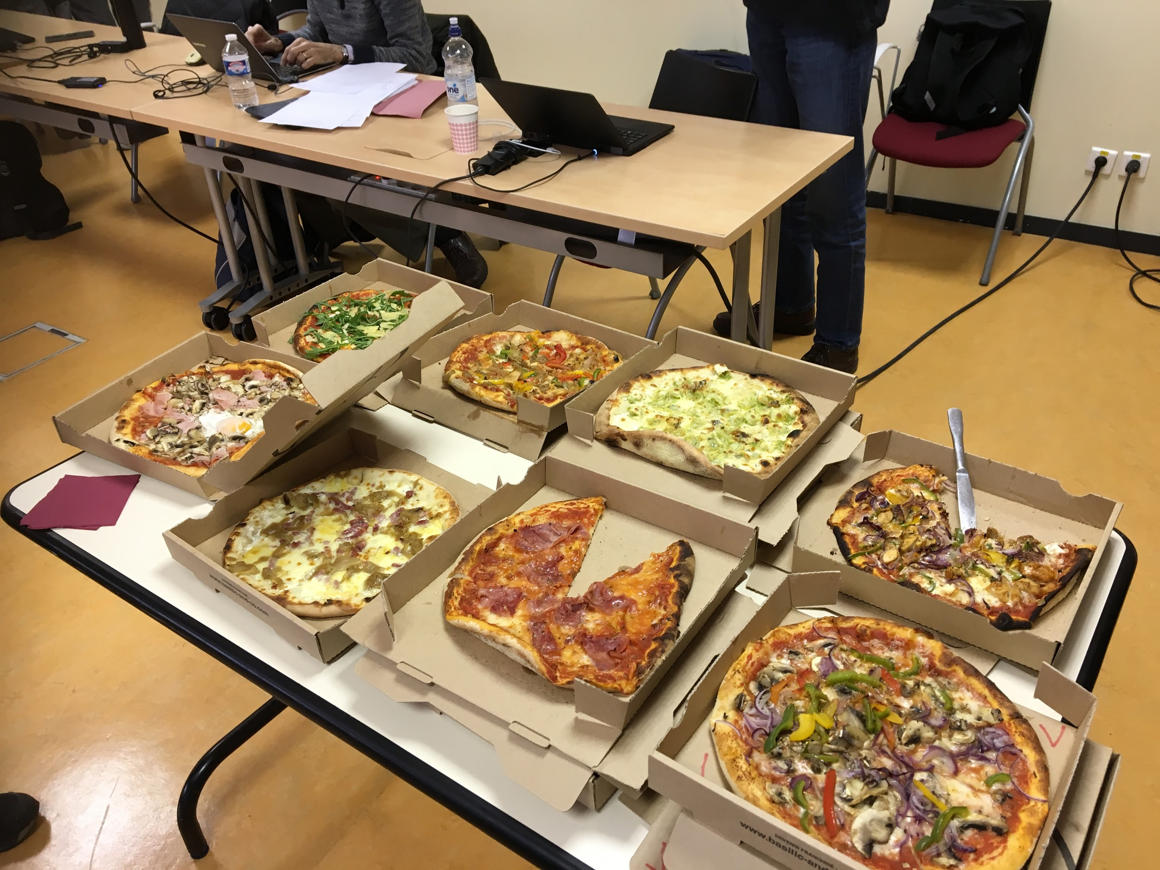
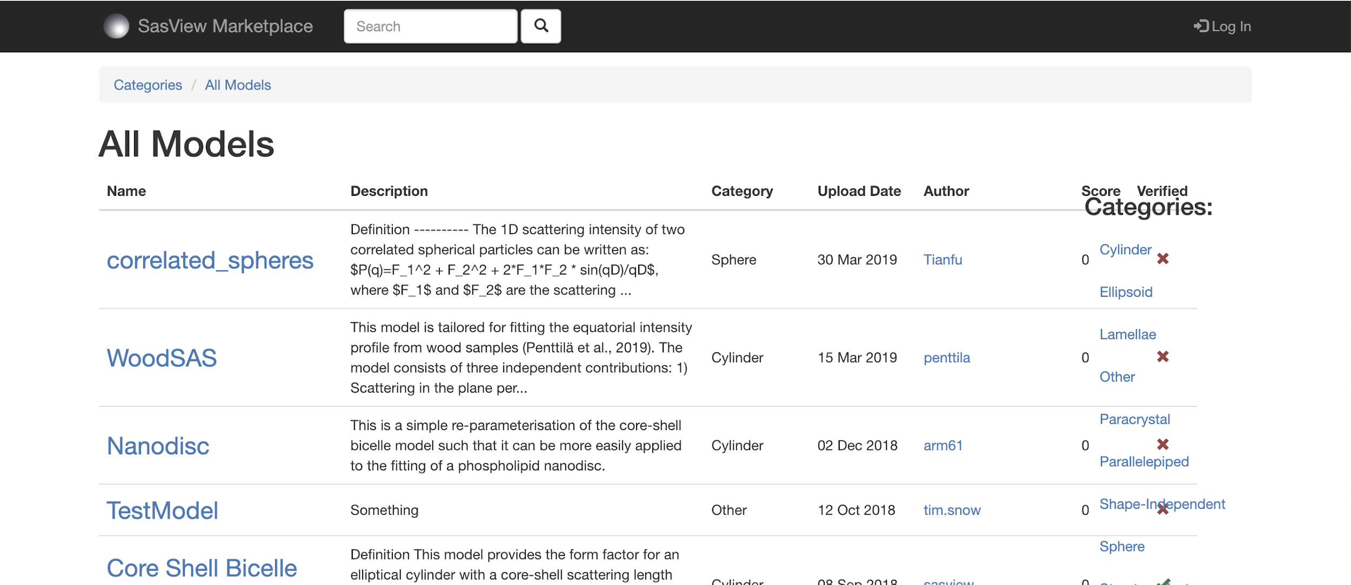

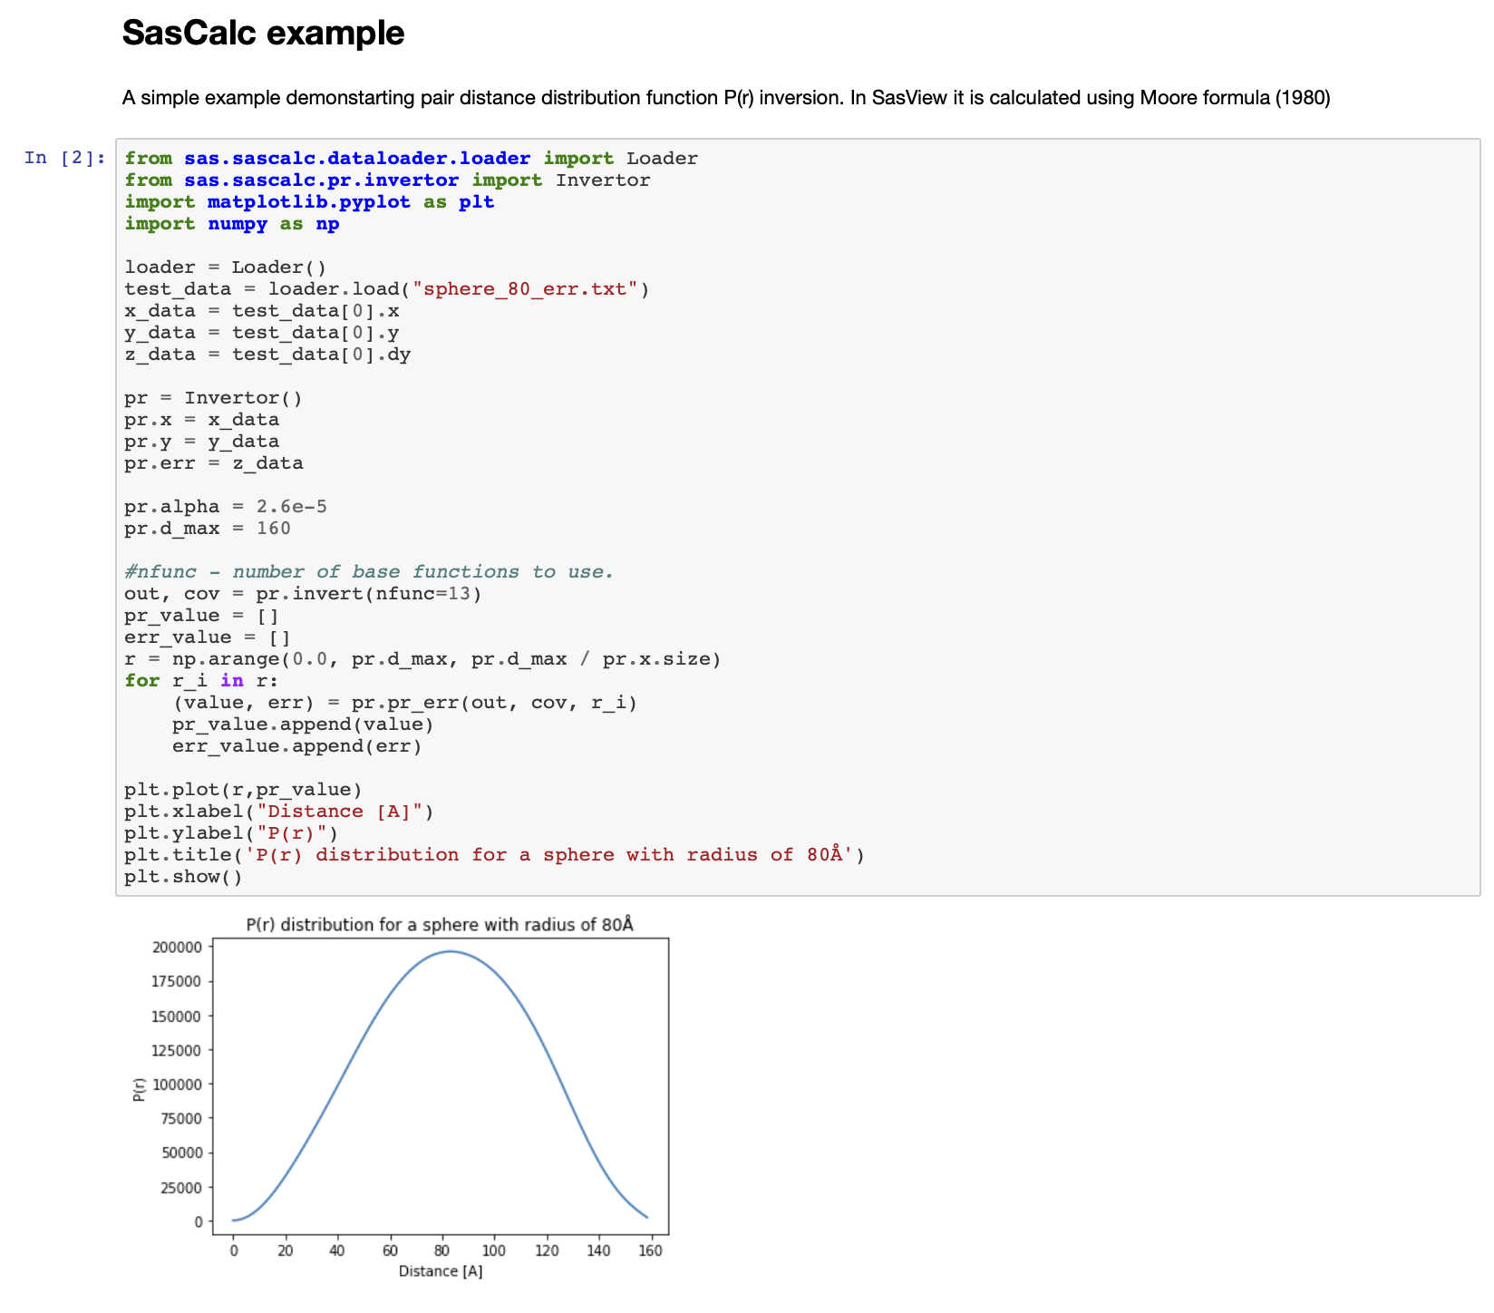

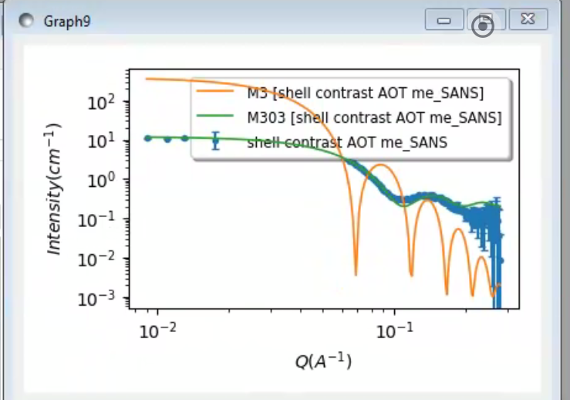
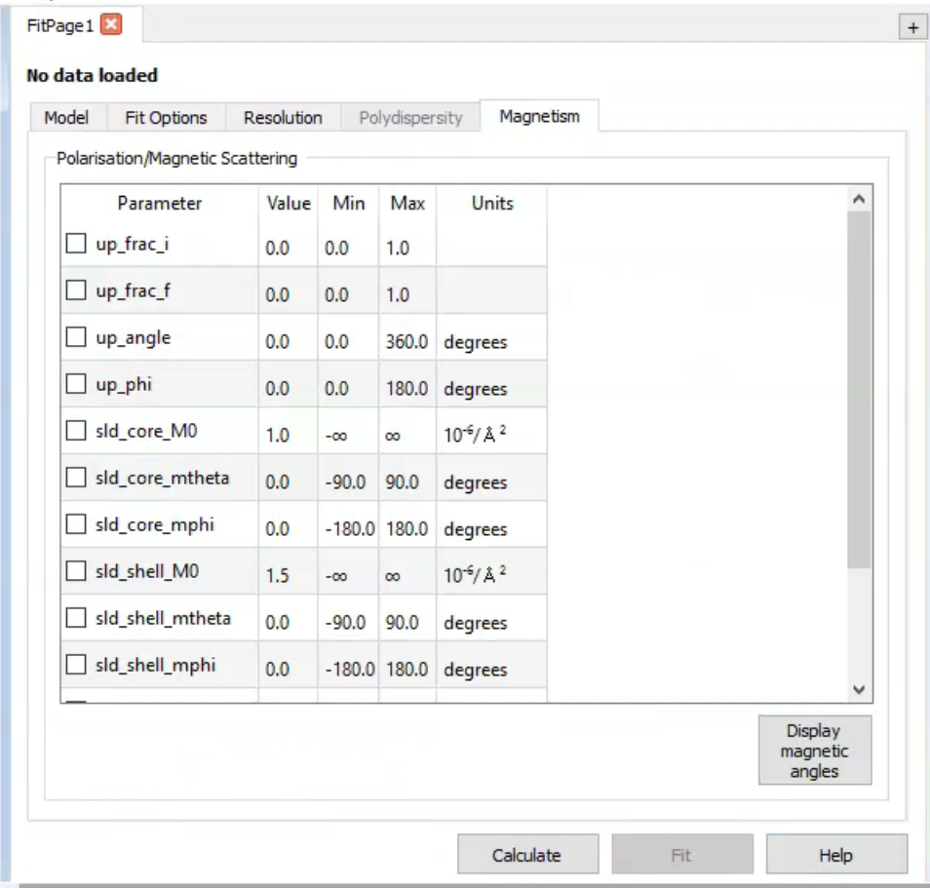
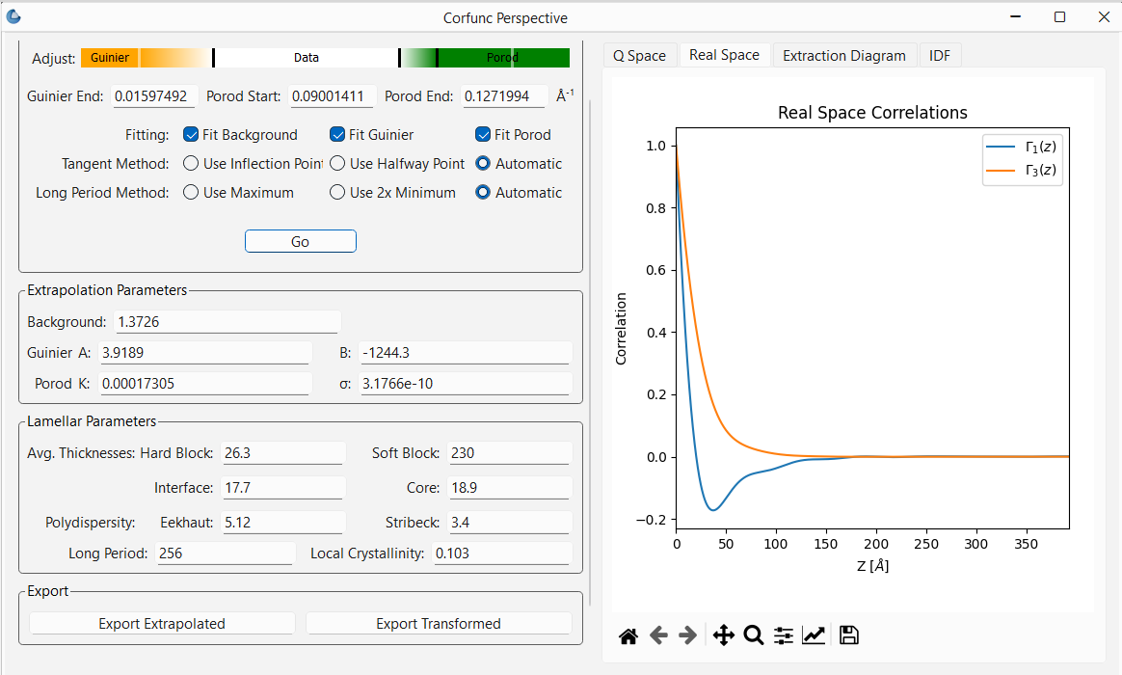
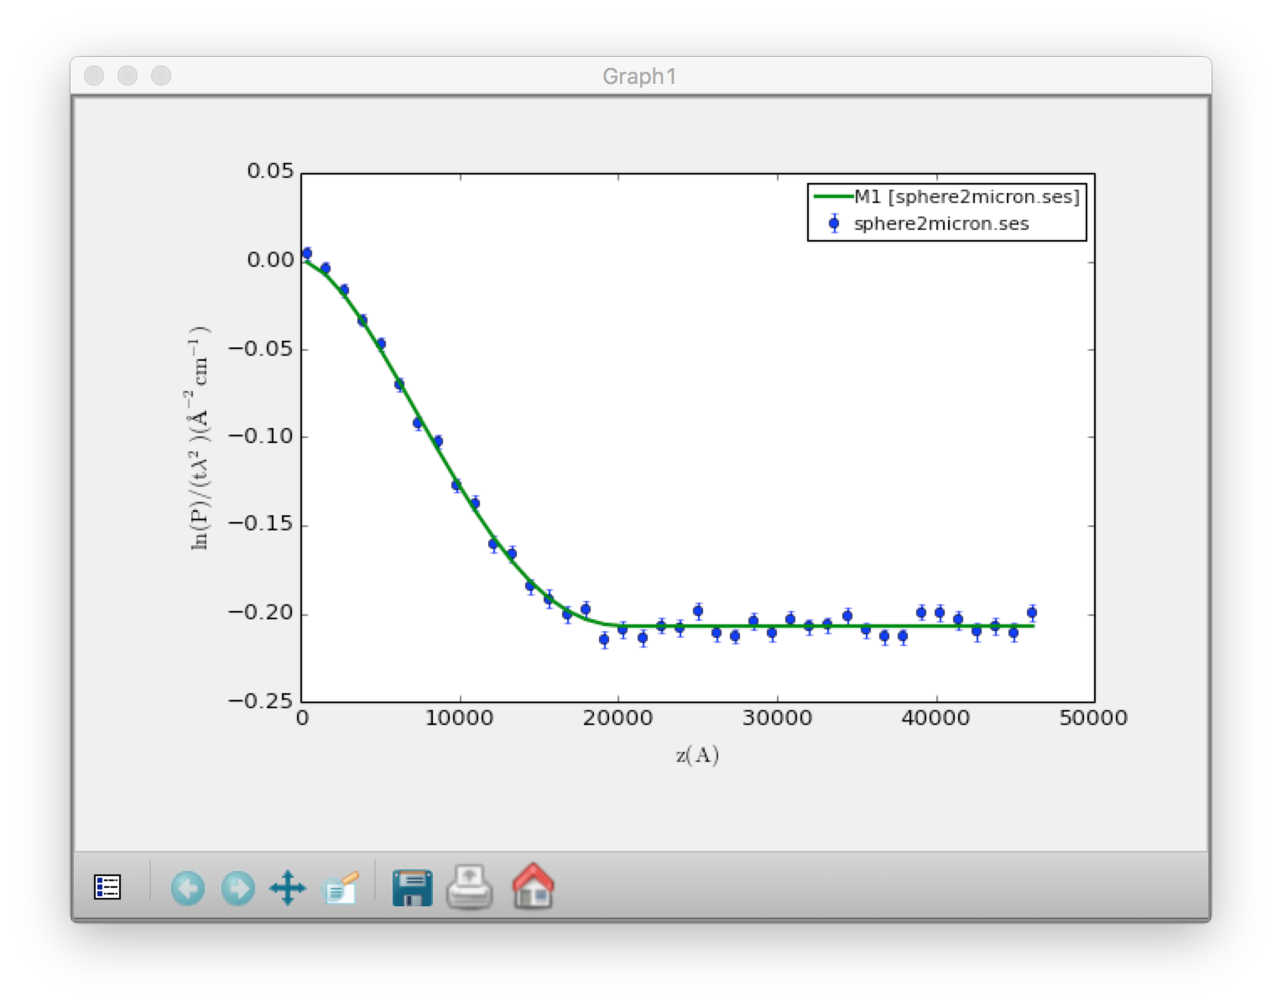
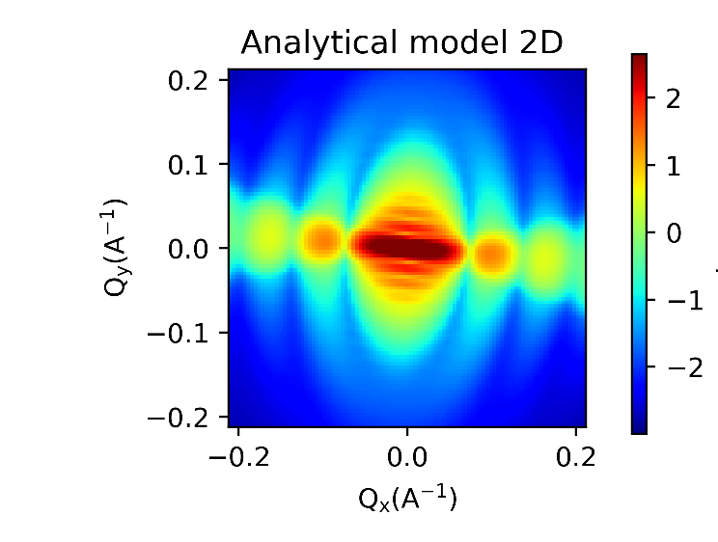
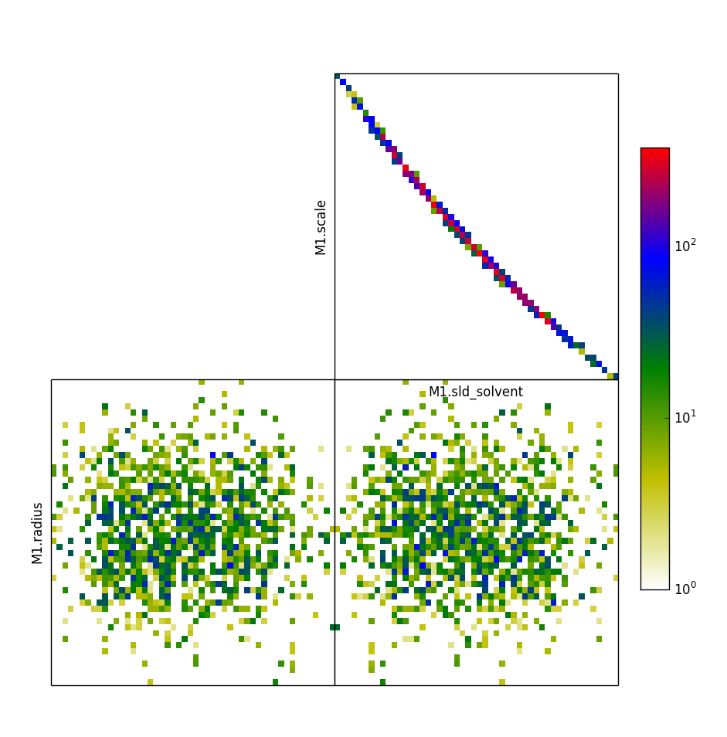
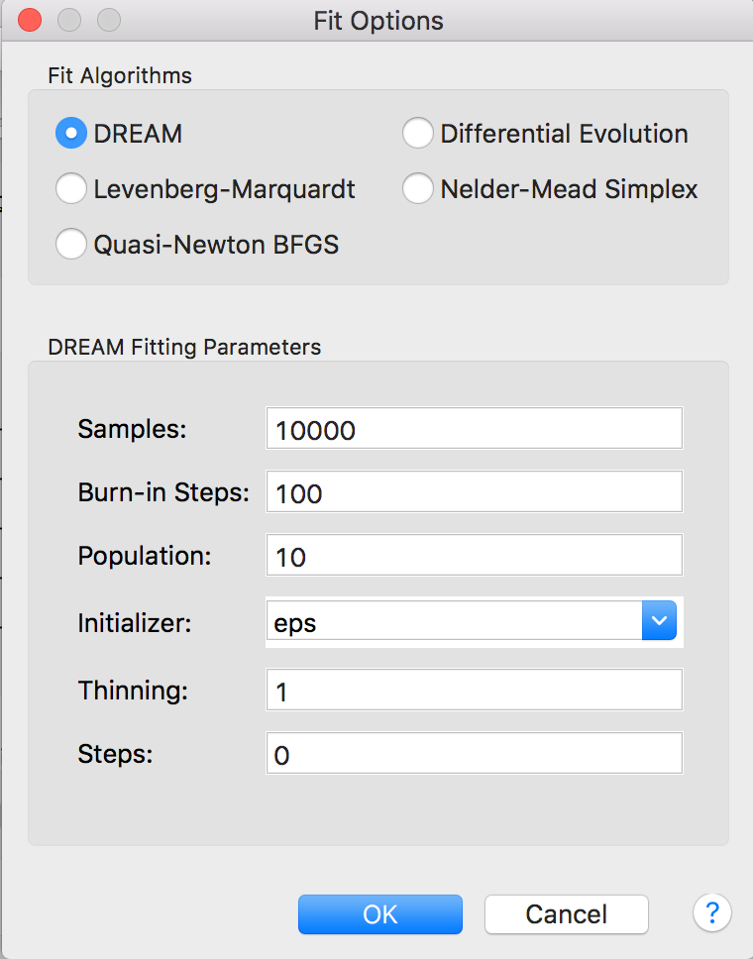
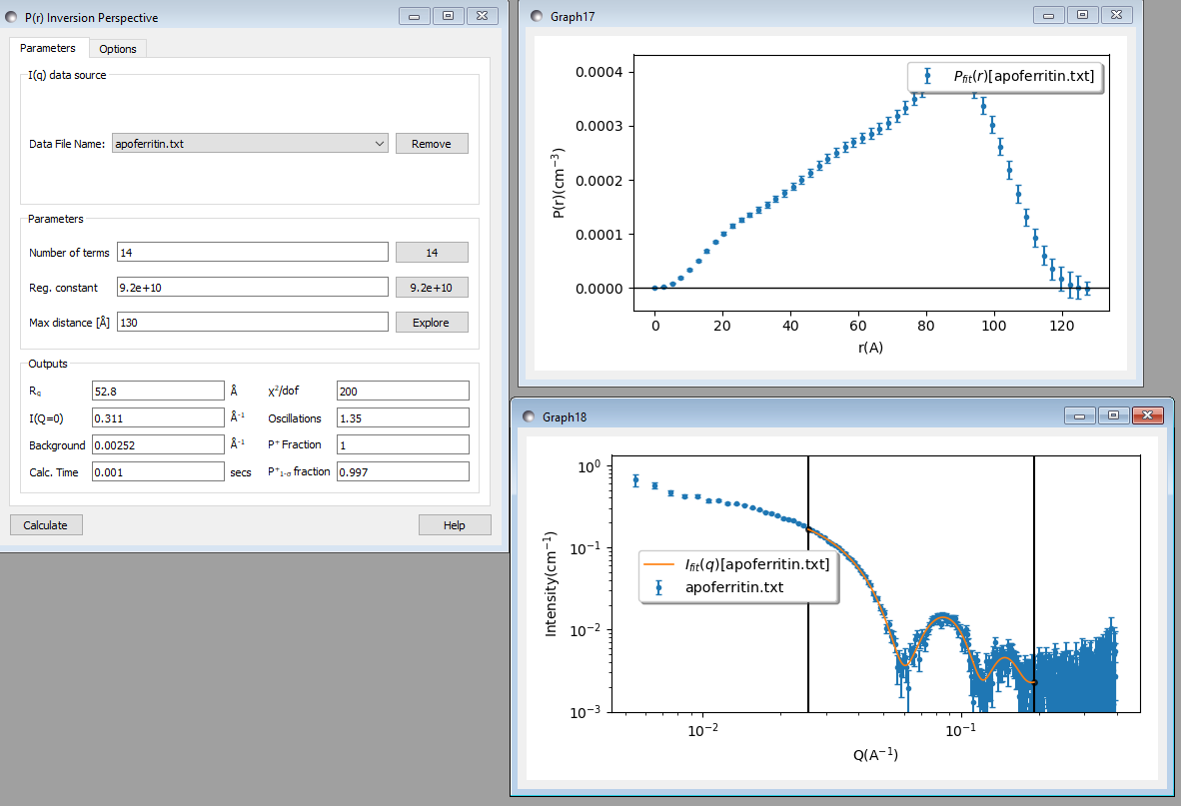
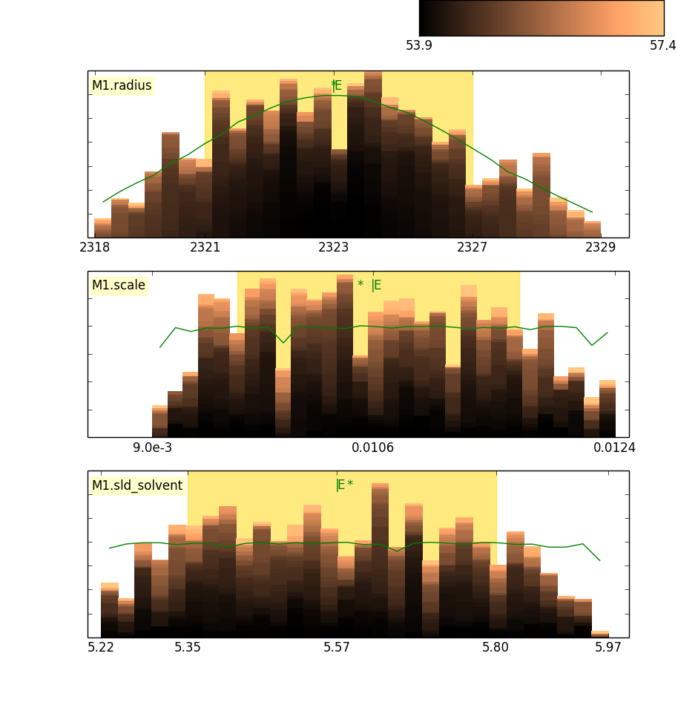
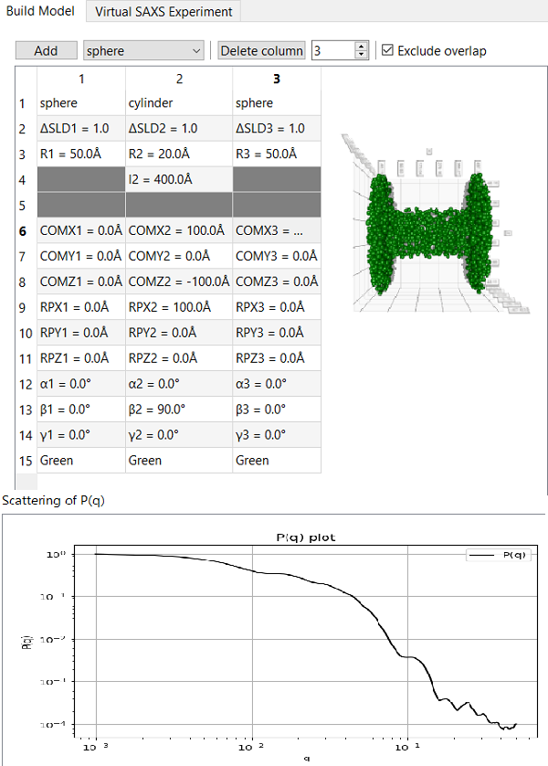
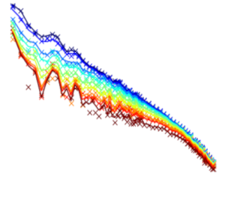
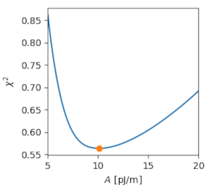
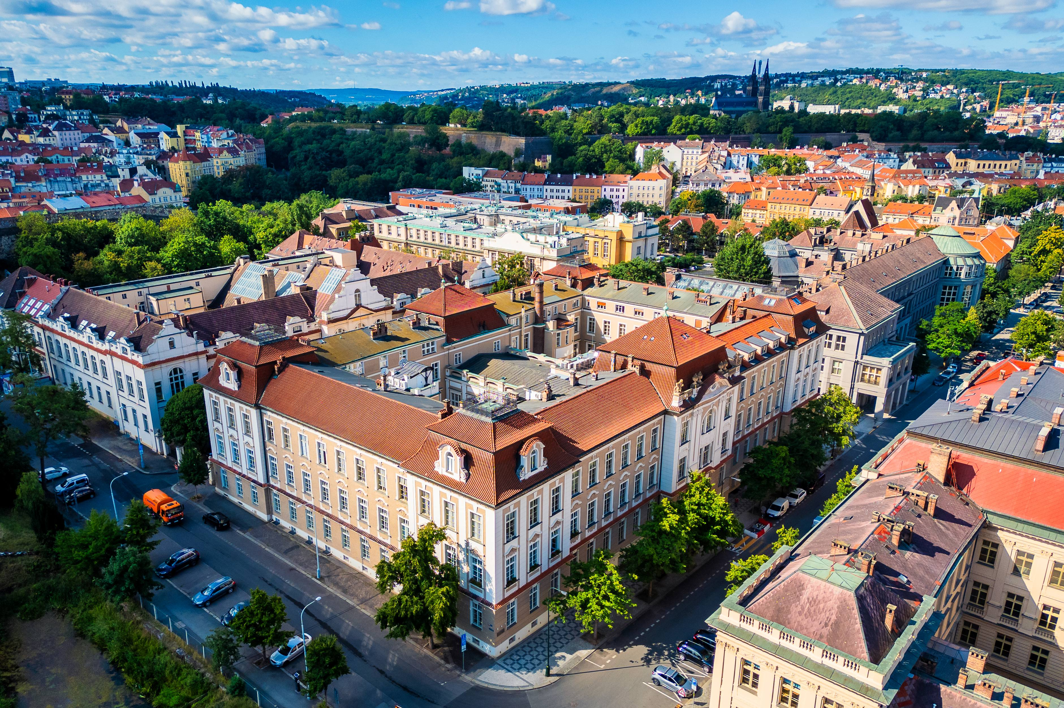
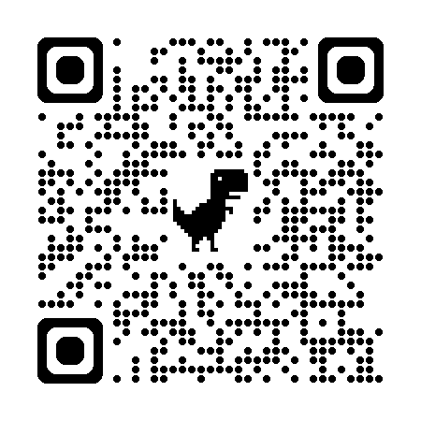
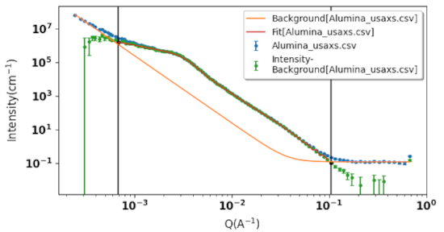
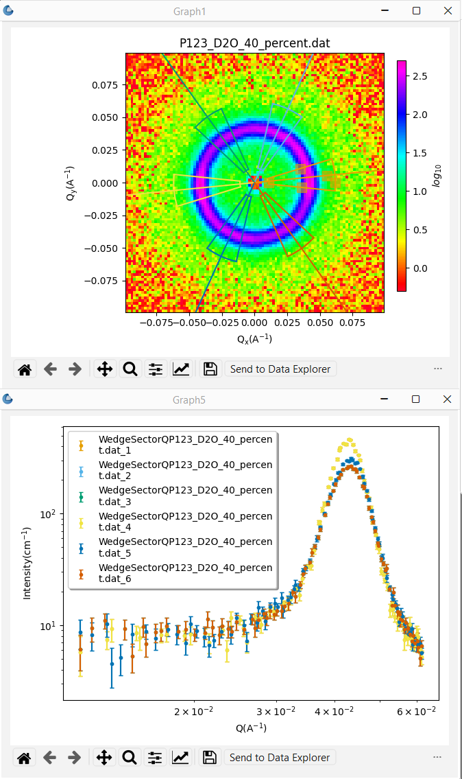
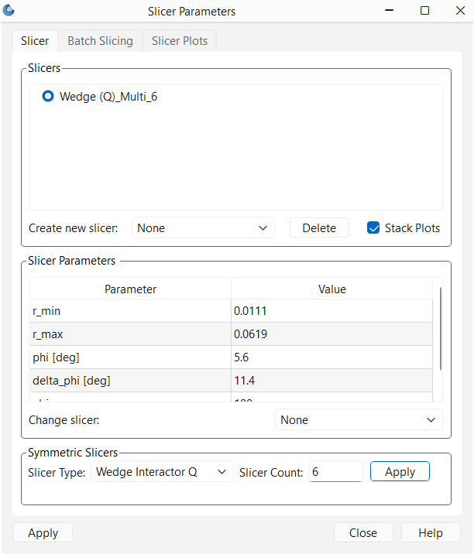
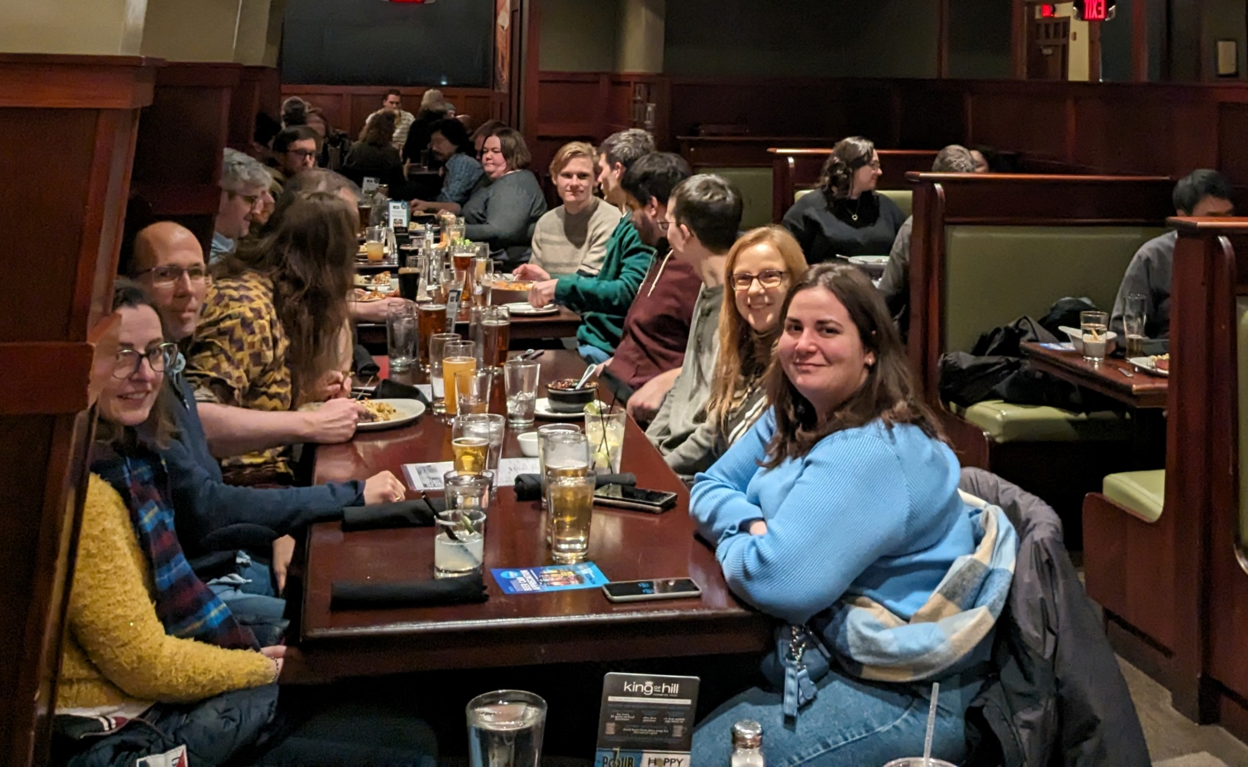
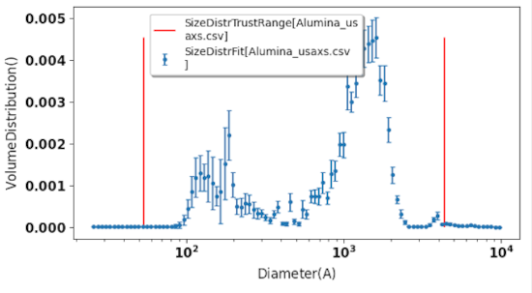
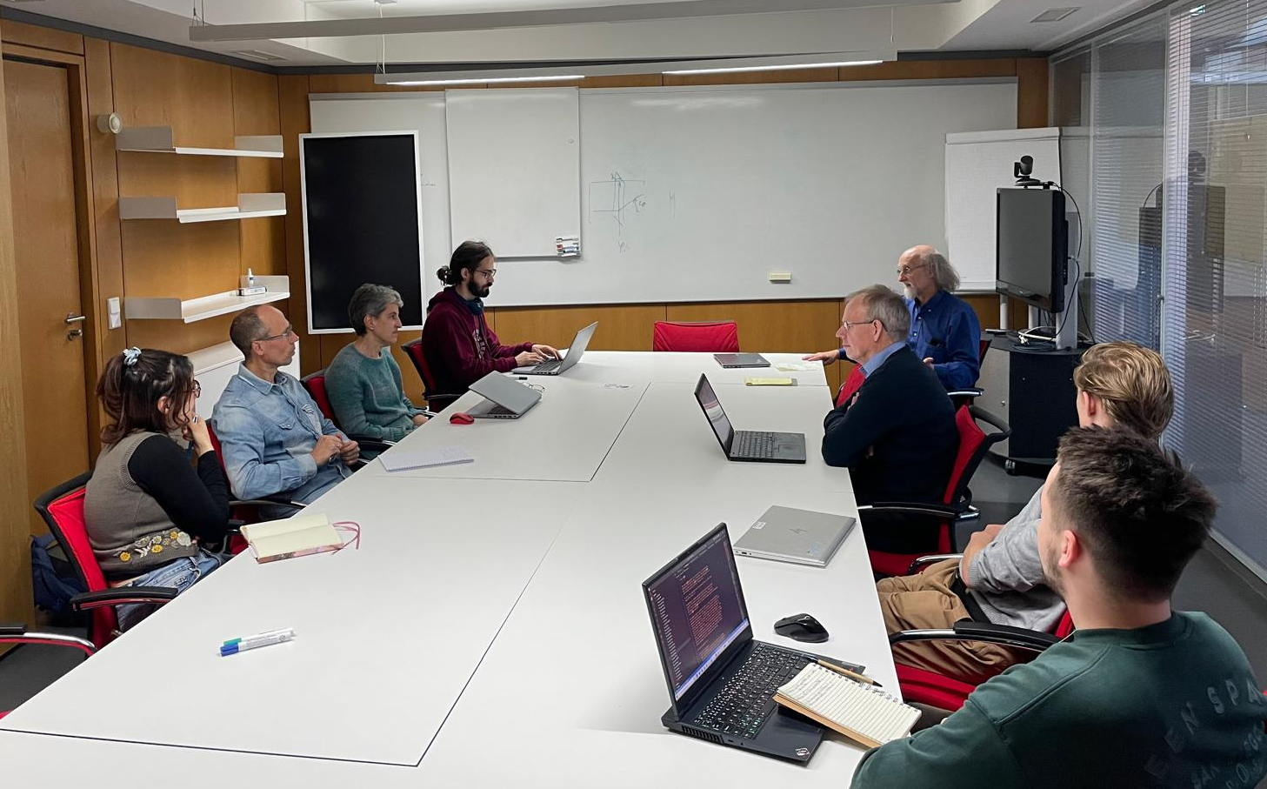
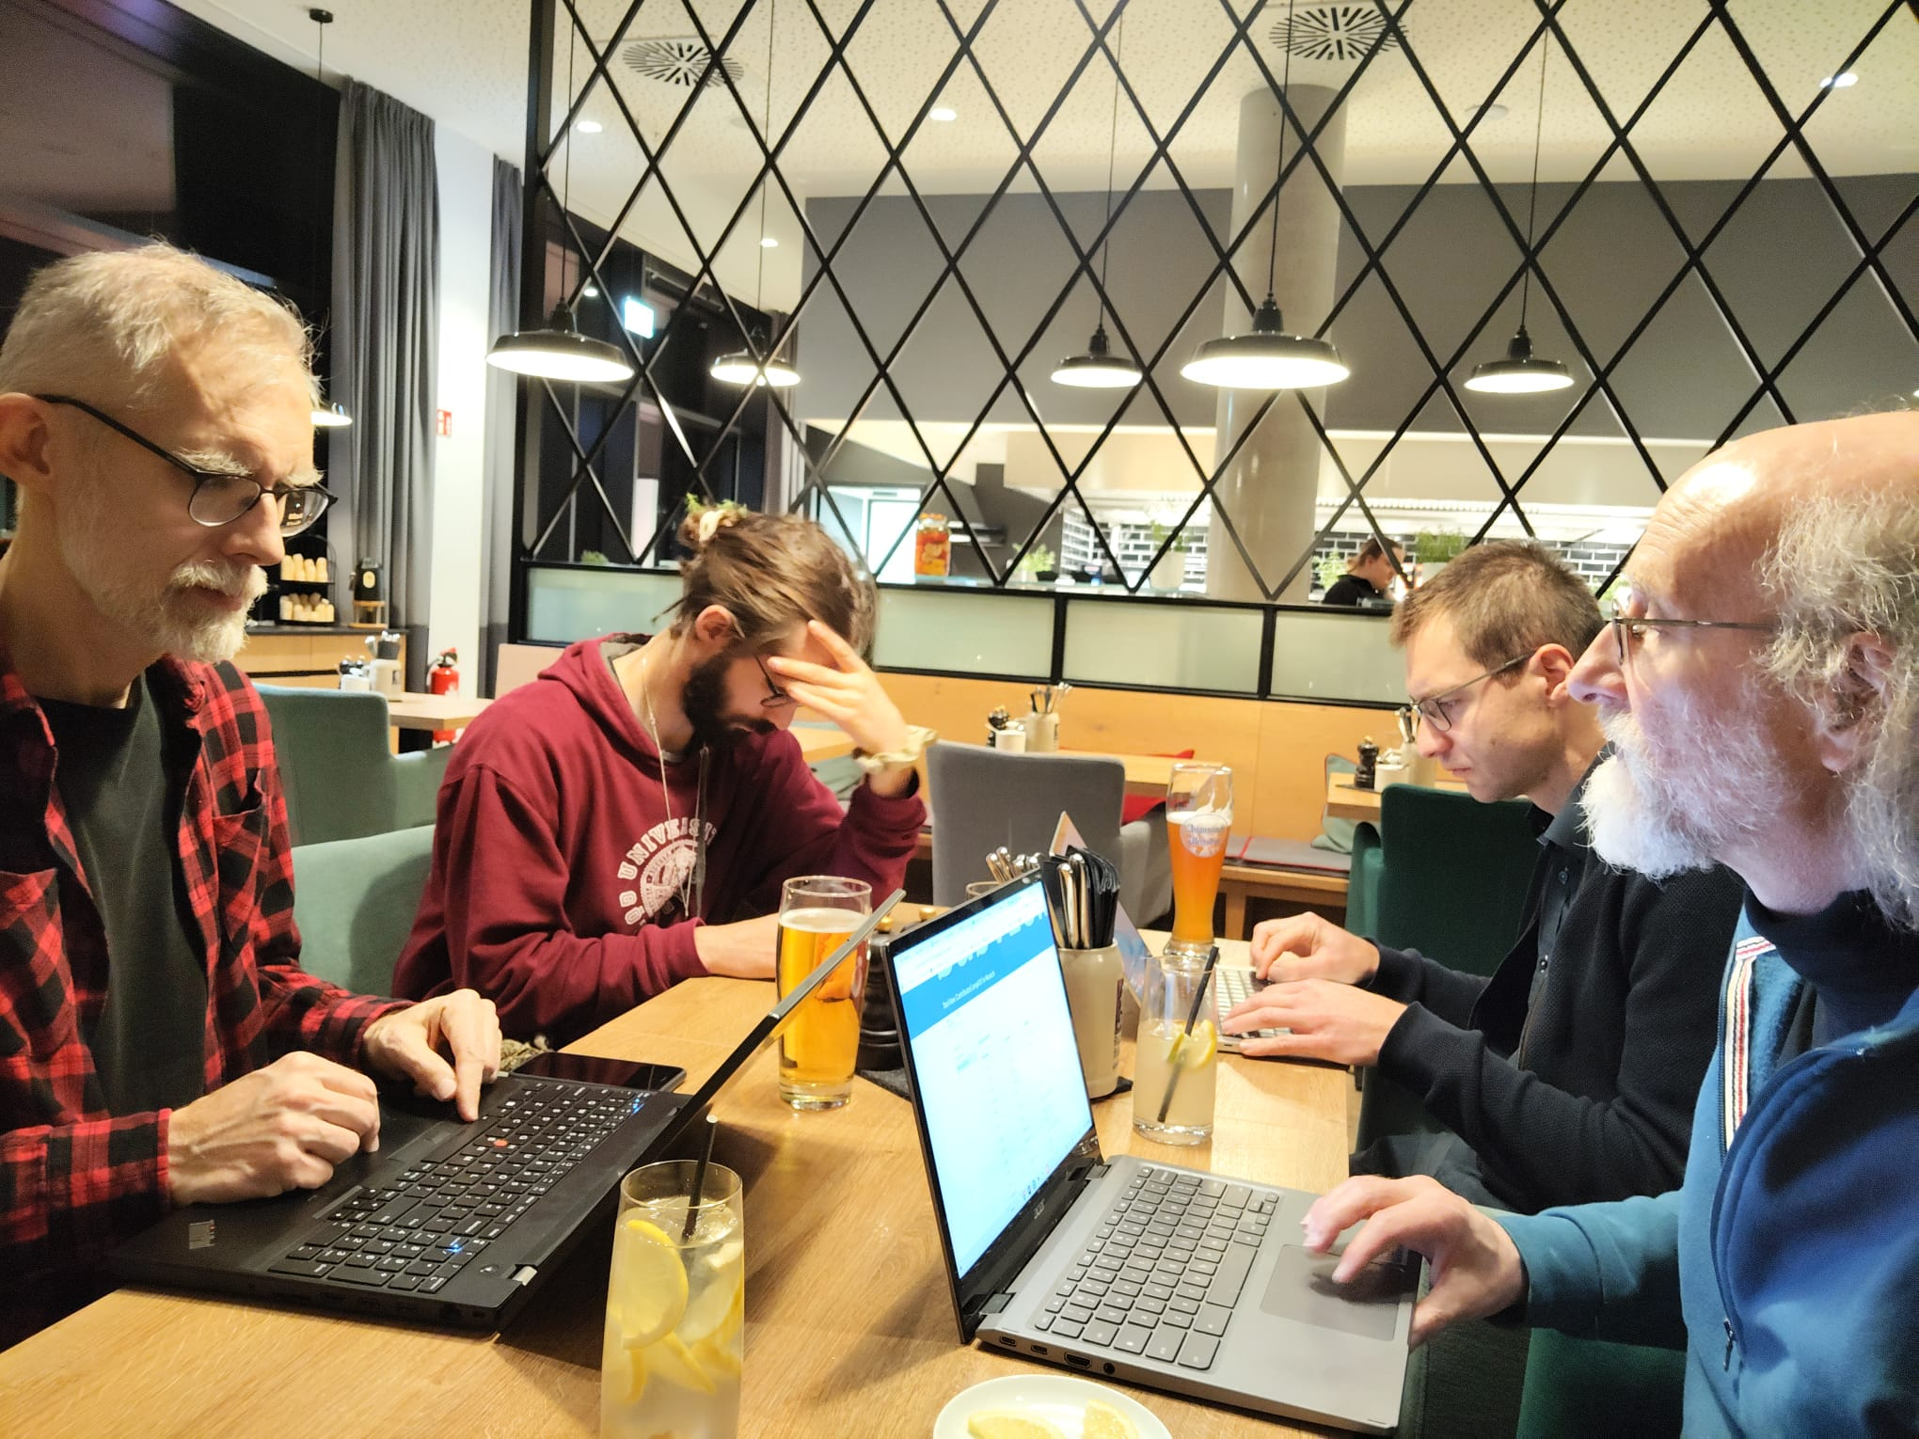
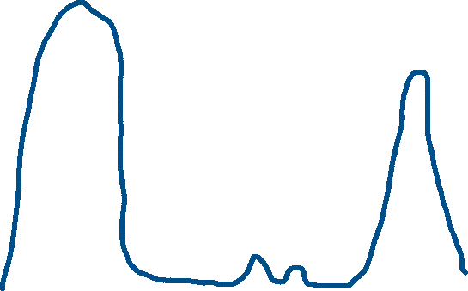
Addressing the resource problem through community:
The SasView Collaboration
The Problem Statement
Today’s analysis is beyond the skill set of most users
The unbounded problem
The SasView approach: vertical and horizontal COLLABORATIONS
Analysis Software - Who’s Job is it Anyway?
Fundamentally all the elements listed in the bar chart are relatively well-defined problems…
Scattering is an analysis tool and part of providing the tool should be the necessary software
→ the FACILITY’S JOB?
EXCEPT ...
Facilities provide foundational support through participation of data and instrument scientists
Grants and other projects provide “bold new functionality”
Community, writ large, helps provide support and functionality
New ideas tested and developed as before by individuals or larger groups (the community)
Once validated and deemed ready for the larger community these groups provide resources (their labor) to integrate while active developer community helps with training on where things go and on parts of interest to them (collaborative)
$$MONEY$$
Last priority with very limited funding left
Analysis Software is really unbounded. The needs are nearly infinite and constantly evolving.
Source Construction
Civil Construction
Reduction Sofware
Analysis is where the science is
→ the USER’S JOB?
Data Hardware
Analysis
Software??
Today’s analysis is beyond the skill set of most users
Instruments
HOWEVER --- Analysis as defined here is also uniquely universal and ripe for collaborative pooling of finite resources
Time
Or maybe …..
→ The Domain Science funding agencies?
The Valley(s) of death
A way to focus limited resources on top priorities (most useful to the science being done) in a world of infinite possibilities
A way to harness funding for bold new ideas without losing the investment in the valleys of death
A way to provide sustained maintenance, development and support in an uncertain funding environment (thriving through the famines)
$$MONEY$$
Facility directors’ discretion, NIH, NSF, DOE, etc.
Special funding (grants) do not fund long term maintenance and ongoing development. They fund “big new (transformative) ideas”
Time
Camp XIII (U. of Delaware)
Camp XIV (Munich)
Open, Collaborative, Community Development
Today’s analysis is beyond the skill set of most users
Website
Documentation: in-program & online
Written Tutorials
Video Tutorials (YouTube)
scattering schools/workshop
E-learning (starting)
Model Marketplace
Twitter
Bootcamps & regional workshops
Slack
help@sasview.org
users@sasview.org
developers@sasview.org
Ask not what the community is going to do for you,
ask what you can do for the community
Code is open source
publicly hosted at Github
Released under BSD 3-clause license
http://www.sasview.org
Collaboration also builds
Community
No MOU ... all are invited and welcome
Two Basic "Rules"
She who pays the piper chooses the tune
Those who bring the resources (time and effort, or funds to buy time and effort) choose what to work on.
And ...
You cannot break existing experiences ...
New dependencies vs long term maintenance (sustainability)
Code quality vs long term sustainability
Changing/degrading the current user experience for the existing user base
  http://github.com/SasView
Twice monthly Zoom calls
Regular ‘camps’ & ‘hackathons’
Developer's mailing list
SasView Slack
Expertise sharing and helping
Small leadership team to facilitate
Code Hosting, Issue Tracking, Developer Wiki & CI on Public Github repos
Rolling 5 Year Roadmap
http://marketplace.sasview.org
(Zenodo) DOI for each release
Hard at work together - Camp XIII
Final Sprint w/Pizza - Camp IX
Original put together by an ISIS Summer Student Lewis O’Driscoll
The SaView Package
Today’s analysis is beyond the skill set of most users
Today’s analysis is beyond the skill set of most users
Data Operation
SLD calculator
Density/Volume calculator
Kiessig Thickness Calculator
Q Resolution Estimator
Orientation Viewer​
Tools
HISTORY/STATUS
Slit Size Calculator
Python Shell/Editor​
Image Viewer​
File Converter​
Generic Scattering Calculator​
MuMag (micromagnetics)
Shape2SAS
Perspectives on the data
Jupyter Notebooks
and Command Line
2006 - originates in NSF DANSE project
2013 - transitions into a community project
2016 - Funded by Sine2020 project (4 years)
2022 - Mostly a “volunteer army”
--------------------
1 to 2 releases/year (6.2.0 planned for July)
Documentation/tutorial projects ongoing
Over the years > 100 contributors from > 30 organizations, including ~ 20 Universities across 12 countries on 3 continents
(BUT only ~5 -15 active at any given time)
USAGE: Seems to be "everywhere“ with >200 publications/year.
Correlation Function
Size Distribution
Invariant
P(R)
Fitting
Data Management
Magnetic Parameters
Most 1D formats and NXcanSAS 2D format supported.
Some image and odd data supported through converters
Data output in NXcanSAS or csv formats.
Calculated curves associated with data (P(Q), S(Q), desmeared model, etc) accessible individually.
Project saving capabilities (currently a bit fragile)
SOME CHALLENGES
1D and 2D analysis
Choice of Optimizers
The price of success: Building community resources is hard (Help IS needed!)
  Professional looking effort leads to the misconception that the project is funded, posing a barrier to engaging community.
  Hard to persuade non-coders of the critical importance of other contributions
Hard to keep up with increasing security issues given resources
P(R) Perspective
Corfunc
SESANS analysis
Today’s analysis is beyond the skill set of most users
MuMag tool
CURRENT PROJECTS
COMING NEXT: 6.2.0
CONTRIBUTOR CAMP
(A Hackathon Week!)
Major refactoring projects:
Data loading, handling and manipulation infrastructure
Plotting infrastructure
Upgraded features
Major slicer upgrade
Major Invariant upgrade
Corfunc UI upgrade
Numerous smaller enhancements
Numerous bug fixes
WHEN: November 3-9, 2026 (7 days of fun!)
WHERE: Prague, Czechia at Charles University
Major current efforts:
Better support for Magnetic and polarized beam SANS and anisotropic data analysis
Better BioSAS support and Generic Scattering Calculator
Reimagining model fitting: Fitting 2.0
COME JOIN
THE PARTY!!
Shape2SAS tool
New slicer
tool
Size Distribution Analysis
Breaking bread together - Camp XIII
Models discussion - Camp XIV
Late night work at the bar- Camp XIV

