Slide 1
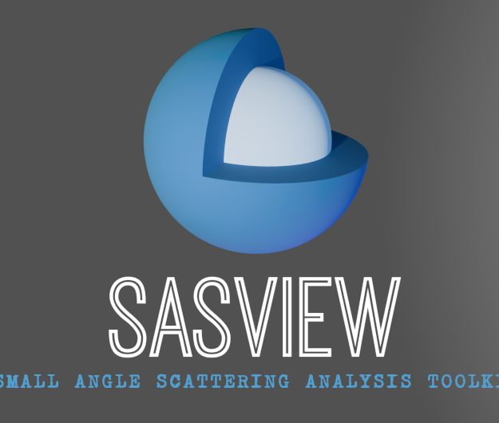
The SasView Organization
‘Disciplined and Professional’
Jeff Krzywon

Slide 2
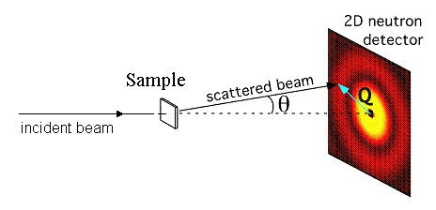
What is SasView
A Small Angle Scattering Data Analysis tool for SAS data in inverse space and SESANS data in correlation space

Slide 3
Code Structure
bumps
sasmodels (on pypi)
Analytical models for various shapes and structures
Applies dispersity and resolution
Runs fits using bumps
sasdata (on pypi)
Package to handle data import/export, data management, and data manipulations
sasview (working release coming to pypi soon)
Overlap between GUI and sascalc
sasdata
sasview
sasmodels
GUI (QtGui)
sascalc

Slide 4




History
2006
2011
2012
NIST Supported initial transition from NSF funding
2013
Transition to Community project.
1st Code Camp at NIST April 2013
2014
2nd Code Camp at ISIS April 2014
v3.0 released (SansView)
3rd Code Camp at ESS Feb 2015
2015
4th Code Camp at Delft March 2016
2016
v4.0 released (SasView with sasmodels)
5th Code Camp at ORNL Oct 2016
1st SasView User Meeting at SAS 2018
2019
v5.0.0 released (Move from wx to Qt)
9th Code Camp at ILL/ESRF March 2019
2020
1st Virtual Code Camp March 2020*
1st Virtual Hackathon May 2020
2024
1st Contributor Camp January 2024
v6.0.0 (sasdata separation)
(Sept/Oct 2024) (in Beta)

Slide 5
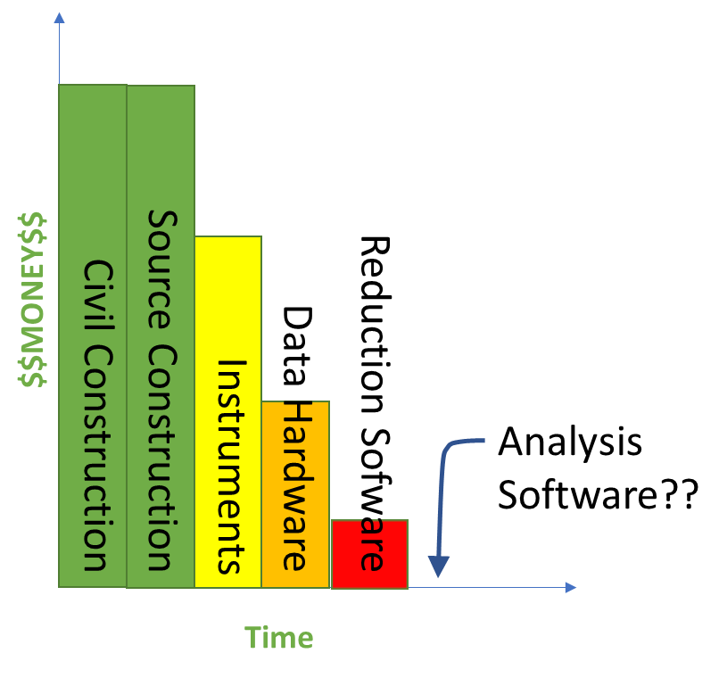
Addressing Resources Through Community
Analysis
What is it?
Whose job is it?
What are the limits?

Slide 6
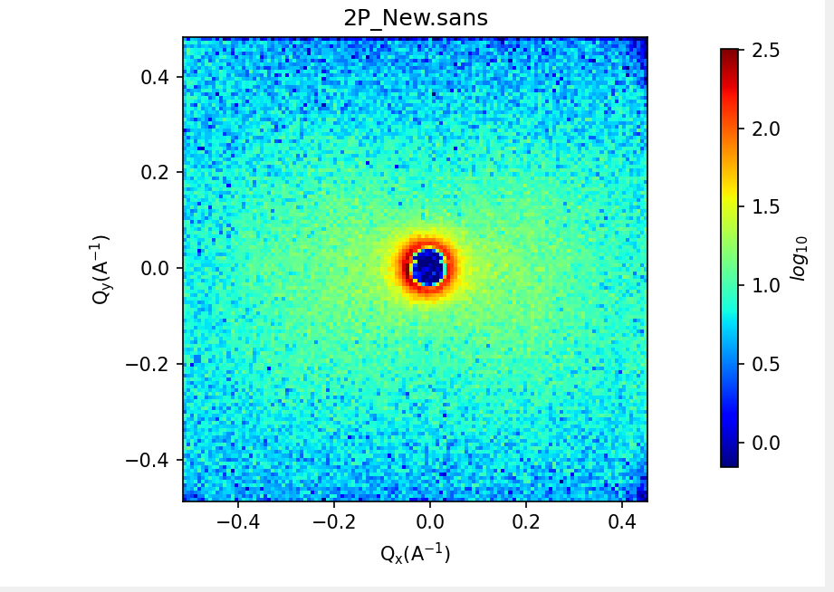
What is Analysis?
Tools
Generic Scattering Calculator to generate empirical models using PDB files (v6.0.0)
SLD Calculator
Q Resolution Estimator
Various import/export methods
Post-reduction averaging
Analysis methods (perspectives)
Fitting – Basic Model Fitting
Invariant – Multi Phase Analysis
P(r) – Real Space Distributions
Correlation Function – Real space

Slide 7
The SasView Approach
An ‘open, collaborative, community development’ platform for Small Angle Scattering Data Analysis

Slide 8
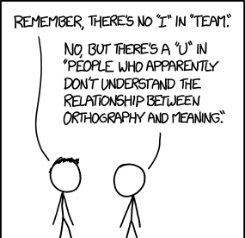
Work With Me, Not For Me
(and not dictate to me…)
Nobody Owns SasView*
Open Source
Free to develop
Python and C
Lessons Learned:
Global collaboration can be difficult
“Small” money is a blessing

Slide 9
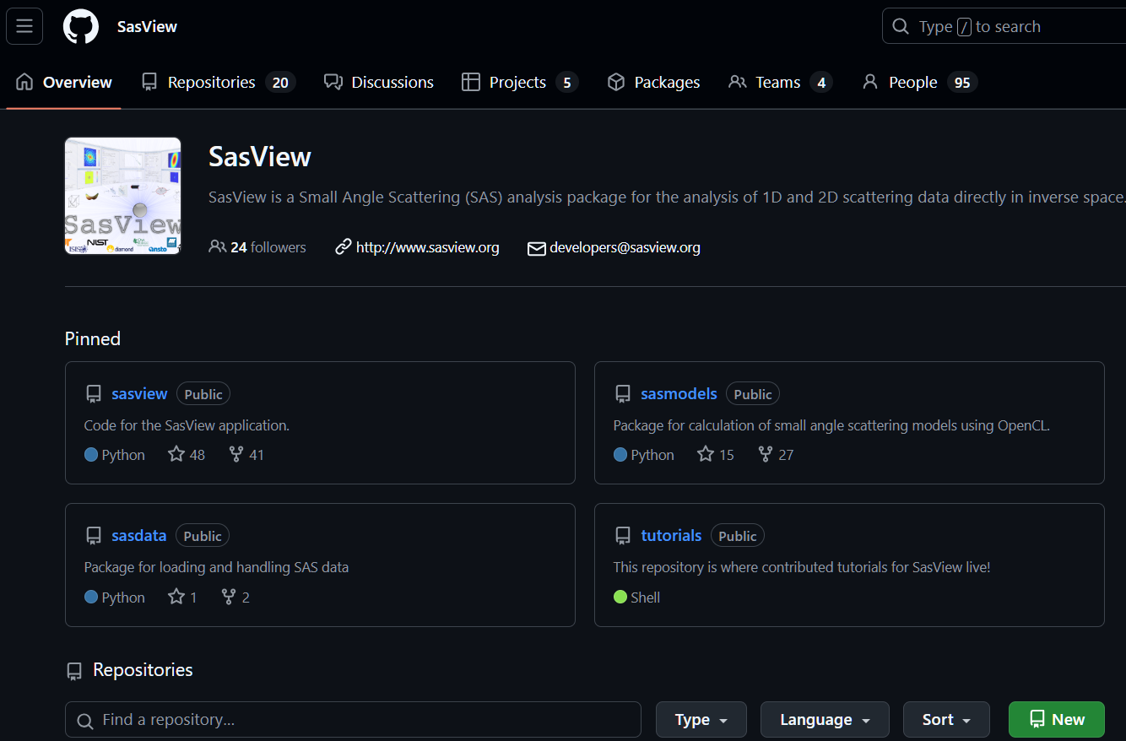
Open, Collaborative, Community Development
Code Hosting, Issue Tracking, Developer Wikis and CI on Public GitHub repos
DOI for each final release (Zenodo)
Coming soon: every GitHub tag
Rolling 5-Year roadmap
Lessons Learned:
Establish good practices (release schedule, branch structure, code structure, etc.)
Flexibility

Slide 10
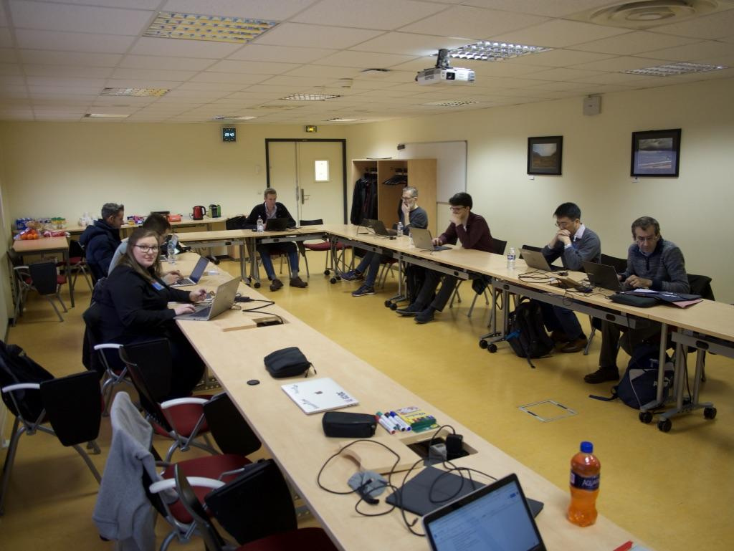
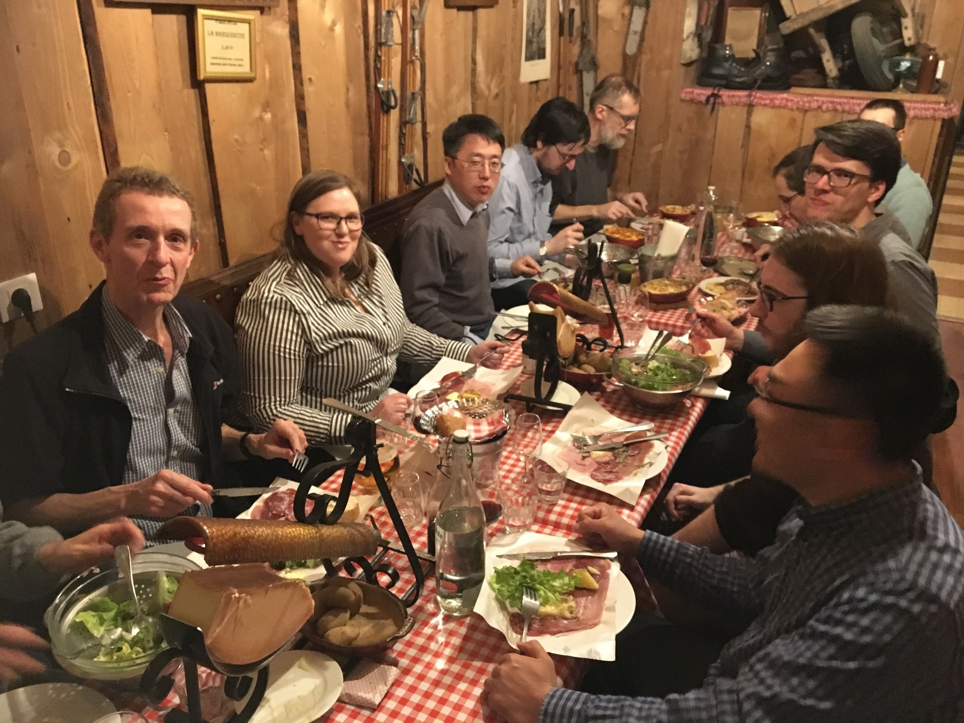
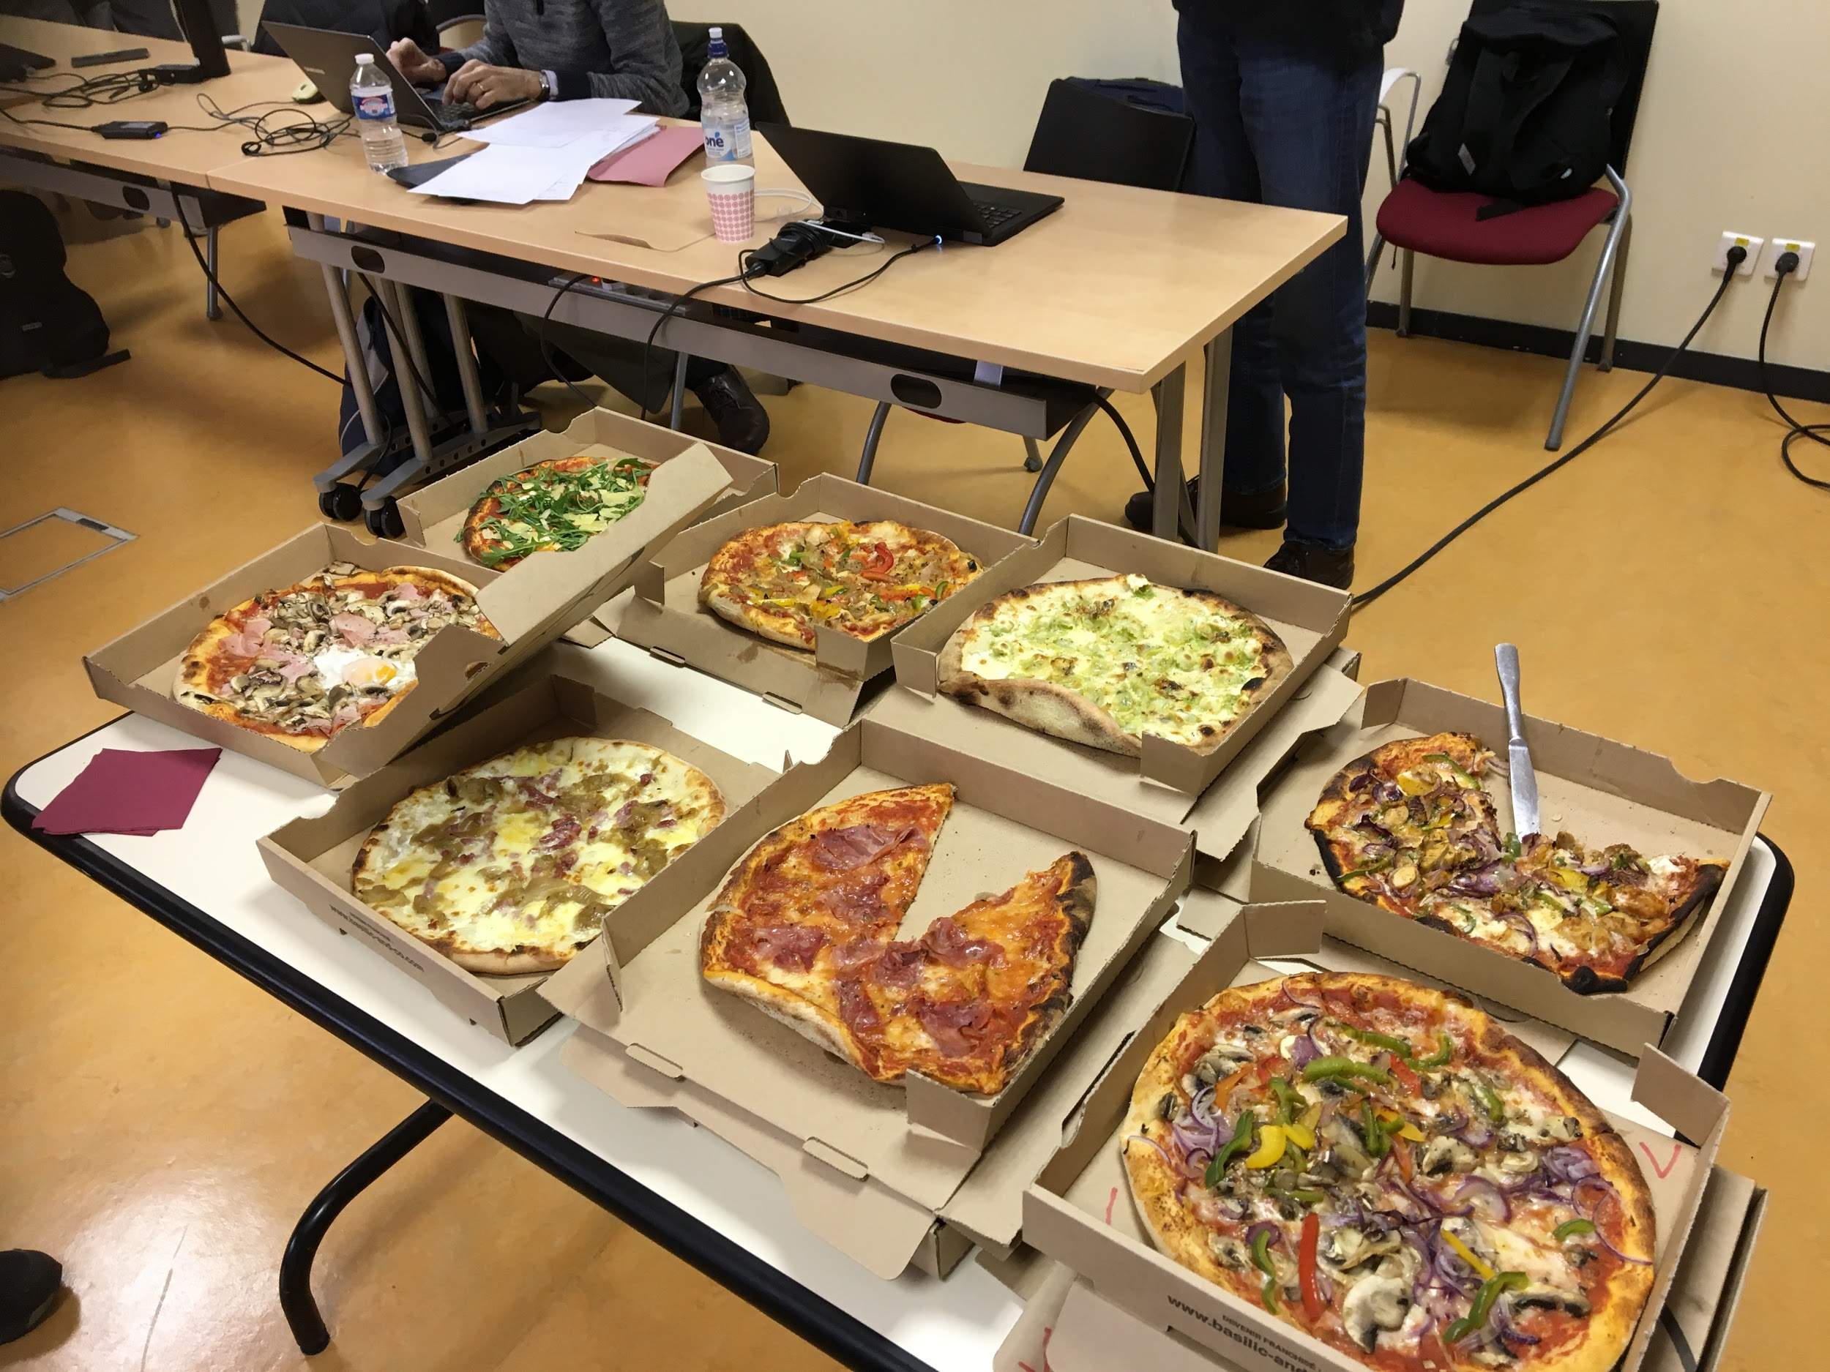
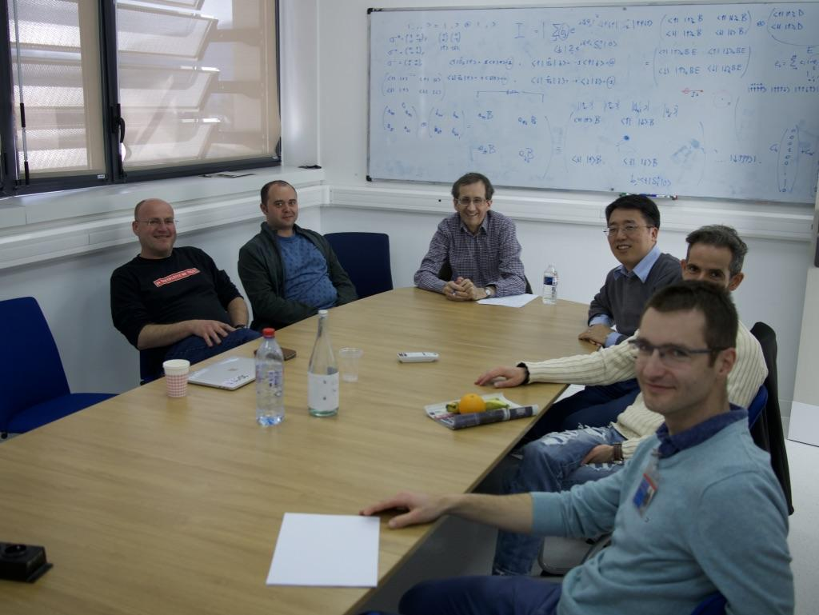
Open, Collaborative, Community Development
Fortnightly Zoom calls
Recurring `camps` and `hackathons`
Mailing lists (developers, help, etc.)
Slack
Small Leadership Team*
Lessons Learned
Steep learning curve - Orientation Required
Actual Collaboration - Response to 'I want this in your software.' Is often 'Great, how can we work together to achieve that goal?'
Abilities vary - Sustained Contributions from ‘Experts’

Slide 11
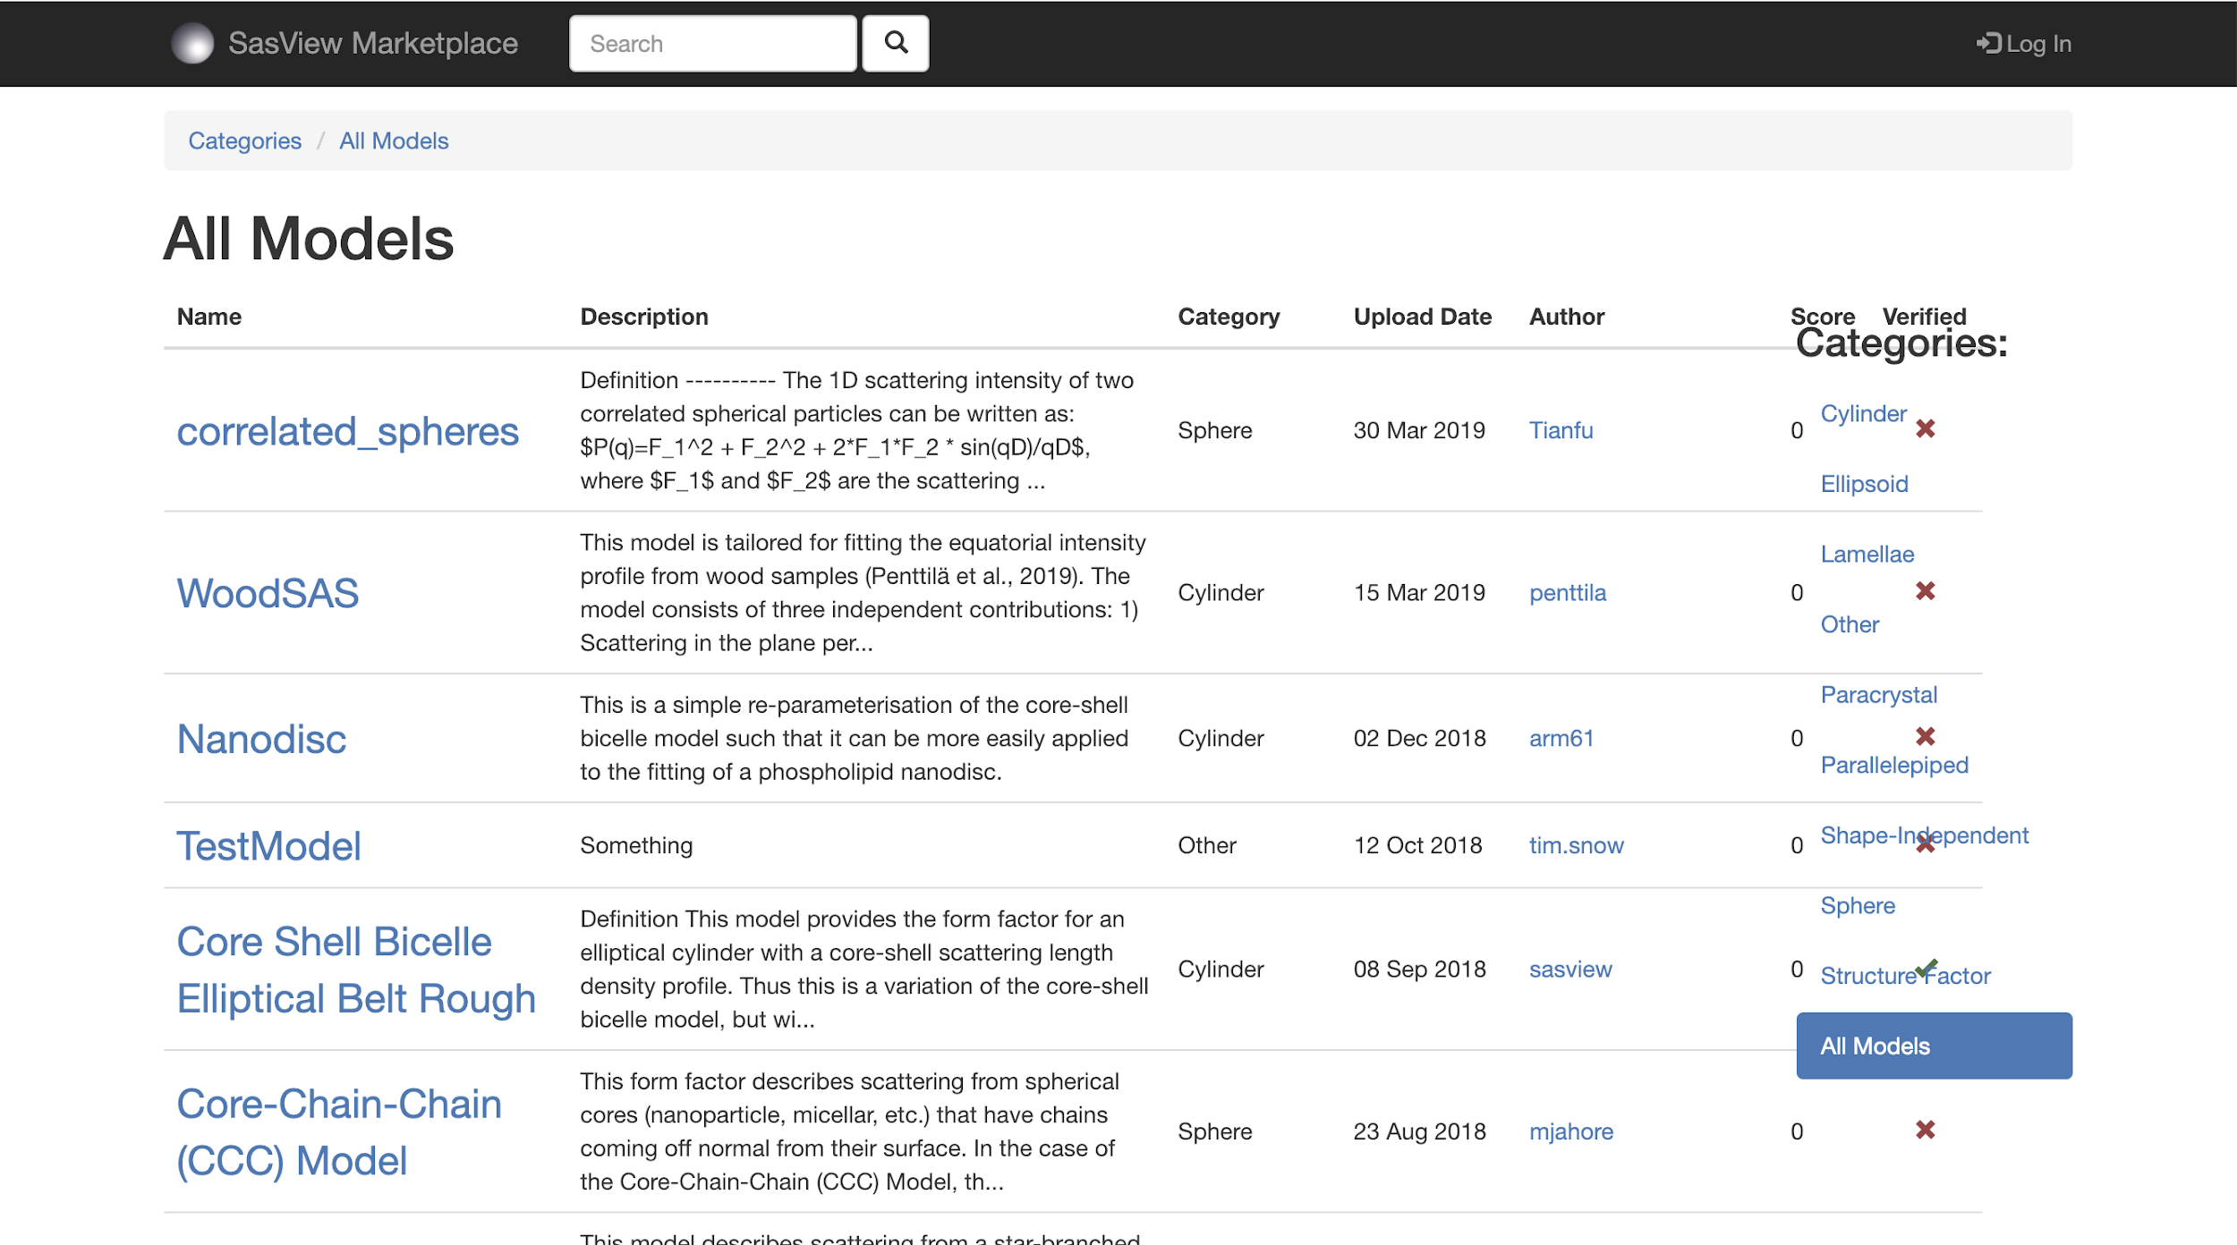
Open, Collaborative, Community Development
Model Marketplace for Users to share their models
Everyone Welcome
Work is done on an as-able basis
Two basic ‘Rules’
Pay the piper, choose the tune
Do not break existing experiences
Lessons Learned
Social Media Presence
Streamline Ways To Contribute

Slide 12










SasView Contributors

Slide 13
How to contribute
Obvious:
Fix Bugs
Add Features
Not so obvious:
Check our math
Check our documentation
Write documentation and tutorials
Video tutorials
Web pages
Review functionality
Host a student
https://github.com/SasView/sasview/wiki/Contributor_NonCodeNeeds

Slide 14
Code Camps
Active and new developers come together
Host decided on a rolling basis or need
Specific need – we can come to you
Length
3-4 days too short
8+ days too long
Sweet spot: ~5-7 days (Tu – M, Sa rest)
Frequency
Twice per year too often
Every other year too little
Goals
Developers come together to work!
Establish ongoing collaboration

Slide 15
Contributor Camp
In Person
Hosted at a new facility/university/etc.
Direct invitees
Length
7 days
Frequency – as needed
Goals
Orient new contributors to SasView
Immediate contribution and feedback to new members
Only hosted one so far… but working on scheduling one for ORNL!

Slide 16
Hackathons
100% Virtual (COVID…)
Short, focused, asynchronous efforts
Established meeting time(s)
Length
1-3 days
Frequency
As often as necessary (short notice)
Goals
Release
PR clean out
New features

Slide 17
Ongoing Projects
Generic Scattering Calculator – Calculation Efficiency*, Magnetic structures, analytical model generation** (all in 6.0.0)
MuMag – Unpolarized Magnetic Scattering Analysis Tool (PR)*
Pore Size Distribution Analysis – Beyond well-defined dispersity functions*
Plotting Refactor – Plot consolidation** and plotting across 'meta' data
Sasdata Refactor – Create a better data contract and intelligently use meta data**
Magnetic Scattering – P(r) upgrades (PR)**, more magnetic modelling, plus more
Web API for remote fitting**
* Contributor Camp
** Student Project

