Slide 1
Can we work together on data analysis?
Wojciech (Wojtek) Potrzebowski
European Spallation Source ERIC

Slide 2

SasView as an example for collaborative data analysis software development
SasView open, collaborative, community development platform for SAS data analysis
SasView originates from NSF funded project DANSE (2006)
Turned into Community project in 2013
Supported by 9 facilities, 40 contributors (~15 active at any one time)
Management team P. Butler (NIST), M. Doucet (ORNL), A. Jackson (ESS), S. King (ISIS)
Biweekly calls
Regular code camps
External funding e.g. SINE2020

Slide 3
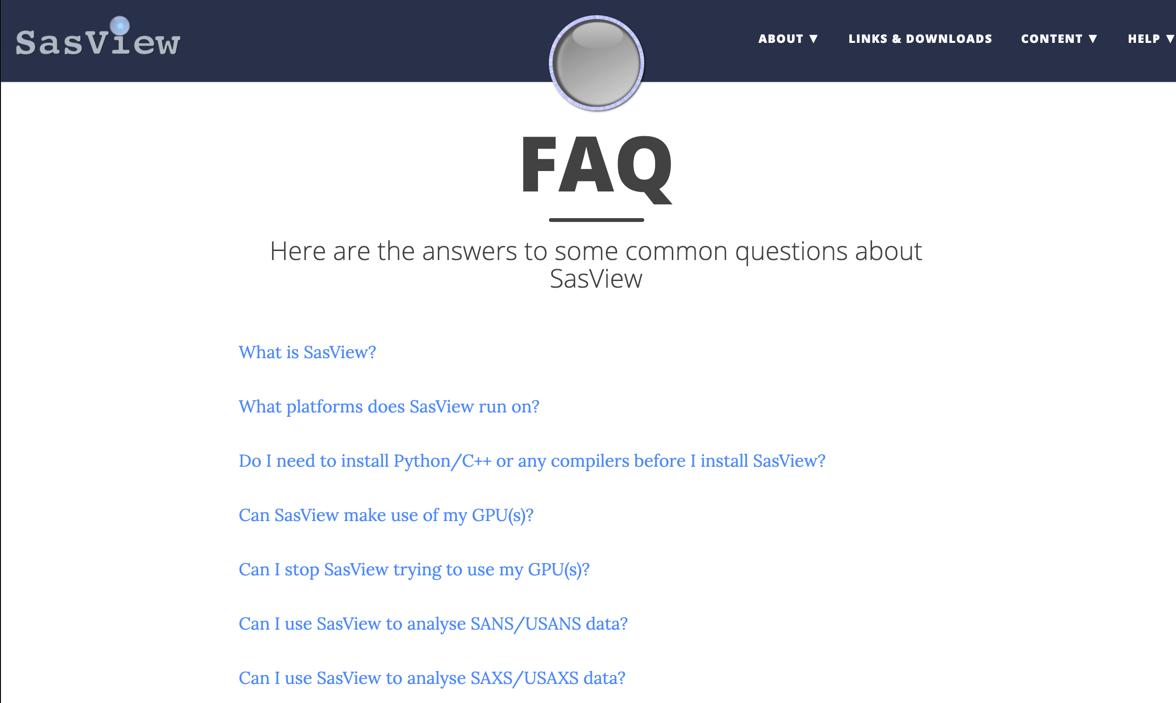
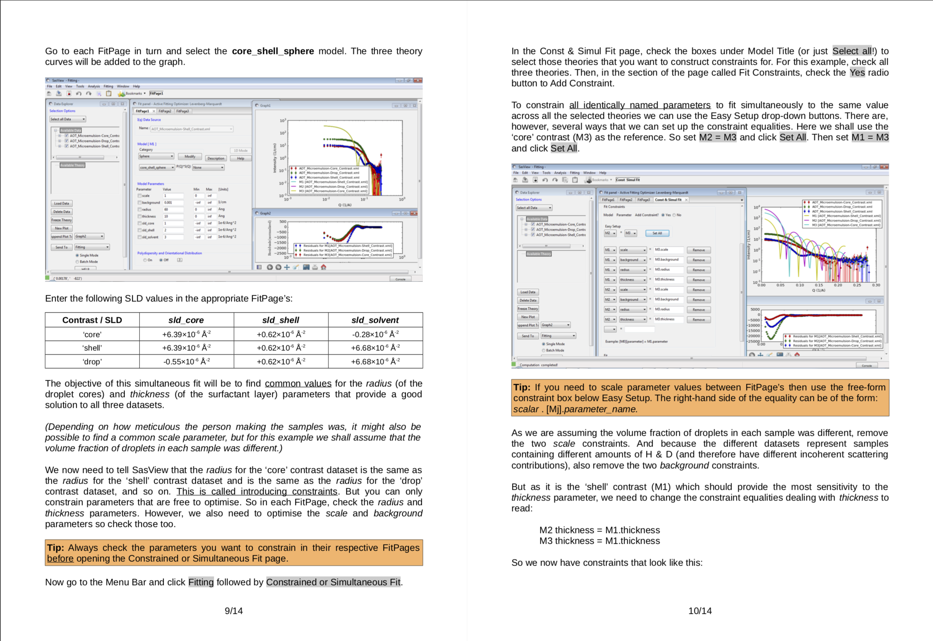
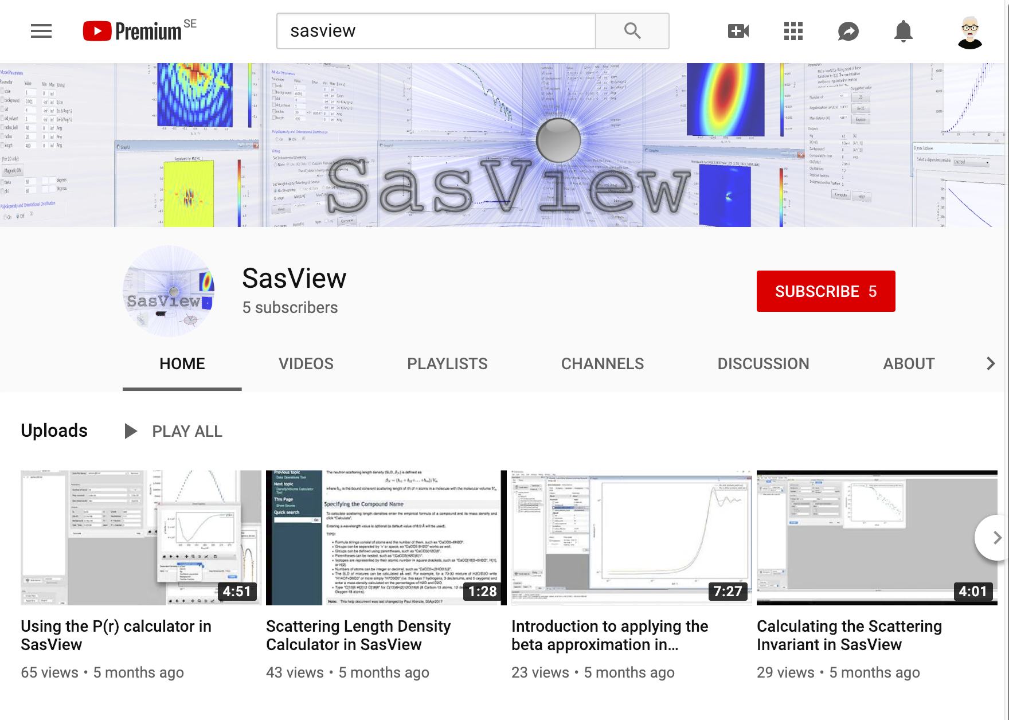
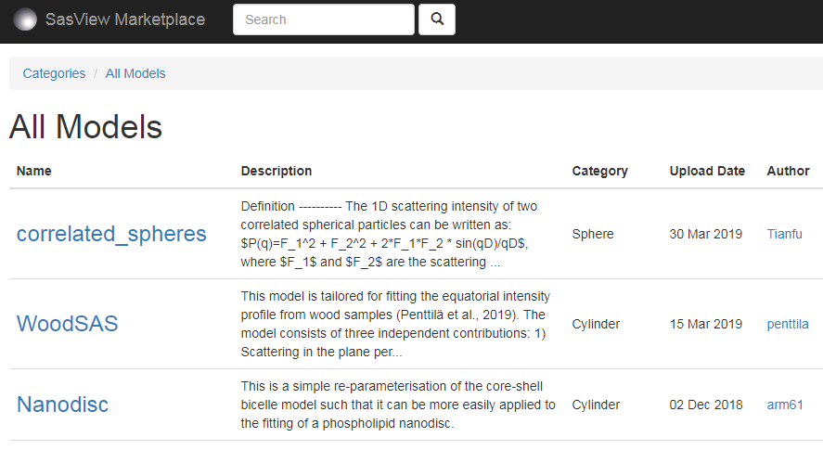
SasView resources, education and outreach
Website
Documentation
Written Tutorials
Video Tutorials (YouTube)
Taught courses
Scattering schools
University courses
E-learning
Twitter
Slack
Mailing Lists
Bootcamps & Regional Workshops
(Marketplace)

Slide 4
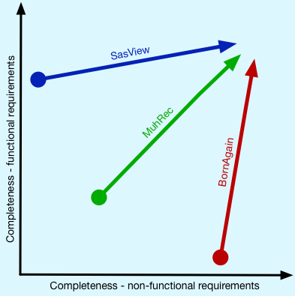
Lessons learned from SasView
SasView has engaged user community that always asks for more – which is good!
But not everything can be done with limited resources
Therefore right model for engaging community is critical
The balance between functional and non-functional requirements (e.g. code quality) is critical
Non-functional requirements are not scientifically exciting but are important. One either needs a lot of resources or better start from the right place

Slide 5
Discussion topic 1
Do we need SasView like platform for reflectometry software?
How do we engage user community?
What can we share between software packages e.g. model library?
How can we start? Is there a proper funding model?

Slide 6
Standards and Guidelines in SINE2020
SINE2020 is EU founded project including work package on data treatment (WP 10)
Guidelines were derived initially from a questionnaire to the neutron community
Based on five different neutron/muon data analysis software tools: BornAgain, Mantid, McStas, Muhrec, SasView
Addresses standards and guidelines in four areas:
Planned to continue/update standard and guidelines and have annual meetings
Setup and support
Architecture
Development
Quality

Slide 7
Software setup, communication and support
As a project grows the advice is to apply a governance model.
Use an Open Source license, such as GPL.
Provide user support, as a minimum through email support.
Provide version controlled user documentation.
Have regular releases, and aim for a minimum of once a year.
With every new release, as a minimum, email out release notes to user mailing-list.
Support multiple operation systems.

Slide 8
Software architecture
Design software to be modular and to support plug-ins
Where software needs to support scripting, the preference is for Python scripting
Where the software uses a GUI, the advice is to use a recent version of Qt
Design software to be able to accommodate different data formats.
Support NeXus/HDF5 data formats.

Slide 9
Software development
Use the programming languages C++ and/or Python.
Factor into your project plan that you will be doing maintenance work on your code (~10-30%).
Using a development methodology is advised, such as an agile methodology.
Use Git for version control.
Use a build tool, such as CMake.
Use tool that makes user installation easy
Use an issue/ticketing system, such as Github.
Provide version controlled developer documentation.

Slide 10
Software quality
Use a tool for continuous integration and automated testing, such as Jenkins.
For software with a large user base, it is advised to have a user testing period prior to releases.
Do code reviews, using a tool such as GitHub.
Use static and/or dynamic analysis tools at least occasionally.
It is advised to follow a coding standard.
More at https://epubs.stfc.ac.uk/work/43005596 (Credits Anders Markvardsen)

Slide 11
Discussion topic 2
Would it be useful to have similar guidelines for reflectometry software?
What is missing or unnecessary?
Should we also standardize on input for user requirements i.e. as a part of communication and support? If yes, how can achieve it e.g. github issues?
Should we align with Standard and Guidelines annual meeting e.g. invite a representative to SXNS meeting in Lund (June 2020)?

