Slide 1
ESS view on SasView
Small Angle Scattering data analysis within the SINE2020
Wojtek Potrzebowski
Data Analysis and Modelling group
Data Management and Software Center
European Spallation Source, ERIC
www.europeanspallationsource.se
14 October 2016

Slide 2

Data analysis that makes user happy
Streaming
Reduction
Analysis
Experiment
Results
Data analysis software requirements:
Exploits underlying science
Easily extendable with new ideas
Robust and easy interface
Up-to-date documentation
Sufficiently fast
Maintainable
Sustainable

Slide 3
Outline
SasView - Small Angle Scattering analysis software
SasView development workflow
Key features of the latest release
SasView within SINE2020 project

Slide 4
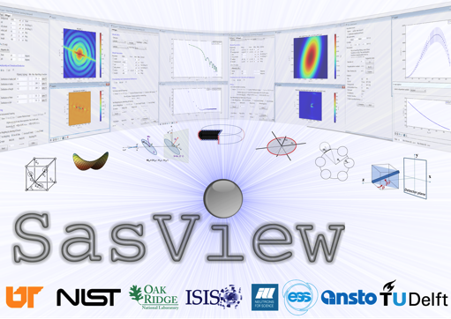
SasView - Small Angle Scattering Analysis Software Package
Operates on reduced scattering data
Performs modeling in inverse space
Data analysis toolbox:
Fitting models to data
P(r) inversion
Model-independent analysis
Other useful tools

Slide 5
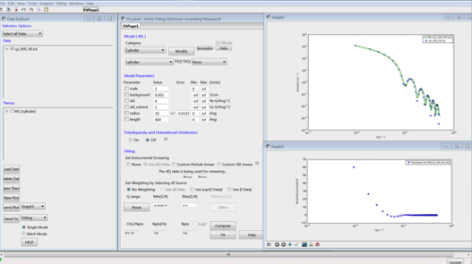
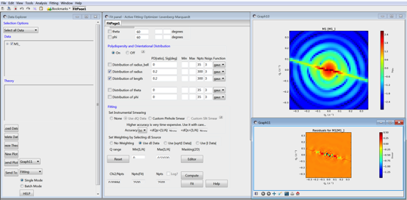
SasView - Fitting
Handles 1D and 2D data
Form and structure factors for various particle shapes
Different optimizers (Bayesian Statistics)
Allows polydispersity
Simultaneous and batch fitting
Plugin models

Slide 6
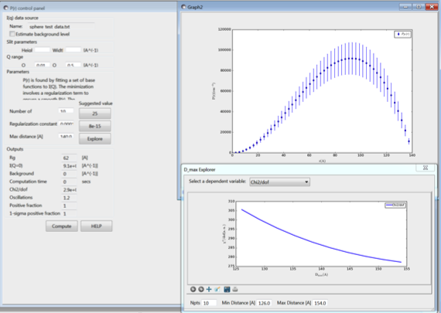
Other useful tools
P(r) inversion
Model independent analysis
SLD calculator
Slit size calculator
Kiessing thickness calculator
Q resolution estimator
Generic scattering calculator
P(r)

Slide 7



SasView History
2006
2012
2014
2016
Community driven project
Releases after code camps
ESS joined the project
SINE2020 two employees at ESS

Slide 8
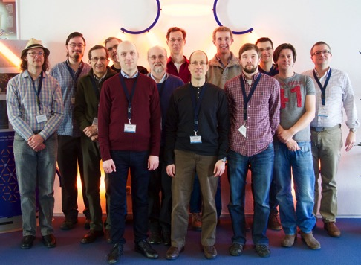
SasView manpower 2016
Management Team:
Paul Butler (NIST)
Mathieu Doucet (ORNL)
Andrew Jackson (ESS)
Steve King (ISIS)
Jurrian Bakker (TUD)
Wim Bouwman (TUD)
Miguel Gonzales (ILL)
Richard Heenan (ISIS)
Dirk Honecker (ILL)
Paul Kienzle (NIST)
Jeff Kryzwon (NIST)
Ricardo Leal (ORNL)
David Mannicke (ANSTO)
Torben Nielsen (ESS)
Lewis O’Driscoll (ISIS)
Steve Parnell (TUD)
Wojciech Potrzebowski (ESS)
Piotr Rozyczko (ESS)
Adam Washington (Sheffield)
and thanks to the many previous contributors, particularly Jae Hie Cho and Alina Gervaise

Slide 9


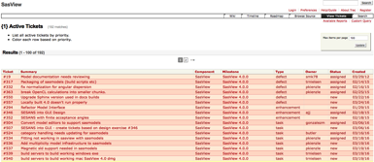
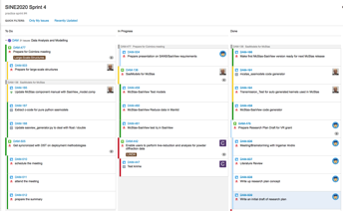
SasView Development Workflow
Code hosted at github
Trac issue tracking system
Build system hosted at ESS -DMSC
Biweekly video conference
Code camp once or twice per year
Web-based and built-in documentation
Tutorial
Mailing lists

Slide 10
SasView Releases
2006
2012
2014
2016
2006
2011
2012
2013
2014
2015
2016
Community driven project
Releases after code camps
SasView 1.0 released
SasView 2.0 released
SasView 3.0 released
SasView 3.1 released
SasView 4.0 just released
ESS joined the project
SINE2020 two employees at ESS

Slide 11

SasView 4.0 is out
SasView "built-in" models have been separated out into an independent package
Easy to add custom user models (including advanced)
Support for OpenCL
All model documentation has been reviewed and updated
Number of minor bugs fixed
Available from:
https://github.com/SasView/sasview/releases/tag/v4.0

Slide 12
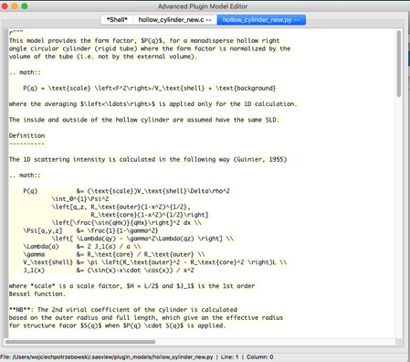
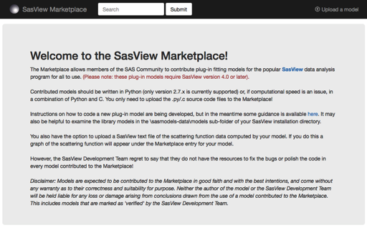
Addition of custom models
Plugin model editor
Python and c files
Syntax and performance testing
SasView Marketplace
http://marketplace.sasview.org/
Credits: Lewis O’Driscoll (ISIS)

Slide 13

SINE2020 goals
Code modularization
New API and CLI
New GUI
Optimization of algorithms for real time analysis
Extension with SASFit models

Slide 14
New API and CLI
SasView “built-in” models moved to an independent package
Separation of the model calculation code from the GUI
Module dependencies considerably reduced
Opens up for use of “built-in” models in pipelines and easy exchange of fitting engines
Before:
SasGUI
SasCalc
SasModels
Prosposed:
SasGUI
SasCore
SasModels
CLI
Web

Slide 15


GUI modernization
Transition from wx-python to PyQt
Platform consistency dialogs look and behave the same across all platforms
Long term maintainability
Ease of development (Qt designer)
Clean separation of UI and code
Native thread support

Slide 16
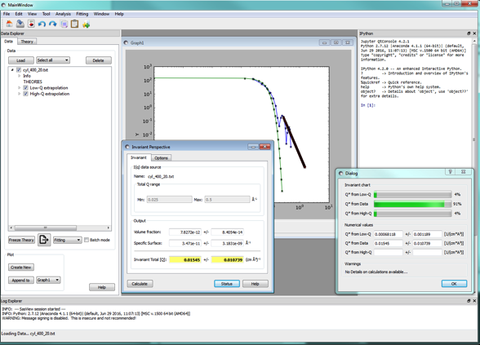
GUI modernization
Working prototype
Plotting
Fitting and P(r) panels
Plugin model editor
PyQt4/Qt4 on Python 2.7
Planned to convert to PyQt5/Qt5 once the code migrated to Python 3
Multithreading with twisted
Credits: Piotr Rozyczko (ESS, DMSC)

Slide 17
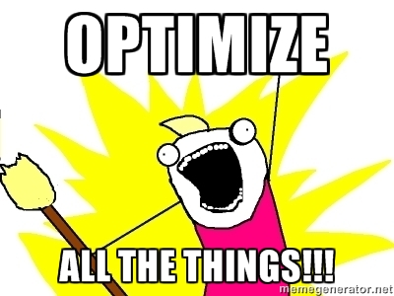
Code optimization
Aim to perform real-time data analysis
Majority of SasView models already ported to GPU
For modern cards single and double precision enabled
Planned support for multiple CPUs/GPUs
Further optimization and testing

Slide 18
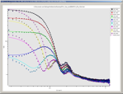

Extending SasView with SasFit models
SasFit
SasFit – a software for analyzing and plotting SAS data developed at PSI
SasFit has a large collection of form and structure factors
Framework for SasFit to SasView models conversion (including testing and comparison)
Models will be uploaded to marketplace
SasFit Models
Conversion Script
SasModels *.c *.py files
Code beautifier
SasView
TEST + COMPARISON
ComparisonWebpage

Slide 19
Conversion script
Extracts code from SasFit models
Reads in model and parameters description
Reads in parameters defaults
Outputs SasView plugin models (*.c and *.py files)
Creates description, parameters table, demo section, etc.
Supplies SasModels functions (Iq, Iqxy, form_volume)
F(q) supplied but not yet fully used by SasView
SasFit Models
Conversion Script
SasModels *.c *.py files
Code beautifier
TEST + COMPARISON
ComparisonWebpage

Slide 20
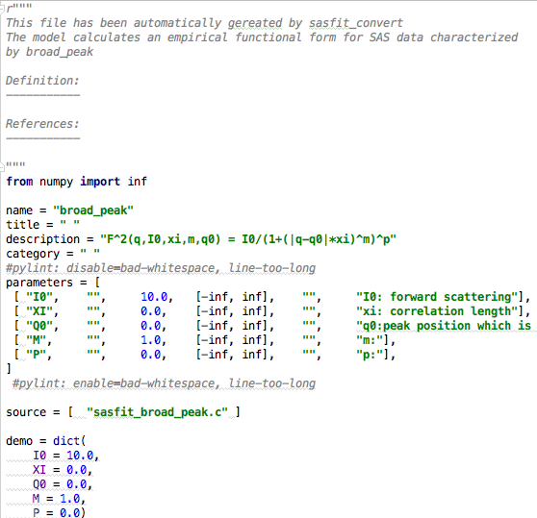
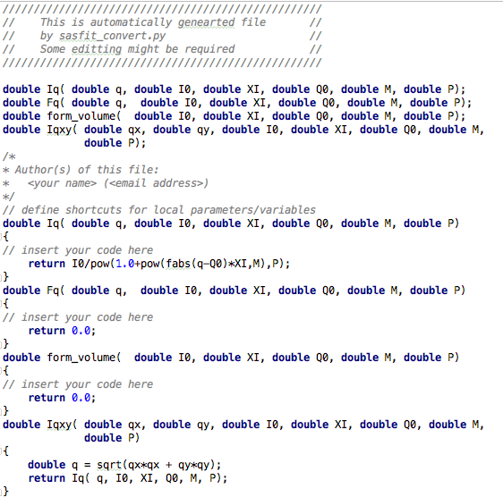
Conversion script
Python file
C file
Documentation needs to be
added manually
Unit tests needs to be
added manually

Slide 21
SasView-SasFit model comaprison
There is a number of overlapping models
Unique models need to be identified
Comparison by name is not sufficient
Requires community effort
SasFit Models
Conversion Script
SasModels *.c *.py files
Code beautifier
TEST + COMPARISON
ComparisonWebpage

Slide 22
Summary
SasView is an open source, collaboratively developed software for the analysis and the modeling of small angle scattering
SasView 4.0 is out!
Sine2020 efforts involve:
Code modularization and optimization
New GUI development
Extension with new models
Our goals:
Easier maintainability
Increased reliability
Better user experience
Real-time data analysis

