Slide 1

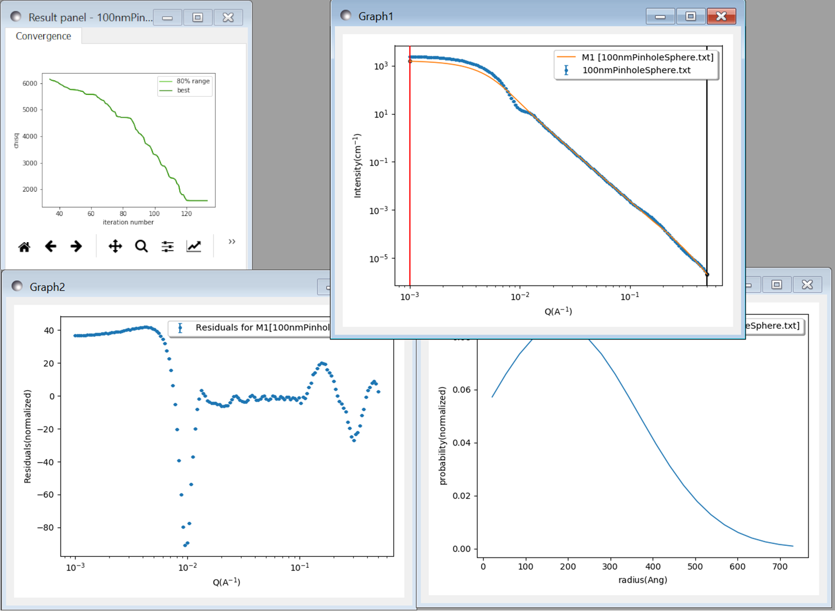
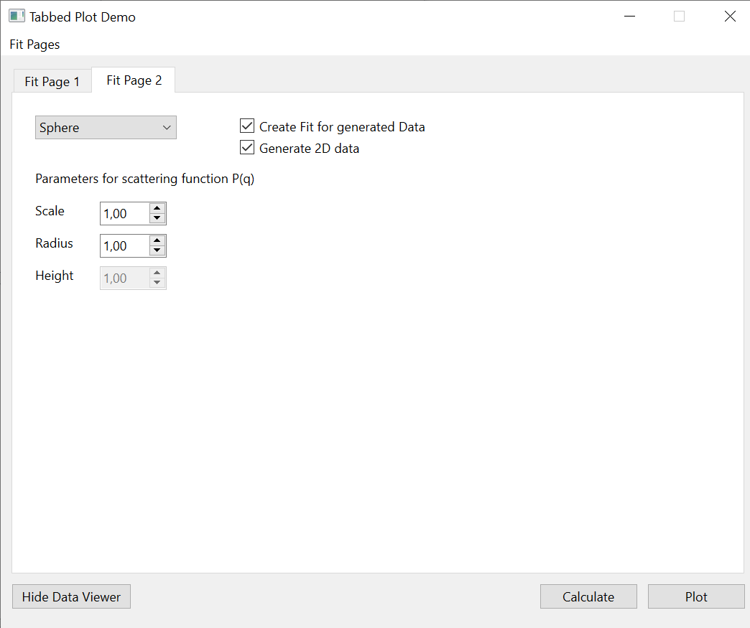
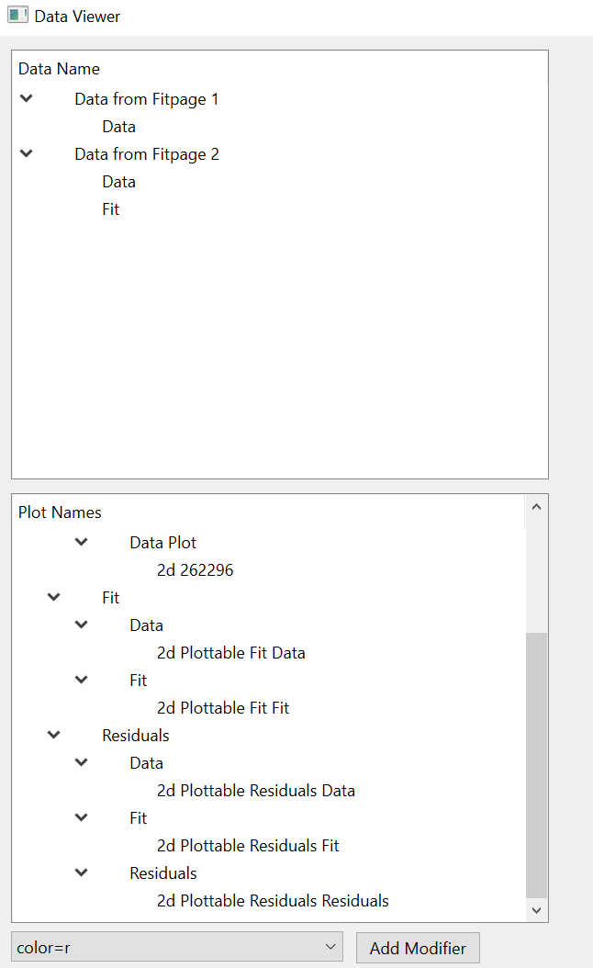
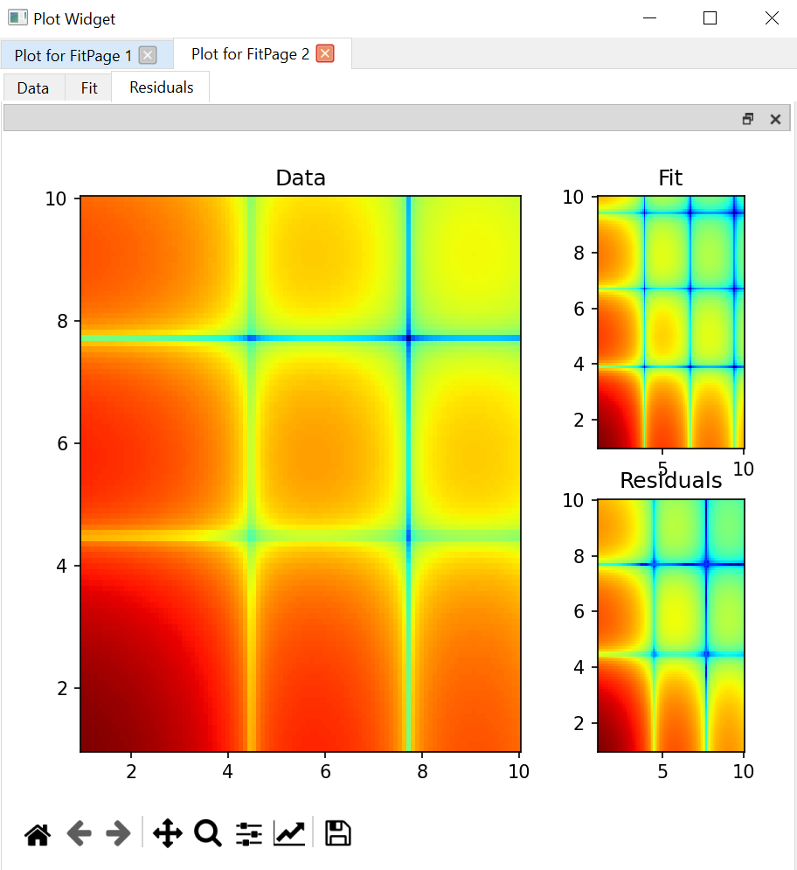
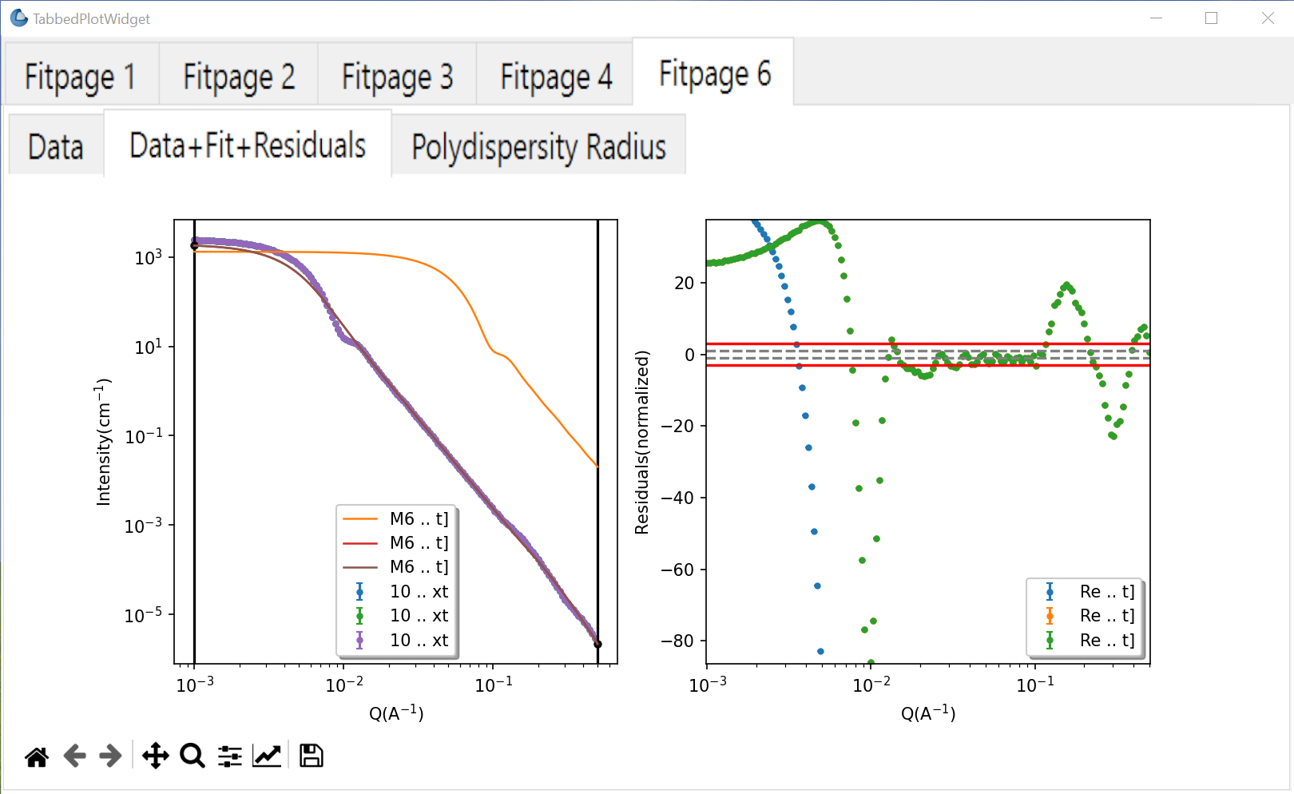
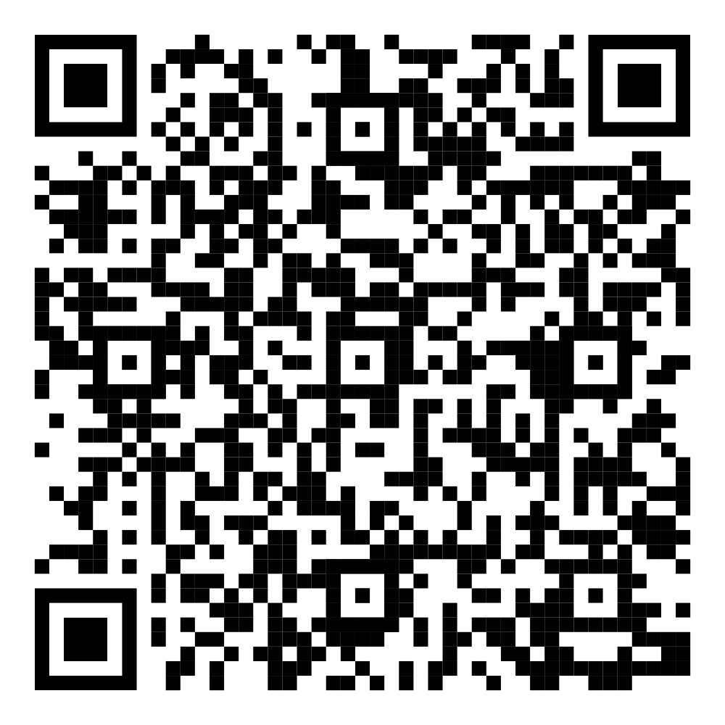
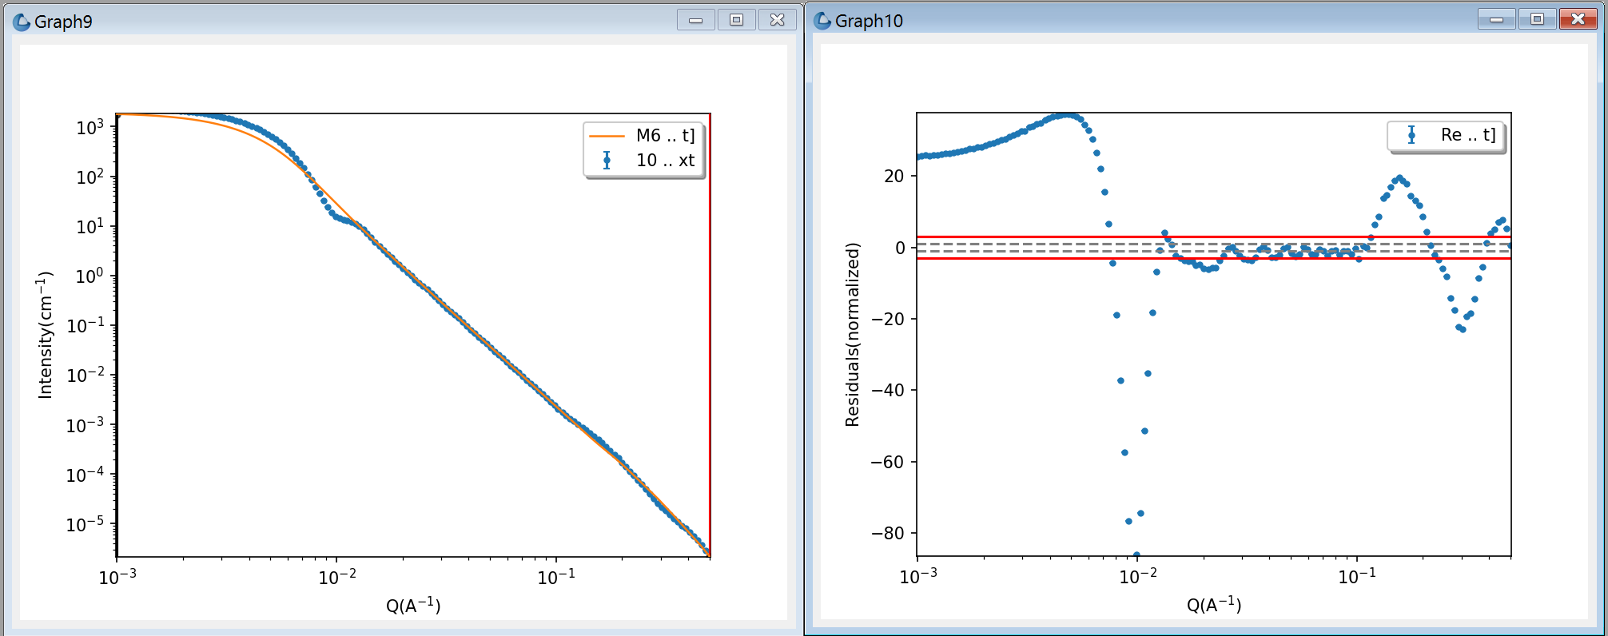











Plotting Refactoring for SasView SAS Analysis Software
Julius Karliczek¹, Jeffery Krzywon², James Crake-Merani³ , Lucas Wilkins³, Stephen King³, Piotr Rozyczko⁴, Miguel Gonzalez¹
¹Institut Laue-Langevin (FR), ²National Institute of Standards and Technology (USA), ³ISIS Neutron and Muon Source (UK), ⁴European Spallation Source ERIC (SE)
Introduction and Goals
The current SasView design approaches the plotting functionality in a very modularized way. Nearly every plot receives its own window.
This provides the possibility of visual comparison of plots from different sources or various simulated curves. Nevertheless, some functionalities in SasView, like batch fitting, can be uncomfortable for the user when using this behavior, since numerous plots will open at the same time upon completion of computation.
The task for this plotting refactoring was finding a way to maintain the current modular aspect of the plotting functionality, while bundling plots from one fitting process together.
Some central questions in the matter of designing this refactoring were:
How can one central window for all plots be realized?
How can this window present a tree-like structure that is similar to the internal bookkeeping of data and simulations?
How can already existing structures in the program be used to realize this new behavior?
Plots from a fitting process with:
1 dimensional dataset
multiple fit parameters
1 fit parameter with polydispersity
Demo project and requirements
To get a better overview of the software requirements for this project, a demo version was designed and regularly reviewed by a broader community of SasView developers.
Main SasView and demo dependencies for this project are:
Python 3.11
Qt for Python (PySide)
Matplotlib
Demo included key features:
Central plot widget representing internal data management structure with two nested tab widgets
Calculation of simulated and noisy data for fitting demonstration purposes
Data visualization with integrated on mouse click function
Docking of the lowest plot widget window
Interactive dataset dragging in the data viewer
Adding plot modifiers e.g. line colors (1d) or color schemes (2d) in data explorer
SasView integration
Integrating functionality from the demo into the existing SasView codebase represents the majority of the work which is left to do.
Rewriting and redesigning parts of the architecture in the data visualization, a big feature in the application, takes a lot of time and thought to produce an acceptable outcome.
Outlook
During 2024, multiple summer interns worked on SasView to improve several features in the software:
Brayden Miller² enhanced the built-in model editor with a more intuitive and efficient user interface
David Okwuchuwu Nwobi³ worked on more accurate integration schemes to ensure reliable data analysis of non-centrosymmetric models.
James Crake-Merani³ worked on a big refactoring project that included data infrastructure and file reading
Integrated features are:
Plotting datasets and their fits in one respective window
Changing plot locations on click
Basic structures that can be enhanced in the future work
Tasks in the future include:
Final migration of demo features
Redesigning more internal infrastructure
Do not forget:
The new version SasView 6.0 is coming out soon!
New features are included and already existing ones have been improved.
If you install the new version, check out the What’s new box to stay tuned.
SasView 6.0.0b2:
This work benefited from the use of the SasView application, originally developed under NSF Award DMR – 0520547. SasView also contains code developed with funding from the EU Horizon 2020 programme under the SINE2020 project Grant No 654000. SasView is a collaborative effort from various large scattering facilities to manage analysis of acquired data. Bringing together methods for scattering techniques, SasView is a powerful tool and undergoes constant improvement while having continuous user support. As of now, scientists and developers from 7 neutron scattering facilities and 1 synchrotron facility are participating in the foregoing project of maintaining SasView as a software. SasView’s codebase management via open source repositories in GitHub lets every user participate by reading code, mentioning current issues and requesting new features.

