Slide 1
SasView Coding Beyond the Models

Slide 2
Large Learning Curve
Massive code base
Sasview 100,000+ lines of python and c
sasmodels, bumps, and other dependencies
Many non source code directories
Multiple protected branches – which one to use?
main branch (v5.x) only recently became the default (2021)
Getting started wiki¹
Developer environment setup
Code Overview
Code guidelines
Side project for most contributors – need to make time for training
Occasional student (temporary and with a focused project)
Others ‘when they can find the time’
[1] https://github.com/SasView/sasview/wiki/DevNotes_DevGuide_GettingStarted

Slide 3
Getting setup
Using Anaconda¹
Install anaconda, git, and MS Visual C++ 14 build tools
Clone sasview and sasmodels from github
Create conda environment and install dependencies from yaml
Sasview/build_tools -> conda env create –f conda_qt5[_min]_<OS>.yml
Optional: Symbolically link sasview and sasmodels repo directories into anaconda environment
Activate conda environment
Conda activate qt5_<OS>
Build and run sasview from base sasview directory
Python setup.py [clean] [docs] [build]
Python run.py – Will run base setup if needed
Optional: src/sas/qtgui/convertUI.py
[1] https://github.com/SasView/sasview/wiki/DevNotes_DevEnviroment

Slide 4
Dependencies
Matplotlib
Plotting utility
Pyqt
Base GUI
Numpy and Scipy
Array and numerical methods
Lxml, Hdf5 and h5py
Load and Save NeXus and XML files
Twisted, cuda, pyopencl & numba
Threading and GPU utilization
Sphinx
Documentation
Tinycc
C compiler
Periodictable
Atomic data

Slide 5
Structure
sasview
/.github/workflows – Github Actions
/build_tools – Conda YAML, Build Scripts
/docs – Documentation and Tutorials
/installers – release generation
/src – Main source directory
/qtgui – GUI elements for v5.0+
/sascalc – Calculation elements
/sasgui – GUI elements before v5.0*
/sasview – Main window loader for pre v5.0 – not used in v5.x
/test – Unit tests for sascalc
sasmodels
/.github/workflows – Github Actions
/.travis – Travis CI
/doc – Documentation
/example – Example Workflows and data
/extra
/sasmodels – Main source directory
kernal(cl|cuda|dll|py).py – kernel model wrappers
Mixture.py – Combine models (A*B + C*D)
resolution(2D).py – resolution calculators
Product.py – P(Q)*S(Q)
Sesans.py – sesans transformations
Weights.py – Dispersion generators (gaussian, log normal, rectangular, etc.)
/models – location of all built-in models

Slide 6
Scriptable portions
Sasmodels
Import sasmodels
Sasmodels.generate <modelname> # Generates DLL model
Sasmodels.compare [options] # Compares models to one another – see documentation for usage
Data Loading
from sas.sascalc.dataloader.loader import Loader
Loader = Loader() # Not a callable class
File = Loader.load(<filePath>) # Returns [dataloader.data_info.Data(1|2)D()]
Fitting
Possible, but more complicated
Generate model, load data, generate bumps fit, generate fit engine, tie all together and run fit()
More to come…
Requires cleaner separation of calculations and GUI
Also requires API for other tools

Slide 7
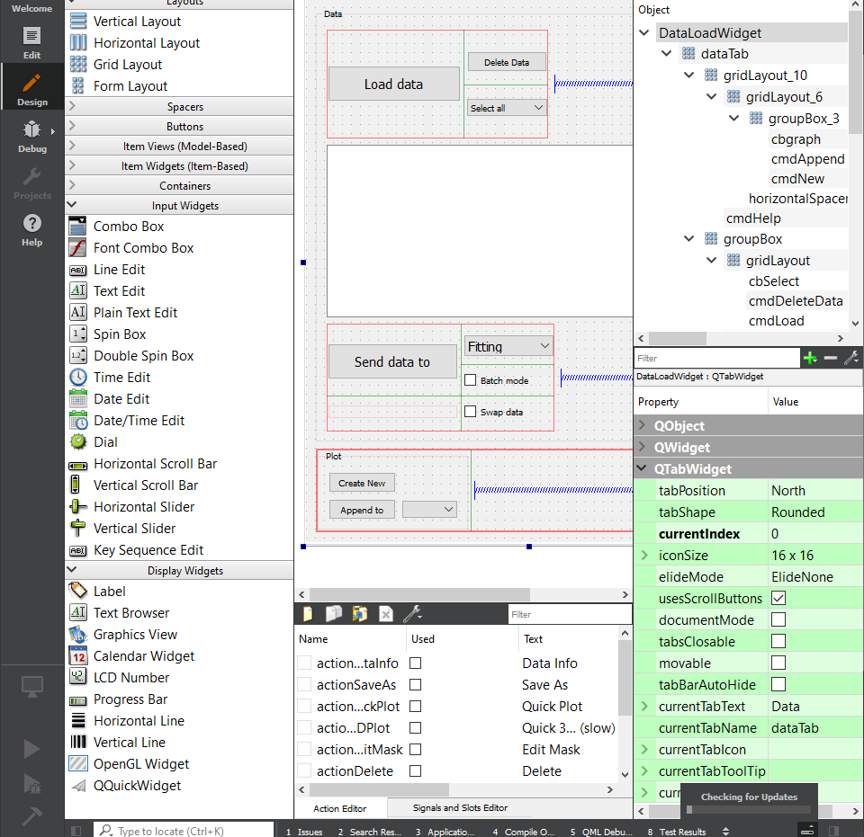
GUI elements
Qt uses an XML format (.UI) to define the layout of each element
Qt Creator (free) can be used to edit and/or create new GUIs, or XML can be edited natively
Housed in qtgui[/subpackage]/UI folders
src/sas/qtgui/convertUI.py generates a python file from the XML, giving each element and interaction a unique python name
.py files in UI directories are included in .gitignore (**/UI/*.py)

Slide 8
Unit testing
Sasview and sasmodels must be in python path!
Tip: Create a symbolic link from repo into python library
Three test locations
Sascalc: Sasview/test
Run_one.py -> python run_one relative/path/to/test/file
Only a single file allowed per run
utest_sasview.py -> python utest_sasview.py
Runs all python files starting with ‘utest’
GUI: Sasview/src/sas/qtgui
GUITests.py -> python GUITests.py [suitename1 suitename2 …]
No suite options provided? Run them all!
Available suites are listed in GUITests.ALL_SUITES
*Not automatically run during build process
Model tests: sasmodels/sasmodels
Model_test.py -> python –m sasmodels.model_test [opencl|cuda|dll|all] model1 [model2 …]
‘all’ instead of model1 […] will test all models

Slide 9
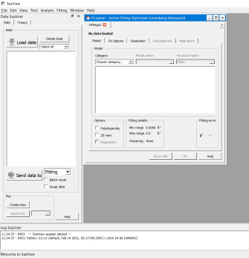
Entry Points: Main Window
No. | qtgui | sascalc | Description
1 | Qtgui.MainWindow.MainWindow.py Qtgui.MainWindow.GuiManager.py | - | Main SasView Window
2 | Qtgui.Utilities.SasviewLogging.py Qtgui.GuiManager -> listWidget | Src.logger_config.py Src.logging.ini | Console log
3 | qtgui.MainWindow.DataExplorer.py Qtgui.MainWindow.DataManager.py Qtgui.MainWindow.DoppableDtaLoadWidget.py | Sascalc.dataloader Sascalc.dataloader.readers | Data explorer
4 | Qtgui.perspectives.Fitting Qtgui.Perspectives.Corfunc Qtgui.Perspectives.Invariant Qtgui.Perspectives.Inversion | Sascalc.fit Sascalc.corfunc Sascalc.invariant Sascalc.pr | Perspectives (default: Fitting)
5 | Qtgui.MainWindow.UI.MainWindowUI.py Perspectives: Qtgui.Mainwindow.GuiManager.py | - | Drop down menu bar
5
3
4
1
2

Slide 10
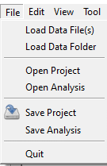
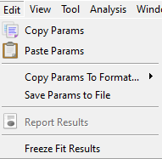
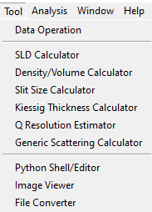
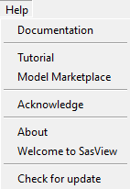
Entry Points: Main Menu Options
No. | Menu Option | qtgui | sascalc | Description
File | Load Data File(s) Load Data Folder(s) Open Project Open Analysis Save Project Save Analysis Quit | MainWindow.DataExplorer.loadFile() MainWindow.DataExplorer.loadFolder() MainWindow.GuiManager.actionOpen_Project() MainWindow.GuiManager.actionOpen_Analysis() MainWindow.GuiManager.actionSave_Project() MainWindow.GuiManager.actionSave_Analysis() MainWindow.GuiManager.actionQuit() | dataloader.loader.load() dataloader.loader.load() - - - - - | Load a list of data files Load all data within a specific folder Open a saved project Open a saved analysis Save the existing project Save the existing analysis Close the program
Edit | Copy Params Paste Params Copy Params To Format… Save Params To File Report Results Freeze Fit Results | GuiManager. actionCopy() GuiManager.actionPaste() GuiManager.actionExcel() -or- actionLatex() GuiManager.actionSaveParamsAs() GuiManager.actionReport() GuiManager. actionFreeze_Theory() | - - - - - - | Copy the fit parameters from a fit page Paste copied parameters into the fit page Copy parameters to Excel or Latex format Export parameters to file Create fit report Freeze a theory to view later
Tool | Data Operation SLD Density/Volume Slit Size Kiessig Thickness Q Resolution Generic Scattering Python Shell/Editor Image Viewer File Converter | Calculators.DataOperationUtilityPanel Calculators.SldPanel DataOperations.DensityPanel DataOperations.SlitSizePanel DataOperations.KiessigPanel Calculators.ResolutionCalculatorPanel Calculators.GenericScatteringPanel Utilities.IPythonWidget Utilities.ImageViewer Utilities.FileConverter | - Periodictable.xsf/nsf Periodictable calculator.slit_length_calculator calculator.kiessig_calculator calculator.resolution_calculator calculator.sas_gen - dataloader.manipulations file_converter. FileConverterUtilities | Add/sub/multi/div two data sets SLD Calculator Density/Volume Calculator Slit Length Calculator Kiessig Thickness Calculator Resolution Calculator Real Space Calculator Python Editor Window Convert images into Arb Int Data Convert non-standard files
Help | Documentation Tutorial Model Marketplace Acknowledge About Welcome to SasView Check for update | GuiManager.actionDocumentation() GuiManager.actionTutorial() GuiManager.actionMarketplace() GuiManager.actionAcknowledge() GuiManager.actionAbout() GuiManager. actionWelcome() GuiManager.actionCheck_for_update() | - - - - - - - | Open a browser with documentation Open the latest toturial Open a browser to the Model Marketplace How to Acknowledge SasView About Sasview (ver, contributors, etc.) Splash screen Check your version against the latest version

Slide 11
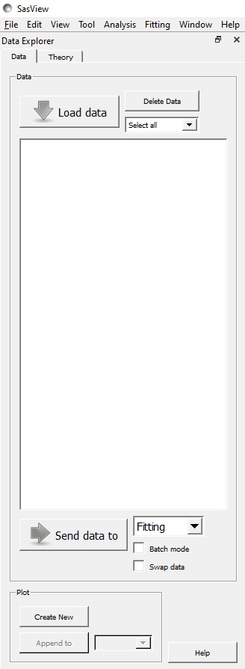
Entry Points: Data Explorer
Qtgui/MainWindow/DataExplorer
1
3
No. | qtgui | sascalc | Description
1 | Variables: DataExplorer.treeView & DataExplorer.freezeView currentChanged: MainWindow.DataExplorer.changeTabs() | - | Data and Theory Tabs
2 | Variable: DataExplorer.cmdLoad Clicked: MainWindow.DataExplorer.loadFile() (Menu Option): MainWindow.DataExplorer.loadFolder() | dataloader.loader.load() Dataloader.file_reader_base_class.read() | Open a file browser and load selected files
3 | Variable: DataExplorer.cmdDeleteData Clicked: MainWindow.DataExplorer.deleteFile() -> [<Perspective>.removeData()] | - | Delete data that are checked and remove data from all perspectives
4 | Variable: DataExplorer.cbSelect Activated: MainWindow.DataExplorer.selectData() | - | Check or uncheck highlighted data sets
5 | Variable: DataExplorer.model itemChanged: MainWindow.DataExplorer.onFileListChanged() | - | List of data
6 | Variable: DataExplorer.cmdSendTo Clicked: MainWindow.DataExplorer.sendData() | - | Send selected data set(s) to the perspective selected in [7]
7 | Variable: DataExplorer.cbFitting Clicked: MainWindow.DataExplorer.updatePerspectiveCombo() -> MainWindow.GuiManager.perspectiveChanged() | - | Changes the active perspective
8 | Variable: DataExplorer.cmdNew Clicked: MainWindow.DataExplorer.newPlot() | - | Create new plots for the selected data
9 | Variable: DataExplorer.cmdAppend Clicked: MainWindow.DataExplorer.appendPlot() | - | Append selected data to existing plot
10 | Variable: DataExplorer.cmdHelp Clicked: MainWindow.DataExplorer.displayHelp() | - | Open data help window
2
4
5
6
7
8
9
10

Slide 12
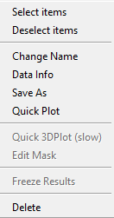
Entry Points: Data Context Menu
Qtgui/MainWindow/DataExplorer
Sascalc/dataloader
 | qtgui | sascalc | Description
Select items | onFileListSelected() | - | Check the boxes of the highlighted data (Ctrl/Shift/Cmd)
Deselect items | onFileListDeselected() | - | Uncheck the boxes of the highlighted data sets (Ctrl/Shift/Cmd)
Change Name | changeName() -> nameChangeBox.show() | - | Open a dialogue to change the display name of the data set
Data Info | showDataInfo() -> txt_widget.show() | Data_info.Data1D.__str__() Data_info.Data2D.__str__() | Show the extended data info including meta data
Save As | saveDataAs() | Loader.save() | Save the selected data set as multi-column text, CVS, canSAS XMl, NXcanSAS
Quick Plot | quickDataPlot() | - | Create a quick plot of the data
Quick 3D Plot | quickData3DPlot() | - | Create a one-off heat-map style plot from a 2D data set
Edit Mask | showEditDataMask() | - | Mask selected data points for 2D data
Freeze Results | freezeSelectedItems() | - | Freeze the theory and send it to the theory tab
Delete | deleteSelectedItem() | - | Delete the data set and remove it from all perspectives

Slide 13
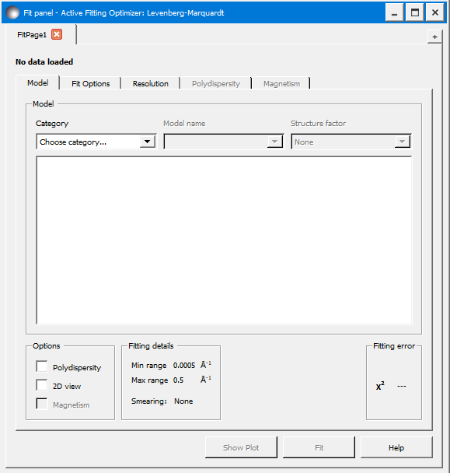
Entry Points: Fitting Perspective
src/sas/qtgui/Perspectives/Fitting
Src/sas/sascalc/fit
sasmodels
No. | qtgui | sascalc | Description
1 | FittingPerspective.__init__() | - | Fit perspective – generated on SasView open
2 | FittingWidget.__init__() & FittingLogic.__init__() | - | Fit tab – generate on loading SasView or when new data sent to fitting perspective
3 | OptionsWidget.__init__() -> FittingOptions.__init__() | - | Fitting Options – generated with new fit tab
4 | Variable: FittingWidget.cbCategory CurrentIndexChanged: FittingWidget. onSelectCategory() | - | Category selector combo box
5 | Variable: FittingWidget.cbModel CurrentIndexChanged: FittingWidget.onSelectModel() | Sasmodels.generate. load_kernel_module() | Model selector combo box
6 | Variable: FittingWidget. cbStructureFactor CurrentIndexChanged: FittingWidget. onSelectStructureFactor() | Sasmodels.product.make_product_info() | Structure factor combo box
7 | Variable: FittingWidget._model_model dataChanged: FittingWidget.onMainParamsChange() -> ViewDelegate.ModelViewDelegate.__init__() | Sasmodels.modelinfo.make_model_info() | Model parameter list
8 | Variable: FittingWidget.cmdPlot Clicked: FittingWidget.onPlot -> plotRequestedSignal | - | Plot button
9 | Variable: FittingWidget.cmdFit Clicked: FittingWidget.onFit -> FitThread -> (batch)FittingCompleted | Sascalc.fit.BumpsFitting.BumpsFit().fit() | Fit button
10 | Variable: FittingWidget.cmdHelp Clicked: FittingWidget.onHelp() | - | Help button
1
2
3
4
5
6
7
8
9
10

Slide 14
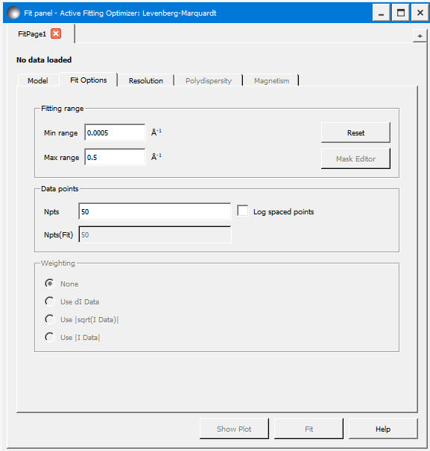
Entry Points: Fitting Options
src/sas/qtgui/Perspectives/Fitting
No. | qtgui | Description
1 | OptionsWidget.__init__() | Options Widget – generated on SasView open
2 | Variable: OptionsWidget.txtMinRange dataChanged: OptionsWidget.onModelChange() | Minimum Q for fit – updates when any options widget model item changes
3 | Variable: OptionsWidget.txtMaxRange dataChanged: OptionsWidget.onModelChange() | Maximum Q for fit – updates when any options widget model item changes
4 | Variable: OptionsWidget.cmdReset Clicked: OptionsWidget.onRangeReset() | Resets the Q range to the original range
5 | Variable: OptionsWidget.cmdMaskEdit Clicked: OptionsWidget.onMaskEdit() | Opens a mask editor window to allow masking of data points – 2D only
6 | Variable: OptionsWidget.txtNpts dataChanged: OptionsWidget.onModelChange() | Number of points selected – updates when any options widget model item changes
7 | Variable: OptionsWidget.txtNptsFit dataChanged: OptionsWidget.onModelChange() | Number of points used for the fit – updates when any options widget model item changes
8 | Variable: OptionsWidget.weightingGroup ButtonClicked: OptionsWidget.onWeightingChoice() | Intensity error weighting – dI becomes available if present in data, others when data is sent to fitting
9 | Variable: FittingWidget.smearing_widget smearingChangedSignal: FittingWidget.onSmearingOptionsUpdate() | Resolution Tab Only option: Instrumental Smearing
10 | Variable: FittingWidget.poly_params -> ViewDelegate.PolyViewDelegate.__init__() | Polydispersity Tab Disabled until Polydispersity box checked on Model tab
11 | Variable: FittingWidget.lstMagnetic -> ViewDelegate.MagnetismViewDelegate.__init__() | Magnetism Tab – only for 2D data sets Disabled until Magnetism box checked on Model tab
1
9
10
11
2
4
3
5
6
7
8

Slide 15
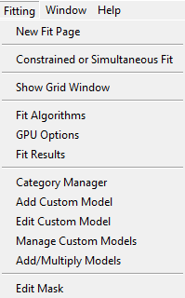
Entry Points: Fitting Menu
src/sas/qtgui/
NB: This menu is only available when the Fitting perspective is active
No. | qtgui | Description
New Fit Page | GuiManager.actionNew_Fit_Page() -> FittingPerspective.addFit() | Add a fit page to the fitting perspective
Constrained or Simultaneous Fit | GuiManager. actionConstrained_Fit() -> FittingPerspective.addConstraintTab() | Create a Constrained/Simultaneous fit page
Show Grid Window | GuiManager.actionCombine_Batch_Fit() | Open the Batch Fit results window
Fit Algorithms | GuiManager.actionFit_Options() -> FittingPerspective.fit_options_widget.show() | Open the Fit optimizer selection panel
GPU Options | GuiManager.actionGPU_Options() -> FittingPerspective.gpu_options_widget.show() | Open the GPU/CPU options panel
Fit Results | GuiManager.actionFit_Results() -> GuiManager.showFitResults() -> GuiManager.results_frame.setVisible(True) | Displays the fit results panel (DREAM optimizer only)
Category Manager | GuiManager.actionCategory_Manager() -> GuiManager.categoryManagerWidget.show() | Open the Model Category Manager CategoryManager()
Add Custom Model | GuiManager.actionAdd_Custom_Model() -> GuiManager.model_editor.show() | Open the model creation window Model_editor = TabbedModelEditor()
Edit Custom Model | GuiManager.actionEdit_Custom_Model() -> GuiManager.model_editor.show() | Open the custom model editor window Model_editor = TabbedModelEditor(edit_only=True)
Manage Custom Models | GuiManager.actionManage_Custom_Models() -> GuiManager.model_manager.show() | Open a list of custom models Model_manager = PluginManager
Add/Multiply Models | GuiManager.actionAddMult_Models() -> GuiManager.add_mult_editor.show() | Open the sum/multiply model window add_mult_editor = AddMultEditor()
Edit Mask | GuiManager.actionEditMask() -> extMaskEditorSignal.emit() | Open the 2D mask editor window

Slide 16
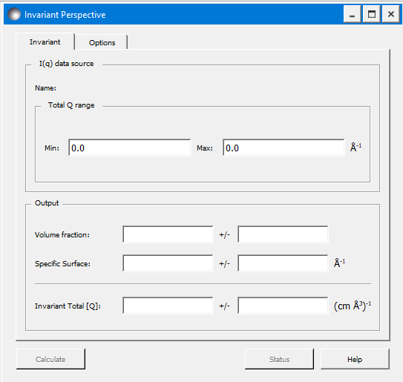
Entry Points: Invariant Perspective
src/sas/qtgui/Perspectives/Invariant
src/sas/sascalc/invariant/invariant.py
No. | qtgui | sascalc | Description
1 | InvariantPerspective.__init__() | Variable: Invariant._calculator -> invariant.InvariantCalculator() | Invariant Perspective Tabs– generated on SasView open
2 & 3 | Variable: txtTotalQMin Variable: txtTotalQMax | - | Minimum and Maximum Q From loaded data
4 & 5 | Variable: txtVolFract Variable: txtVolFractErr | get_volume_fraction() | Calculated Volume Fraction and Error
6 & 7 | Variable: txtSpecSurf Variable: txtSpecSurfErr | get_surface_with_error() | Calculated Specific Surface and Error
8 & 9 | Variable: txtInvariantTot Variable: txtInvariantTotErr | get_qstar_with_error() | Calculated Total Invariant and Error
10 | Variable: cmdCalculate calculateInvariant() -> calculateThread() | set_extrapolation(), get_qstar_low(), get_qstar_high() | Calculate Button Calculates the high and/or low Q extrapolation
11 | Variable: cmdStatus onStatus() -> InvariantDetails.py | - | Invariant Details Button Opens window with bar chart with % for low, high, and total invariants
12 | Variable: cmdHelp onHelp() | - | Help Button
1
2
3
4
5
6
7
8
9
10
11
12

Slide 17
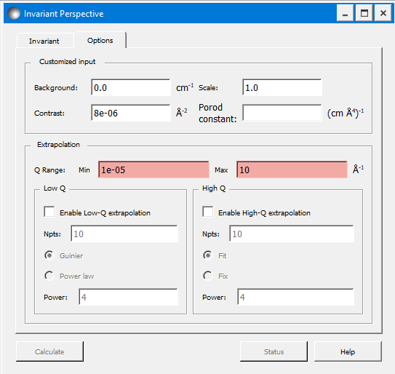
Entry Points: Invariant Options
src/sas/qtgui/Perspectives/Invariant
src/sas/sascalc/invariant/invariant.py
No. | qtgui | sascalc | Description
1 | InvariantPerspective.__init__() | - | Invariant Perspective Tabs
2 | Variable: txtBackgd textChanged: updateFromGui() | - | Background entered by user
3 | Variable: txtScale textChanged: updateFromGui() | - | Scale factor entered by user
4 | Variable: txtContrast textChanged: updateFromGui() | - | Contrast factor entered by user
5 | Variable: txtScale textChanged: updateFromGui() | - | Porod constant entered by user
6 | Variable: txtExtrapolQMin, txtExtrapolQMax textChanged: checkQMinRange(), checkQMaxRange() | - | Extrapolated Q range
7 | Variable: chkLowQ, chkHighQ stateChanged: stateChanged(), checkQExtrapolatedData() | - | Enable Low and High Q ranges
8 | Variable: txtNptsLowQm txtNptsHighQ textChanged: updateFromGui(), checkLength(), checkQRange() | - | Number of points used for low and high Q
9 | Variable: rbGuinier, rbPowerLawLowQ Toggled: lowGuinierAndPowerToggle() | - | Low Q Guinier/Power Law Radio Buttons
10 | Variable: rbFitHighQ Toggled: hiFitAndFixToggle() | - | High Q Fit/Fix Radio Buttons
11 | Variable: txtPowerLowQ Textchanged: updateFromGui() | - | Low Q Guinier or Power Value
12 | Variable: txtPowerHighQ Textchanged: updateFromGui() | - | Help Button
1
2
3
4
5
6
7
8
9
10
11
12

Slide 18
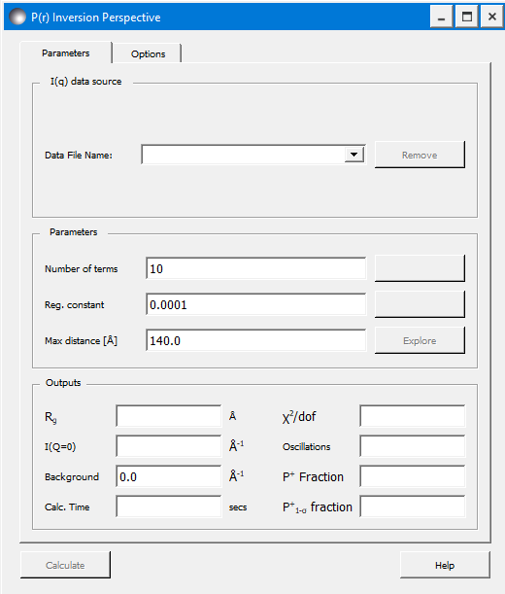
Entry Points: Inversion Perspective
src/sas/qtgui/Perspectives/Inversion
src/sas/sascalc/pr/
No. | qtgui | sascalc | Description
1 | InversionPerspective.__init__() | Inverter.Invertor() | P(r) Inversion perspective – generated on SasView open, but hidden
2 | dataList | - | Data file combo box (for future batch capabilities)
3 | Variable: removeButton Clicked: removeData | - | Delete the data set selected in the combo box
4 | noOfTermsInput | Invertor.nfunc | Number of terms used in the inversion calculation
5 | noOfTermsSuggestionButton Clicked: acceptNoTerms | estimate_numterms() | Value is generated when data is loaded, and the estimate method is run
6 | regularizationConstantInput | set_alpha() | Alpha/scaling factor
7 | regConstantSuggestionButton Clicked: acceptAlpha | estimate_alpha() | Value is generated when data is loaded, and the estimate method is run
8 | maxDistanceInput | set_dmax() | Maximum real space distance
9 | explorerButton Clicked: openExplorerWindow() | - | Opens the data explorer window to show correlations between parameters
1
2
3
4
5
6
7
8
9
10
11
12
13
14
15
16
17

Slide 19
Entry Points: Inversion Perspective
src/sas/qtgui/Perspectives/Inversion
src/sas/sascalc/pr/
No. | qtgui | sascalc | Description
10 | rgValue | Rg() | Calculated radius of gyration
11 | chiDofValue | Chi2 | Calculated chi^2
12 | iQ0Value | Iq0() | Calculated I(Q=0)
13 | oscillationValue | oscillations() | Oscillation parameters for the P(r)
14 | backgroundValue | Background | Calculated background value for
15 | posFractionValue | get_positive() | Calculated fraction of the P(r) > 0
16 | sigmaPosFractionValue | get_pos_err() | Calculated fraction of P(r) the is 1-sigma greater than 0
17 | computationTimeValue | elapsed | Computation time in seconds
1
2
3
4
5
6
7
8
9
10
11
12
13
14
15
16
17

Slide 20
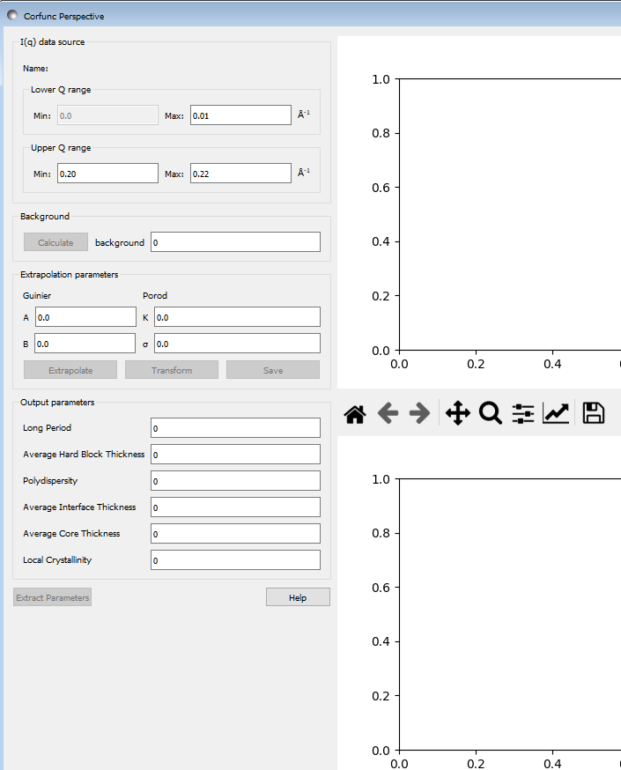
Entry Points: Corfunc Perspective
src/sas/qtgui/Perspectives/Corfunc
src/sas/sascalc/corfunc/
No. | qtgui | sascalc | Description
 | Basis: CorfuncWindow.__init__() | Basis: CorfuncCalculator() | Corfunc Perspective Generated and hidden on loading
1 | txtLowerQMin, txtLowerQMax _update_calculator() | 0.0, min(_data.x) Linked to slider on plot | Lower Q Range
2 | txtUpperQMin, txtUpperQMax _update_calculator() | Linked to slider on plot | Upper Q Range
3 | cmdCalculateBg Clicked: calculate_background() | Compute_background() | Background calculation button
4 | txtBackground _update_calculator() | background | Calculated background
5 | txtGuinierA, txtGuinierB | Calculated in extrapolate() | Guinier Parameters A and B I(Q) = Ae^{Bq^2}
6 | txtPorodK, txtPorodSigma | Calculated in extrapolate() | Porod Parameters I(Q) = Kq⁻⁴e^{-q^2sigma^2} + Bg
7 | _canvas | - | SAS Data Plot
8 | _realplot | - | Real Space Plot
1
2
3
4
7
5
6
9
10
11
12
13
14
8

Slide 21
Entry Points: Corfunc Perspective
src/sas/qtgui/Perspectives/Corfunc
src/sas/sascalc/corfunc/
No. | qtgui | sascalc | Description
9 | cmdExtrapolate Clicked: extrapolate() | compute_extrapolation() | Extrapolate Button
10 | cmdTransform Clicked: transform() | Threaded: compute_transform() | Transform Button – Fourier transform high and low Q data
11 | cmdSave Clicked: on_save() | - | Save data as a multi-column text file
12 | txtAvgCoreThick, txtAvgIntThick, txtAvgHardBlock, txtPolydisp, txtLongPeriod, txtLocalCrystal | extract_parameters() | Correlation parameters Calculated when ‘Extract’ button is clicked
13 | cmdExtract Clicked: extract() | extract_parameters() | Extract correlation parameters button
14 | cmdHelp Clicked: showHelp() | - | Help button
1
2
3
4
7
5
6
9
10
11
12
13
14
8

