Slide 1
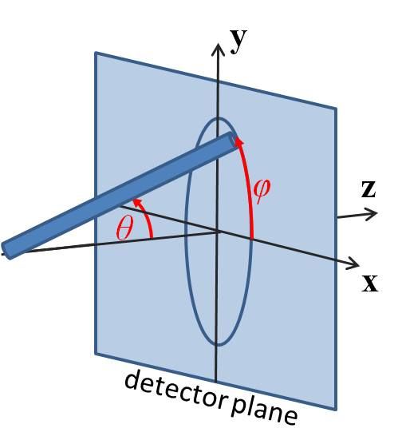
δ₁
δ₂
Ψ
b
a

Slide 2
δ₁
δ₂

Slide 3
Ψ
b
a

Slide 4
δ₁
δ₂
Ψ
b/2
a/2

Slide 5
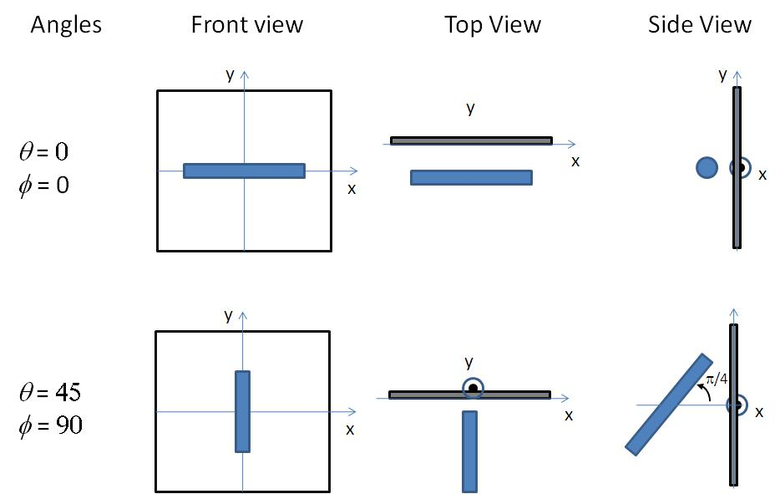
90

Slide 6
90

Slide 7
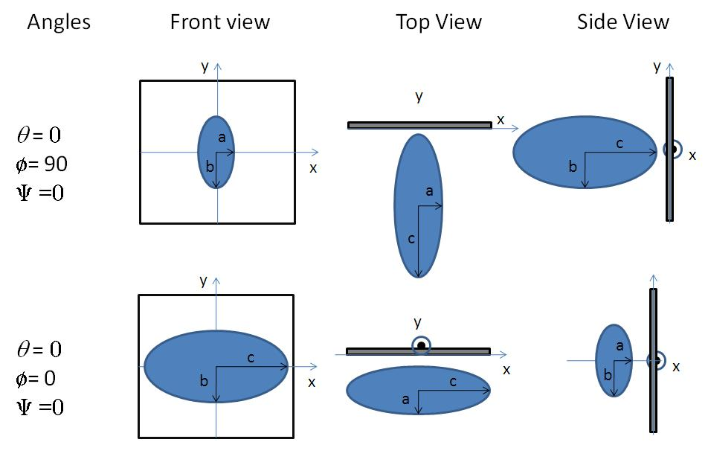
0
90

Slide 8
90

