Slide 1
SasView Architecture Overview
SasView Code Camp
April 2-7, 2013
Mathieu Doucet

Slide 2
What are we talking about
General information
Where to find things
Build servers
Build support
Code organization
Class diagrams
Application design
Loaders
Models
Development tips

Slide 3
Where is everything?
Web site: http://sasview.org/
Build servers:
ORNL: https://builds.sns.gov/view/Other%20Software/view/SansView/
ISIS: http://download.mantidproject.org/jenkins/view/All/job/sasview_snowleopard_32bit/
Code: http://sourceforge.net/projects/sasview/
To find it all:
http://danse.chem.utk.edu/daily_dev.html
We need a better build server solution for Windows and OSX before the next release

Slide 4
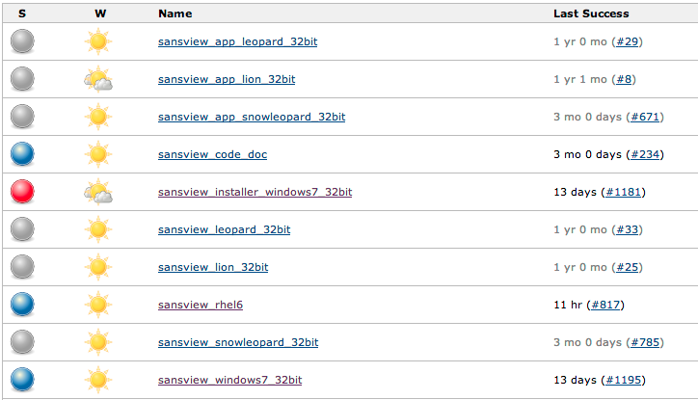
ORNL build server
Used for dev and release builds
No longer supports Snow Leopard

Slide 5

ISIS build server
Meant to be used for Snow Leopard dev and release builds
Still needs to be completely set up
A detailed description of how to build on the Mac can be found here: http://sourceforge.net/apps/trac/sansviewproject/wiki/MacBuild

Slide 6

Build support
Using the top-level setup.py is enough to install SasView and run it from the command line.
Windows: sansview/setup_exe.py is used to generate a Windows executable.
Mac: sansview/setup_mac.py is used to generate a Mac app.
RHEL: The build_tools/rpm directory contains a script that will generate a spec file to build an rpm.
New developers: You don’t need to compile an installer during
development. Just run
python sansview.py

Slide 7
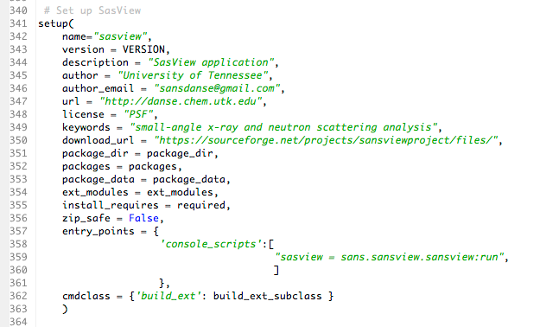
What is installed when running setup.py
This creates a script to start SasView.
This script is usually on the system path and it a convenient way to deploy the application on unix-like systems.

Slide 8
User data
SasView writes to the user’s home directory:
~/sasview.log is the application log
~/.sasview/config/custom_config.py contains customization settings
~/.sasview/plugin_models contains your user models

Slide 9
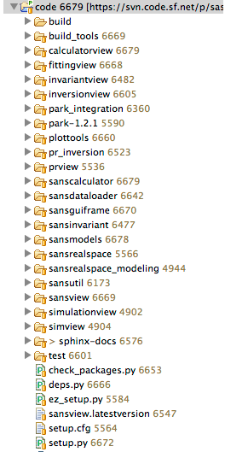
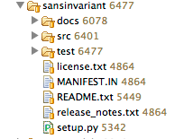
Code structure
Code is organized by packages
The computations are done in a different module than the UI that presents them to the user
sansinvariant does the computations
invariantview is a UI plug-in
Each module has a test directory for unit tests

Slide 10
Class diagram
The following is a good source of class diagrams: http://danse.chem.utk.edu/diagrams.html
sansview.py
guiframe
sansdataloader
calculatorview
plottools
inversionview
invariantview
fittingview
sanscalculator
pr_inversion
sansinvariant
sansmodels
park_integration
scipy
park

Slide 11
The SasView application
class SasView():
def __init__(self):
self.gui = SasViewApp(0)
self.gui.set_manager(self)
# Fitting perspective
import sans.perspectives.fitting as module
fitting_plug = module.Plugin()
self.gui.add_perspective(fitting_plug)
# P(r) perspective
import sans.perspectives.pr as module
pr_plug = module.Plugin(standalone=False)
self.gui.add_perspective(pr_plug)
# Invariant perspective
import sans.perspectives.invariant as module
invariant_plug = module.Plugin(standalone=False)
self.gui.add_perspective(invariant_plug)
# Calculator perspective
import sans.perspectives.calculator as module
calculator_plug = module.Plugin(standalone=False)
self.gui.add_perspective(calculator_plug)
# Welcome page
self.gui.set_welcome_panel(WelcomePanel)
self.gui.build_gui()
self.gui.MainLoop()
Initialization
‘Perspectives’
Welcome page
Build & start

Slide 12
SasView plugin code
from sans.guiframe.plugin_base import PluginBase
class Plugin(PluginBase):
def __init__(self, standalone=False): …
def help(self, evt): …
def get_panels(self, parent): …
def get_context_menu(self, plotpanel=None): …
def other_public_method(self): …
def _other_private_method(self): …
Fill those out to define panels and context menu items.
See inversionview/src/sans/perspectives/pr/pr.py for an example.

Slide 13
Data loaders
The loaders are registered with an XML settings file according to the file extension they deal with.
sans.dataloader.loader.Loader
cansas_reader.Reader
<?xml version="1.0"?>
<SansLoader version="1.0”>
<FileType extension='.xml' reader='cansas_reader'/>
<FileType extension='.txt' reader='ascii_reader'/>
<FileType extension='.asc' reader='IgorReader'/>
<FileType extension='.dat' reader='red2d_reader'/>
<FileType extension='.tif' reader='tiff_reader'/>
<FileType extension='.abs' reader='abs_reader'/>
<FileType extension='.d1d' reader='hfir1d_reader'/>
<FileType extension='.sans' reader='danse_reader'/>
<FileType extension='.nxs' reader='nexus_reader'/>
</SansLoader>
ascii_reader.Reader
nexus_reader.Reader
A valid reader only needs a read() method that returns an instance of sans.dataloader.data_info.Data1D. A save() method can also be provided.

Slide 14
Loading files
from sans.dataloader.loader import Loader
# Loader is a singleton
loader = Loader()
# Loader tries the best loader for the given file
# When in trouble, it defaults to ASCII
data = loader.load(“some_data_file.xml”)
# You can programmatically associate a reader to
# a particular extension
loader.associate_file_reader(“.mathieu”, MatReader())
# If your Reader class has a save method…
loader.save(“path_to_new_file”, data, “.mathieu”)
Your Reader should be stateless because it’s going to be re-used
It’s not a bad idea to look at the code in
sansdataloader/src/sans/dataloader/data_info.py

Slide 15
Basic python models
class CylinderModel(BaseComponent):
def __init__(self):
self.name = ‘Cylinder’
self.description = ‘A cylinder model’
self.details = {‘radius’: [‘Angstrom’, min, max],
‘length’: [‘Angstrom’, min, max],
‘phi’: [‘degrees’, min, max]}
self.orientation_params = [‘phi’]
self.params = {‘radius’:20.0,
‘length’: 100.0,
‘phi’:0.0}
def run(self, x):
return f(x)
def runXY(self, x):
return f(x[0], x[1])
def evalDistribution(self, x):
# x is either an array of x values (1D)
return [ f(x_i) for x_i in x ]
# or a list of lists… [x[], y[]]
return [ f(x[0][i], x[1][i]) for i in len(x[0]) ]
def set_dispersion(self, parameter, dispersion): …
Only works with C++ models

Slide 16
C++ models
cylinder.h
#include “parameters.hh”
//[PYTHONCLASS] = CylinderModel
//[DISP_PARAMS] = radius
//[DESCRIPTION] = “this is a model”
//[FIXED] =
//[ORIENTATION_PARAMS] =
class CylinderModel {
public:
// [DEFAULT]=radius=20.0 Angstrom
Parameter radius;
CylinderModel();
double operator()(double q);
double operator()(double qx, double qy);
};
Important meta-data used for automatically generating the python wrapper
Defines the parameter for python wrapper generation
cylinder.cpp
#include “parameters.hh”
#include “cylinder.h”
CylinderModel::CylinderModel() {
radius = Parameter(20.0, true);
};
CylinderModel::operator()(double q) {
return f(q);
};
True here means that this parameter can have polydispersity

Slide 17
Parameter class
parameters.hh
class Parameter {
public:
/// Current value of the parameter
double value;
/// True if the parameter has a minimum bound
bool has_min;
/// True if the parameter has a maximum bound
bool has_max;
/// Minimum bound
double min;
/// Maximum bound
double max;
/// True if the parameter can be dispersed or averaged
bool has_dispersion;
/// Pointer to the dispersion model
DispersionModel* dispersion;
Parameter();
Parameter(double);
Parameter(double, bool);
/// Method to set a minimum value
void set_min(double);
/// Method to set a maximum value
void set_max(double);
/// Method to get weight points for this parameter
void get_weights(vector<WeightPoint>&);
/// Returns the value of the parameter
double operator()();
/// Sets the value of the parameter
double operator=(double);
};
CylinderModel
*
Parameter
value
1
DispersionModel
*
WeightPoint
Available dispersion models:
GaussianDispersion
LogNormalDispersion
RectangleDispersion
SchultzDispersion
ArrayDispersion

Slide 18
Polydispersity in C++
cylinder.h
#include “parameters.hh”
class CylinderModel {
public:
// [DEFAULT]=radius=20.0 Angstrom
Parameter radius;
};
Remember this?
double CylinderModel::operator()(double q) {
// Get the nominal value of the parameter
double radius_value = radius();
// Get dispersion points
vector<WeightPoint> weights;
radius.get_weights(weights);
// Loop over radius weight points
double sum = 0.0;
double norm = 0.0;
for(size_t i=0; i<weights.size(); i++) {
radius_value = weights[i].value;
sum += weight[i].weight*f(radius_value, q);
norm += weight[i].weight;
}
return sum/norm;
};
It gives us the weight points to average over
cylinder.cpp

Slide 19
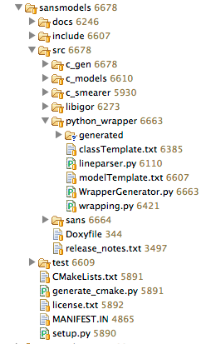
Exposing C++ models to python
The setup.py installation takes care of exposing your C++ models to python.
It generates a C++ wrapper and the python model using templates.
It pulls most of the information it needs from the header file (cylinder.h)

Slide 20
Exposing C++ models to python
You don’t need to write the python model yourself
Polydispersity is also taken care off
class CylinderModel(CCylinderModel, BaseComponent):
def __init__(self):
self.name = ‘Cylinder’
from sans.models.CylinderModel import CylinderModel
from sans.models.dispersion_models import GaussianDispersion
m = CylinderModel()
d = GaussiantDispersion()
m.set_dispersion(‘radius’, d)
m.model.dispersion[‘radius’][‘width’] = 0.25
m.model.dispersion[‘radius’][‘npts’] = 100
m.evalDistribution(numpy.asarray([0.001, 0.002]))

Slide 21
Everything you ever wanted to know about C++ models
BaseComponent
CCylinderModel
python
+params = {…}
+dispersion = {…}
+set_dispersion()
CylinderModel
1
CylinderModel
python
C++
C++
*
DispersionVisitor
Parameter
C++
C++
1
DispersionModel
PyCObject_AsVoidPtr(disp)
1
DispersionModel
python
C++
*
WeightPoint
C++

Slide 22
Development tips
A long time ago Paul Kienzle and I wrote “Team Rules” for new developers. They included things like:
Golden Rule: committed code should NEVER break
Silver Rule: never commit to a ‘release’ branch directly
Follow PEP-8: www.python.org/dev/peps/pep-0008
Golden Rule of Error Handling: if you catch an exception and all you do is calling pass or print, you have not dealt with the error properly

