Slide 1
Flight Delay Prediction
Mostafa ElSheikh
Supervised by Dr. Mohamed Kholief

Slide 2
What is Apache Spark?
Apache Spark is a distributed processing system developed to handle Big Data workloads just like various other Big Data tools i.e Hadoop, Hive, Cassandra, etc. Apache Spark can be used in use-cases such as Data Integration and ETL, High-Performance Batch Processing, Machine Learning, and Stream Processing in Real-Time.

Slide 3

Spark Architecture
Apache Spark Architecture comprises 3 main components that are: Driver Program, Cluster Manager, and Worker Node(s).

Slide 4
Spark MLlib
Spark MLlib comprises of almost all the components of an ML pipeline. These components are data pre-processing, feature extraction, feature selection, feature transformations, and almost all Machine Learning models (except form DL models). The advantage MLlib possesses over other machine learning libraries is that it has a built-in ecosystem that is able to process Tera-bytes of dataset within seconds.

Slide 5
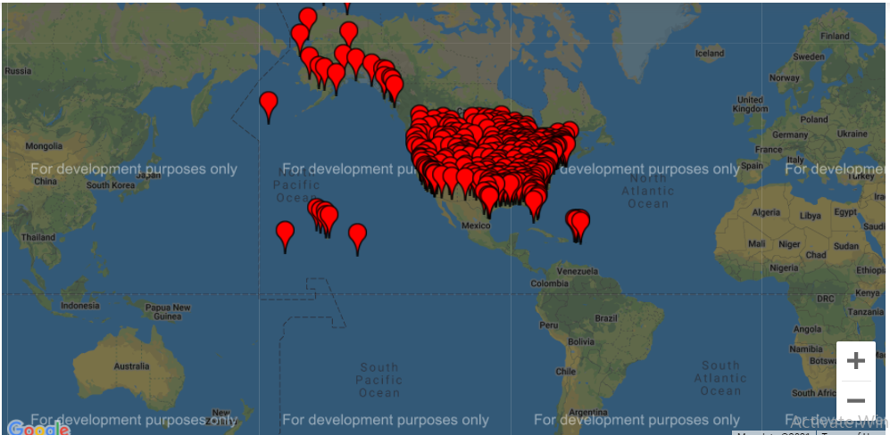
Flight Delays Dataset 2015
Source: https://www.kaggle.com/datasets/usdot/flight-delays?resource=download&select=flights.csv

Slide 6
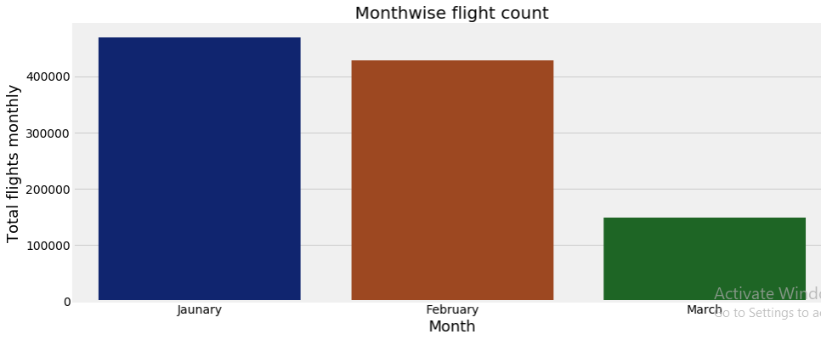
Flight Delays Dataset 2015
Source: https://www.kaggle.com/datasets/usdot/flight-delays?resource=download&select=flights.csv

Slide 7
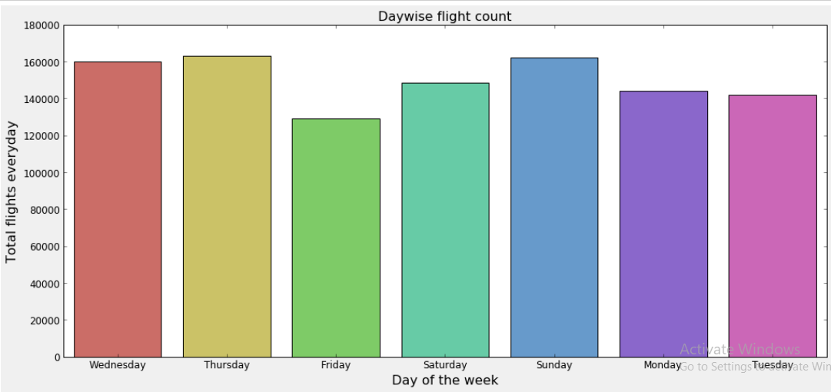
Flight Delays Dataset 2015
Source: https://www.kaggle.com/datasets/usdot/flight-delays?resource=download&select=flights.csv

Slide 8
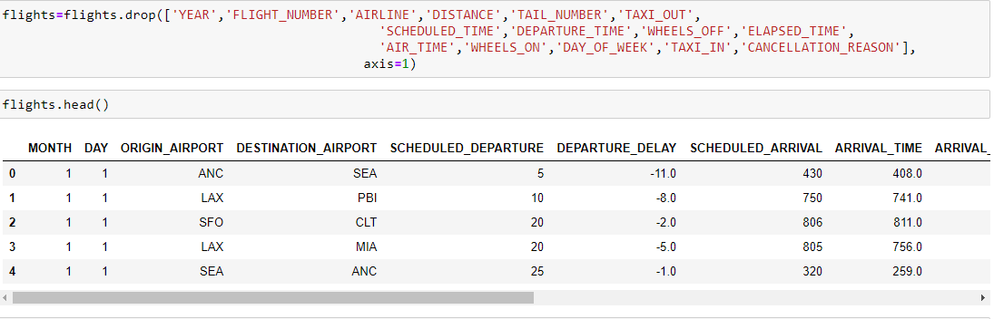
Cleaning Data

Slide 9
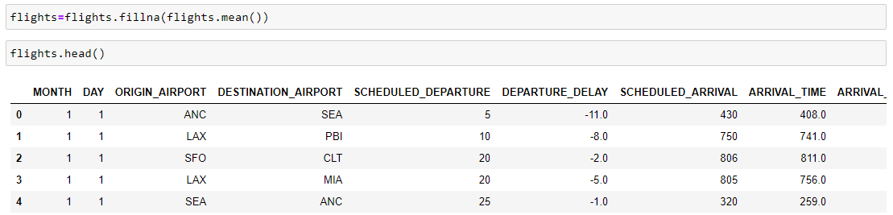
Cleaning Data

Slide 10
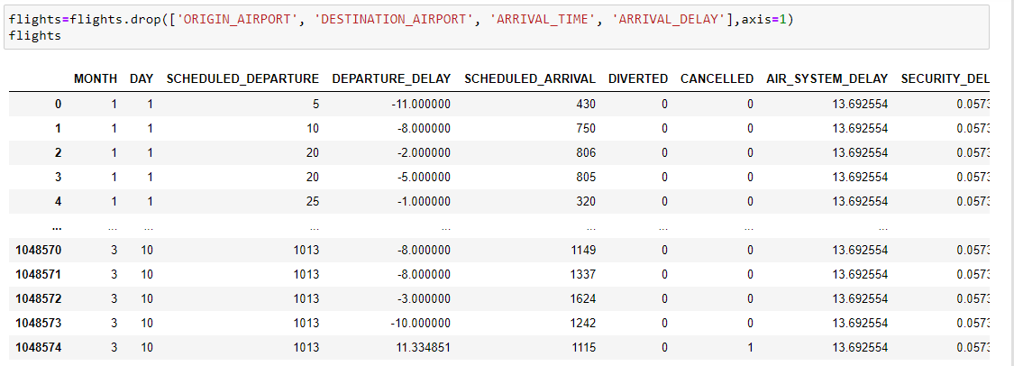
Extracting Input Features

Slide 11
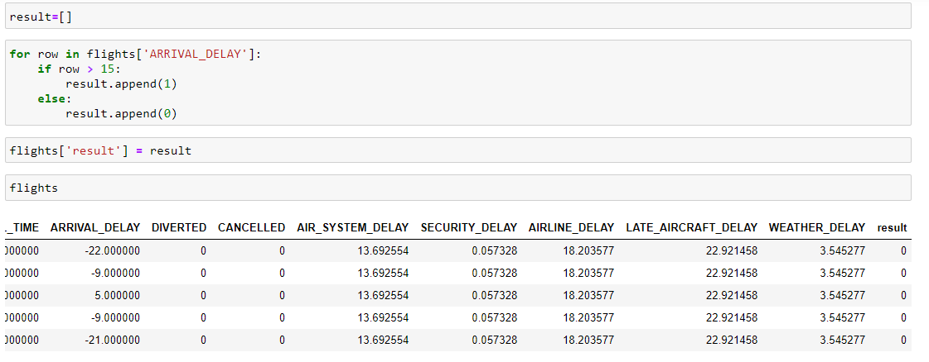
Extracting Output Feature

Slide 12

Normalize Features

Slide 13
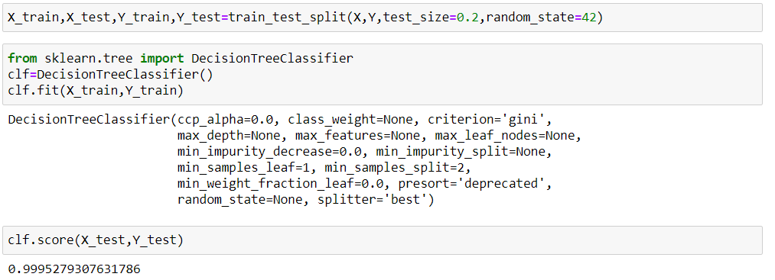
Model Creation

Slide 14
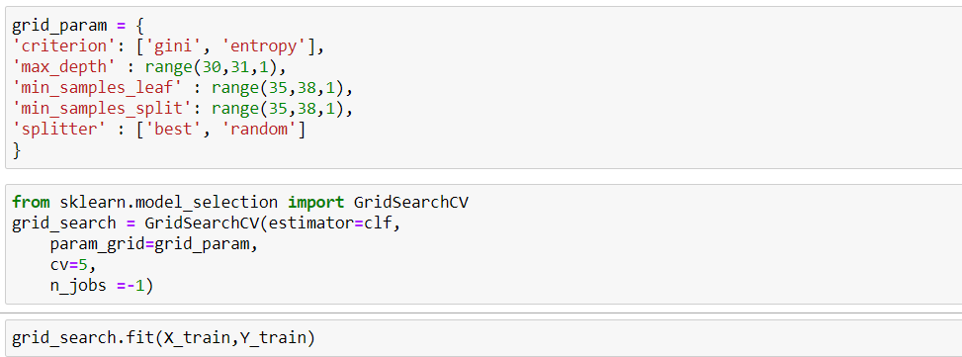
Model Creation

Slide 15
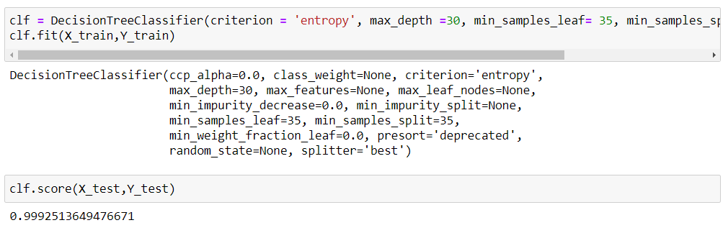
Model Creation

Slide 16
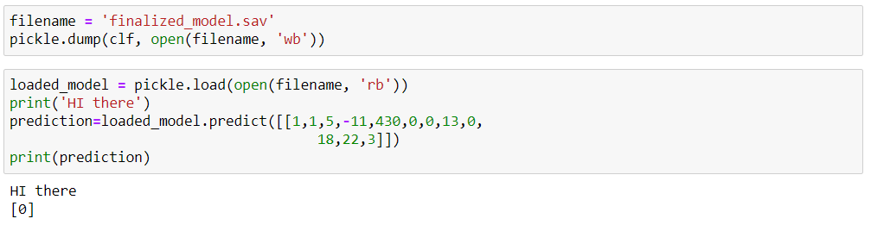
Saving Model

Slide 17
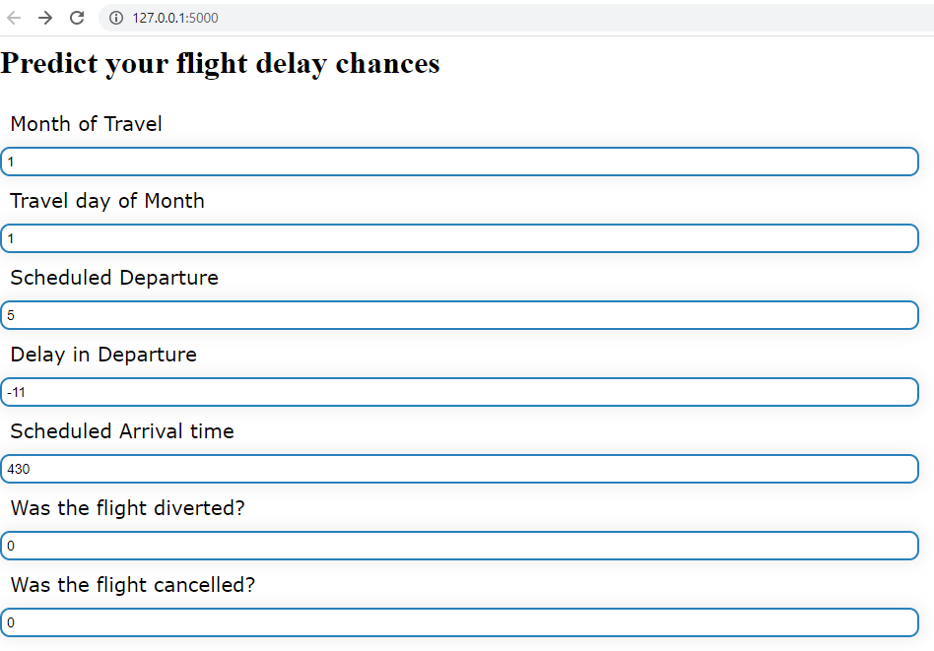
Flight Delays Prediction

Slide 18
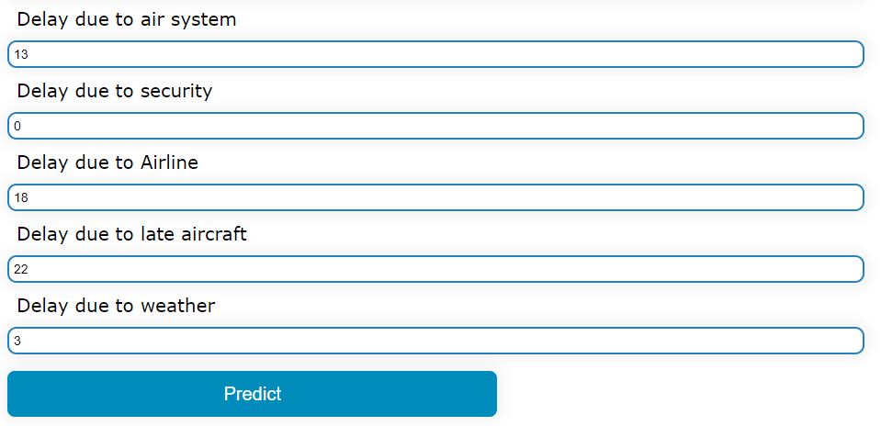
Flight Delays Prediction

Slide 19
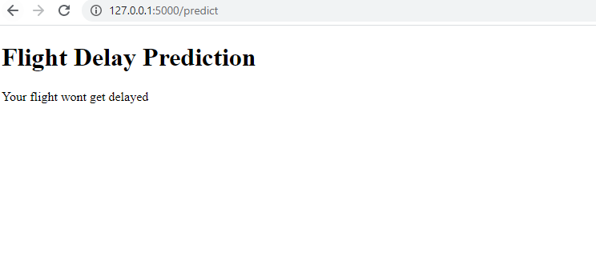
Flight Delays Prediction

