Slide 1

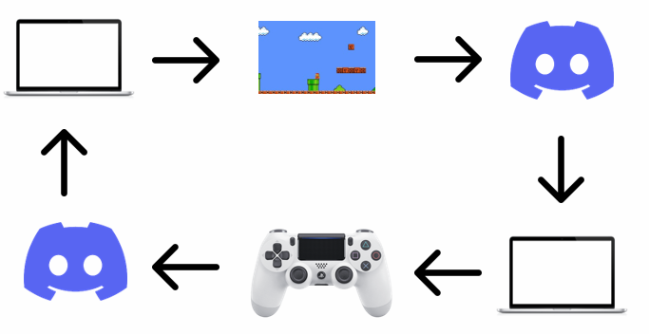


Chat-based Controller Sharing
Sasa Kuzmanovic – C00249246
Software which focuses on enabling players to share controls of their game to whomever they want
Players get a real-time stream of gameplay on discord so they can see what is happening in the game at any moment
Assign a role to the player you want to control the game, and let them beat the game for you with their own controller anywhere on the planet

