Slide 1


1
24AIM112 : Molecular biology and basic cellular physiology
24aim115 : Ethics, innovative research, businesses and IPR
PROJECT TITLE :
Exploring the role of epigenetics in
diseaseS and health
TEAM
H Nikhil Kasyap (CB.AI.U4AIM24012)
M Sasaank (CB.AI.U4AIM24026)
K Haveesh Chowdary (CB.AI.U4AIM24018)
Y V S Harshith (CB.AI.U4AIM24049)

Slide 2

2
Introduction
What is Epigenetics ?
Epigenetics is the study of how genes become active or inactive without changing the actual DNA sequence.
It helps control how cells function and can be influenced by the environment, lifestyle, and even passed to future generations.
Why is Epigenetics Important ?
Controls development – Skin and brain cells act differently despite having the same DNA.
Responds to environment – Diet, stress, and pollution can change gene activity.
Influences diseases – Linked to cancer, diabetes, and Alzheimer’s

Slide 3
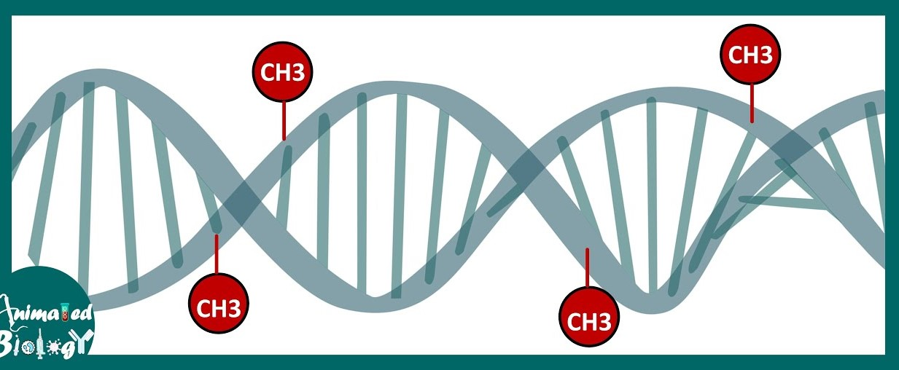
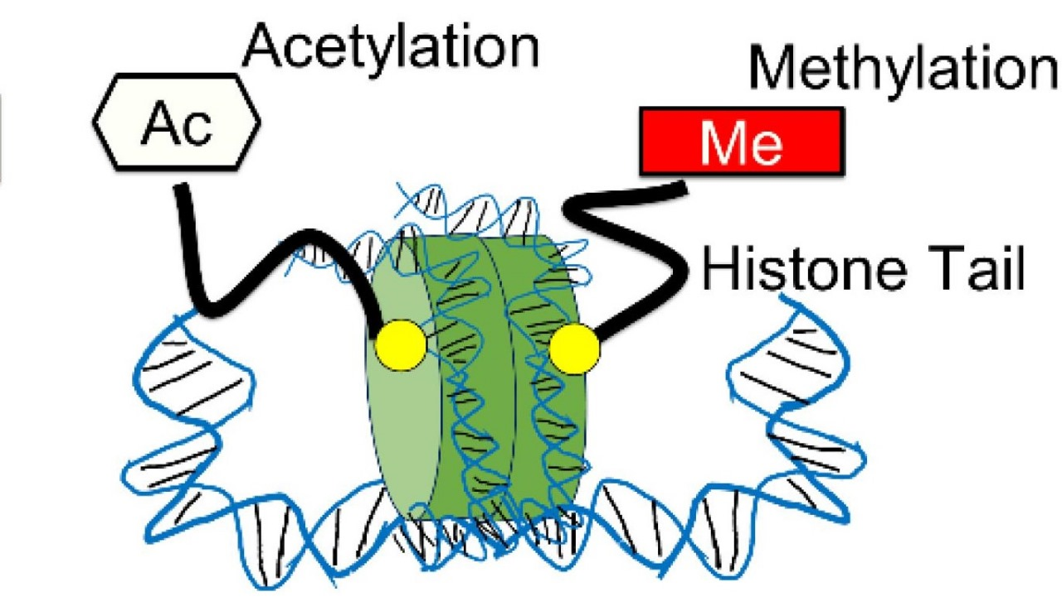
3
DNA Methylation 🧬
A small chemical tag (methyl group, -CH₃) attaches to DNA.
This turns genes off, stopping them from making proteins.
Example :- In cancer, methylation can silence tumor-suppressor genes, allowing uncontrolled growth.
Histone Modifications 🧪
DNA is wrapped around proteins called histones, like thread on a spool.
Chemical changes like acetylation and methylation which loosen or tighten DNA, controlling gene access.
Example :- In Alzheimer’s, histone changes can affect memory-related gene activity.

Slide 4
4
Objectives
Understanding Epigenetic Mechanisms
To study how DNA methylation and histone modifications which regulate gene expression and cell function.
Exploring Disease Associations
To analyze how epigenetic changes contribute to diseases like cancer, diabetes, neurological disorders, and autoimmune conditions.
Environmental and Lifestyle Influences
Understand how factors like nutrition, stress, and chemical exposure affect the epigenome.
Computational Modelling and Simulation
Use MATLAB and machine learning models to simulate epigenetic changes and their effects on gene expression and disease.
Ethical Considerations in Epigenetics
Address fairness, privacy, and accessibility issues in epigenetic treatments and personalized medicine.

Slide 5
5
Literature Review
Title of the Paper | Authors | Summary | Source
Epigenetics and Environmental Health | Min Zhang, Ting Hu | This article looks at how environmental factors can change gene activity, leading to health problems like developmental disorders, aging, heart diseases, and cancer. | https://link.springer.com/article/10.1007/s11684-023-1038-2
Environmental Epigenetics and Its Implication on Disease Risk and Health Outcomes | Shuk-Mei Ho, Abby Johnson | This review looks at how environmental factors influence disease risk and health by changing gene activity through processes like DNA methylation, histone changes, and microRNA expression. | https://pmc.ncbi.nlm.nih.gov/articles/PMC4021822/

Slide 6
Title of the Paper | Authors | Summary | Source
Epigenetics and the Environment: Emerging Patterns and Implications | Robert Feil, Mario F. Fraga | The paper looks at how environmental factors change genes through DNA methylation and histone modifications, affecting gene control and disease prevention. | https://www.nature.com/articles/nrg3142.pdf
Environmental Influences on the Epigenome: Exposure-Associated DNA Methylation in Human Populations | Elizabeth M. Martin, Rebecca C. Fry | This paper explores how environmental factors affect DNA methylation, influencing gene activity and disease risk, with a focus on epigenetic markers for disease prediction. | https://pubmed.ncbi.nlm.nih.gov/29328878/
Epigenetics: Linking environmental factors and gene regulation | Signe Penner- Goeke, Elisabeth B Binder | Environmental stressors can influence the epigenome, potentially affecting gene expression and contributing to various health outcomes. | https://elifesciences.org/articles/96710
6

Slide 7
Computational aspects
7
Simulating Epigenetic Changes
Using MATLAB, we are simulating models of DNA methylation and histone modifications to understand how these epigenetic changes influence gene expression over time and contribute to health and disease.
Analyzing Disease Associations
By analyzing simulated data and graphs, we are studying the connection between changes in DNA methylation and histone modifications with diseases like cancer, diabetes, and neurological disorders, using a blood cells dataset.
Machine Learning Models
We are implementing machine learning models both classification and regression to analyze epigenetic and environmental data.
These models aim to predict disease risk and classify samples based on the given data.

Slide 8
8
Explanation of the project
Our project explores how environmental factors like pollution, stress, and diet impact epigenetic modifications, specifically DNA methylation and chromatin state changes.
We use blood cell images to extract Mean Intensity (chromatin openness) and Edge Count (chromatin structure complexity).
These features are combined with environmental factor data to analyze their influence on gene regulation.
A Support Vector Machine (SVM) model is used to predict whether chromatin is open or closed and estimate DNA methylation levels.
The simulation helps visualize how external conditions can alter epigenetic mechanisms.

Slide 9
9
Ethics related to the project
Environmental Justice :- Certain communities may be more exposed to harmful chemicals and pollutants that cause epigenetic changes, leading to unfair health risks.
Discrimination Risks :- Epigenetic information could be misused by third parties (like employers or insurers) to treat people unfairly, based on perceived genetic risks, even if those risks don't necessarily mean someone will get sick.
Ethical, Legal, and Social Issues :- As epigenetics is used in personalized medicine, there are concerns about privacy, fairness, and accessibility of treatments.
This project will also transgenerational inheritance, where environmental factors like diet, pollutants, stress cause epigenetic changes that may pass to future generations.
This raises ethical concerns in genetic counseling, health monitoring, and biomarker reliability due to individual variability and uncertain long-term effects.

Slide 10
10
Intellectual Property Rights (IPR)
Machine Learning for Epigenetic Status Estimation (Patent No. US11795495B1): This patent uses machine learning to predict DNA methylation patterns. (Google Patents)
Epigenetic Biomarkers for Disease Prediction (Patent No. US6251594B1): This method identifies DNA methylation patterns as biomarkers for cancer diagnosis. (Google Patents)
AI-Based Chromatin Accessibility Prediction (Patent No. WO2017218908A2): This patent uses AI models to classify open vs. closed chromatin states. (World Intellectual Property Organization (WIPO) database)

Slide 11
11
References
1) Adjakly M, Bosviel R, Rabiau N, Boiteux JP, Bignon YJ, Guy L, Bernard-Gallon D. 2011. DNA methylation and soy phytoestrogens: Quantitative study in DU-145 and PC-3 human prostate cancer cell lines. Epigenomics 3:795–803
2) Waddington CH. The epigenotype. Int J Epidemiol 2012; 41(1): 10–13
3) Cross-reactivity between histone demethylase inhibitor valproic acid and DNA methylation in glioblastoma cell lines.Barciszewska AM, Belter A, Gawrońska I, Giel-Pietraszuk M, Naskręt-Barciszewska MZ.Front Oncol. 2022 Nov 16;12:1033035. doi: 10.3389/fonc.2022.1033035. eCollection 2022.PMID: 36465345
4) Aristizabal MJAnreiter IHalldorsdottir TOdgers CLMcDade TWGoldenberg AMostafavi SKobor MSBinder EBSokolowski MBO’Donnell KJ (2020) Biological embedding of experience: a primer on epigenetics PNAS 117:23261–23269.
5) Kreibich EKleinendorst RBarzaghi GKaspar SKrebs AR (2023) Single-molecule footprinting identifies context-dependent regulation of enhancers by DNA methylation Molecular Cell 83:787–802.

