Slide 1

Full-Gradient Representation for
Neural Network Visualization
Fairness, Accountability, Confidentiality and Transparency in AI
Notes:
Hello, we are Mathieu, Laurence, David and Daan and we are gonna present our reproduction of the paper, Full-Gradient Representation for Neural Network Visualization. First we will explain the findings of the original paper and then we will share our findings and discuss them.

Slide 2
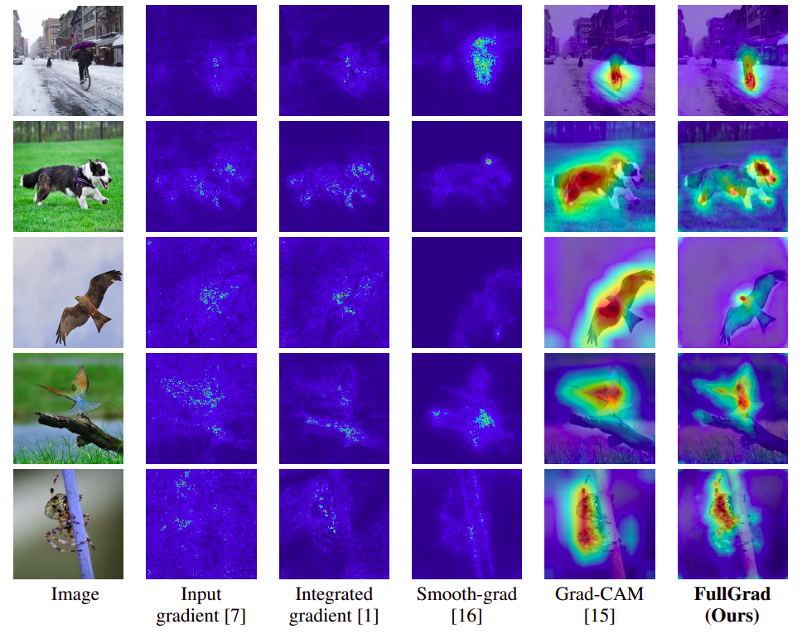
Original findings
Saliency map
Local vs Global attribution
Full-gradients
FullGrad
Github repository
Notes:
The original findings consisted of 3 general ideas. But first I should explain what a saliency map is. A saliency map is a heatmap of the input features which ascribes a notion of importance to each feature. There will be examples on the next slide. The researchers note that such saliency maps can never satisfy both local and global attribution to a saliency map, meaning a saliency map can never give due to a bixels local and global importance simultaneously. They give a proof for this in the paper. Next they define their main idea, which is full-gradients. THis is a way of rewriting a neural network based on its input and bias gradients which is the only way to exactly rewrite a neural network, other than the usual feed forward pass. The last idea is a modification on full-gradients, specifically for convolutional neural networks called FullGrad. This method generates a saliency map similar to the full-gradients. However, it is still a saliency map so does not satisfy either local or global attribution.

Slide 3
Experiments
Pixel Perturbation
RemOve And Retrain (ROAR)
Ethnic Transparency

Slide 4
Pixel perturbation experiment
Create datasets (ImageNet) where k% least salient pixels of images are removed
Use pre-trained VGG11 network to classify datasets
Compare how the output changes
Absolute Fractional Output Change (AFOC)
Kullback-Leibler divergence value
Notes:
The pixel perturbation experiment is an experiment where we give an image to the model, save the output, remove x% of the least salient pixels and ask the model again what the model thinks the output should be. Given that we remove the least salient pixels - it is expected that there should be little change in the output. To confirm this we use two different measurements; the Absolute Fractional Output Change and KL-divergence. More about this in the a min but first let’s take a look what these new images look like

Slide 5
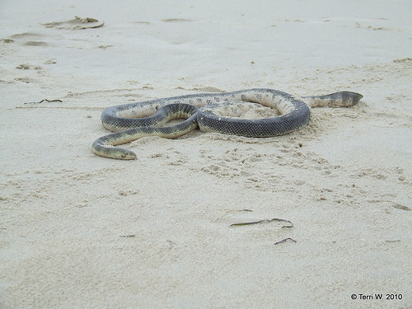
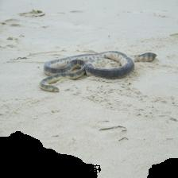
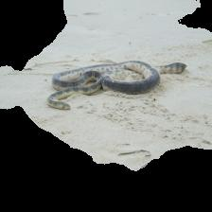
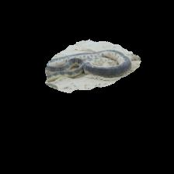
Pixel perturbation - Removal of least salient pixels
Original Image
10% removal
50% removal
90% removal
Notes:
Here we see a snake image of the ImageNet dataset and these images show x% least salient pixels removed - where the saliency map was acquired by using the FullGrad method.
AFOC: How does the probability change that this image is a snake when we remove k % least salient pixels

Slide 6
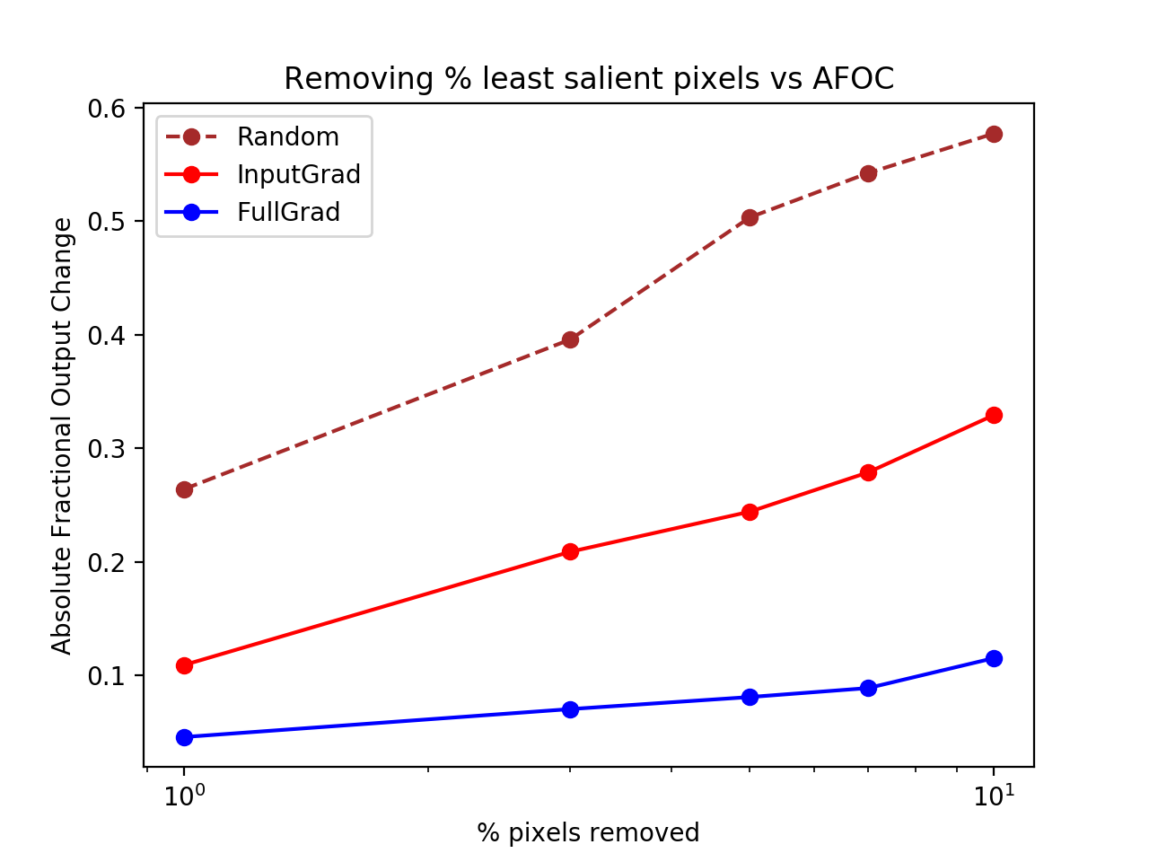
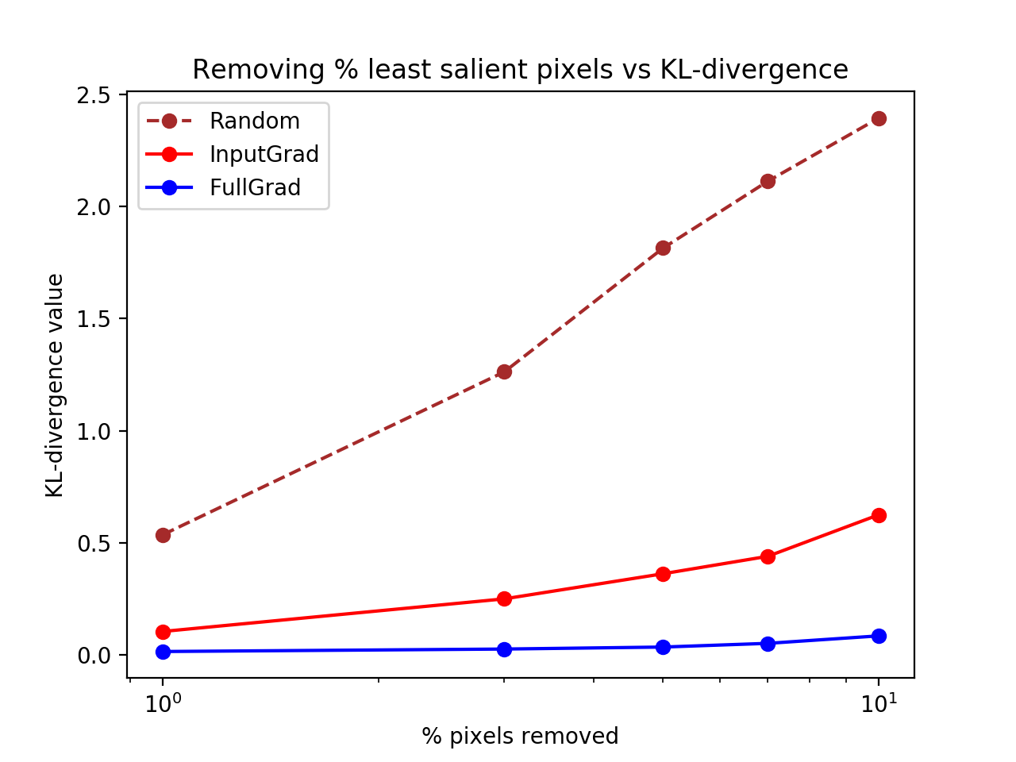
Pixel Perturbation - Results
Notes:
The results confirm what the original paper presented, although we were not able to achieve the exact same values as the original paper we do have the same shape - direction and curves. FullGrad is superior to the other models, as expected.

Slide 7
RemOval And Retrain (ROAR)
Obtain datasets with k% of most salient pixels removed (Cifar-10)
Obtain a saliency map of a sample
Create new images by removing k% most salient pixels
Train network based on adjusted dataset
Capture accuracy based on adjusted test set
Expectations
Notes:
Within the ROAR experiment we first created three different datasets. The datasets were created by removing different percentages of most salient pixels. The most important pixels are based on two different saliency maps, Moreover, was it also another time done at random to get a baseline.
After creating these datasets we trained VVG-11 models based on the adjusted datasets, and after training acquired the accuracies on the test set for all different models.
We expect that full grad trained models will achieve the lowest accuracies while the most salient pixels are removed. We based this expectation because we assume that the most important information will be deleted and therefore the model has a harder time to predict the right labels.
##mathieu We will now turn around the test that laurence just described

Slide 8
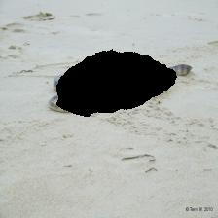
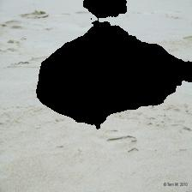
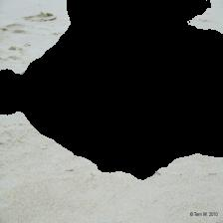

ROAR - Removal of most salient pixels
10% removal
30% removal
50% removal
90% removal
Notes:
Some examples of removed pixels, where we can see that first the object is deleted and afterwards less useful background pixels.

Slide 9
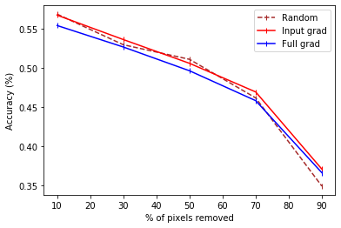
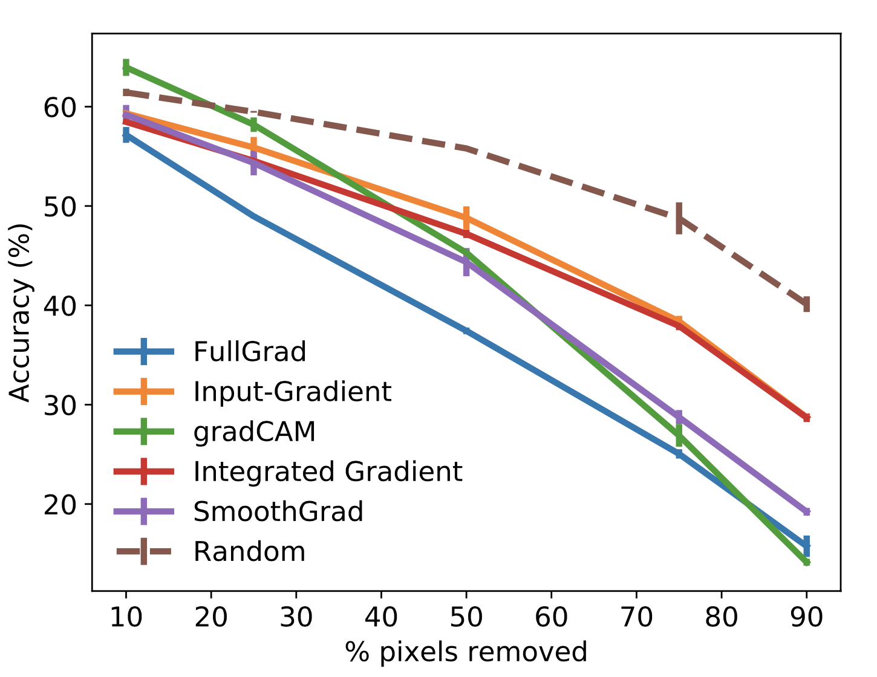
ROAR - Results
Similar shape and values
Quantitative differences
Hyper-parameter tuning
Qualitative difference
Difference in datasets used
Notes:
Reasons for the difference in the quantitative-results can be due to the fact that the authors of the original paper did not specify their hyper parameter tuning for their trained models.
However, when we look at the qualitative differences we see that the lines for Input Grad and Full Grad lie closer too each other then in the original plot, moreover, achieves random even better for 90%.
However this could be due to the fact that we used a different dataset. In their experiment they made use of cifar-100 instead of cifar-10, which makes the classification task more complicated. We argue, that because we tested a simpler classification task the input gradients provided enough information to clear this experiment, and that the added bias gradients for full grad where not necessary.

Slide 10

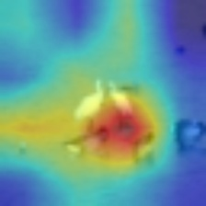
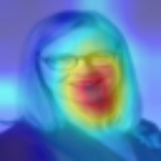
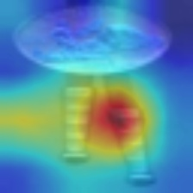

Transparency in Fairness
Experimental setup
From problem state to insight
Result
Notes:
The method from the paper shows promising results in retrieving important regions in an image. Keeping in mind the scope of this project, namely fact, we thought of a new experiment combining transparency and fairness. We got our idea from the first guest lecture from miss hinda. She talked about facial recognition software from IBM that was tested on a dataset with ethnicity labeled. The results were shocking! They found that people with darker colored skin where more often misclassified. We tried to reproduce these results and gain insights using the full-gradient method. We trained a classifier on celeberty faces and imagenet to train a classifier to recognise faces. After we gained similar results as ibm, as showed here, we used the full-grad method to gain insights into some classifications. From these handpicked examples we gained the insight that in some cases wrongly classified faces were not actually based on the pixels that contain a face. and that the central region of an image is important for this classification, which makes sense as the celeberty dataset is centered! This experiment shows the potential of a good working method for finding the salience map
“To narrow the gap between transparency and fairness”

Slide 11
Conclusion
Pixel perturbation - successful
ROAR - unsuccessful
Fairness and Transparency
Not definitive

