Slide 1

EVENT MANAGEMENT
BBA – 1st Semester
Planning • Organizing • Executing • Evaluating
1/5

Slide 2
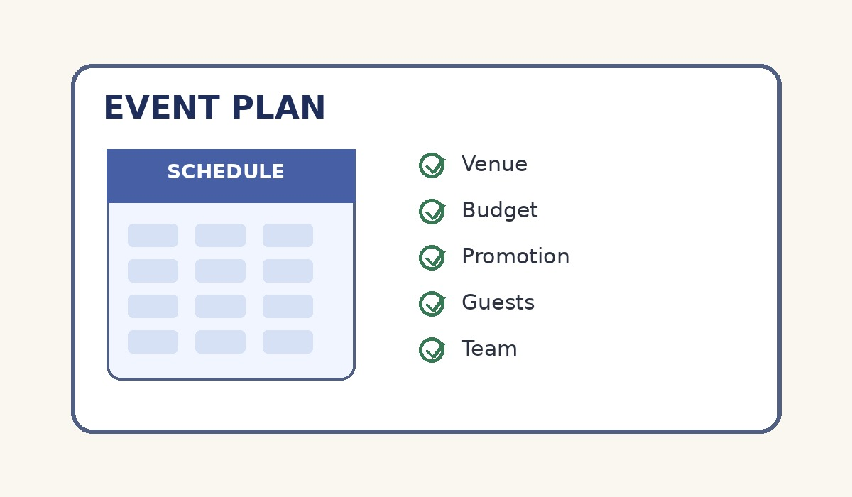
What is Event Management?
Meaning and objectives
• Event management is the process of planning, organizing and controlling an event.
• It includes selecting the venue, managing people, budget, logistics and promotion.
• The main aim is to achieve the event’s purpose within the available time and resources.
• Examples: seminars, conferences, college fests, exhibitions, weddings and product launches.
2/5

Slide 3
Types of Events
Common categories in business and society
Corporate
Meetings, conferences, product launches
Social
Weddings, birthdays, celebrations
Academic
Seminars, workshops, college fests
Cultural
Festivals, concerts, exhibitions
3/5

Slide 4
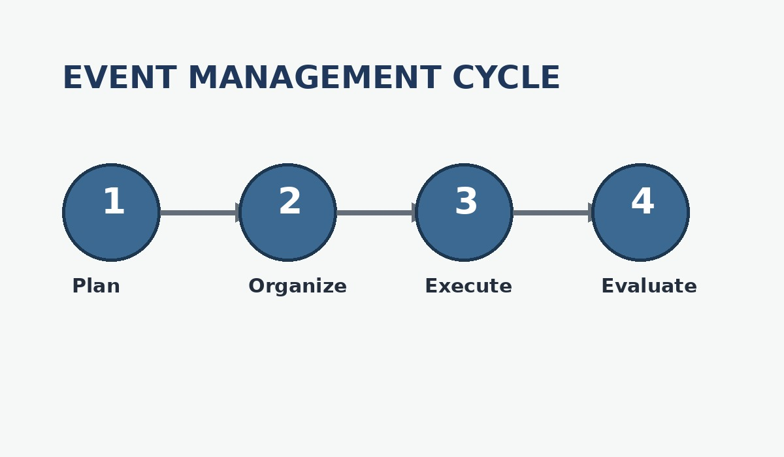
Event Management Process
A simple four-stage cycle
Planning → Organizing → Execution → Evaluation
4/5

Slide 5
Importance of Event Management
• Creates a smooth experience for participants.
• Helps control cost, time and resources.
• Builds communication, teamwork and leadership.
• Supports branding, networking and organizational goals.
• A successful event is well-planned, well-coordinated and reviewed after completion.
Thank You
5/5

