Slide 1

Efficient Attention Impact on Transformer Backbones for Perceptual Similarity
Master of Science in AI & Robotics
Computer Vision
Mattia Di Marco 2019367
Simone La Bella 1995847
Academic Year 2025/26

Slide 2

Project overview
Impact of efficient attention mechanisms on a DINO-based DreamSim-like pipeline
Task
Perceptual image similarity using NIGHTS dataset
Backbone
DINO ViT-B/16 + Efficient Attention Layer
Goal
Reduce computational cost while preserving perceptual accuracy
Notes:
The aim of the project is to study the impact of different efficient attention mechanisms in a Vision Transformer for a perceptual image similarity task.
Our starting point is a DINO ViT backbone inserted into a DreamSim-like pipeline.
The main goal is to understand whether the standard self-attention mechanism can be replaced with more efficient alternatives while preserving performance.

Slide 3




NIGHTS Dataset & Perceptual Similarity Task
Each sample contains:
Reference Image
Left Candidate
Right Candidate
Human Preferences
Notes:
We use the NIGHTS dataset. Each sample contains a reference image, a left image, a right image, and a human preference indicating which of the two images is closer to the reference.

Slide 4



NIGHTS Dataset & Perceptual Similarity Task
Metric: 2AFC accuracy
$$2AFC=\frac{corrent human preference predictions}{total comparision}$$
Sampled with $≥6$
Training: 50% of train split Validation: 50% of validation split Test: full filtered test split
Notes:
We filtered the dataset to keep samples with at least 6 grades and due to computational constraints we used 50% of the dataset.
As our main evaluation metric, we use 2AFC, or Two-Alternative Forced Choice, which measures whether the model agrees with the human preference between the left and right images.

Slide 5
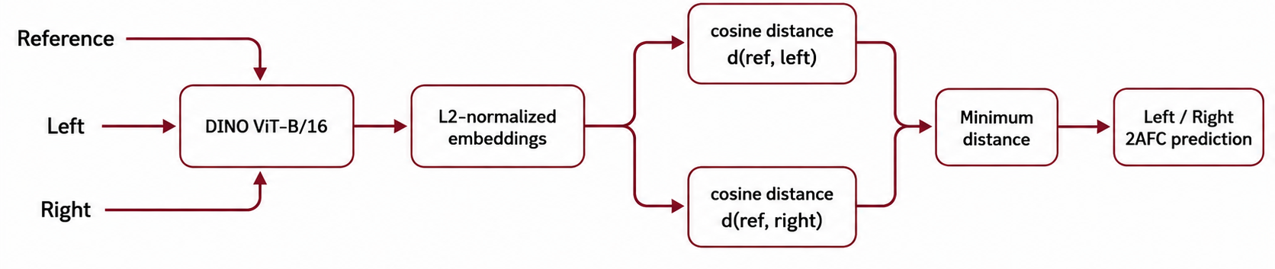
DreamSim-like Perceptual Similarity Pipeline
What we tested?
How we tested?
Baseline → Standard Self-Attention
SRA → Spatial Reduction Attention MetaFormer → Pooling Token Mixer MoH → Mixture-of-Heads
Full → Blocks 0-11 replaced
HALF → Blocks 6-11 replaced
Notes:
We built our own DreamSim-like pipeline using DINO ViT as the backbone. u can see the pipeline structure in the slide.
We tested three different efficient attention mechanisms using two configurations. In the full configuration, we replaced the attention mechanism in all 12 Transformer blocks, while in the half configuration, we replaced it only in the last 6 blocks.

Slide 6
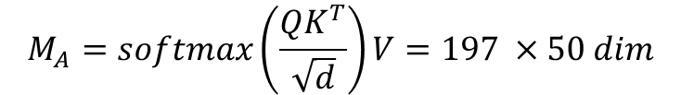
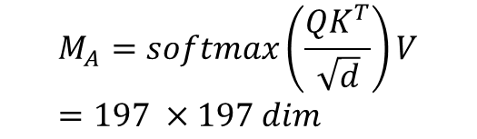
Spatial Reduction Attention — PVT-inspired
Standard Attention
SRA (sr_ratio = 2)
Q : 197 tokens
K : 197 tokens
V : 197 tokens
Q : 197 tokens
K,V = 14x14 patches
$$M_{A}=softmax\left(\frac{{QK}^{T}}{\sqrt{d}}\right)V=197 ×50 dim$$
$$M_{A}=softmax\left(\frac{{QK}^{T}}{\sqrt{d}}\right)V=197 ×197 dim$$
Spatial reduction 7x7 patches
Reduce K/V spatial resolution while preserving full-resolution queries
K,V= 50 tokens (49+CLS)

Slide 7
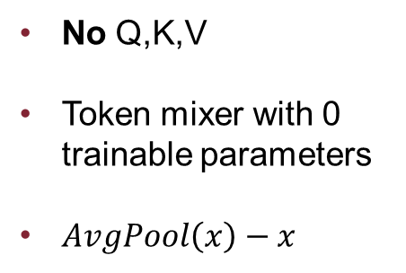
Alternative Efficient Token Mixings
MetaFormer
Mixture-of-Heads
Self-Attention removed
2 Shared heads
10 Routed heads
No Q,K,V
Token mixer with 0 trainable parameters
$AvgPool\left(x\right)−x$
Dynamic head routing
Load-balancing auxillary loss
Preserves pretrained DINO QKV
3x3 Average Pooling
Top-k routing
Local Token Mixing
2 shared + 4 routed = 6 active head

Slide 8
Training & Perceptual Quality
 |  | RTX 4070 SUPER 12GB VRAM |  | GTX 1060 6GB VRAM
Model | Efficient Blocks | Train time | Eval 2AFC | Train time | Eval 2AFC
Baseline | 0/12 | 9min 33sec | 95.12% | 1h 29min | 94.88%
SRA Full | 12/12 | 8min 52sec | 93.60% | 1h 38min | 93.48%
SRA Half | 6/12 | 8min 47sec | 95.35% | 1h 33min | 95.00%
MetaFormer Full | 12/12 | 9min 06sec | 78.95% | 1h 02min | 78.48%
MetaFormer Half | 6/12 | 8min 56sec | 85.81% | 1h 10min | 86.04%
MoH Full | 12/12 | 9min 05sec | 92.09% | 1h 00min | 91.86%
MoH Half | 6/12 | 8min 51sec | 94.88% | 1h 08min | 94.65%
Notes:
Prima di entrare nel dettaglio della presentazione, è importante spiegare cos’è un tumore cerebrale e perche è un area cruciale di ricerca.
I tumori cerebrali sono delle masse anomale di cellule che crescono all’interno del cervello, ne esistono varie tipologie e si possono classificare in primari e secondari in base al modo nella quale si creano. Sono formati da diversi tessuti ognuno con caratteristiche proprie.
L’utilizzo della risonanza magnetica ci permette di distinguere in maniera accurata questi tessuti.

Slide 9
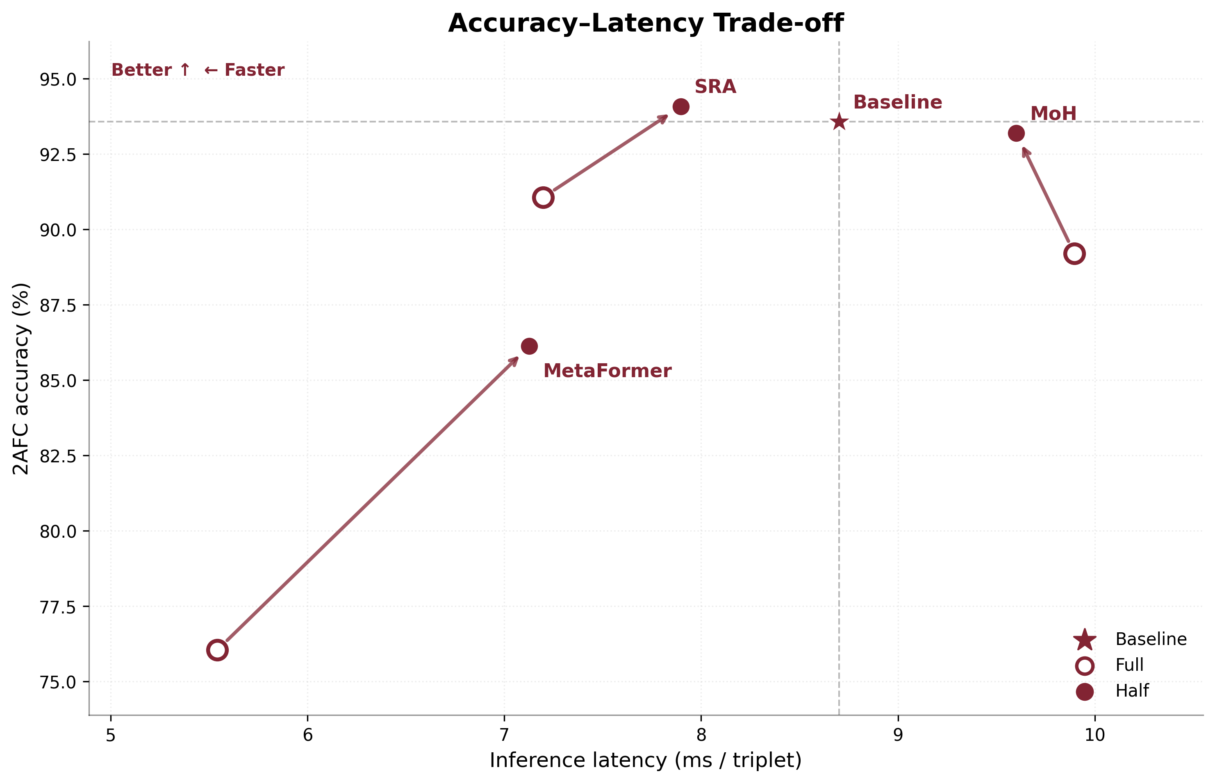
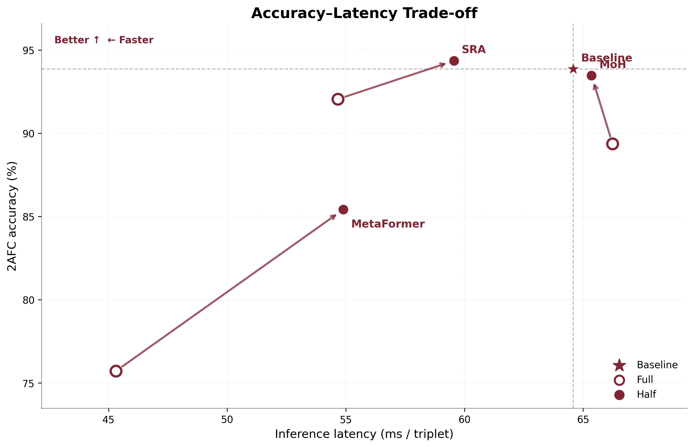
Efficiency–Accuracy Trade-off
Partial replacement > Full replacement
SRA Half provides the best quality trade-offs
Efficiency is architecture and implementation dependent
Notes:
Prima di entrare nel dettaglio della presentazione, è importante spiegare cos’è un tumore cerebrale e perche è un area cruciale di ricerca.
I tumori cerebrali sono delle masse anomale di cellule che crescono all’interno del cervello, ne esistono varie tipologie e si possono classificare in primari e secondari in base al modo nella quale si creano. Sono formati da diversi tessuti ognuno con caratteristiche proprie.
L’utilizzo della risonanza magnetica ci permette di distinguere in maniera accurata questi tessuti.

Slide 10

Thank you for the attention!
Mattia Di Marco, Simone La Bella
Academic Year 2025/26

