Slide 1

Standardization of Spirometry
ATS/ERS 2019 Update — Key Technical Standards & Clinical Implications
Sasanka Barman
Spirometer / Ultrasonic Flow Measurement System — MSP430FR6043
ATS/ERS Technical Statement • Am J Respir Crit Care Med 200:e70–e88 (2019)

Slide 2
Agenda
Why This Matters
01 Introduction & Scope
Spirometry is the most common pulmonary function test. Accurate, reproducible measurements are critical for diagnosis, monitoring, and device development. The 2019 ATS/ERS update revised every major criterion — from maneuver acceptability to equipment accuracy to grading systems — impacting both clinical labs and embedded firmware developers.
02 Equipment & QA
03 FVC/FEV₁ Maneuver
04 Acceptability Criteria
05 Key Parameters Reported
06 Grading System
2019
190+
1,760
07 Bronchodilator Testing
ATS/ERS Update
Directly Relevant Studies
Patients Surveyed
08 Device Design Implications

Slide 3
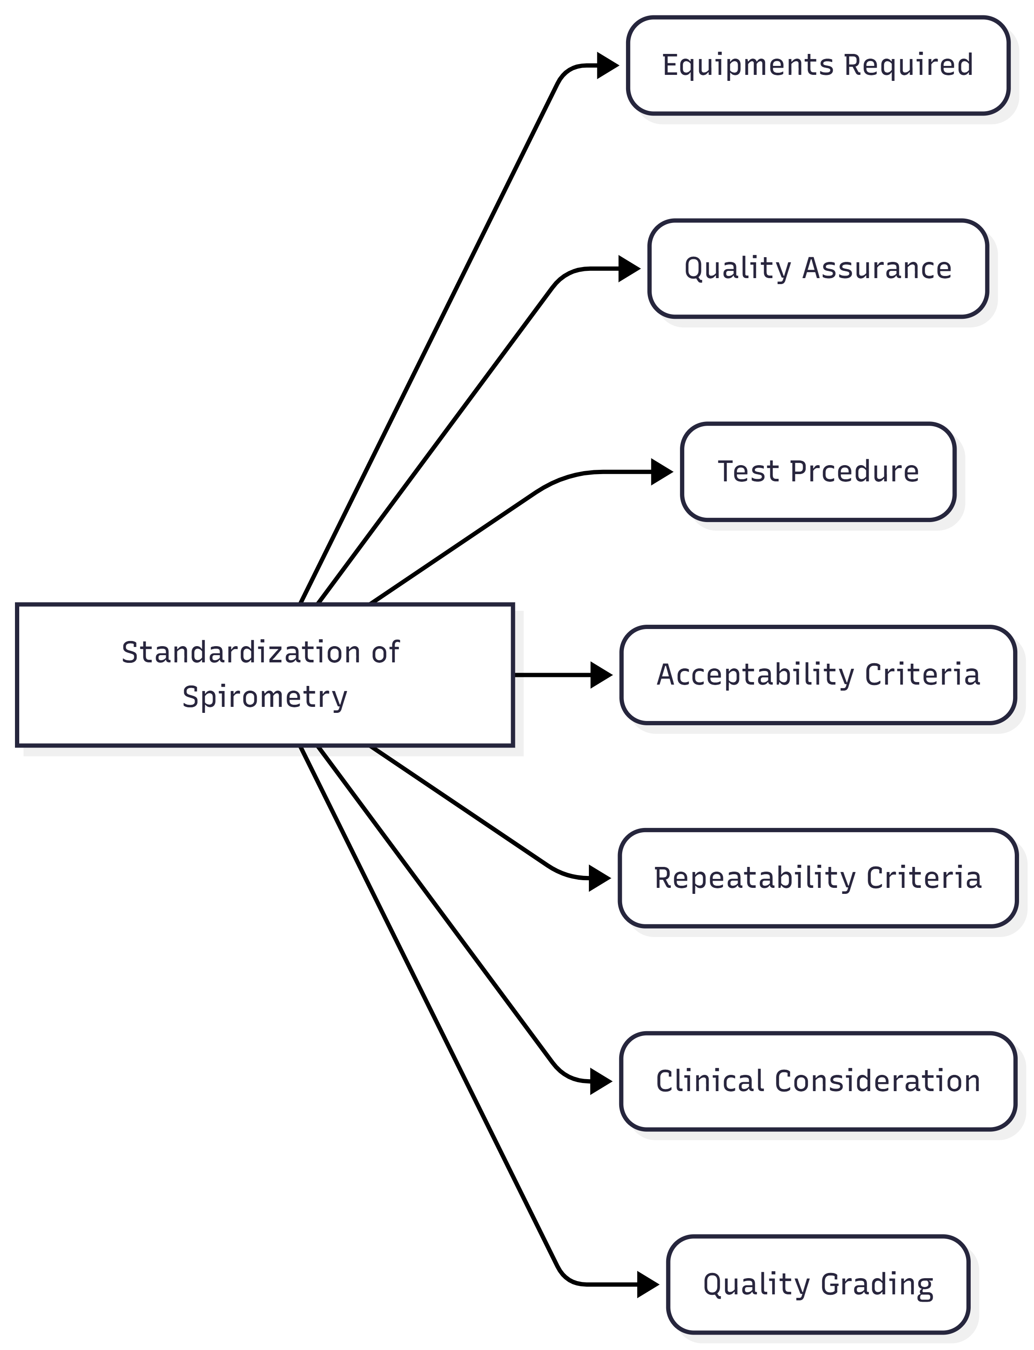
Standardization of Spirometry — Overview Mind Map

Slide 4

Introduction & Scope
Spirometry — a physiological test measuring the maximal volume of air an individual can inspire and expire with maximal effort. The primary signal is either volume or flow as a function of time.
Primary Variables
Document Scope
FVC
Forced Vital Capacity — volume expelled from full inspiration with maximal effort
Definitions & terminology
FEV₁
Forced Expiratory Volume in 1 second
Equipment specifications (ISO 26782)
FEV₁/FVC
Ratio indicating airflow obstruction
Patient preparation & contraindications
PEF
Peak Expiratory Flow
Maneuver acceptability & repeatability
FEF₂₅₋₇₅
Mean flow in mid-expiratory phase
Quality grading system
Data reporting standards

Slide 5




Equipment & Quality Assurance
ISO 26782 Compliance
Daily QA Checklist
BTPS Correction
▸ Max permissible error: ±2.5%
▸ 3-L syringe calibration verification
▸ All results at BTPS conditions
▸ Flow range: 0–14 L/s
▸ Flow range: 0.5 – 12 L/s
▸ Temperature accuracy: ±1°C
▸ Volume range: ≥8 L (BTPS)
▸ Accuracy tolerance: ±3%
▸ For volume spirometers: measure internal temp per breath
▸ Sampling rate: >100 Hz
▸ Zero-flow baseline set
▸ Error up to 6% if ambient temp assumed
▸ Min resolution: 12 bits
▸ Filter used in test = filter in cal
▸ Alert if rapid changes >3°C in 30 min
▸ Resistance: <1.5 cmH₂O·L⁻¹·s⁻¹
▸ Log all cal results & failures
3-L syringe accuracy: ±0.015 L or ±0.5% of full scale | Monthly leak test required | Dropped/damaged syringe = out of calibration until verified

Slide 6
FVC / FEV₁ Maneuver — Four Phases
01
02
03
04
Maximal Inspiration
"Blast" of Expiration
Continued Full Expiration
Maximal Inspiration (Post)
Rapid full inspiration to TLC. Pause at TLC <2 s. Slow or prolonged pause reduces PEF and FEV₁.
Immediate maximal forced expiratory effort. BEV must be <5% of FVC or 0.100 L. Rise time 10→90% PEF: <150 ms.
Sustain effort up to 15 s. EOFE plateau: <0.025 L change in 1 s. System beeps: 1 beep = plateau, 2 beeps = 15 s.
Rapid return to TLC after EOFE. Provides FIVC — used to confirm starting volume. FIVC − FVC > 0.100 L → invalid.
FIVC recorded here
Back-extrapolation → Time 0
FVC, FEV₁, FEF₂₅₋₇₅ measured
Flow-volume loop completed

Slide 7
Within-Maneuver Acceptability Criteria
Criterion
FEV₁ Accept.
FVC Accept.
FEV₁ Usable
FVC Usable
BEV < 5% of FVC or 0.100 L
✓
✓
✓
✓
No faulty zero-flow setting
✓
✓
✓
✓
No cough in first 1 s
✓
—
✓
—
No glottic closure in first 1 s
✓
✓
✓
✓
No glottic closure after 1 s
—
✓
—
—
EOFE plateau <0.025 L in 1 s
—
✓
—
—
No obstructed mouthpiece
✓
✓
—
—
No leak
✓
✓
—
—
FIVC − FVC < 0.100 L or 5% FVC
✓
✓
—
—
BEV = Back-Extrapolated Volume | EOFE = End of Forced Expiration | FIVC = Forced Inspiratory Vital Capacity

Slide 8
EOFE Criteria & Between-Maneuver Repeatability
EOFE Acceptability (any one of 3):
Between-Maneuver Repeatability
①
Plateau
<0.025 L change for ≥1 s
→ Single beep
Metric
Age > 6 yr
Age ≤ 6 yr
FVC diff (2 largest)
< 0.150 L
< 0.100 L or 10%
FEV₁ diff (2 largest)
< 0.150 L
< 0.100 L or 10%
②
Time limit
FET ≥ 15 seconds
→ Double beep
Min acceptable maneuvers
3
3
Max maneuvers (adults)
8
> 8 possible
Safety threshold: If FEV₁ from acceptable maneuver drops below 80% of start value, terminate testing.
③
Restrictive pattern
FVC ≥ prior FVC or within repeatability tolerance
(e.g. children, restrictive disease)
Goal: ≥3 acceptable FEV₁ AND ≥3 acceptable FVC (may come from different maneuvers)

Slide 9
Quality Grading System (ATS 2019)
Grade
# Maneuvers
Repeatability (>6 yr)
Repeatability (≤6 yr)
Key Points
A
≥3 acceptable
< 0.150 L
< 0.100 L*
• Grade A = highest confidence result is patient's true best
B
2 acceptable
< 0.150 L
< 0.100 L*
• Grade U = usable but not acceptable
C
≥2 acceptable
< 0.200 L
< 0.150 L*
D
≥2 acceptable
< 0.250 L
• Grades < A are still clinically informative
< 0.200 L*
E
≥2 acceptable
> 0.250 L or 1 accept.
> 0.200 L*
• Grading informs interpreter confidence, not lung health
U
0 acceptable, ≥1 usable
N/A
N/A
• Goal is always best quality per patient session
F
0 acceptable, 0 usable
N/A
N/A
* Or 10% of highest value, whichever is greater — applies for age ≤ 6 years only. Graded separately for FEV₁ and FVC, and separately for pre- and post-bronchodilator sets.

Slide 10
Bronchodilator Responsiveness Testing
Protocol Flow
Reported Values
01
02
03
04
FVC
L (2 decimal places, BTPS)
Baseline
Spirometry
BD
Admin.
Wait
Period
Post-BD
Spirometry
FEV₁
L (2 decimal places, BTPS)
FEV₁/FVC
Decimal fraction to 0.01
3 acceptable
FEV₁ & FVC pre-BD
Dose/route per
facility protocol
Per agent
withholding time
3+ acceptable
FEV₁ & FVC
PEF
L/s
Bronchodilator Withholding Times
FET
Seconds
Agent Class
Example
Withhold
FIVC
Largest inspiratory VC post-EOFE
SABA
Albuterol / Salbutamol
4–6 h
Δ FEV₁ / FVC
Absolute + % change vs. pre-BD
SAMA
Ipratropium bromide
12 h
FEF₂₅₋₇₅
From maneuver: largest FEV₁+FVC sum
LABA
Formoterol / Salmeterol
24 h
Ultra-LABA
Indacaterol, Vilanterol
36 h
LAMA
Tiotropium, Umeclidinium
36–48 h

Slide 11


Device Design — ATS/ERS Requirements for Developers
Signal Acquisition
Real-Time Processing
QA & Reporting
▸ Sampling rate > 100 Hz
▸ Simultaneous flow-volume & volume-time display
▸ Automated acceptability feedback
▸ Min ADC resolution: 12 bits
▸ PEF rise time detection (<150 ms threshold)
▸ Grade A–F + U flagging
▸ Flow range: 0 – 14 L/s
▸ Plateau detection: <0.025 L in 1 s
▸ Calibration log generation
▸ Volume: 0.5 – 8 L (BTPS)
▸ EOFE audio alerts (1 beep/2 beep)
▸ ±2 SD alert on cal factor drift
▸ Back-extrapolation for Time 0
▸ FET timer with 15 s hard stop
▸ Zero-flow verification before each test
▸ BEV detection & flagging
▸ BTPS compensation per breath
▸ Operator override capability
MSP430FR6043 context: USS SW Library computes AbsTOF_UPS/DNS → VFR at 400 Hz → all 6 requirements above directly map to firmware pipeline design

Slide 12
Key Takeaways
Equipment
Maneuver
ISO 26782 compliance; ±2.5% max error; >100 Hz sampling; daily 3-L syringe cal verification
4-phase FVC; BEV <0.100 L; EOFE plateau <0.025 L in 1 s; back-extrapolation for Time 0
Acceptability
Grading A–F, U
9 within-maneuver criteria; min 3 acceptable for each of FEV₁ & FVC; ≤8 adult attempts
A = highest confidence; repeatability tolerances tighten for younger patients; graded per set
BD Testing
Device Design
Pre & post BD spirometry; agent-specific withholding (4 h – 48 h); report absolute & % Δ
>100 Hz ADC, real-time BTPS, plateau detection, dual-display, automated operator feedback required
ATS/ERS 2019 — Miller et al., Eur Respir J 2005; Graham et al., Am J Respir Crit Care Med 2019

