Slide 1


Truning Sales Data into Insights
Balaji Fast Food Sales

Slide 2

Why I Choose This Project:
I chose this project because fast food sales data is closely related to real-life business scenarios.
Every food business generates a large amount of sales data, but raw data alone is not useful.
Through EDA(Exploratory Data Analysis), we can convert this raw data into meaningful insights that helps in better decision making.

Slide 3

Dataset Overview :
• This dataset contains information such as Order_ID, Date, Item_name, Item_type,
Item_price, Quantity, Transaction_amount, Transaction_type, Received_by,
Time_of_sale.
• The dataset helps us understand what customers buy, when they buy, and how they pay.

Slide 4
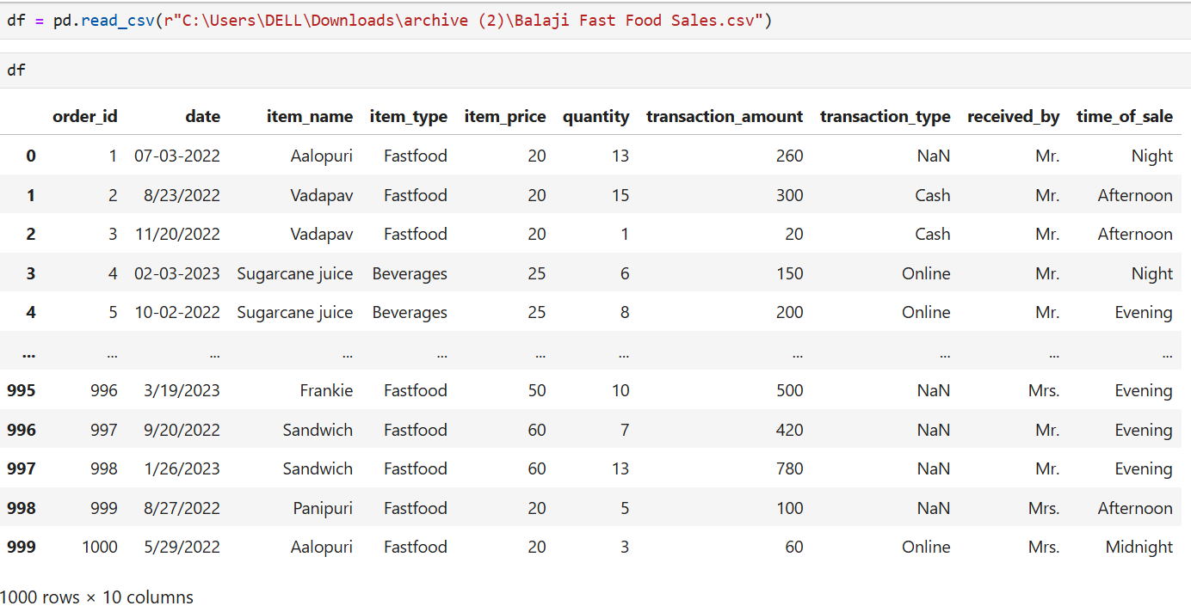

Reading Dataset :

Slide 5
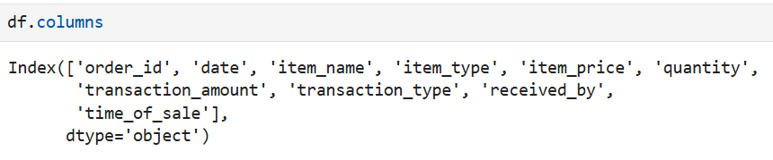
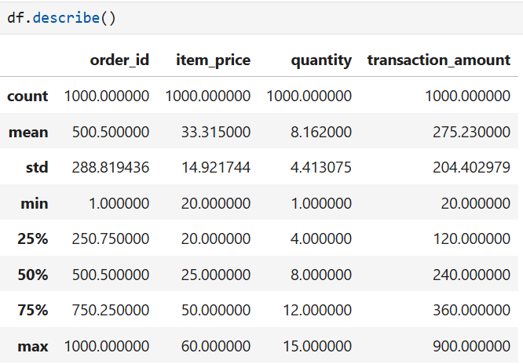
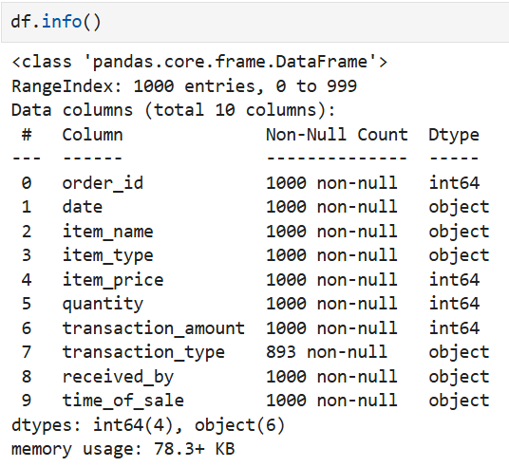
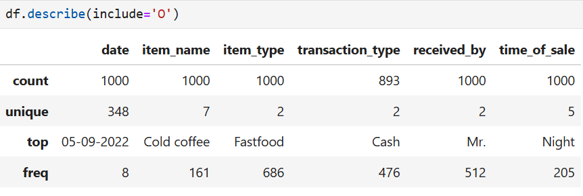

Basic Checks:
Columns of the Dataset:
Checking Summary Statistics of Numerical Columns:
Checking the Structure of the Dataset:
Checking Summary Statistics of Categorical Columns:

Slide 6
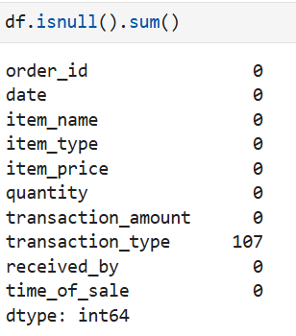


Preprocessing Techniques on Dataset Individual Columns:
Checking Missing Values:
One Column has missing values.
No Duplicates.
Now ,I want to perform some Preprocessing Techniques on columns like:
✔Handling Missing Values
✔Handling Inconsistence Data
✔Data Type Conversions
Checking Duplicates:

Slide 7
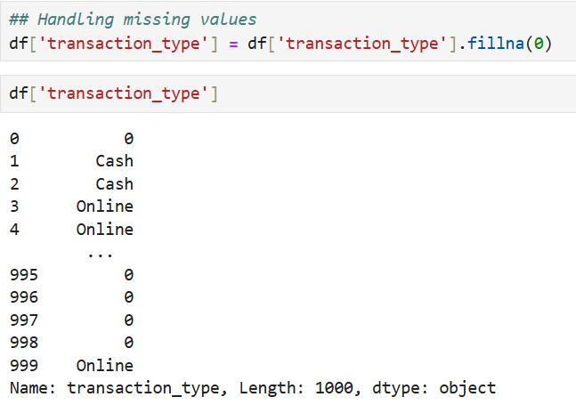
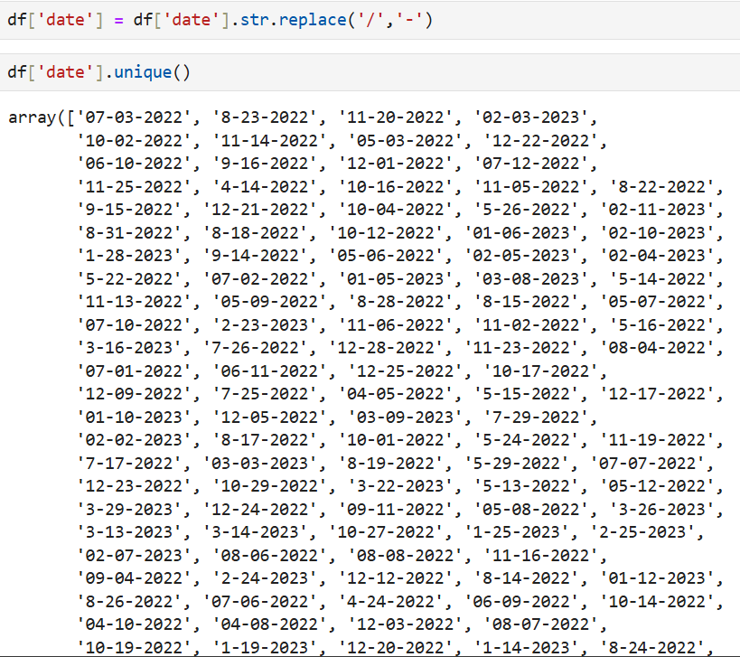

Handling Missing Values:
Handling missing values:
Handling missing values means identifying empty or null values in the dataset and treating them properly. Missing values are either filled or removed to avoid errors ans ensure accurate analysis.
Handling Inconsistence Data:
Handling inconsistent values means correcting data that represents the same information in different formats or spellings. Standardizing these values makes the data uniform and improves analysis results.
Handling Inconsistence Data:
Data Type Conversions:
Data type conversion invloves changing string values into appropriate data types such as numeric or datetime. This helps in correct calculations, proper visualization, and error free analysis.

Slide 8
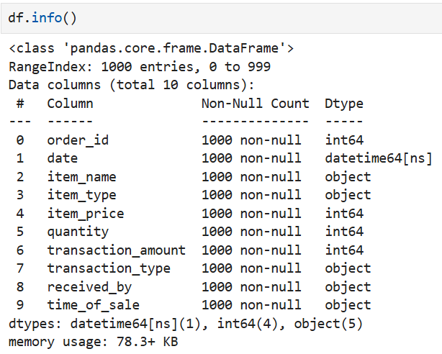
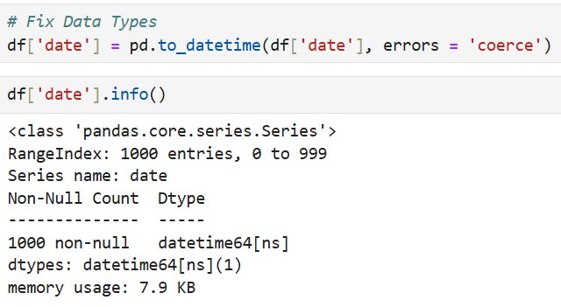
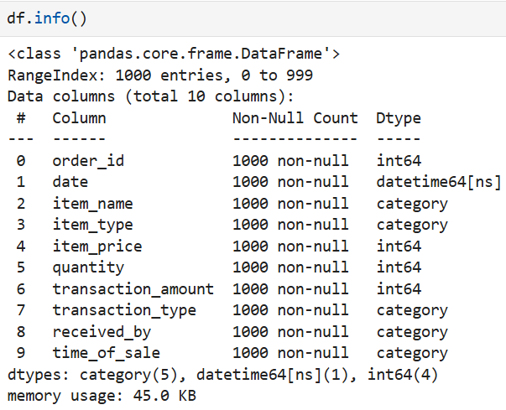
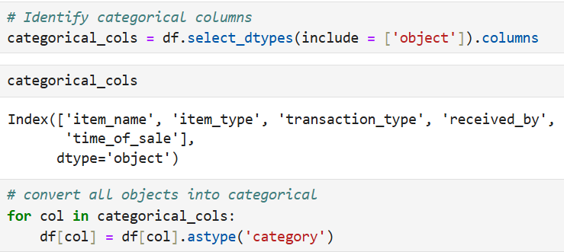

Data Type Conversions:
After Conversion:

Slide 9
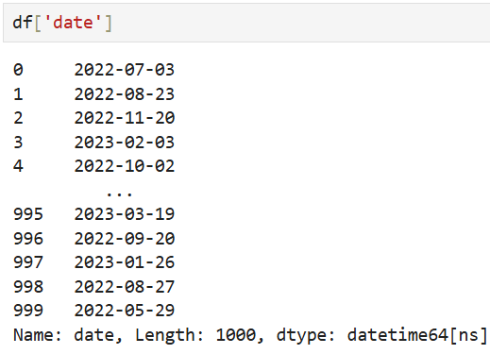
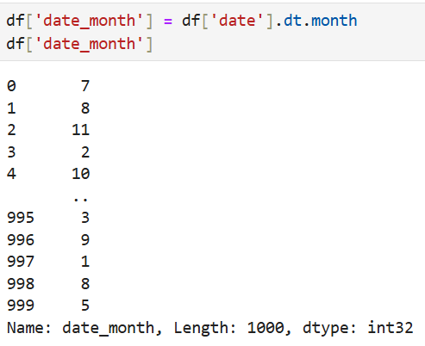
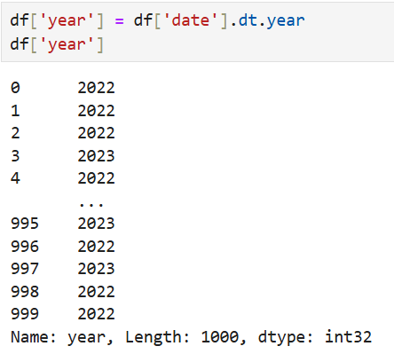
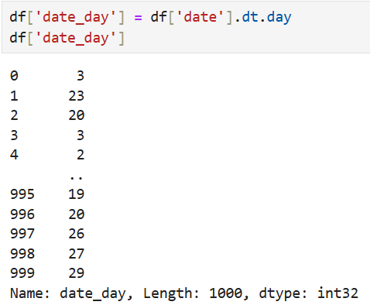


Slide 10
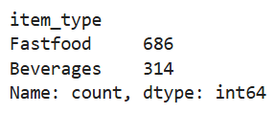
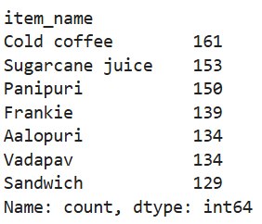
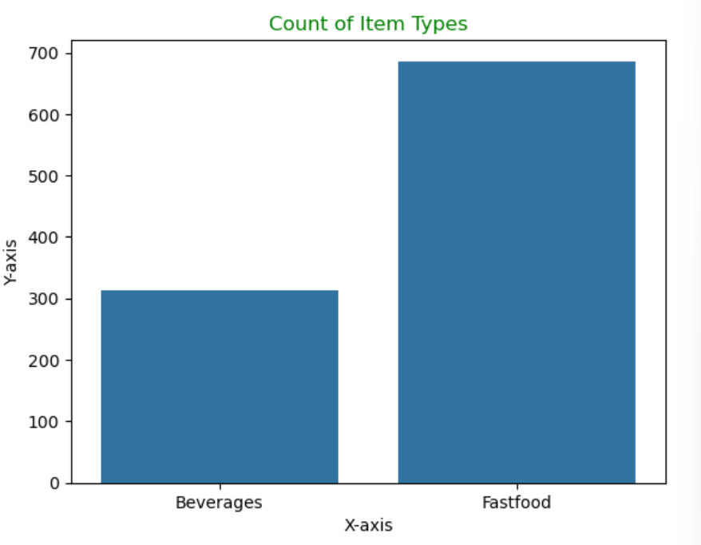
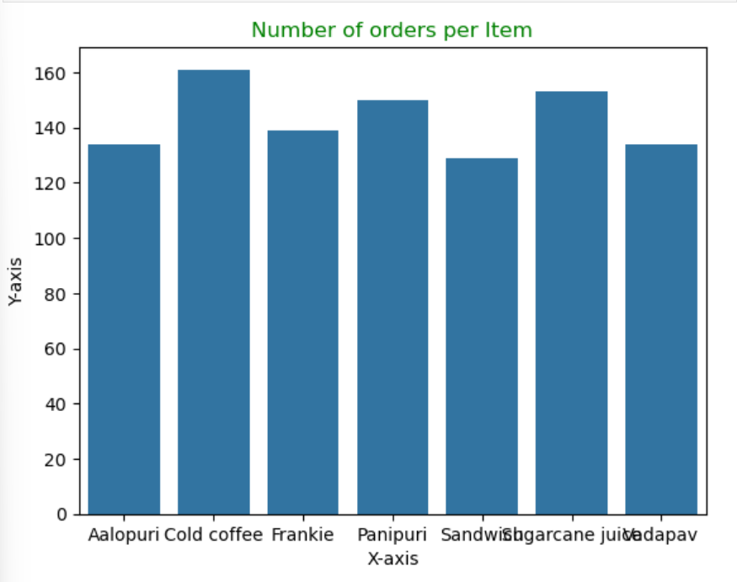

Data Analysis through Visualizations:
Univariate Analysis:
The chart shows the number of items in two categories. Fast food has more items than beverages. Beverages have a smaller count. This means fast food items are available in greater quantity.
This bar chart shows the number of orders for different food items. Cold coffee has the highest number of orders. Sandwich has the lowest number of orders. The remaining items have a similar number of orders. This shows which items are ordered more and less by customers.

Slide 11
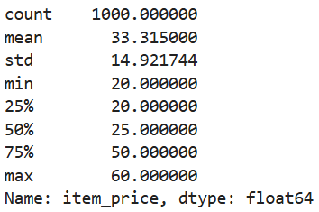
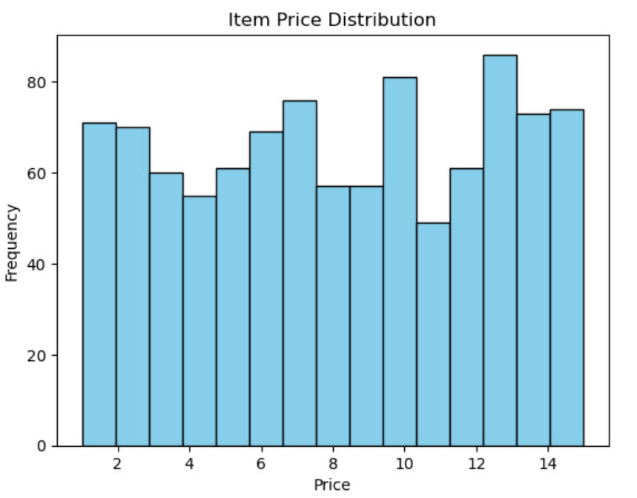
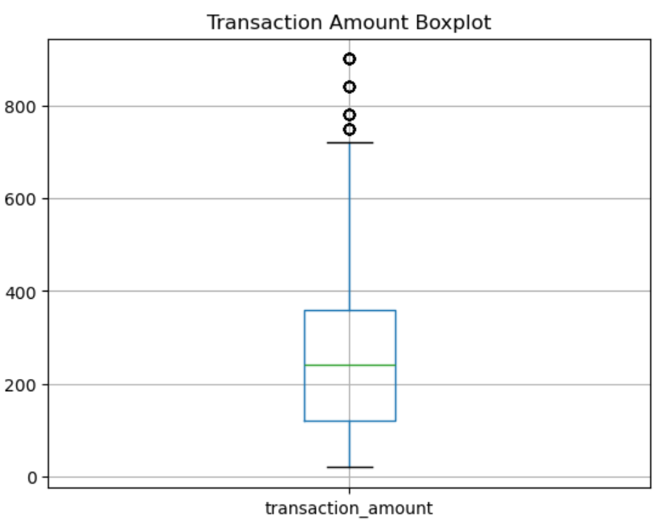

This chart shows how much money people spend. Most people spend a small to medium amount. Only a few people spend a lot of money.
This chart shows the prices of items. Most item prices are spread across different ranges, showing there are both low-priced and high-priced items.

Slide 12
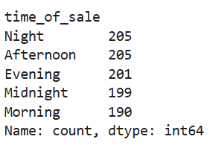
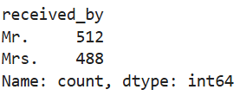
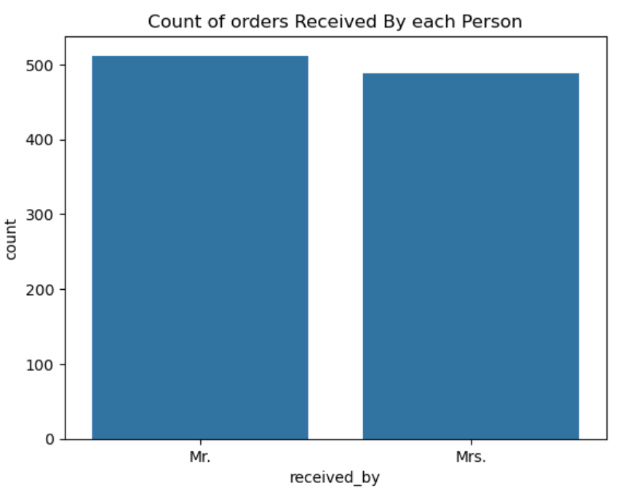
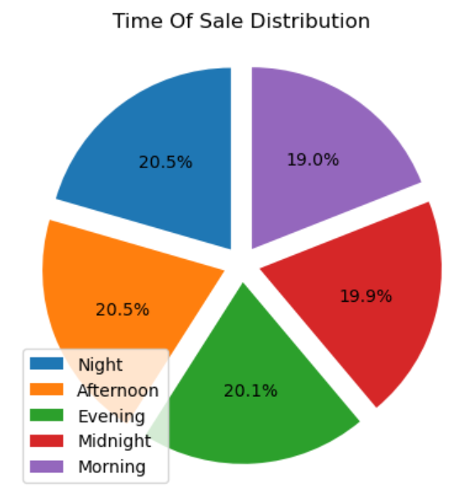

This pie chart shows sales at different times of the day. Sales are almost equal in the morning, afternoon, evening, night, and midnight.
This bar chart shows the number of orders received by each person. Mr. received slightly more orders than Mrs., but both received almost the same number of orders.

Slide 13
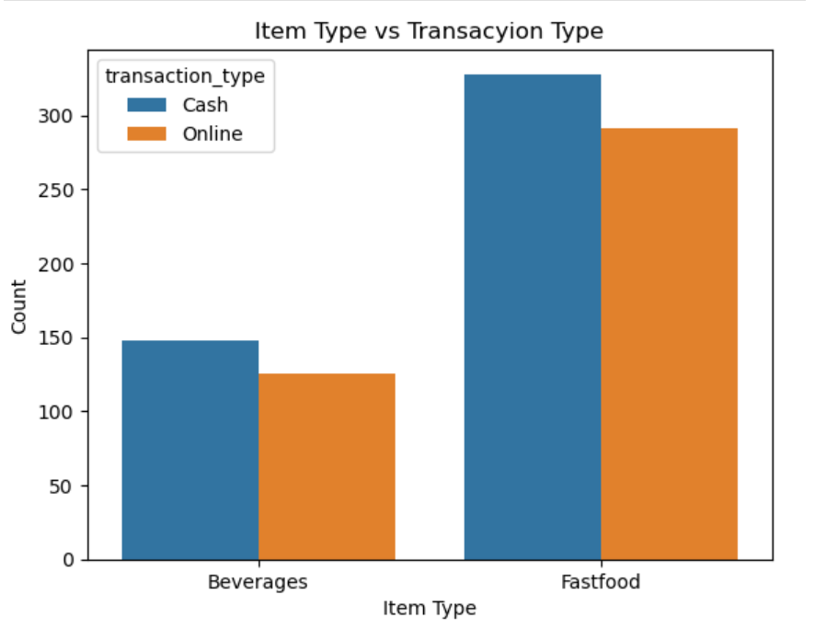
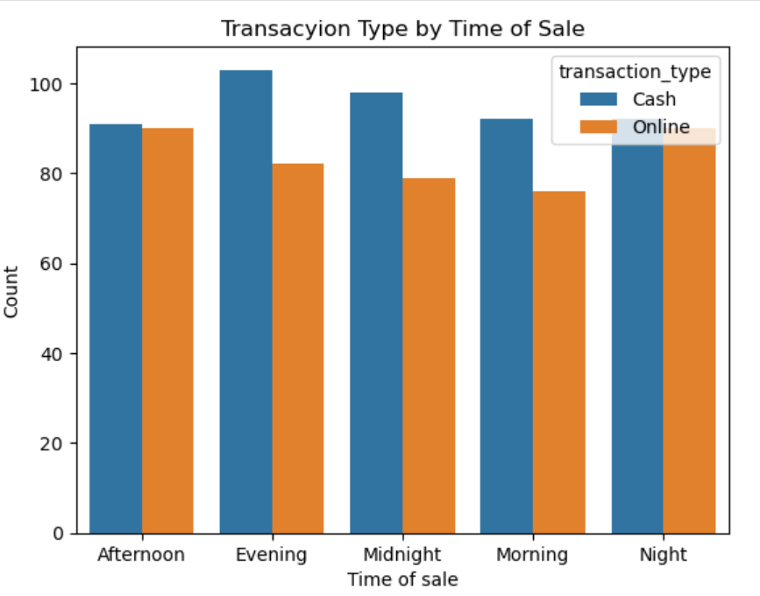

Bivariate Analysis-Categorical and Categorical:
This chart compares item types with payment methods. Fast food has more orders than beverages, and cash payments are used more than online payments for both items.
The bar chart compares cash and online transactions at different times of the day. Cash transactions are higher than online transactions in most time periods. The difference is especially noticeable in the evening.

Slide 14
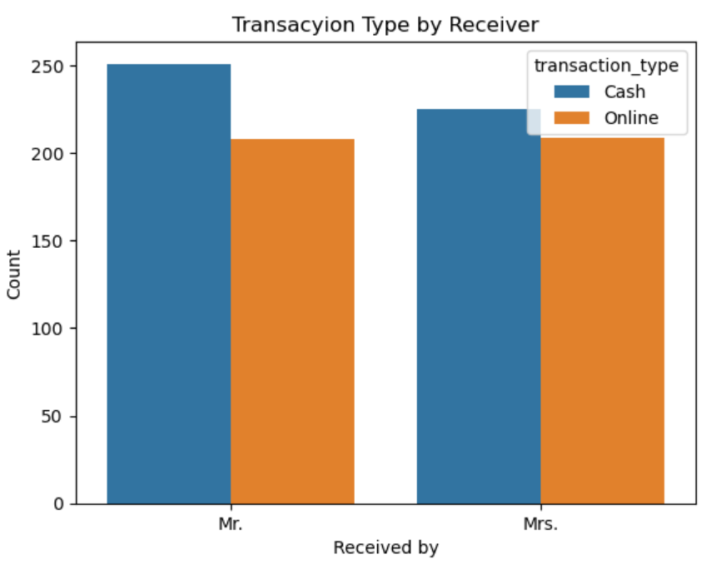
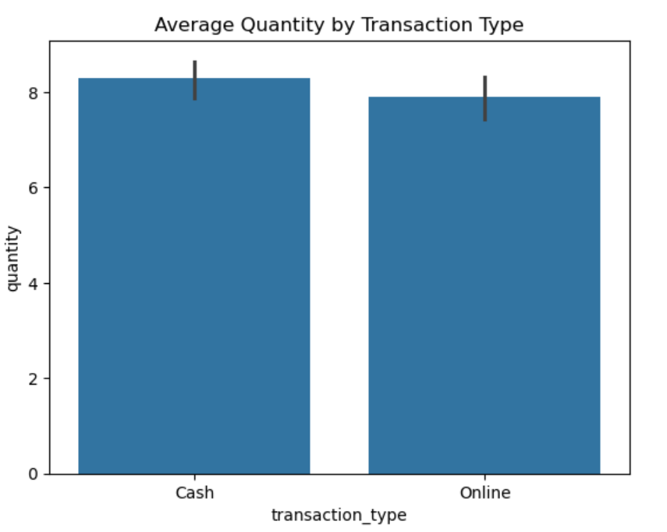

The bar chart shows cash and online transactions received by Mr. and Mrs.
Mr. received slightly more total transactions than Mrs.
For both receivers, cash transactions are higher than online transactions.
The bar chart shows the average quantity for cash and online transactions.
Cash transactions have a slightly higher avereage quantity that online transactions.
The error bars indicates variation in the average values.

Slide 15
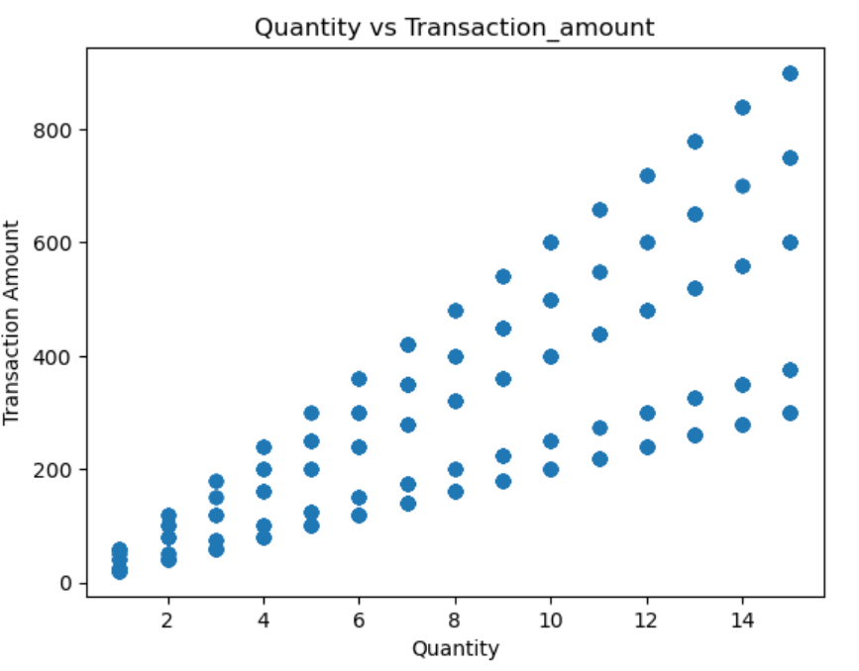
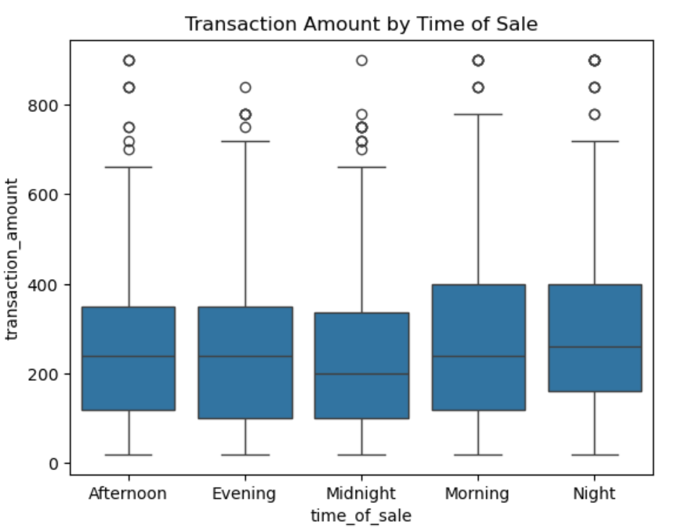

The scatter plot shows the relationship between quantity and transaction amount.
As quantity increases, the transaction amount generally increases.
The spread of points shows variation in transaction amounts for smiliar quantities.
The box plot shows transaction amounts across different times of the day.
The median transaction amount is similar for all periods.
Morning and night show slightly higher variation and higher maximum values.
Outliers are present in all tim periods.

Slide 16
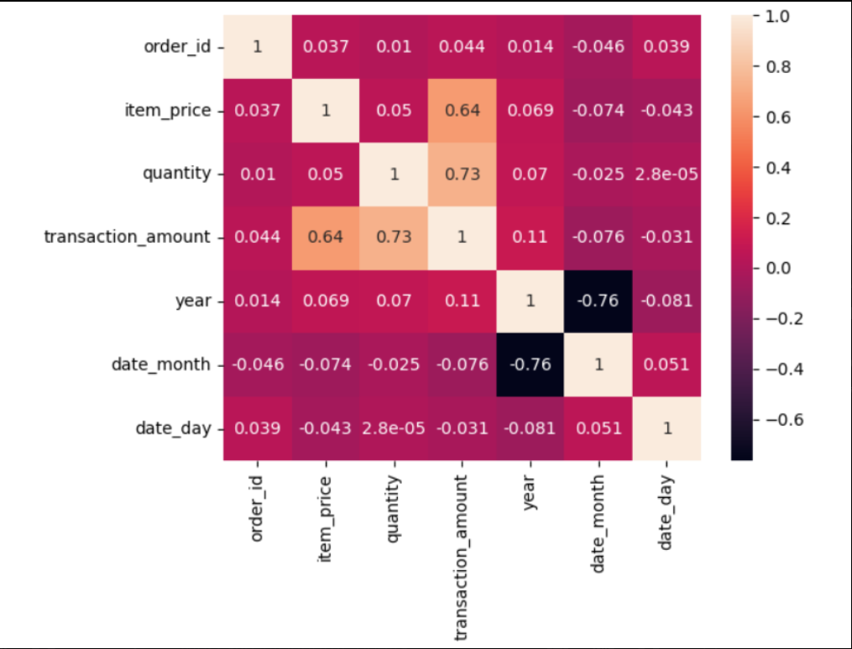

Multivariate Analysis:
https://discord.com/channels/@me/1432287560759115841/1457616108856016968https://discord.com/channels/@me/1432287560759115841/1457616108856016968
This chart shows how strongly different values are related to each other.
Numbers close to 1 mean strong relation, 0 means weak, and negative means opposite relation.

Slide 17
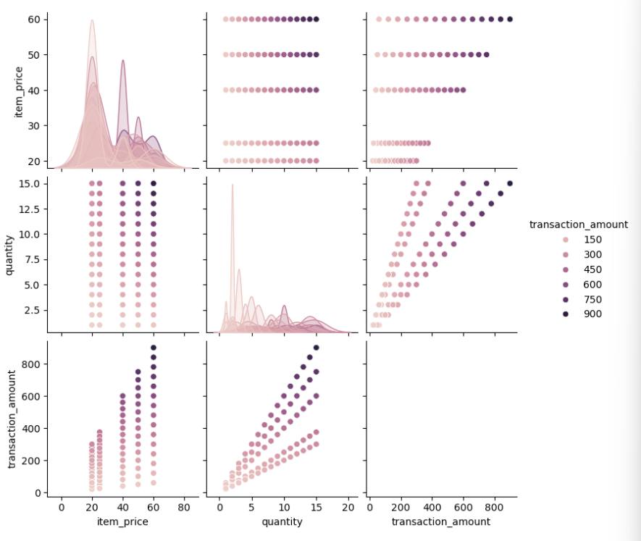

This chart shows the relationship between item price, quantity, and transaction amount.
Darker dots mean higher transaction amount.

Slide 18
Thank you
Adapt it with your needs and it will capture all the audience attensions.

