Slide 1

Screen time and Sleep
Sasha Johnson

Slide 2
Does Screen time have a relationship with sleep hours ?

Slide 3
Null and Alternative Hypothesis
H₀: There is no relationship between screen time and sleep hours
H_{a}: There is a relationship between screen time and sleep hours

Slide 4
Variables
Independent Variable
Screen Time
Dependent Variable
Sleep time

Slide 5
Data Collection
iPhone Screen tracking
Good old fashion alarm clocks**
** Sleep times were calculated from the previous nights total sleep – Not 12am to 12pm

Slide 6

So what?

Slide 7
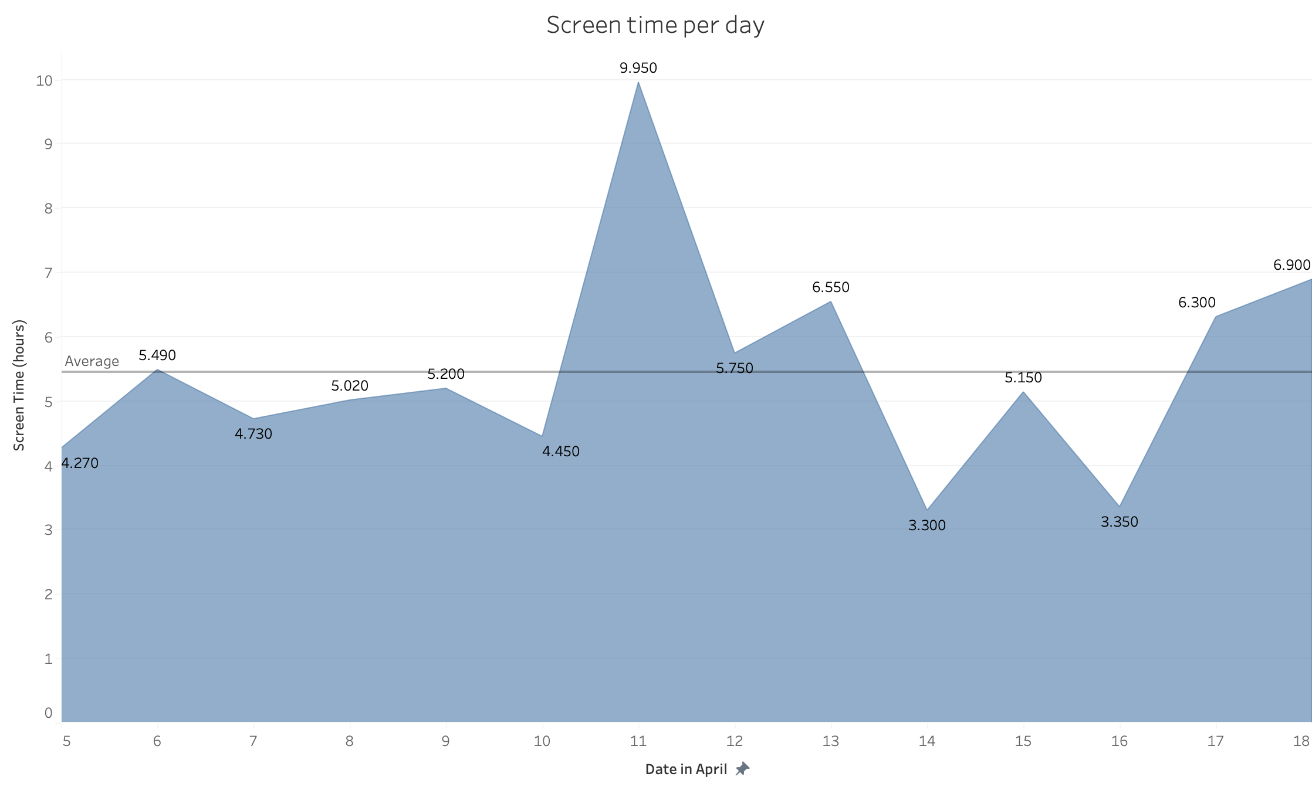

Slide 8
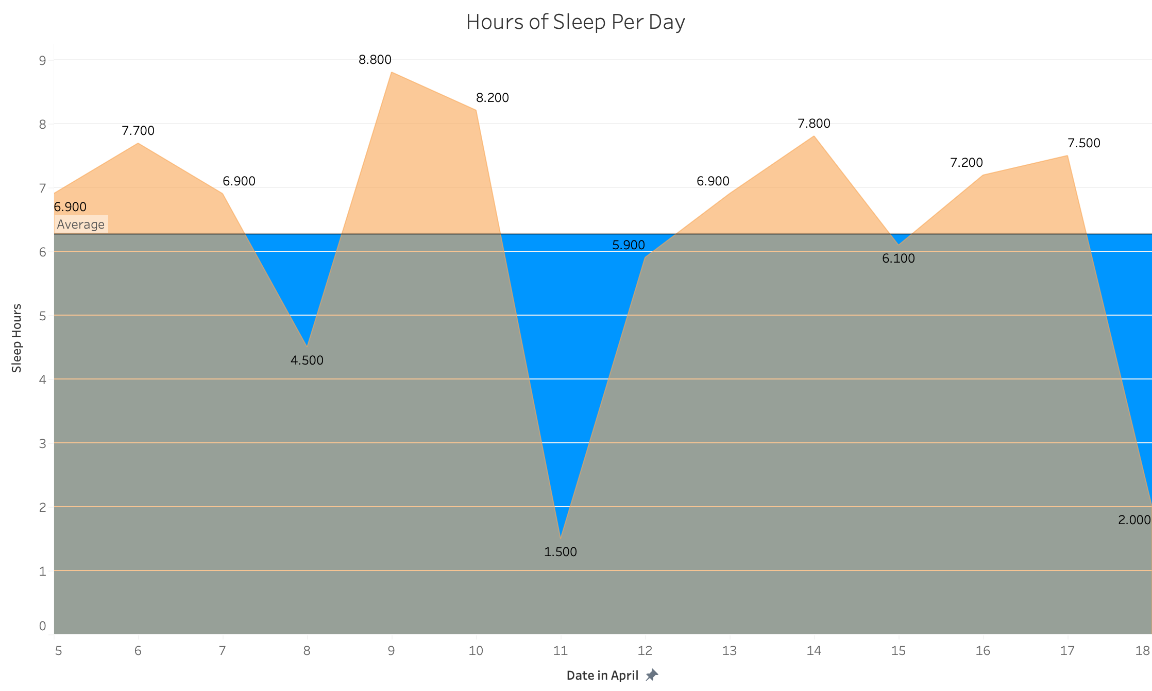

Slide 9
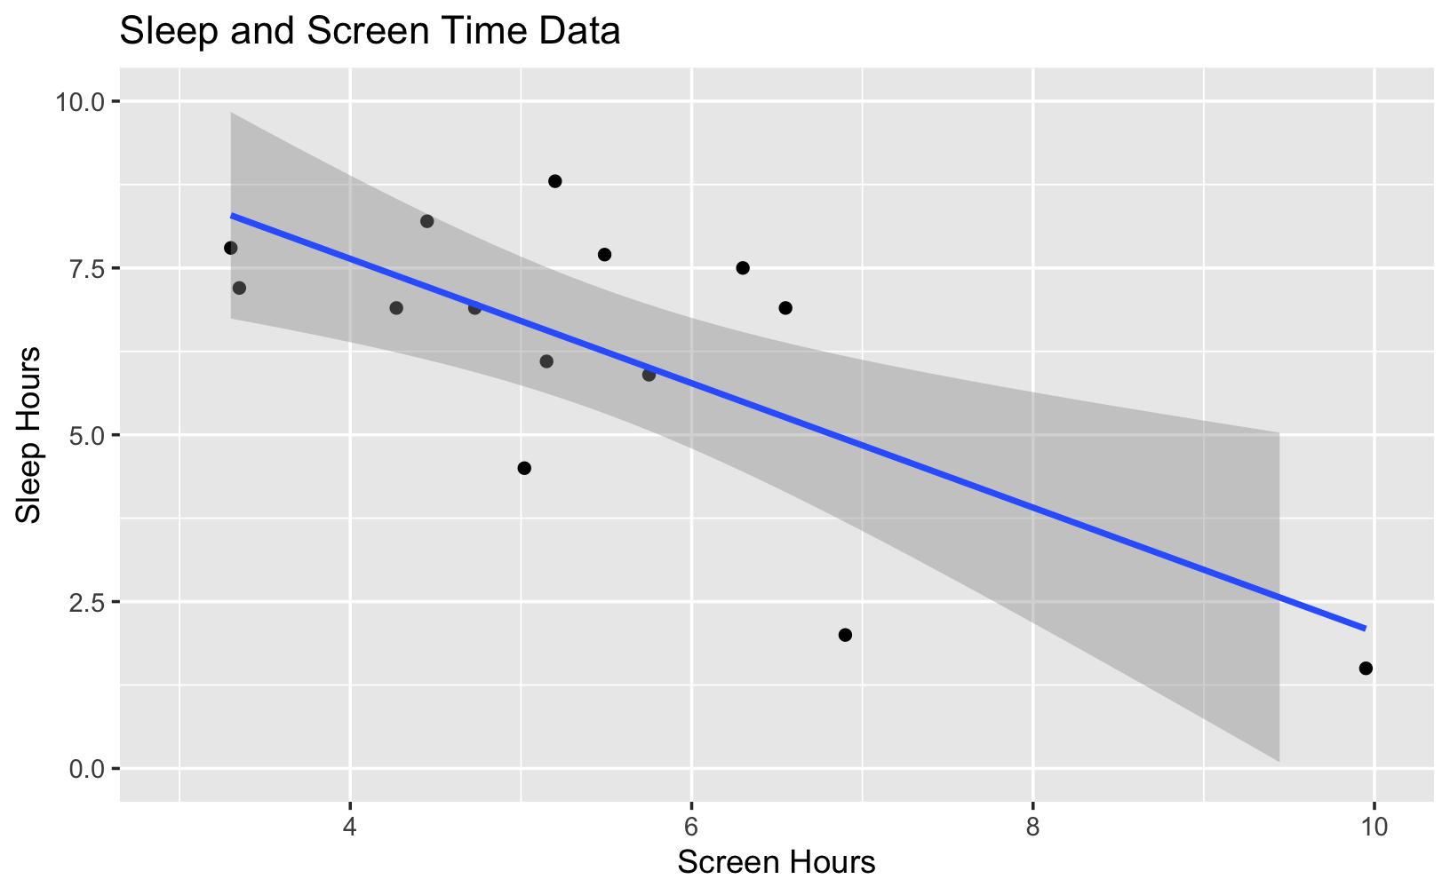

Slide 10
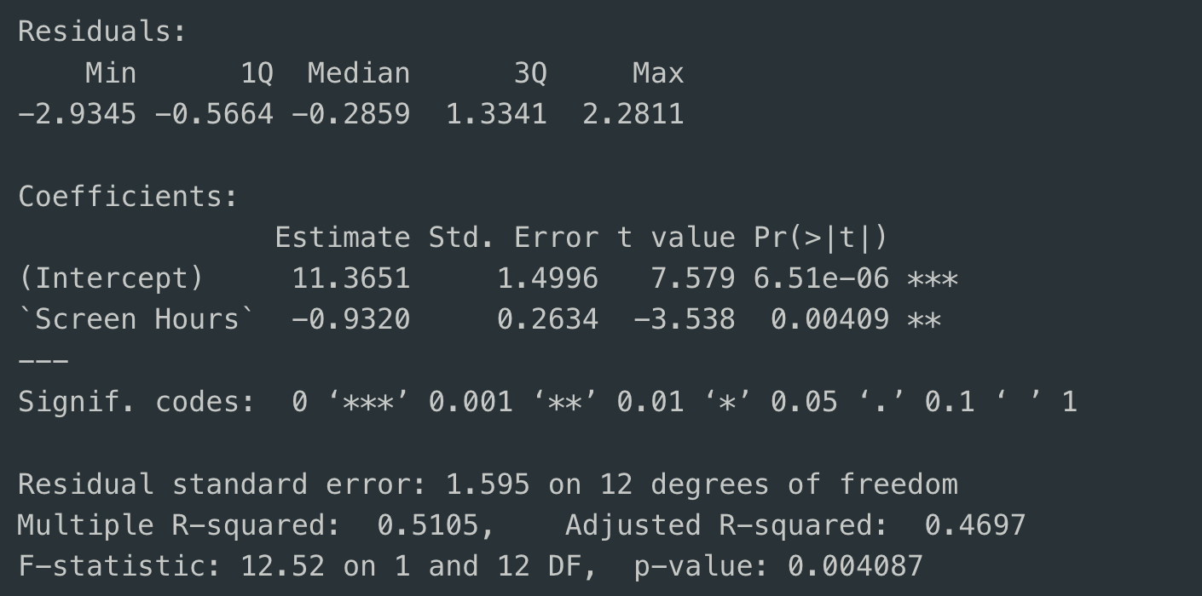

Slide 11
Conclusion
Get off the phone
Get to bed
There is evidence to support a negative relationship between my screen time and sleep time – Reject Null Hypothesis

Slide 12
Limitations
Small sample
Use maps for work
Traveling probably has a more substantial acute effect and can throw off data
Traveled more than typical last two weeks, like altered sleep and screen time

Slide 13
Github Repo
https://github.com/Sasb-Industries/Data211-project.git

