Slide 1
Airbnb Price Analysis
Sasha Johnson
Stat 311

Slide 2
Research Question
Which listing characteristics, host attributes, and availability factors significantly affect the price of an AirBnB listing?

Slide 3
What’s the point
Helps determine what drives pricing
Allows hosts to determine pricing strategy
Allows customers to make informed value decisions

Slide 4
Dataset

Slide 5
Inside Airbnb - https://insideairbnb.com/
Data on Denver, CO Airbnb listings
Approx 4,900 listings (raw)
4301 (clean)
Observational data
Gathered Sep 30, 2025

Slide 6
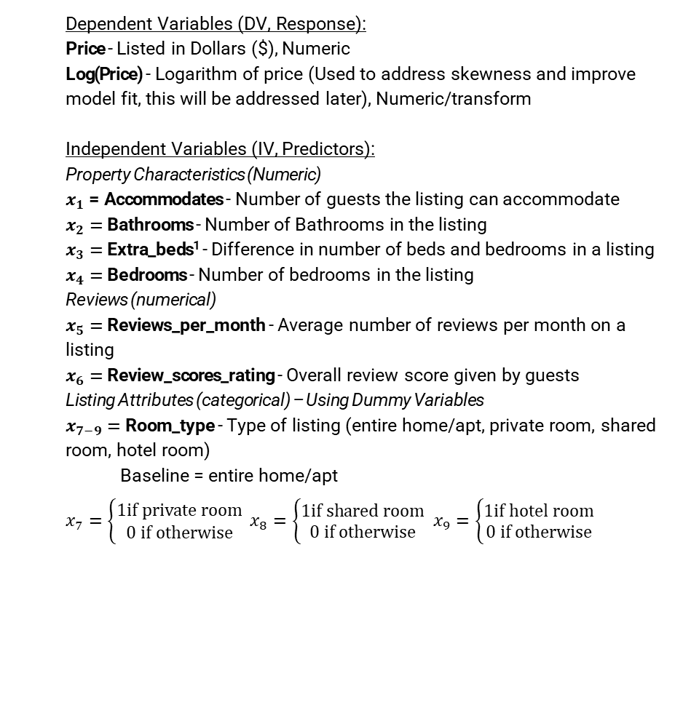
Variables
Dependent Variables (DV, Response):
Price - Listed in Dollars ($), Numeric
Log(Price) - Logarithm of price (Used to address skewness and improve model fit, this will be addressed later), Numeric/transform
Independent Variables (IV, Predictors):
Property Characteristics (Numeric)
$x_{1}$ = Accommodates - Number of guests the listing can accommodate
$x_{2}=$Bathrooms - Number of Bathrooms in the listing
$x_{3}=$Extra_beds¹ - Difference in number of beds and bedrooms in a listing
$x_{4}=$Bedrooms - Number of bedrooms in the listing
Reviews (numerical)
$x_{5}=$Reviews_per_month - Average number of reviews per month on a listing
$x_{6}=$Review_scores_rating - Overall review score given by guests
Listing Attributes (categorical) – Using Dummy Variables
$x_{7−9}=$Room_type - Type of listing (entire home/apt, private room, shared room, hotel room)
Baseline = entire home/apt
$x_{7}=\left\{\begin{aligned}1if private room \\ 0 if otherwise\end{aligned}\right. x_{8}=\left\{\begin{aligned}1if shared room \\ 0 if otherwise\end{aligned}\right.$ $x_{9}=\left\{\begin{aligned}1if hotel room \\ 0 if otherwise\end{aligned}\right.$

Slide 7
EDA
Exploratory Data Analysis

Slide 8
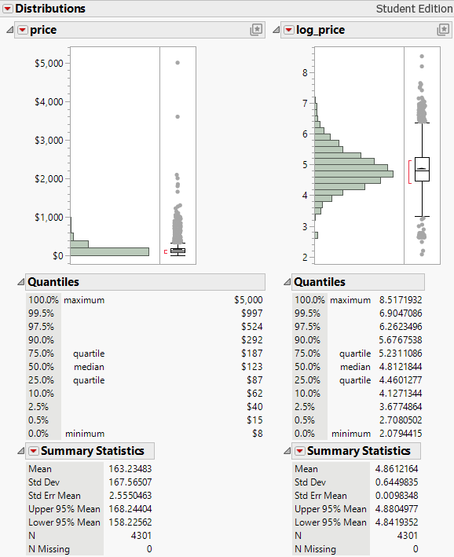
Response Variable
Price
Not symmetric
Heavy right skew
Lots of lower priced listings with few very expensive ones
Log(price)
More symmetric (normal)
Skew addressed
Outliers less apparent

Slide 9
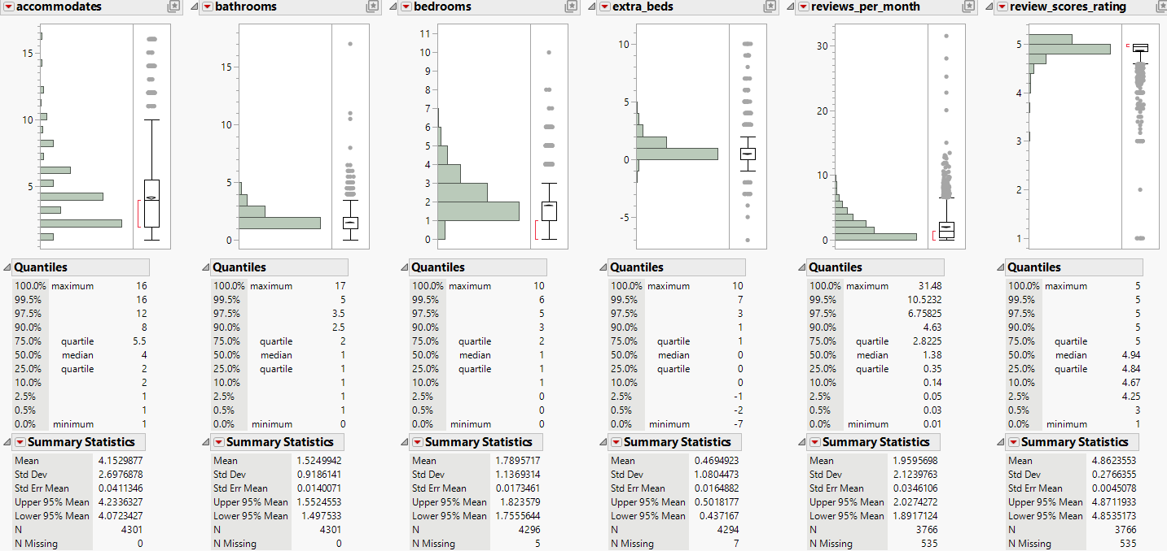
Summary of IV’s

Slide 10
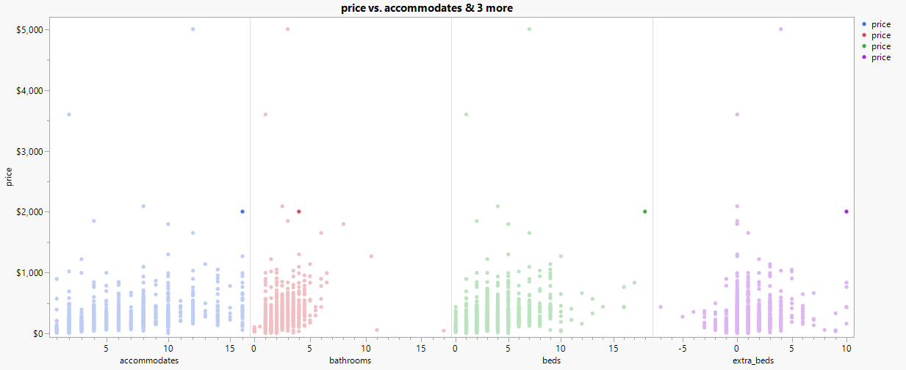
Price Vs

Slide 11
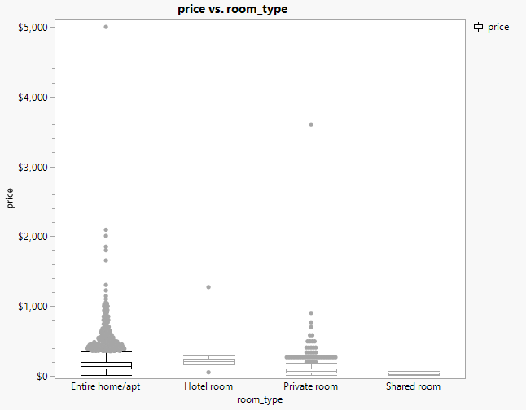
Price Vs Cont
Entire Home/apt most common listing
Entire Home/apt most variation and highest prices
Shared room low variation (low n) and lower prices (intuition)

Slide 12
Models
And modeling strategies

Slide 13
Model Strategy
Model 1 → full model based on raw price
Model 2 → simplified and improvement
Model 3 → Full model based on log(price)
Model 4 → simplified and improvement
Model | Response | Predictors | R² | Adj R² | RMSE | F-stat | Prob > F
Model 1 | Price | 9 | 0.3005 | 0.299 | 141.78 | 179.08 | <0.0001
Model 2 | Price | 7 | 0.2869 | 0.2857 | 141.69 | 246.29 | <0.0001
Model 3 | Log(Price) | 9 | 0.5184 | 0.5173 | 0.4374 | 448.78 | <0.0001
Model 4 | Log(Price) | 8 | 0.5184 | 0.5174 | 0.4373 | 505.00 | <0.0001

Slide 14
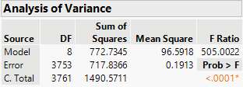
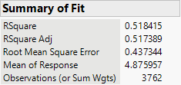
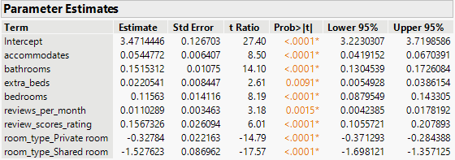


Model 4
$$E\left\{\log\left(y\right)\right\}=β_{0}+β_{1}x_{1}+ β_{2}x_{2}+ β_{3}x_{3}+β_{4}x_{4}+β_{5}x_{5}+β_{6}x_{6}+ β_{7}x_{7}+ β_{8}x_{8}$$
$$H_{O} : β_{i}=0 where i=1−8$$
$$H_{A} :at least one β_{i} ≠0 where β_{i}=1−8$$
Best metrics across the board
Explained about 51.8% of the variance seen in log(price)
Adj $R^{2}$ is almost same as $R^{2}$
Regression model assumptions were improved

Slide 15
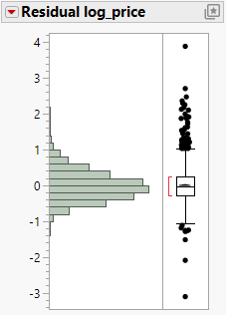
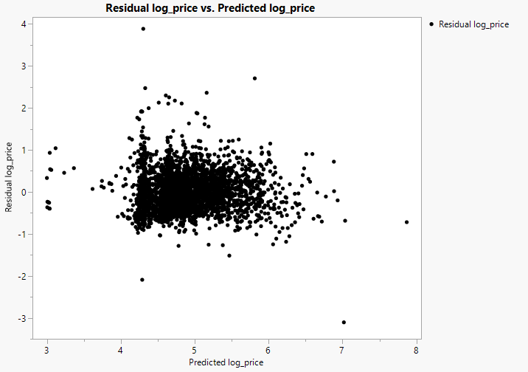
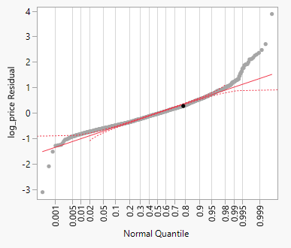
Residuals improved - Residual normality improved - Residual vs predicted funnel shape fixed

Slide 16
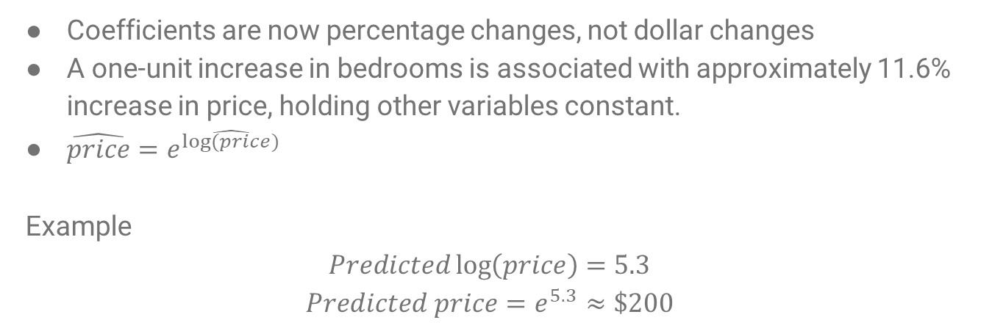
Interpreting log(price)
Coefficients are now percentage changes, not dollar changes
A one-unit increase in bedrooms is associated with approximately 11.6% increase in price, holding other variables constant.
$\hat{price}=e^{\hat{log⁡(price)}}$
Example
$$Predicted\log\left(price\right)=5.3$$
$$Predicted price=e^{5.3}≈\$200$$

Slide 17
Conclusion
Listing size drives price
Accommodates, Bathrooms, bedrooms, extra beds
Room Type matters
Reviews Matter
Log model works best

Slide 18
Limitations
Only valid for Denver, CO
Not comparing seasonal changes
Observational Data
Influential Outliers

Slide 19
Questions ?

