Slide 1
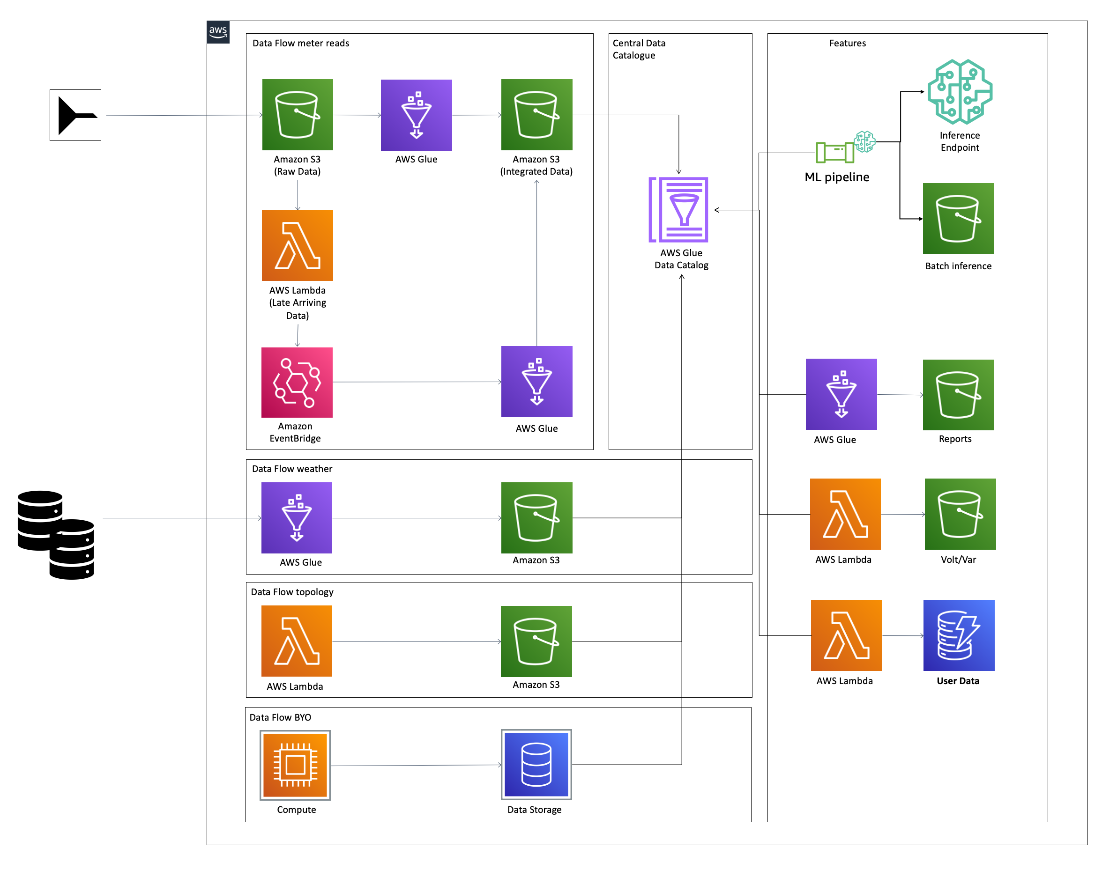
Figure 1. QuickStart architecture for MDA on AWS
As shown in Figure 1, the QuickStart sets up the following:
An extract, transform, load (ETL) pipeline:
S3 buckets to store data from the meter source system. Staging and Integrated data are stored in separate S3 buckets.
An AWS Glue workflow:
Crawlers, jobs, and triggers to crawl, transform, and convert incoming raw meter data into clean data in the desired format and partitioned business data.
Data Catalog to store metadata and source information about the meter data.
Amazon EventBridge which receives an event as soon as late dater are detected on ingestion
An ML pipeline:
AWS Step Functions workflows:
Batch processing, which uses the partitioned business data and the data from the model as a basis for forecasting.
Model training, which uses the partitioned business data to build an ML model.
Amazon S3 for storing the processed data.
Amazon SageMaker for real-time forecasting of energy usage.
AWS Lambda to query the partitioned business data through Amazon Athena or invoke SageMaker to provide API query results.
Amazon API Gateway to deliver API query results for energy usage, anomalies, and meter outages.

Slide 2












AWS Cloud
Weather data
Weather data
Topology data
Load topology data
Topology data
AWS Step Functions model training workflow
MDM and HES system meter data
Raw data
Transform meter data
Partitioned business data
AWS Glue Data Catalog
Amazon SageMaker
Process late data
ML model
AWS Step Functions batch processing workflow
Amazon EventBridge
Processed data
API query results
Amazon Athena
Query data
API Gateway
Figure 1. Architecture for the Utility Meter Data Analytics on AWS Partner Solution
As shown in Figure 1, the QuickStart sets up the following:
AWS Glue crawlers to transform meter data from MDM/HES systems into clean and partitioned business data.
Amazon Simple Storage Service (Amazon S3) buckets to store the following:
Weather and topology data from external databases.
MDM/HES system data.
Partitioned business data converted by AWS Glue crawler.
Processed data from the AWS Step Functions model training workflow.
AWS Lambda functions to do the following:
Load and transform topology data from an external database.
Process late-arriving data.
Obtain API query results of partitioned business data and Amazon SageMaker inferences.
Amazon EventBridge to process and store late data in the correct partition.
AWS Glue Data Catalog for a central catalog of weather, topology, and meter data.
Amazon Athena to provide query results of partitioned data.
Two AWS Step Function workflows.
Model training to build an ML model using partitioned business data.
Batch processing of partitioned business data from AWS Glue Data Catalog and ML model data for use in energy usage forecasting.
Amazon SageMaker to generate energy usage inferences using the ML model.
API Gateway to deliver query results for energy usage, anomaly, and meter outage.

Slide 3


AWS Cloud
Amazon EventBridge
Insert worker jobs
Generate readings and insert records
Amazon Timestream
Amazon SQS
AWS Cloud
Amazon EventBridge
Insert worker jobs
Generate readings and insert records
Amazon Timestream
Amazon SQS

Slide 4



AWS Cloud
AWS Step Functions workflow
HES simulator
Invoke file generation
Meter reads file
Check file generation status
Download generated file
File storage
Extract file
Event
Range extractor
Amazon SQS
Range worker
Amazon Kinesis

Slide 5


AWS Cloud
External database
Data loader
Purpose-built database
AWS Glue Data Catalog

