Slide 1
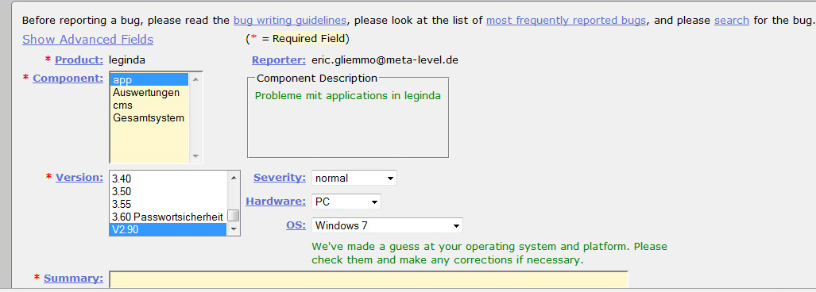
Product | Leginda
Reporter | eric.gliemmo@...
Component | app
Version | V2.90
Severity | normal
Hardware | PC
OS | Windows 7
Summary | ---
Product | Leginda
Reporter | ---
Component | app
Version | 3.40
Severity | not found
Hardware | PC
OS | ---
Summary | ---

Slide 2
Product | Leginda
Reporter | eric.gl...
Version | V2.90
Severity | normal
OS | Windows 7
bug tracking system
put our marked
report in a bug
tracker
apply our mining tool
mining tool
Product | Leginda
Reporter | eric.gl...
Version | V2.90
Severity | normal
OS | Windows 7
extract data
from the injected
bug

