Slide 1
Adaptive Issue Mining Through Data Tracking
Eric Gliemmo
Advisor: Sascha Just
Notes:
----- Besprechungsnotizen (20.02.14 00:02) -----
Name is..
Welcome..
give introduction..
sascha just....
-because don't started with the programming
talk about base frame & intention of my work

Slide 2








scenario
Notes:
----- Besprechungsnotizen (20.02.14 00:02) -----
-generally deal with bug reports and BTS...
-examples most popular most used trackers...
-(ein paar vorlesen)
-later runs we will primarily deal with SF, JIRA, BUGZILLA
-also in evaluation case respresentative ones

Slide 3
scenario
researchers mine bug tracker to extract information
analyze the bugs
reference them to the original code
to predict failures in the code
Notes:
----- Besprechungsnotizen (20.02.14 00:02) -----
-talk about the scenario...the way things stand at the moment...
-analysis of BT remarkable field in software mining...
-given dataset, researchers mine issues to connect to source code..
-extract information to predict failures in the program...
-we choose similar approach, but more on this later.....

Slide 4
problem
different bug tracking systems
different structure and components
various scales of classification
Notes:
----- Besprechungsnotizen (20.02.14 00:02) -----
-What are the problems of these methods...
-most obvious problem represents....
-different BTS have distinct...one tracker components neglected...
-or various scales....f.e. 5 levels of priority, the other 3
-all this leads to problems concerning f.e. the compare of results...

Slide 5
problem
Bugzilla
Redmine
SourceForge
standardised representation of issues
Notes:
----- Besprechungsnotizen (20.02.14 00:02) -----
-because of this difference...stand rep of issues desirable...
-and actually there is a need for it.
-f.e. at the augmenting software developer support symposium last year in ascona the desire for a stand view of BR became apparent...
-especially for evaluation case later, this stand very beneficial to compare bug reports among each other

Slide 6
problem
Bugzilla 4.5.0
development
Bugzilla 4.5.2
development
Bugzilla 4.5.1
development
changing API of bug trackers
Notes:
----- Besprechungsnotizen (20.02.14 00:02) -----
-next problem..
-software programs like BUGZ evolving and changing interface....
-fact very unfavourable for current issue miners,
-modifications remain undetected & mining software isn't working...
-or the data are not reliable anymore...
-furthermore no guarantee of the correctness...

Slide 7
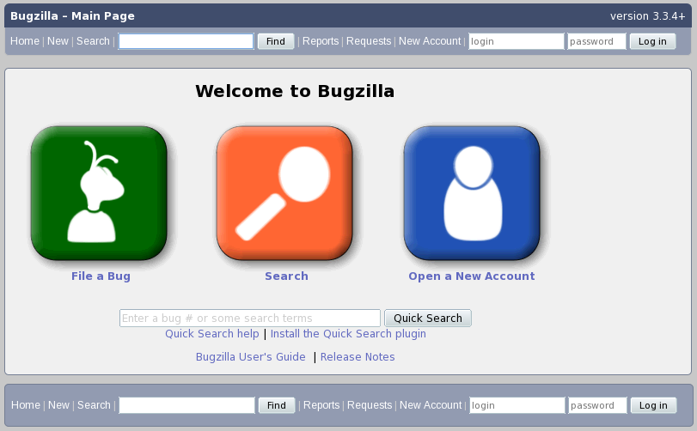
problem
Notes:
----- Besprechungsnotizen (20.02.14 00:02) -----
3.3.4+
-why?.. mentioned changing interface....
-small, but for bug miners crucial modifications....
-login visible, user able to login directly...

Slide 8
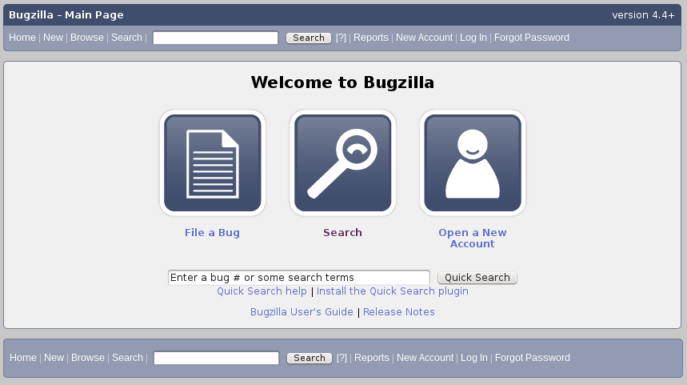
problem
Notes:
----- Besprechungsnotizen (20.02.14 00:02) -----
-for comparison 4.4+...
-user has to click login button first, befor being able to enter...

Slide 9
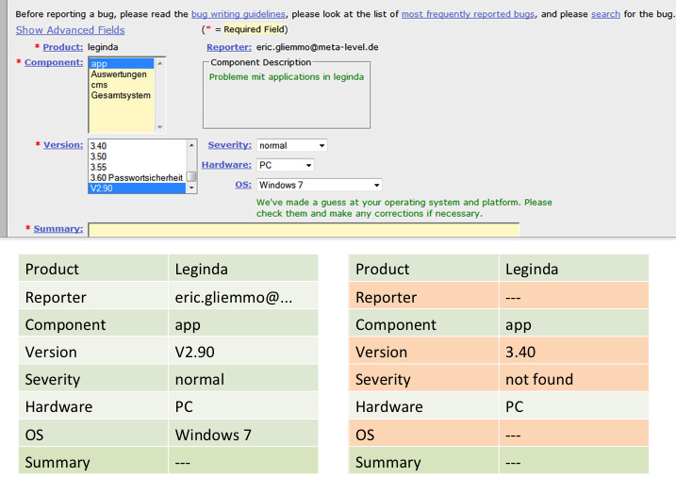
problem
Notes:
----- Besprechungsnotizen (20.02.14 00:02) -----
-these modif influence information miners want to extract...
-location of data could change, as in example...
-additional link could be necessary to access resp inf...

Slide 10
problem
how to access the data?
HTML – Web front end
Why HTML?
Notes:
----- Besprechungsnotizen (20.02.14 00:02) -----
-how acces data?...
-choose HTML surface.. why?
-all other poss. Rest API, RSS, SOAP or XML-RPC
incomplete or same problem as HTML - changing due to ch. interface
-web front end only pos. to mine that guarantee completeness...

Slide 11
solution
adaptive miner
standardized model of bug reports
generates mining plan
independent of tracking system
Notes:
----- Besprechungsnotizen (20.02.14 00:02) -----
-solution we provide...
-adaptive miner..mine bug reports independent certain TS
-method to have a stand model of bug reports...
-after that develop tool that generates mining plan..
-individual and independent of the TS...

Slide 12


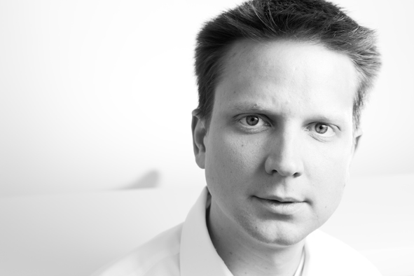
standardized tracker
Kim Herzig
Post-doc Researcher
Microsoft Research
Sascha Just
Software Engineering Chair
(Prof. zeller)
Notes:
----- Besprechungsnotizen (20.02.14 00:02) -----
-first part is stand....
-there already exists MOZKITO, that realises tasks..
-dev. by K.M & S.J. models bug reports in a way, that we can abstract all these tracker...
-MOZKITO mines, but not adaptive, but it yields a stand...

Slide 13
generate a mining plan
benchmark
mark fields of standardized bug reports
put them in a tracking system
retrieve the markers
create a mining plan
Notes:
----- Besprechungsnotizen (20.02.14 00:02) -----
-next step is to generate a mining plan...
-benchmark that covers all scenarios of stand view...
-2. we mark all the fields of obtained stand...
-every field unique sequence of letters, able to identify
-put the adapted bugs in BTS... than crawler
-crawler validate hyperlinks and html code...
-memorize where we found the markers...
-create mapping that clarifies which field found where...
-abortive goal obtain mining plan, gives instruction

Slide 14
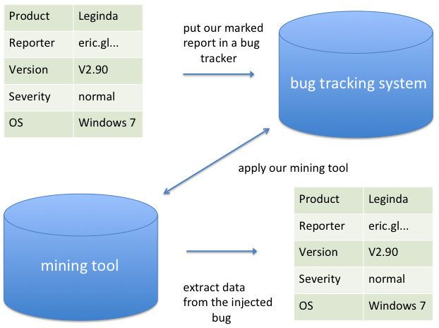
generate a mining plan
Leginda → $$##Product1: Leginda##$$
Notes:
----- Besprechungsnotizen (20.02.14 00:02) -----
-example of an mining process...
-example of an unique mark of one field...

Slide 15
retrieve the information
HTML surface of the bug tracker
Crawler searches the markers
have to remember the path to find
Notes:
----- Besprechungsnotizen (20.02.14 00:02) -----
-how to retrieve the information exactly?....
-1. access HTML surface of the BT...
-as mentioned before, search markers with crawler...
-if find, remember to path..

Slide 16
contribution
standardized view of bug reports
reception of a benchmark
approach of adaptive mining
Notes:
----- Besprechungsnotizen (20.02.14 00:02) -----
-what's the contirbution?...
-1. achieve a stand view of BR. --> MOZKITO...
-2. receive benchmark. create set of BR. Partly manually, partly extract from the MOZKITO data base
-additionally basis on which ither tools can test mining results...
-finally already discribed approach of adapt mining...

Slide 17
evaluation
apply our method to the benchmark
use three different kinds of tracking systems
SourceForge
JIRA
Bugzilla
Notes:
----- Besprechungsnotizen (20.02.14 00:02) -----
-to guarantee correctness, have to test and evaluate...
-obvious pos. apply method to our benchmark..
-also apply method to BR that are not part of that...
-to not limit ourselves to a particular case, 3 diff. kind of BT
SF, JIRA, BUGZILLA...

Slide 18
evaluation
choose a set of random bugs
put them into three bug tracking systems
compare the results after applying our tool with the original benchmark data
Notes:
----- Besprechungsnotizen (20.02.14 00:02) -----
-mean in detail?...
-choos a set of bugs, partly of us, partly extern...
-put in to BTS...
-after applying method, compare results with orig data...

Slide 19
results
perfect scenario
retrieve all information
equivalence to the original data
unsatisfying result
Notes:
----- Besprechungsnotizen (20.02.14 00:02) -----
-desirable results?...
-perfect scenario following...
-retrieve all information, are equivalent to orig data
-what would be unsatisfying result?
-of course the contrary... not... not

Slide 20
results
What problems could appear:
don‘t retrieve all information of the original reports
only two of three bug tracking systems yield good statistics
Notes:
----- Besprechungsnotizen (20.02.14 00:02) -----
-so what problems could appear?...
-one hand, won't retrieve all inf...
-other hand, only 2/3 or only one BTS yields good statistics, after evaluation progress...

Slide 21
future work
on-the-fly production of bug tracker miners, given a way to deploy our created data set
Interface Optimization and Data Traceability
Analyzing Web Service Front-End Evolution
aspects like security and testing
Notes:
----- Besprechungsnotizen (20.02.14 00:02) -----
-some words about the future work...
-if able to deploy data set, produce on-the-fly. advantage, if deployment defective, recognie because of original data set...
-further idea following: assume have mining plan, see how easy or laborius to gain access to data --> pursuing in direction of....
-given tool, knowing where & what data is delivered. analyze evolution of API ... themes like ... are close to our tool
-continue idea: is data output, that not output before f.e...

Slide 22
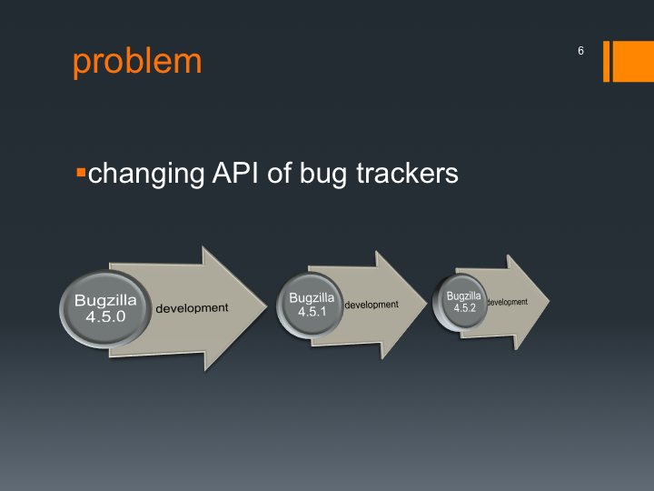
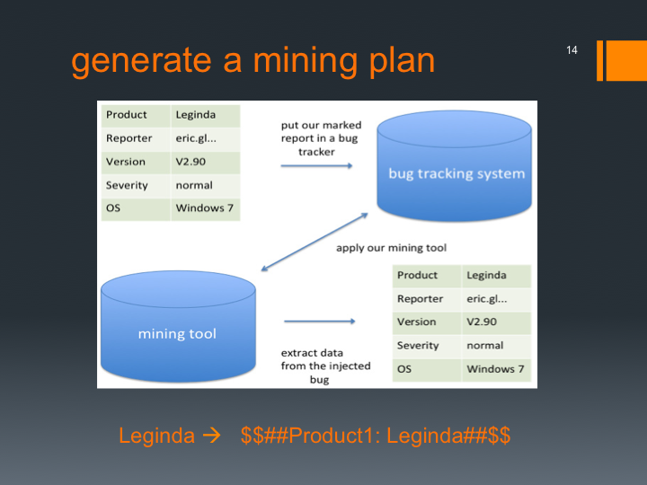
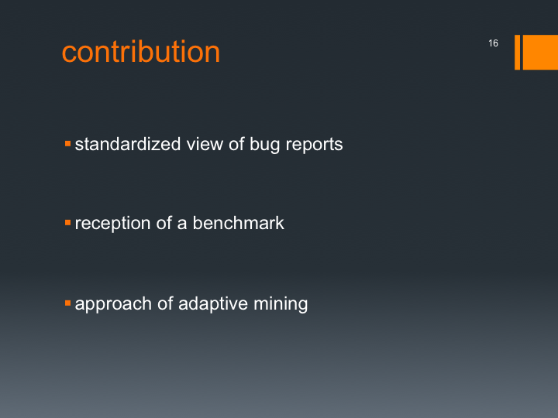
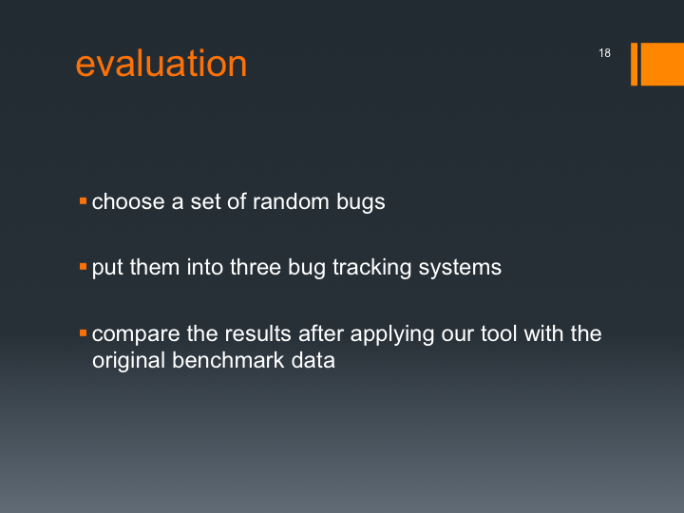
Notes:
----- Besprechungsnotizen (20.02.14 00:02) -----
- finally a short summary

