Slide 1


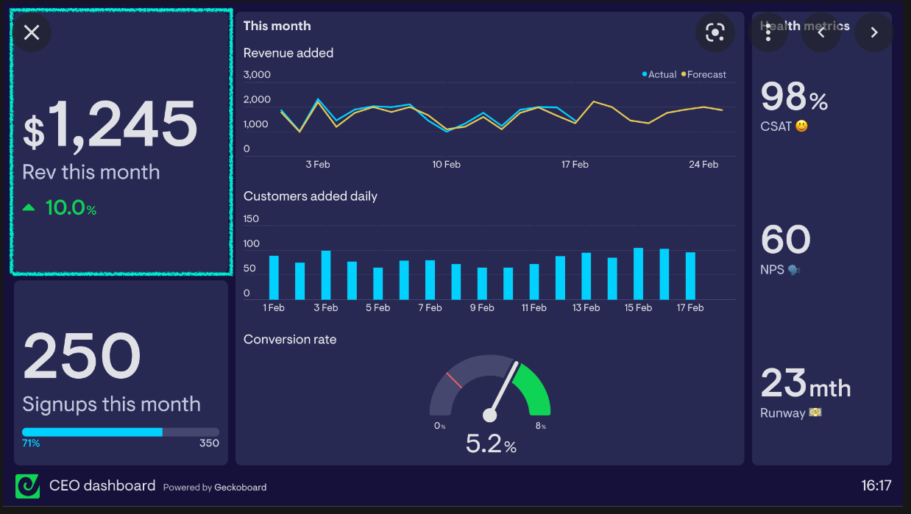
ICE Hockey Stats
Performance Board
Seasonal Stats
Team
Line
Player
Predictions
Team
Line
Player
Shot Tracker
Team
Line
Player

