Slide 1
SUPERSTORE SALES & PROFIT ANALYTICS
Power BI Interactive Dashboard
Project Presentation
Sales • Profitability • Customers • Regional Performance
Based on the Superstore Power BI dashboard shown in the project reference.

Slide 2
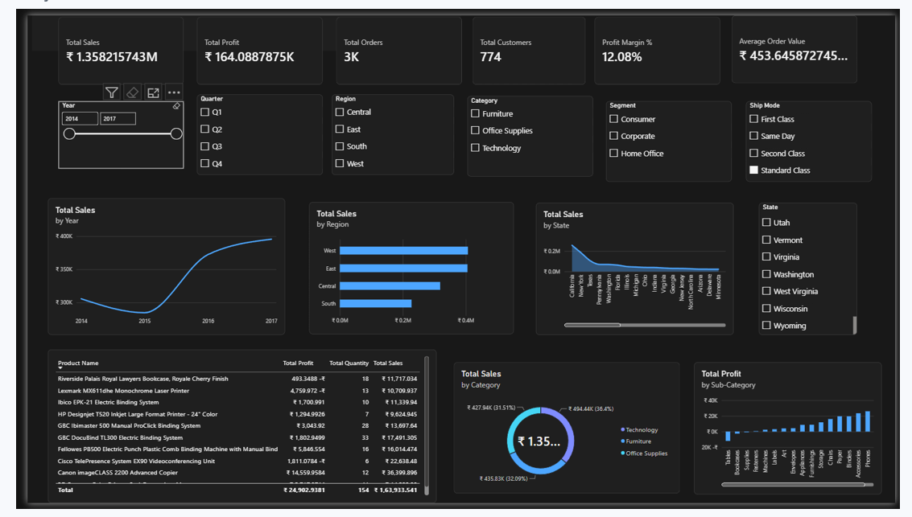
Power BI Interactive Dashboard
Overview of the dashboard and key business metrics
Dashboard includes KPI cards, filters, trend analysis, regional/state views, product details, category mix and sub-category profit.

Slide 3
Executive KPI Snapshot
Headline measures visible on the dashboard
Total Sales
Total Profit
Total Orders
₹ 1.358B
₹ 164.09K
3K
Overall revenue generated
Profit earned across orders
Approximate order volume
Total Customers
Profit Margin
Average Order Value
774
12.08%
₹ 453.65
Customer count shown
Profitability indicator
Average value per order

Slide 4
Key Performance Observations
Sales show a dip from 2014 to 2015, followed by a strong recovery and growth through 2016–2017.
The West and East regions are the strongest contributors to total sales, followed by Central and South.
Technology contributes the largest category share, while Furniture and Office Supplies also represent substantial portions of sales.
The state-level view indicates a concentration of sales in a small number of leading states, with the remaining states contributing smaller amounts.
The sub-category chart shows meaningful variation in profitability, highlighting opportunities to protect high-profit products and review weaker performers.
Interpretation is based on the visual patterns and KPI values displayed in the supplied dashboard.

Slide 5
Business Insights & Recommendations
Prioritize the West and East regions with targeted campaigns, retention programs and inventory availability.
Investigate the 2014–2015 sales decline to identify changes in customers, products, pricing or order mix.
Use category and sub-category profitability to guide product-level promotions rather than relying only on sales volume.
Focus on high-value customers and products to increase average order value while maintaining the 12.08% profit margin.
Build a recurring Power BI review using the existing filters for year, quarter, region, category, segment and ship mode.
Recommended actions should be validated with detailed transaction-level analysis before implementation.

Slide 6
Conclusion
The dashboard provides a single view of Superstore sales, profitability and customer performance.
It can be used to identify growth trends, regional opportunities, product-level profitability and areas requiring deeper investigation.
Thank You

