Slide 1

The Internet of Things
CHANGING HOW WE LIVE AND WORK
Service Management
IoT
Oleksandr Rotaienko
Notes:
Hello everyone, my name is Oleksandr Rotaienko, and I’m excited to welcome you to today’s presentation: “The Internet of Things – Changing How We Live and Work.”
Let’s start with a quick thought. Look around you—how many devices are connected to the internet right now? Your phone, laptop, smartwatch, maybe even a smart speaker at home or a car parked outside? We’re surrounded by things that are quietly exchanging information without our constant attention.
That’s what we’re diving into today—how these connected “things” are building a network of intelligence that is transforming everything from personal convenience to global industry. We’ll explore the core concepts of IoT, real-world applications, technical architecture, cybersecurity risks, the evolving tech stack, and the ethical questions it raises.
As IT professionals in training, understanding IoT is not just beneficial—it’s essential. Because this isn’t just another trend. It’s a foundational technology that’s reshaping the infrastructure of modern society.

Slide 2
Roadmap
01
What is the Internet of Things?
02
03
04
Why IoT matters?
Technical architecture
Real-world use cases
05
06
07
Cloud, Edge, and AI integration in IoT
Ethical and social implications
Security risks
Notes:
Before we start let me give you a quick overview of what we’ll cover today. We’ll start by defining IoT—what it is and how it works. Then, we’ll look at why it matters and where it’s used in the real world, especially in IT-heavy environments like smart cities and healthcare.
We’ll also speak how IoT systems are built—from sensors and networks to cloud platforms and user apps. We’ll cover some of the biggest security risks, including real-world attacks like the Mirai botnet. Then we’ll look at what the future holds, especially when you add AI, edge computing, and digital twins into the mix.
After finally, i’ll talk about roles in IoT—what kinds of jobs exist, what skills are needed.
Slide 2: What Is IoT and Why It Matters

Slide 3

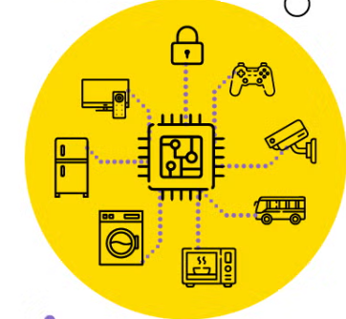
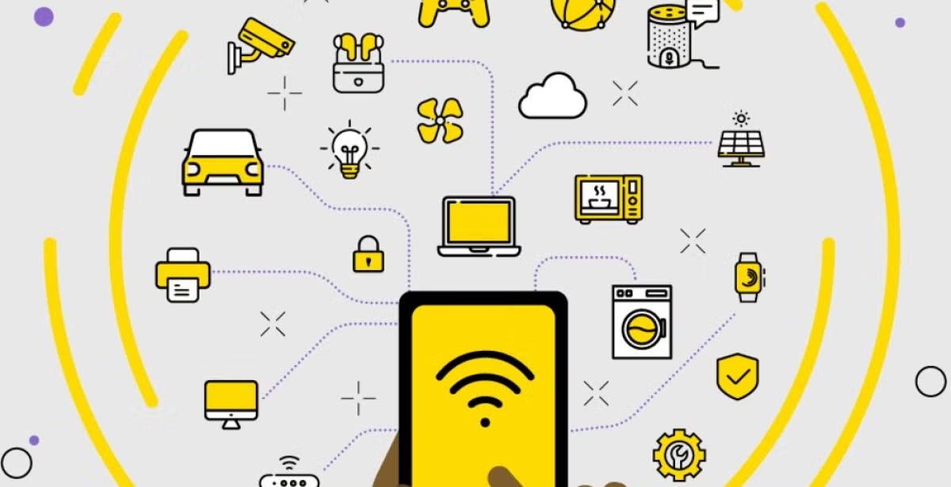
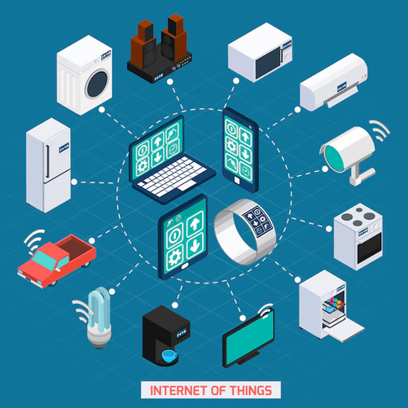
What Is IoT?
Connecting physical objects to the internet to collect and share data
Notes:
So what is the Internet of Things? It’s the idea of connecting everyday physical objects—like thermostats, smartwatches, factory machines, and even refrigerators—to the internet. These devices are embedded with sensors and software that allow them to collect and share data.
The power of IoT is in this constant stream of information. A smartwatch might track your heart rate and steps, but in a broader system—say, healthcare—it can send alerts to doctors in real-time. This is just one of many use cases we’ll explore.
Let’s make this more concrete. A smart thermostat like Nest learns your daily patterns—when you leave for work, when you return, what temperature you prefer at night. It uses sensors to monitor data, shares it with a central system, and adjusts accordingly. Multiply this by millions of devices, and you get an ecosystem that adapts to us in real time.
And IoT isn’t limited to homes. Think pacemakers that send alerts to doctors, or smart cities adjusting streetlights to pedestrian flow. These are not futuristic ideas—they are happening right now.
As we go deeper, remember this: IoT is not a single product or system. It’s a network of interconnected solutions, supported by IT infrastructure, protocols, data systems, and hardware. It touches nearly every part of modern life.

Slide 4
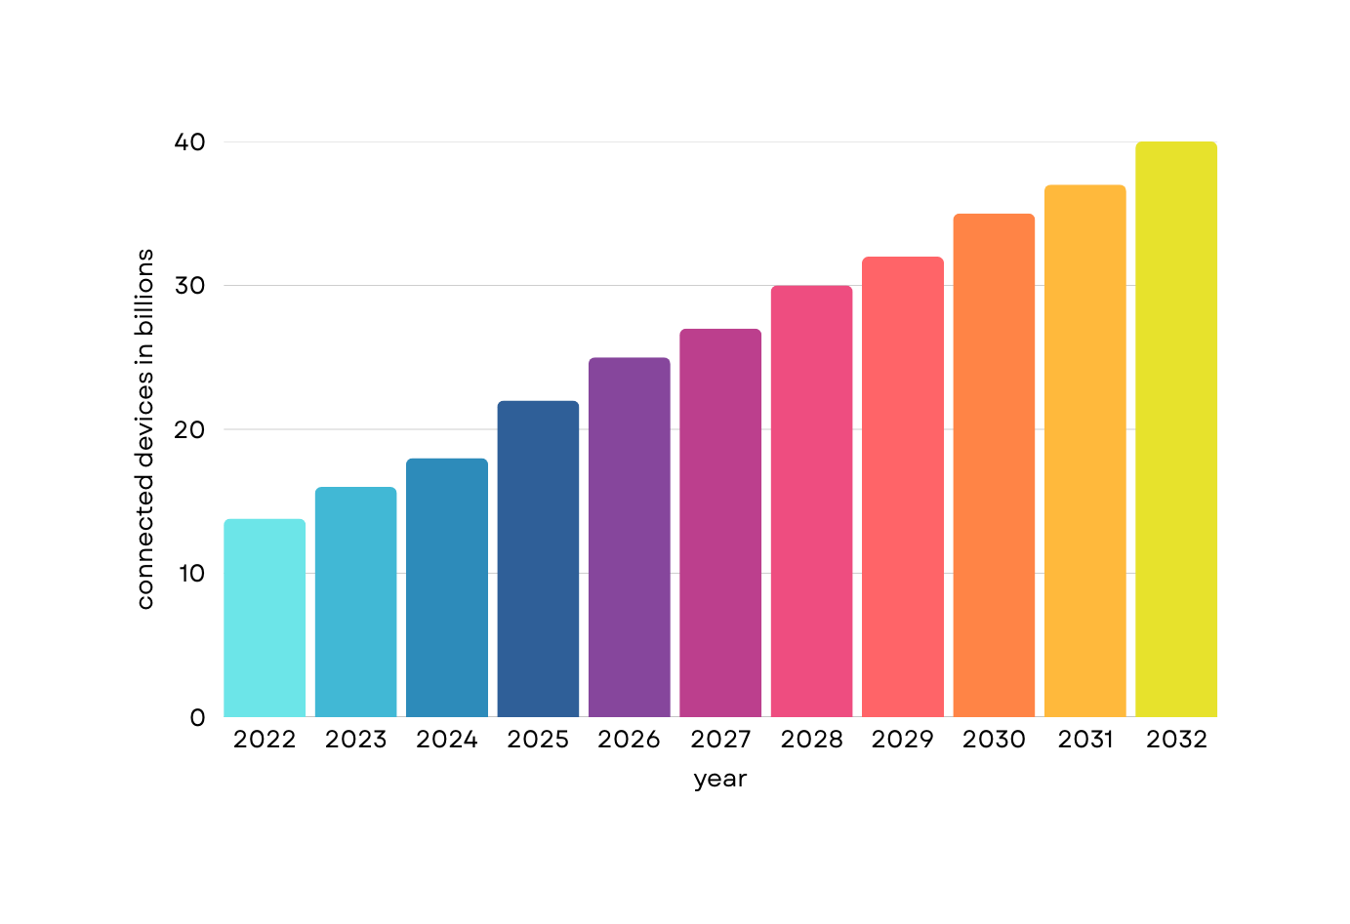

Why IoT Matters
25+ billion devices by 2030
Notes:
So why does IoT matter? For starters, it’s growing fast. By 2030, it’s expected there will be more than 25 billion IoT devices globally. That’s more connected objects than people.
This technology already affects our daily lives—from smart homes that save energy, to traffic systems that adapt in real time, to supply chains that optimize themselves. And this is just the beginning. understanding IoT means being ready for the next era of digital infrastructure.
Let me give you a few more numbers. According to McKinsey, IoT could unlock $11 trillion in economic value per year by 2030. That value comes from improved operations, cost savings, better data, and entirely new business models.
Consider agriculture: farmers use soil sensors and weather stations to automate irrigation. This saves water, reduces costs, and improves crop yields. In logistics, companies like FedEx and Amazon use IoT to track packages, optimize delivery routes, and manage fleet maintenance.
In the healthcare sector, IoT enables remote monitoring, reducing the burden on hospitals. Patients with chronic conditions can be monitored from home, saving time and improving care quality.
The impact is massive. But to make sense of it, we need to understand how these systems actually work. That’s where we’re heading next.

Slide 5
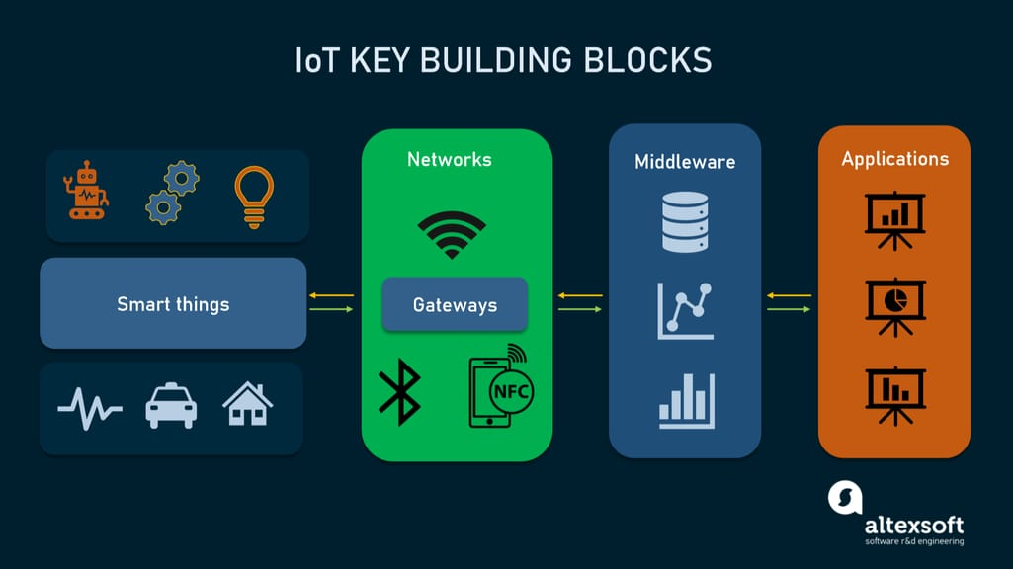
Core Architecture of IoT Systems
Notes:
Let’s now look at what makes IoT work under the hood.
At the foundation, we have the **Perception Layer**—this includes all the sensors and actuators. Sensors measure real-world inputs: temperature, light, motion, sound, humidity, etc. Actuators perform physical actions based on received instructions—like turning a valve or rotating a camera.
The data from these devices moves through the **Network Layer**. This can be Wi-Fi, Bluetooth, Zigbee, NB-IoT, 5G, or even satellite internet. The choice of protocol depends on the range, power, and bandwidth needs.
Once data is transmitted, it reaches the **Processing or Middleware Layer**. Here we filter, analyze, and sometimes make decisions. This is where cloud services or edge devices come into play. Platforms like AWS IoT Core or Microsoft Azure IoT Hub are often used here. If latency is critical, data is processed locally on the edge.
Finally, we reach the **Application Layer**, where users interact with the data. This could be a dashboard, mobile app, or even automated rules that trigger other systems.
In short, a full IoT system isn’t just about a sensor—it’s a combination of hardware, networks, cloud platforms, analytics, and user experience. Each part has to be optimized to handle potentially millions of devices and billions of data points.

Slide 6



Real-World Use Cases in IT and Industry
Smart Infrastructure:
Healthcare IT
Smart Factories (IIoT)
Cyber-Physical Systems:
+
Notes:
Slide 5: Real-World Use Cases in IT and Industry
Let’s take a closer look at how IoT is already being used across major industries—especially from an IT perspective.
First: **Smart Infrastructure**. Cities now use IoT to manage energy consumption, traffic flow, and public utilities. Sensors embedded in roads or streetlights monitor traffic and adjust signal timing dynamically. Water and energy grids use IoT to detect leaks or outages in real time.
Second: **Healthcare IT**. Hospitals are implementing smart beds, remote vitals monitoring, and RFID tracking of medical equipment. For patients, wearables collect data like heart rate, oxygen levels, and sleep patterns, which are automatically sent to doctors and stored in medical records—supporting real-time decision making. This also helps with compliance and audit trails under standards like HIPAA or GDPR.
Third: **Manufacturing and Smart Factories**. In IIoT (Industrial IoT), sensors on machines detect vibration patterns that might predict mechanical failure. That enables preventive maintenance, saving companies thousands in downtime. Digital twins simulate equipment or production lines based on real-world data.
Fourth: **Cyber-Physical Systems**. These are systems where software interacts with physical processes in real time—like autonomous vehicles or robotic surgery. They depend on ultra-reliable and ultra-low-latency IoT to function.
All of these examples require a solid IT foundation—reliable networks, cloud infrastructure, secure APIs, and good data management. IoT is not replacing IT—it’s becoming one of its most powerful extensions.

Slide 7
IoT Security Risks and Real Incidents
01
02
03
Problem 1
Problem 2
Problem 3
Default passwords and outdated firmware
Lack of encryption or authentication
The Mirai botnet (2016) hijacked hundreds of thousands of IoT devices to launch one of the largest DDoS attacks in history
Notes:
With all of this power and connectivity, security becomes a major challenge in IoT.
Most IoT devices are not built with security in mind. Many are low-cost, mass-produced, and run outdated or unpatched firmware. Common vulnerabilities include:
- Default usernames and passwords left unchanged
- No encryption during data transmission
- Open or unprotected APIs
- Physical tampering of devices in public spaces
One of the most well-known attacks was the **Mirai botnet** in 2016. It scanned the internet for IoT devices using default credentials, hijacked them, and turned them into a massive botnet. This botnet then launched a massive Distributed Denial-of-Service (DDoS) attack that temporarily took down major sites like Twitter, GitHub, and Netflix.
Why was this possible? Because security had been ignored at the device level. Cameras, routers, and DVRs were left exposed.
This teaches us that IoT security must be multi-layered:
- Firmware should be updated regularly
- Data should be encrypted at rest and in transit
- Devices should use secure boot mechanisms
- APIs should require authentication and limit access
And from an IT perspective, we need tools to monitor traffic, detect anomalies, and shut down threats before they spread across a network. Cybersecurity is not optional in the age of IoT—it’s critical.
IoT security is one of the most critical and overlooked aspects. Many devices are deployed without proper hardening—no updates, weak passwords, or insecure data transfers. A single vulnerable device can give attackers access to entire networks.
For example, the Mirai botnet used unsecured IP cameras and routers to build a massive attack network that crashed major websites. But it didn’t stop there—similar attacks have targeted smart baby monitors, connected cars like Tesla, and even pacemakers. These aren’t just technical threats—they’re real safety issues.
A key approach to modern IoT security is Zero Trust Architecture—never trust a device by default, even if it's inside your network. Devices must authenticate themselves and constantly prove their legitimacy.
There’s also the OWASP IoT Top 10, which outlines the most common security flaws in IoT systems, such as: weak authentication, insecure updates, lack of physical hardening, and exposed interfaces.
To protect IoT environments, we need layered defense strategies: encrypted data, strict access control, routine patching, and strong identity management. Security is no longer optional in the age of connected everything—it’s mandatory, and it must be designed from the ground up.

Slide 8
IoT + Cloud + Edge = The Future
Edge Computing
Local data processing reduces latency (e.g., AWS Greengrass, Azure IoT Edge)
Cloud Integration
AIoT
Digital Twins
Scalable data storage, ML/AI training models, centralized dashboards
AI + IoT = autonomous decision-making systems (e.g., smart surveillance, maintenance prediction)
Virtual models of real-world systems that mirror and predict behavior using live IoT data
Notes:
Now let’s look at where IoT is headed.
As the number of devices grows, it’s not practical—or safe—to send all data directly to the cloud. That’s where **Edge Computing** comes in. Instead of relying solely on central servers, edge devices—like gateways—process data locally. This improves response time, reduces bandwidth, and enhances privacy.
At the same time, the **Cloud** remains vital for storage, data lakes, analytics, and running machine learning models. Platforms like AWS IoT Core and Azure IoT Hub allow massive scalability and integration with other cloud services.
Now combine IoT with Artificial Intelligence, and you get **AIoT**—systems that not only collect data, but use it to make intelligent decisions. For example:
- Cameras that detect intrusions and alert security automatically
- Machines that schedule their own maintenance before failing
- Smart thermostats that learn your behavior and optimize energy use
And then there’s the concept of **Digital Twins**—real-time virtual models of physical assets. Imagine a wind turbine that constantly updates a 3D simulation of itself based on live sensor data. Engineers can use that model to predict wear and optimize performance before failures occur.
All of this creates a new kind of IT architecture—decentralized, intelligent, and highly adaptive. It requires new ways of thinking about system design, data flow, and integration.

Slide 9
Developer Roles and Tech Stack
Embedded Developer
IoT Architect:
Embedded Developer
Embedded Developer
Cybersecurity Specialist
Design entire system flow from devices to cloud
Write firmware for sensors and microcontrollers
Set up MQTT brokers, manage data pipelines on AWS IoT Core
Use tools like Grafana to visualize sensor trends or predict anomalies
Secure APIs, encrypt payloads, and test for vulnerabilities
Notes:
Now let’s look at where IoT is headed.
As the number of devices grows, it’s not practical—or safe—to send all data directly to the cloud. That’s where **Edge Computing** comes in. Instead of relying solely on central servers, edge devices—like gateways—process data locally. This improves response time, reduces bandwidth, and enhances privacy.
At the same time, the **Cloud** remains vital for storage, data lakes, analytics, and running machine learning models. Platforms like AWS IoT Core and Azure IoT Hub allow massive scalability and integration with other cloud services.
Now combine IoT with Artificial Intelligence, and you get **AIoT**—systems that not only collect data, but use it to make intelligent decisions. For example:
- Cameras that detect intrusions and alert security automatically
- Machines that schedule their own maintenance before failing
- Smart thermostats that learn your behavior and optimize energy use
And then there’s the concept of **Digital Twins**—real-time virtual models of physical assets. Imagine a wind turbine that constantly updates a 3D simulation of itself based on live sensor data. Engineers can use that model to predict wear and optimize performance before failures occur.
All of this creates a new kind of IT architecture—decentralized, intelligent, and highly adaptive. It requires new ways of thinking about system design, data flow, and integration.

Slide 10





Ethical and Social Implications of IoT
Autonomy vs. Automation
Data Privacy
Surveillance
Bias and Discrimination
Digital Divide
Notes:
Slide 9: Ethical and Social Implications of IoT
So far we’ve talked about the technology. But with great tech comes great responsibility. Let’s take a moment to discuss the ethical and social side of IoT.
First, **privacy**. When your smart speaker is listening for voice commands, is it also recording your conversations? Many people don’t even realize how much data they’re giving up—until something goes wrong.
Second, **surveillance**. Smart cities use IoT to optimize traffic, but those same cameras and sensors can be used to monitor citizens. In some places, this raises serious questions about civil liberties.
Third, **bias in data**. AI-powered IoT systems can unintentionally discriminate. For instance, facial recognition systems have shown racial and gender biases because of poor training data. When these systems are used in public spaces, the consequences can be severe.
Fourth, the **digital divide**. Not everyone has access to smart devices or fast internet. This creates inequality. As more services go online and become automated, people without access could be left behind.
Finally, **autonomy vs automation**. When systems make decisions without human input—like a self-driving car or an automated healthcare alert—we have to ask: when should a machine decide, and when should a human be involved?
As developers and engineers, we’re not just building tech. We’re shaping the future. So it’s on us to ask these questions—and build systems that are not just smart, but fair, inclusive, and respectful of human rights.
While IoT brings innovation, it also introduces ethical dilemmas. Devices that track movement, speech, or habits may violate personal privacy—sometimes without users realizing it. Moreover, as AI becomes part of these systems, we must ask: are the decisions fair and explainable?
Take surveillance, for example. In China, facial recognition is used in some cities for public security—but critics argue it crosses a line between safety and authoritarianism. What if that technology misidentifies someone? Or flags someone unfairly because of skin tone or behavior bias in the algorithm?
Then there's the question of access. Many people still don’t have high-speed internet, let alone smart devices. If healthcare or public services rely too much on IoT, these communities are left out—and inequality grows.
We also need to be cautious about over-automation. For instance, if a smart building automatically calls emergency services for someone who collapsed—what if it’s a false alarm? Or worse, what if it doesn’t trigger when it should?
As IT professionals, we shape the future—not just through code, but through choices. We must build systems that respect privacy, consider fairness, and are inclusive by design. Ethics isn't a side-topic—it's part of responsible development.

Slide 11
Final Thoughts
01
02
03
IoT is reshaping how we build and use IT infrastructure
Deep knowledge in networking, security, data, and systems architecture is essential
Edge + Cloud + AI is where innovation is heading
Notes:
We’ve covered a lot today, so let’s take a moment to recap.
IoT—The Internet of Things—is about connecting the physical world to the digital one. It allows us to automate, optimize, and transform industries and lifestyles in ways we never could before.
We talked about the layered architecture of IoT: perception, network, processing, and application. We explored real-world use cases—from smart agriculture and healthcare to smart factories and smart cities.
We looked at the risks—especially in security. We discussed the importance of edge computing, AI, and digital twins in the future of connected systems. And we identified roles that IT professionals like you can step into right now, whether you prefer coding hardware, building cloud systems, or securing networks.
But perhaps most importantly—we acknowledged the ethical responsibilities that come with this power. Technology isn’t neutral. How we design, deploy, and regulate IoT will have a deep impact on privacy, fairness, and inclusion.
So where do we go from here?
If you’re a student: start building small. Get your hands on a microcontroller, build a simple sensor network, connect it to a cloud dashboard. Learn how data flows, how to secure it, and how to use it to create value.
IoT is not the future—it’s the present. And whether you work in development, security, research, or design, there’s a role for you in shaping how the Internet of Things evolves.
Thank you for your time—and now, I’d love to open it up for questions.

Slide 12
Thank You
FOR YOUR TIME
Service Management
IoT
Oleksandr Rotaienko

