Slide 1
AB Test

Slide 2
Two different designs were launched for two different groups: a design with a reduction and a design without a reduction.
Control group (Group A): Clients downloaded a live screen with a subscription offer.
Test group (Group B): Customers could change the screen with a subscription offer, which increases the reduction by 50%. In the mobile window, the customer could click on the screen with a subscription to promote the current premium subscription for the same price of $4.99, otherwise it is shown as a 50% discount.
Test description

Slide 3

Test hypothesis
The reason for conducting the test: to determine whether the conversion rate will increase if we present a subscription as one that is paid at a 50% discount.
Current conversion: 5.78%
34%*17%/100 = 5.78%
The result to be awaited: An alternative design to the subscription screen, which notifies customers about the 50% discount, increases the conversion (hundreds of customers who buy a subscription) is equal to the exact design by 20%, resulting in a new conversion rate - approximately 7.056%.

Slide 4
Results
The number of users in groups A and B, respectively
Group A = 10013
Group B = 9985
The number of conversions in groups A and B, respectively;
Group A = 611
Group B = 889
The conversion rate in groups A and B, respectively;
Group A = 0.061021 = 6.1 %
Group B = 0.089034 = 8.9 %
The start date and end date of the test, as well as the duration of the test in days
First_date = 2023-07-03 01:42:34.033708
Last date = 2023-07-25 01:41:19.152664
Duration = 22

Slide 5

Results
Conversion in group B became 8.9%, which is 2.8% higher in comparison to conversion in group A.
Also, the new model of the landing page, leaded to an increase in conversion by 45.90%, while 20% was expected

Slide 6
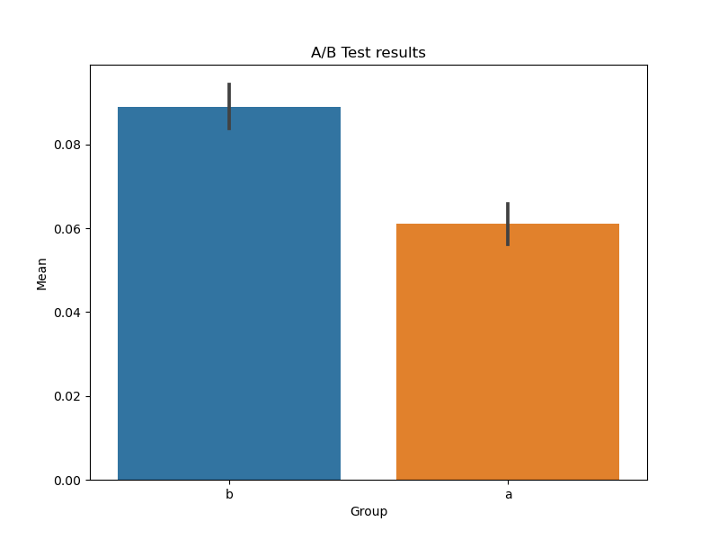
visualization to equalize the mean values ​​in groups with 95% confidence intervals
According to the results of the analysis, group B has a significantly higher average conversion rate in comparison to group A.
Therefore, it can be concluded that the change in test group B leads to an improvement in conversion compared to control group A.
TITLE
02
04
TITLE

Slide 7

TEST RESULTS
The specified test results (Student's t-test, permutation test, and Chi-square test) has revealed a statistically significant differences between groups, which confirms that changes can have an impact on conversion.
It is recommended to make the following changes:
- a subscription offer priced at $4.99 with an alternative screen design that displays a 50% reduction.
This may result in an increased conversion and increase gross revenue from the subscription offer.

