Slide 1
Solar Irradiance Variability Due To Rotation
Per-scenario regression of SSI on TSI across nine magnetic-feature distributions
Model: solar rotation (P = 27 d, B₀ = 0). Grid: 180 × 360. n_steps = 120.

Slide 2
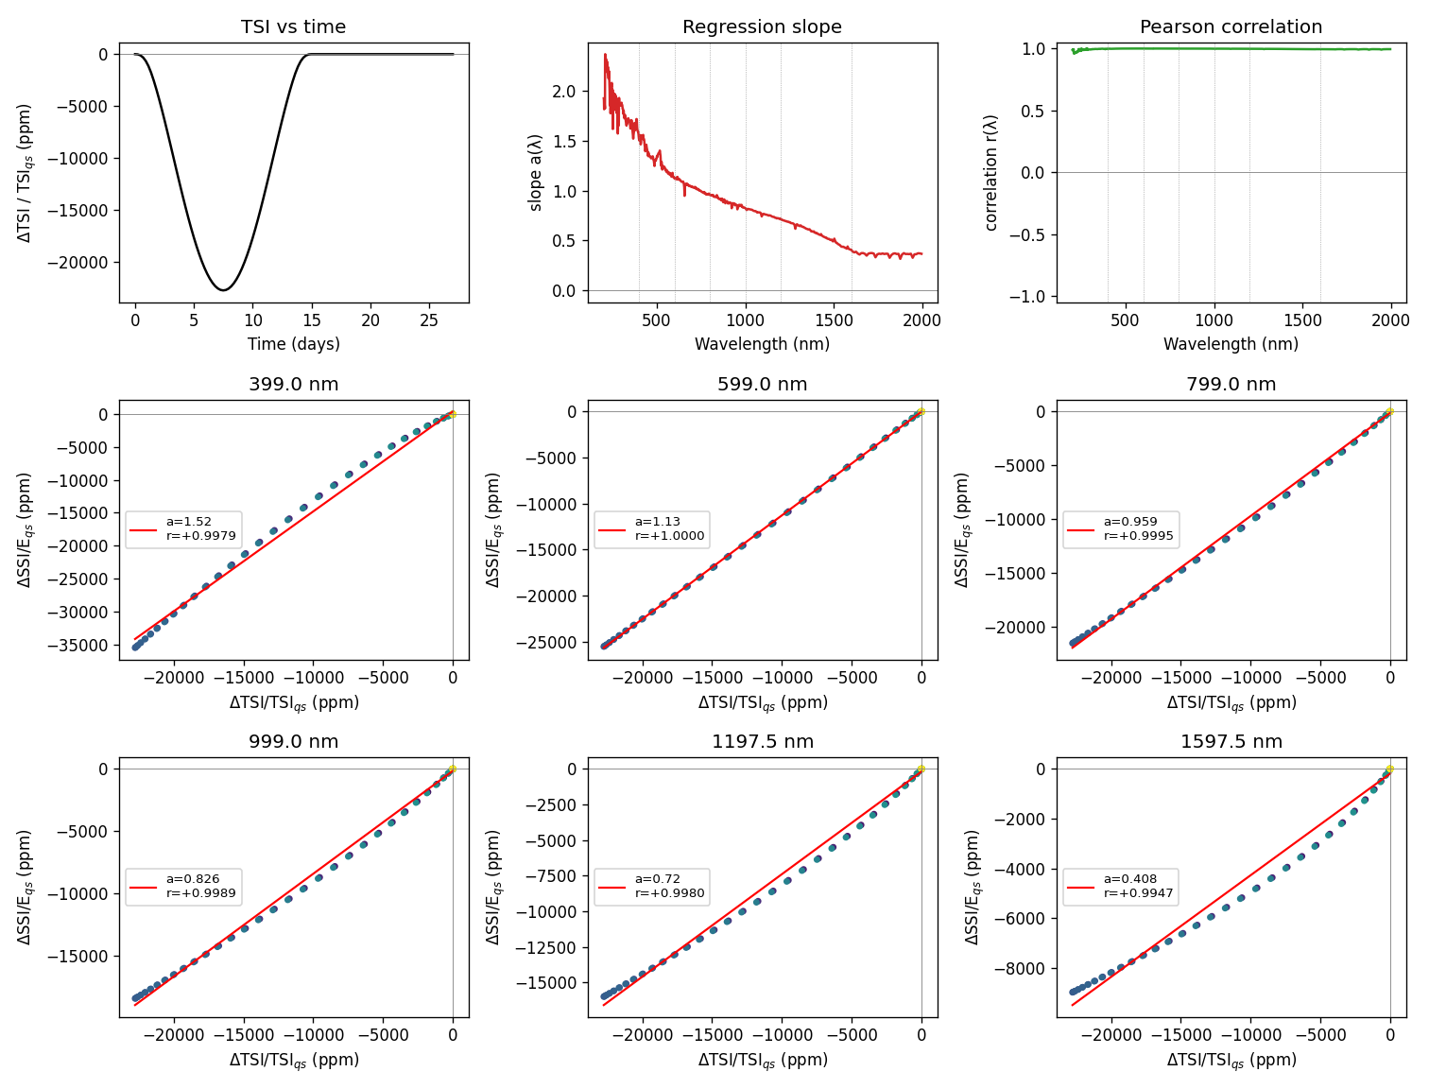
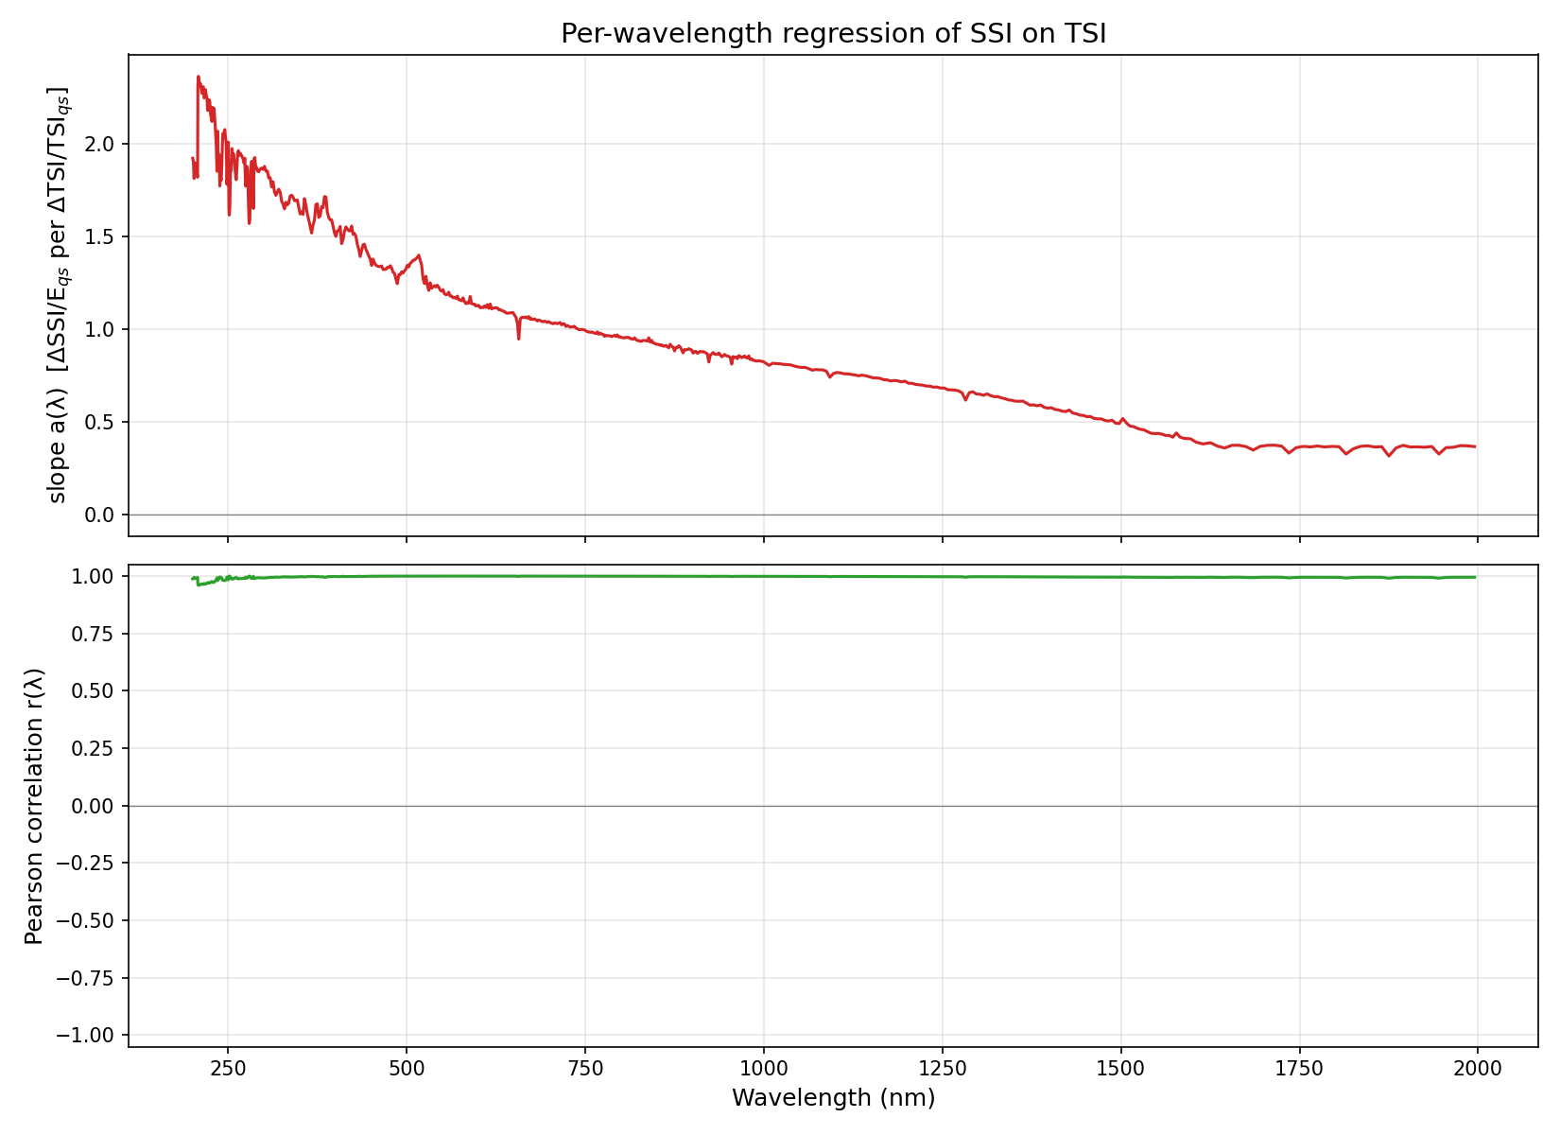
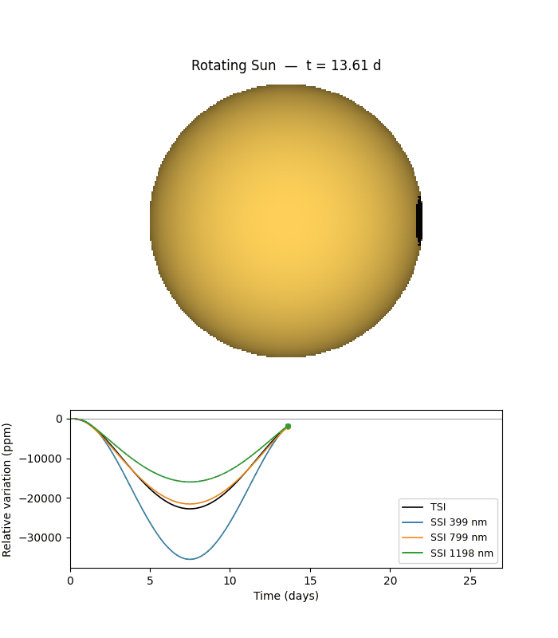
1. Single Umbra
One 10° circular umbra at the equator; placed just behind the east limb at t=0.
Diagnostic: TSI, a(λ), r(λ), per-λ scatter with fit
Animation: 01_single_umbra/animation.gif (middle frame shown; open the .gif in a browser or Quick Look to play)
Main result: regression slope a(λ) and correlation r(λ)

Slide 3
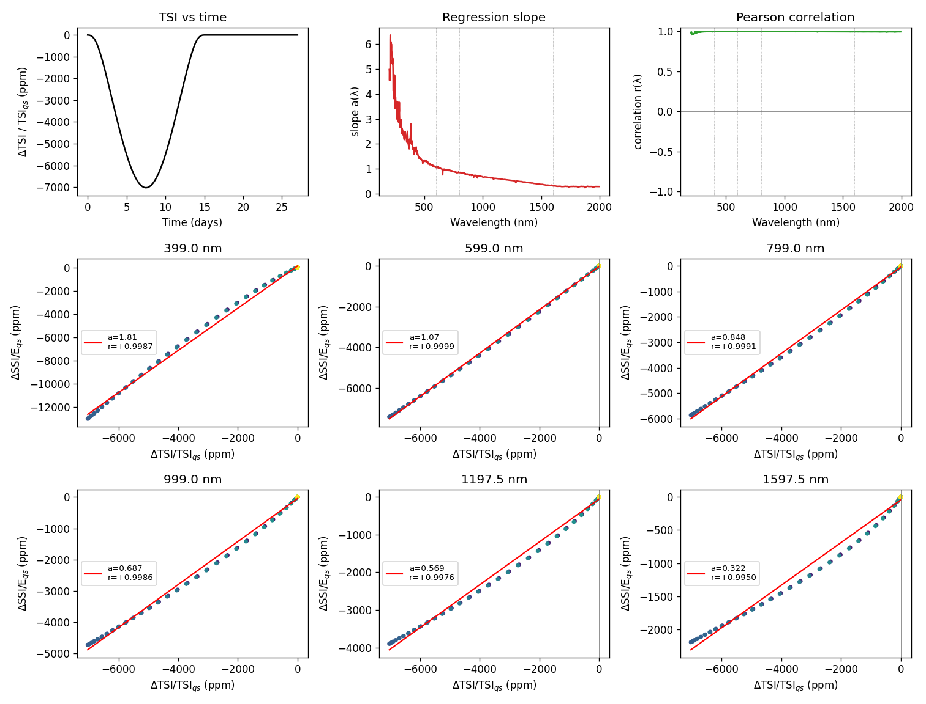
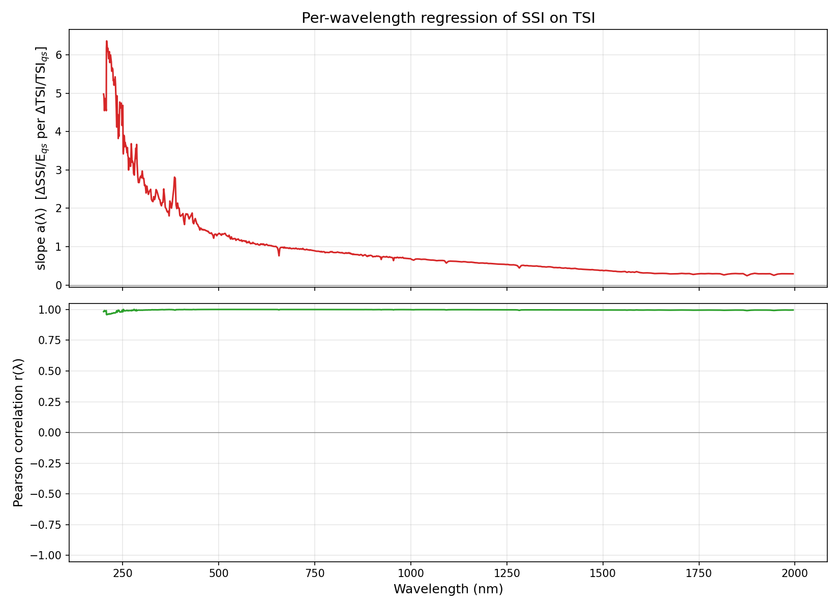

2. Single Penumbra
One 10° circular penumbra at the equator; placed just behind the east limb at t=0.
Diagnostic: TSI, a(λ), r(λ), per-λ scatter with fit
Animation: 02_single_penumbra/animation.gif (middle frame shown; open the .gif in a browser or Quick Look to play)
Main result: regression slope a(λ) and correlation r(λ)

Slide 4
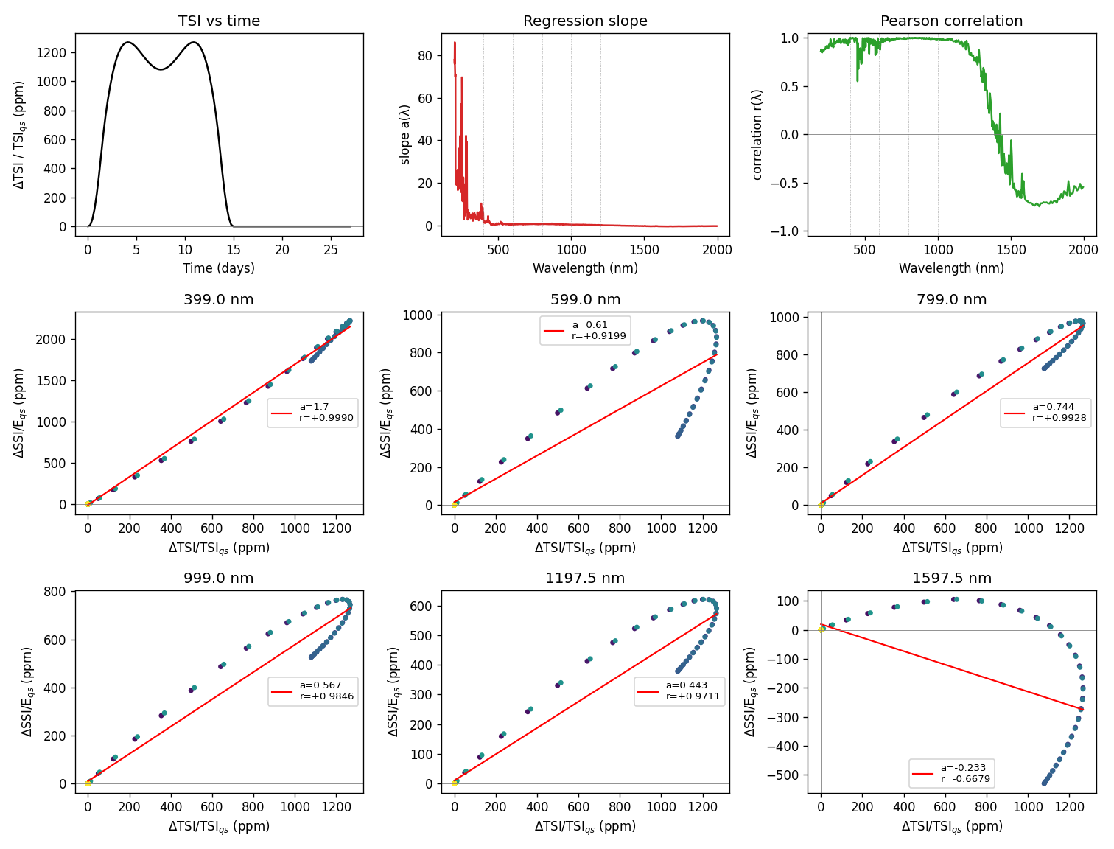
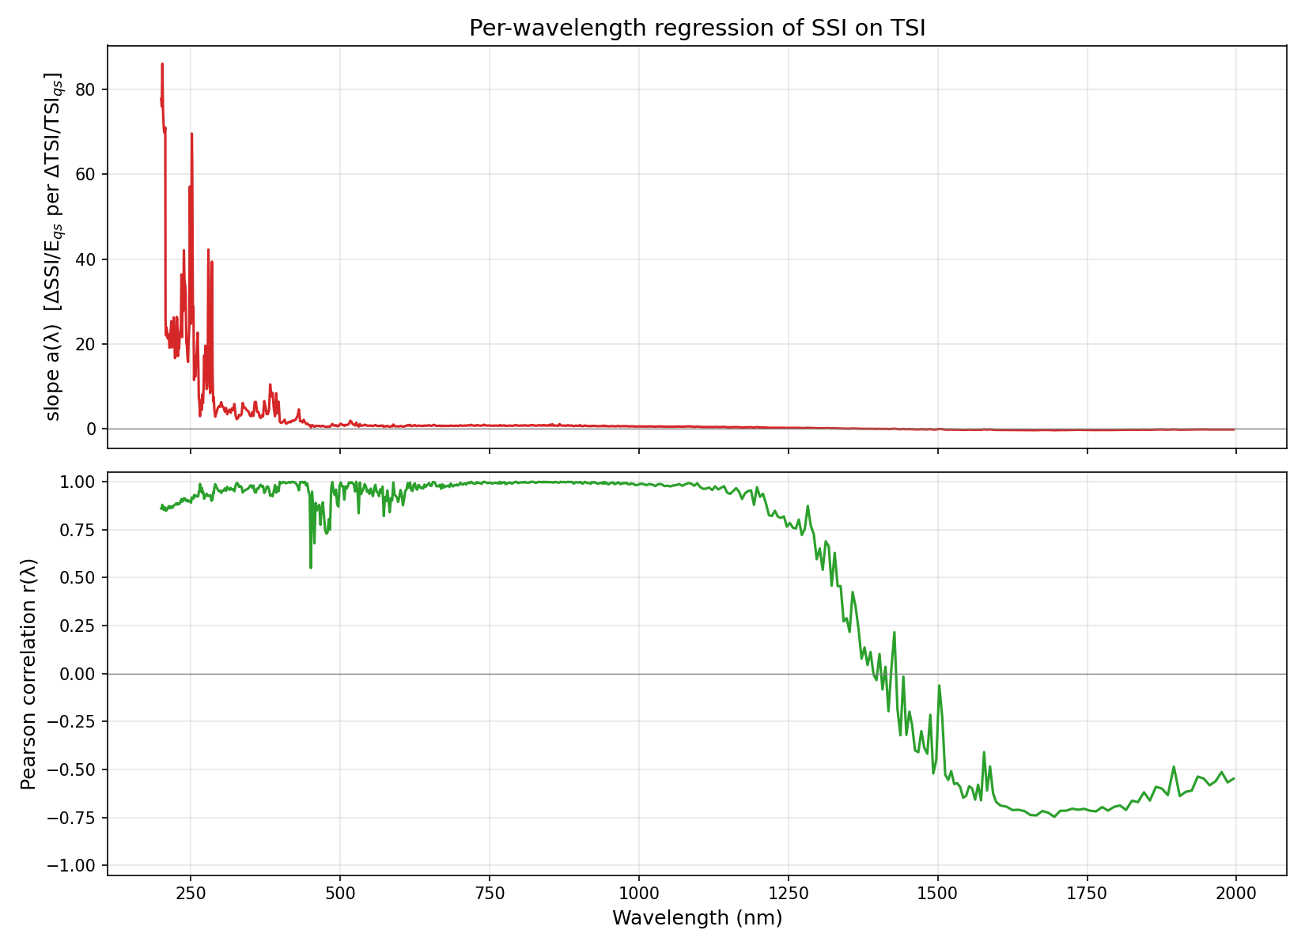
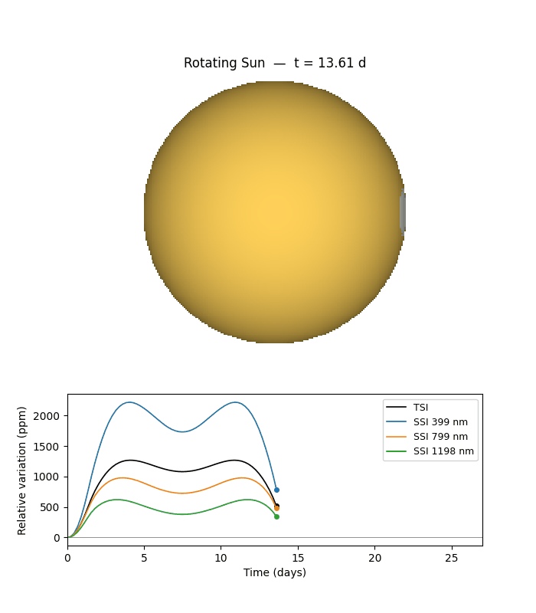
3. Single Faculae
One 10° circular faculae patch at the equator; just behind the east limb at t=0.
Diagnostic: TSI, a(λ), r(λ), per-λ scatter with fit
Animation: 03_single_faculae/animation.gif (middle frame shown; open the .gif in a browser or Quick Look to play)
Main result: regression slope a(λ) and correlation r(λ)

Slide 5
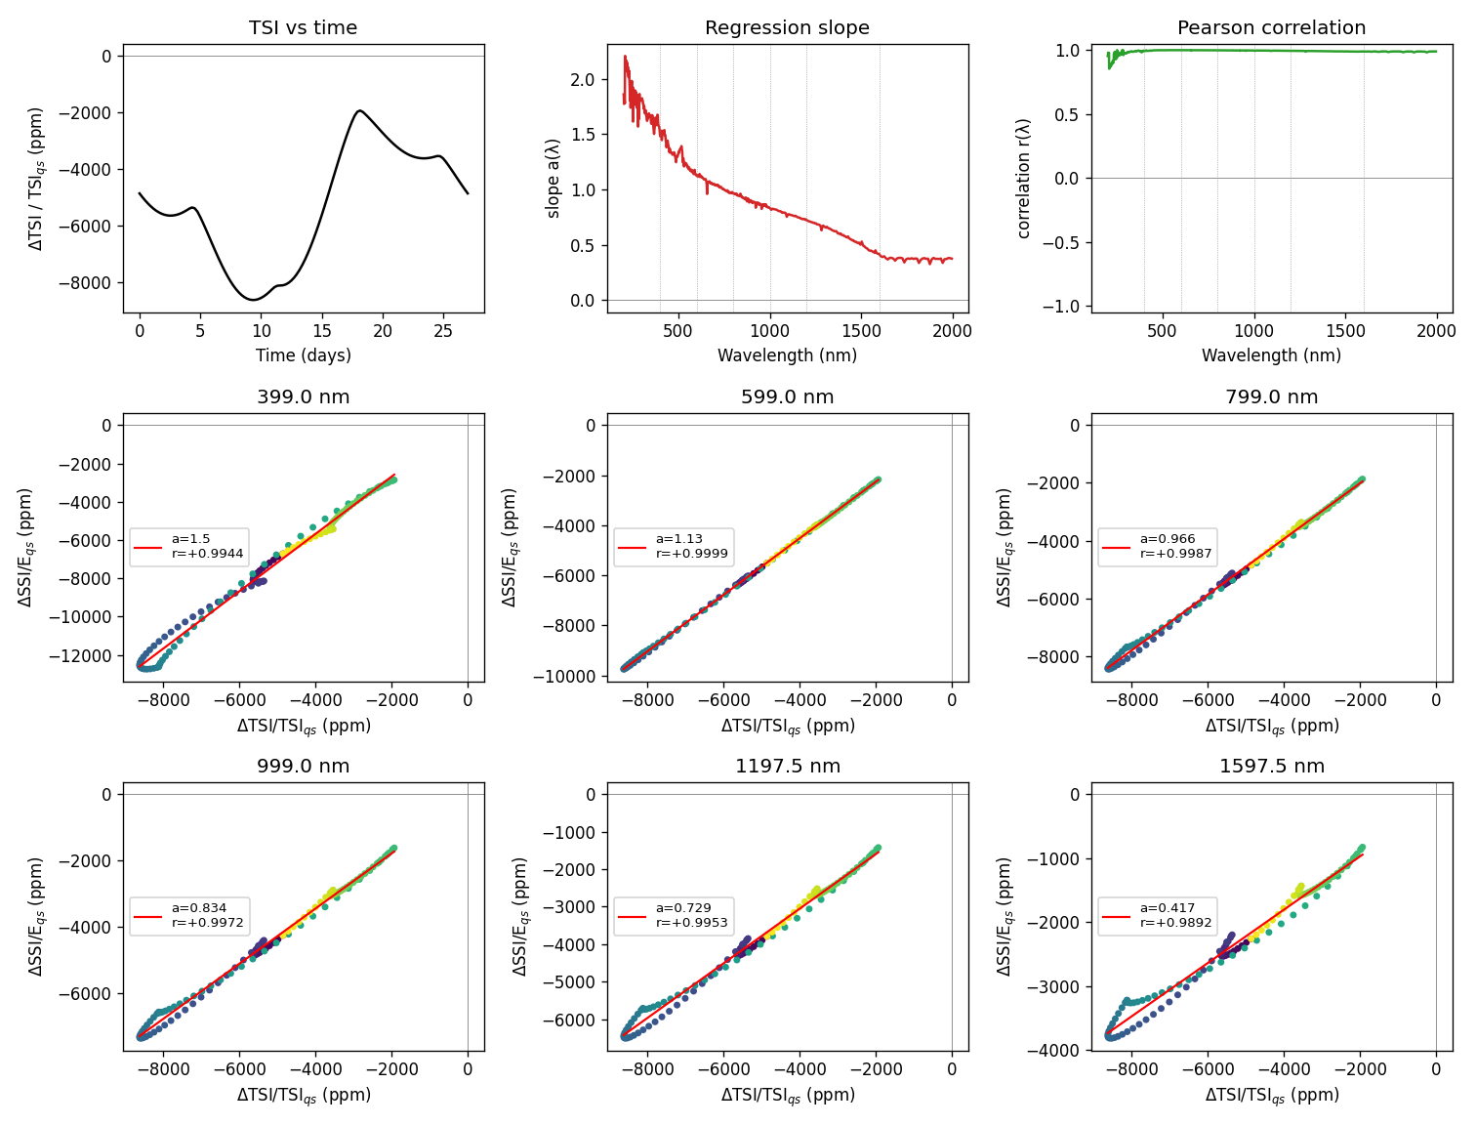
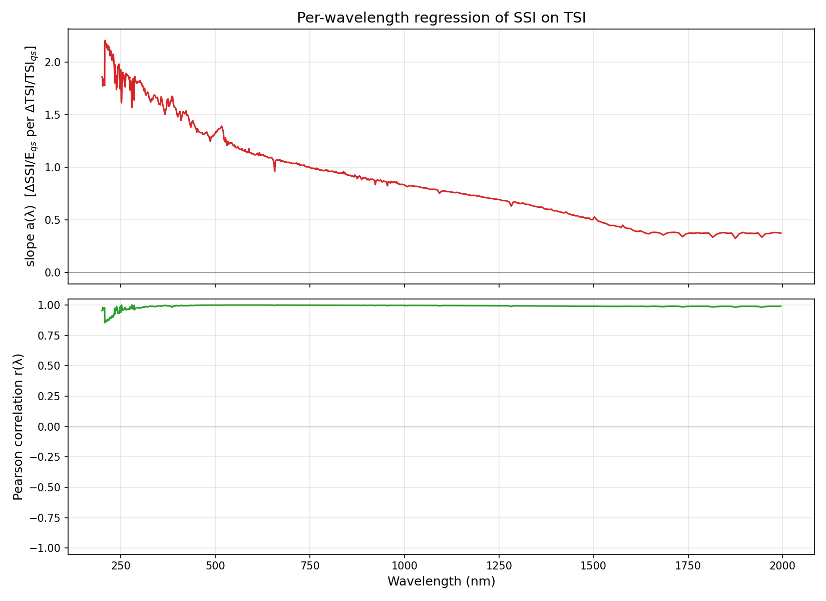
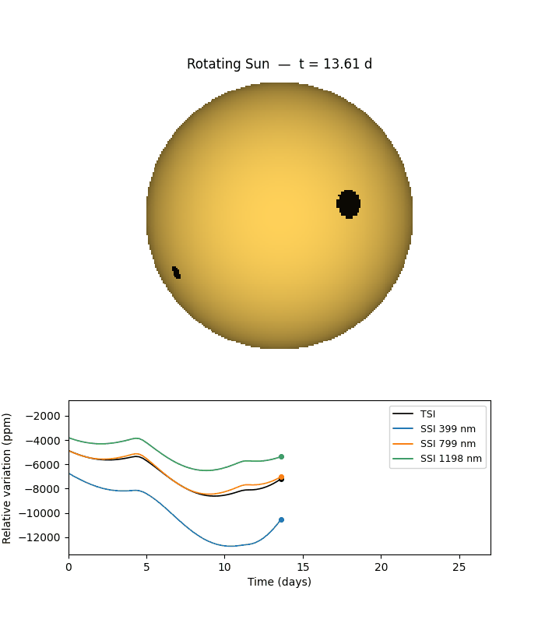
4. Multi Umbrae
Four scattered circular umbrae at varying latitudes and longitudes.
Diagnostic: TSI, a(λ), r(λ), per-λ scatter with fit
Animation: 04_multi_umbrae/animation.gif (middle frame shown; open the .gif in a browser or Quick Look to play)
Main result: regression slope a(λ) and correlation r(λ)

Slide 6
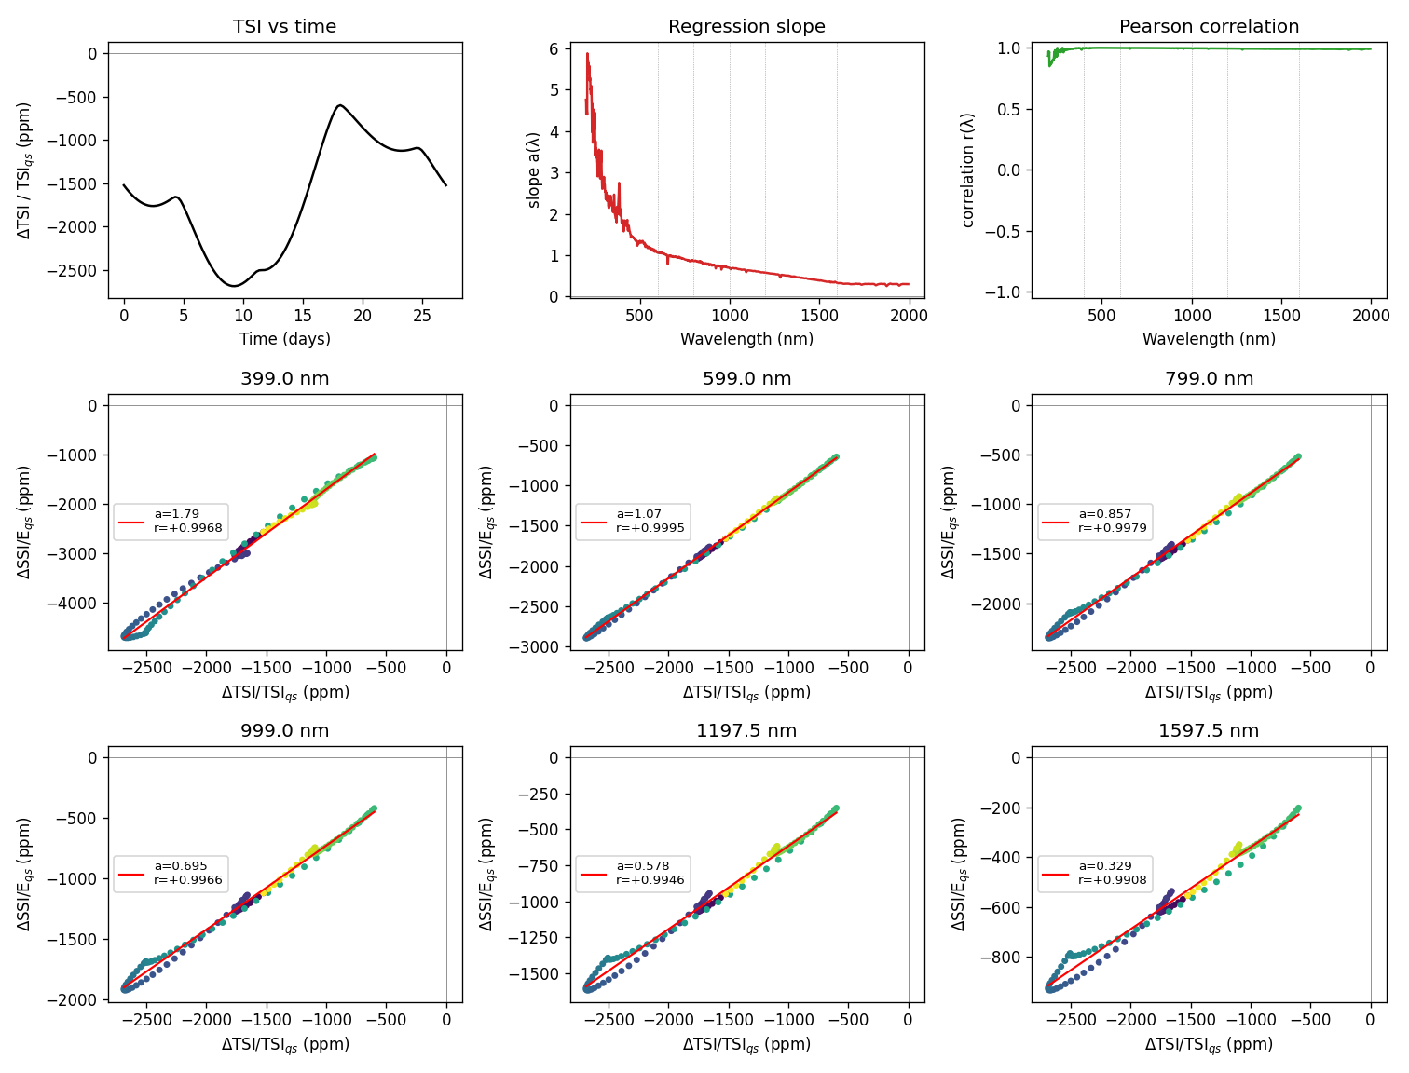
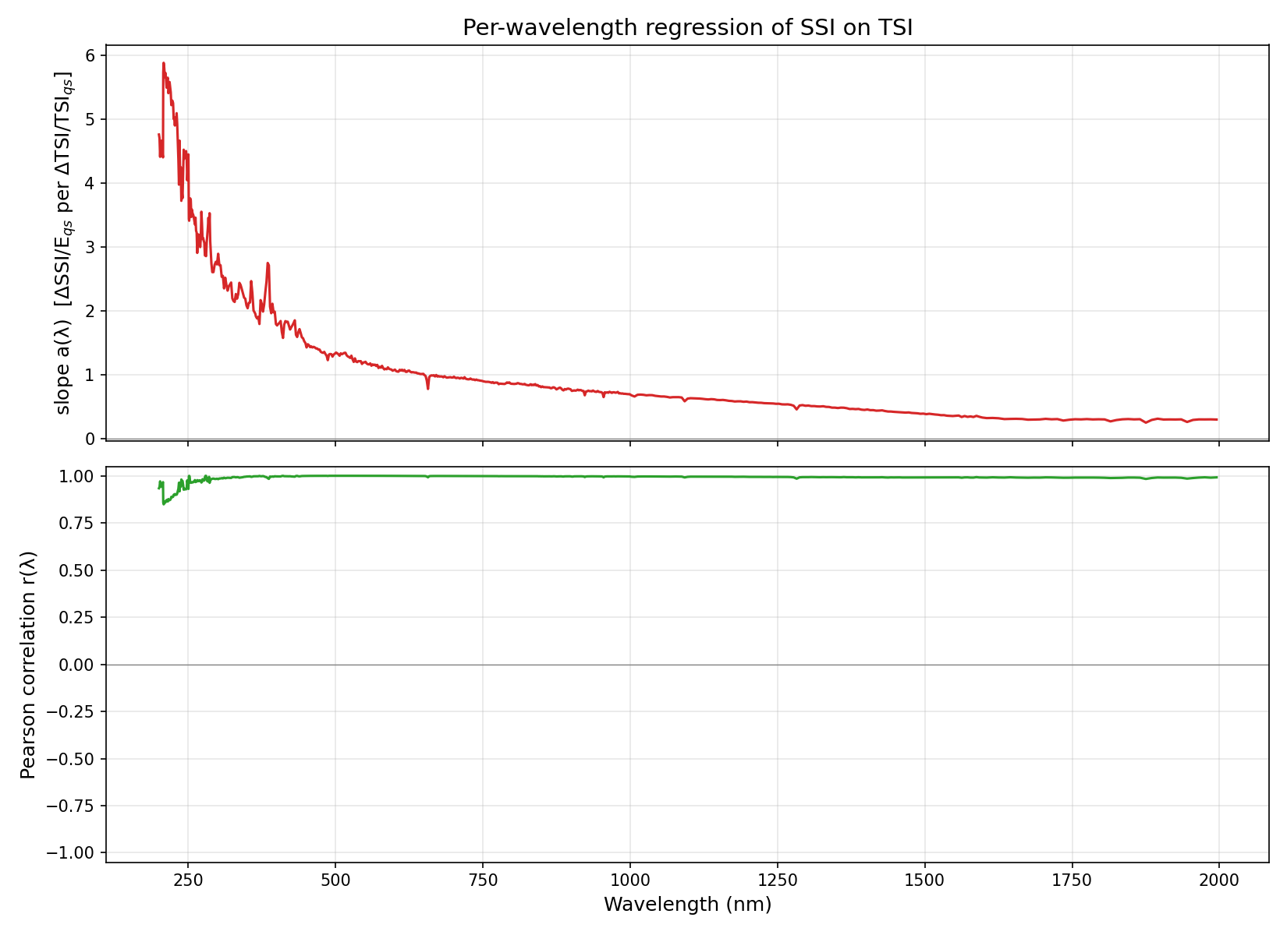
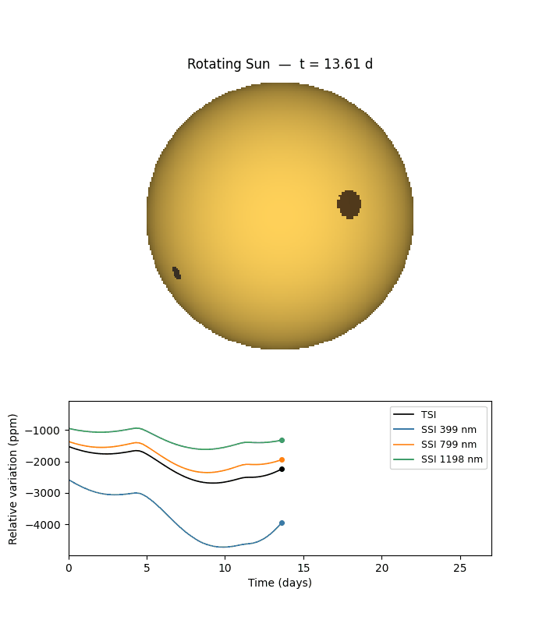
5. Multi Penumbrae
Four scattered circular penumbrae (same positions as multi_umbrae).
Diagnostic: TSI, a(λ), r(λ), per-λ scatter with fit
Animation: 05_multi_penumbrae/animation.gif (middle frame shown; open the .gif in a browser or Quick Look to play)
Main result: regression slope a(λ) and correlation r(λ)

Slide 7
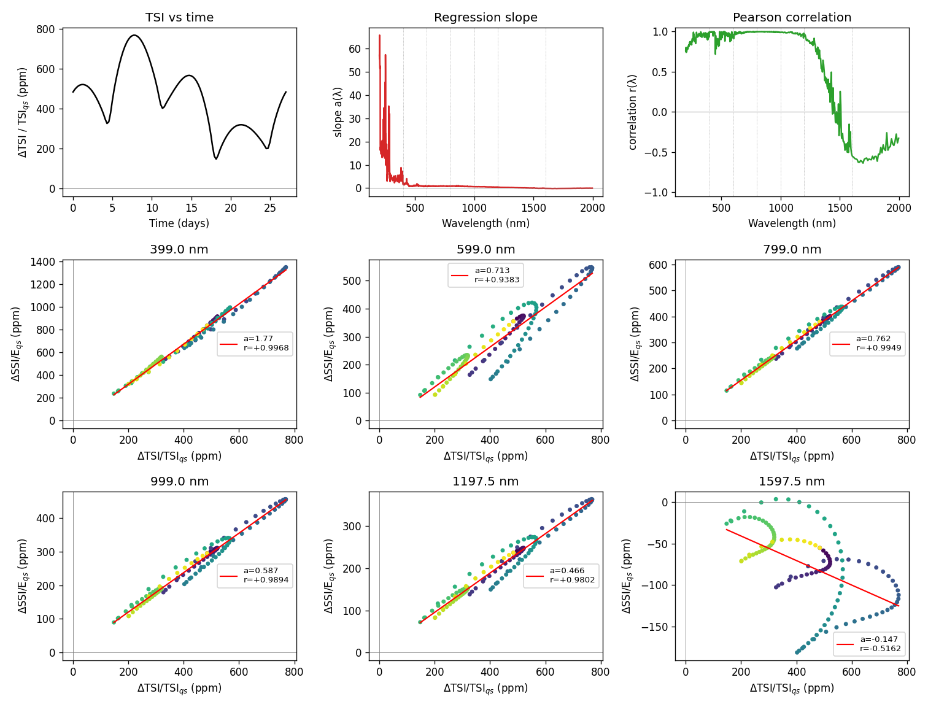
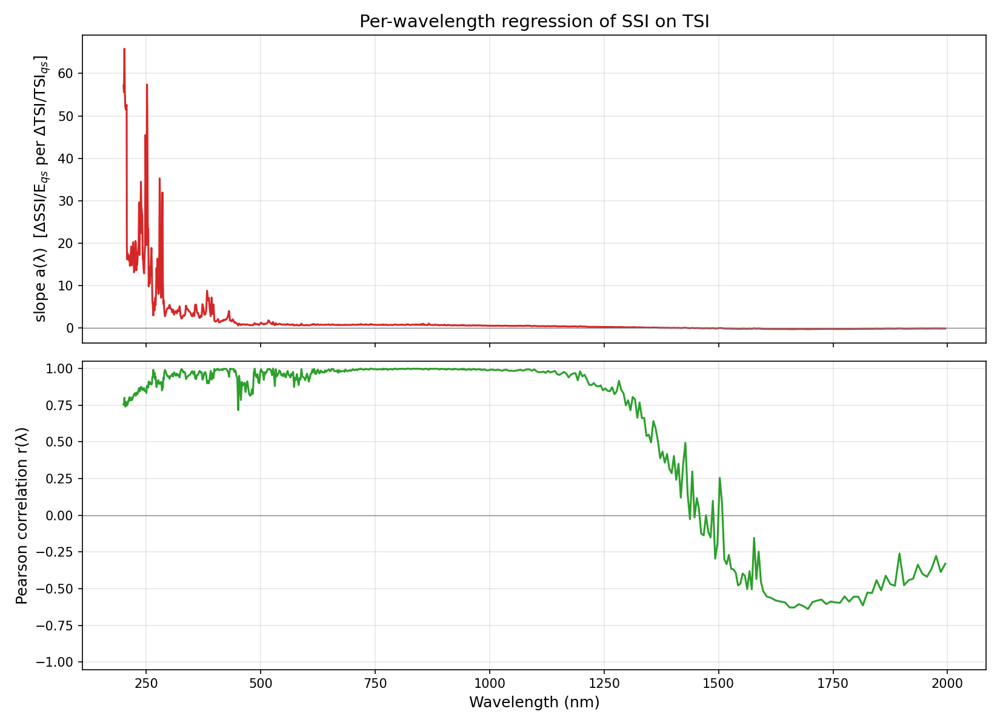
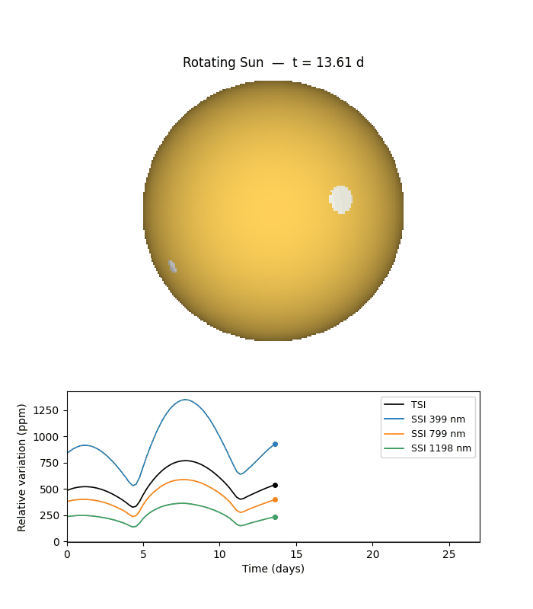
6. Multi Faculae
Four scattered circular faculae patches (same positions as multi_umbrae).
Diagnostic: TSI, a(λ), r(λ), per-λ scatter with fit
Animation: 06_multi_faculae/animation.gif (middle frame shown; open the .gif in a browser or Quick Look to play)
Main result: regression slope a(λ) and correlation r(λ)

Slide 8
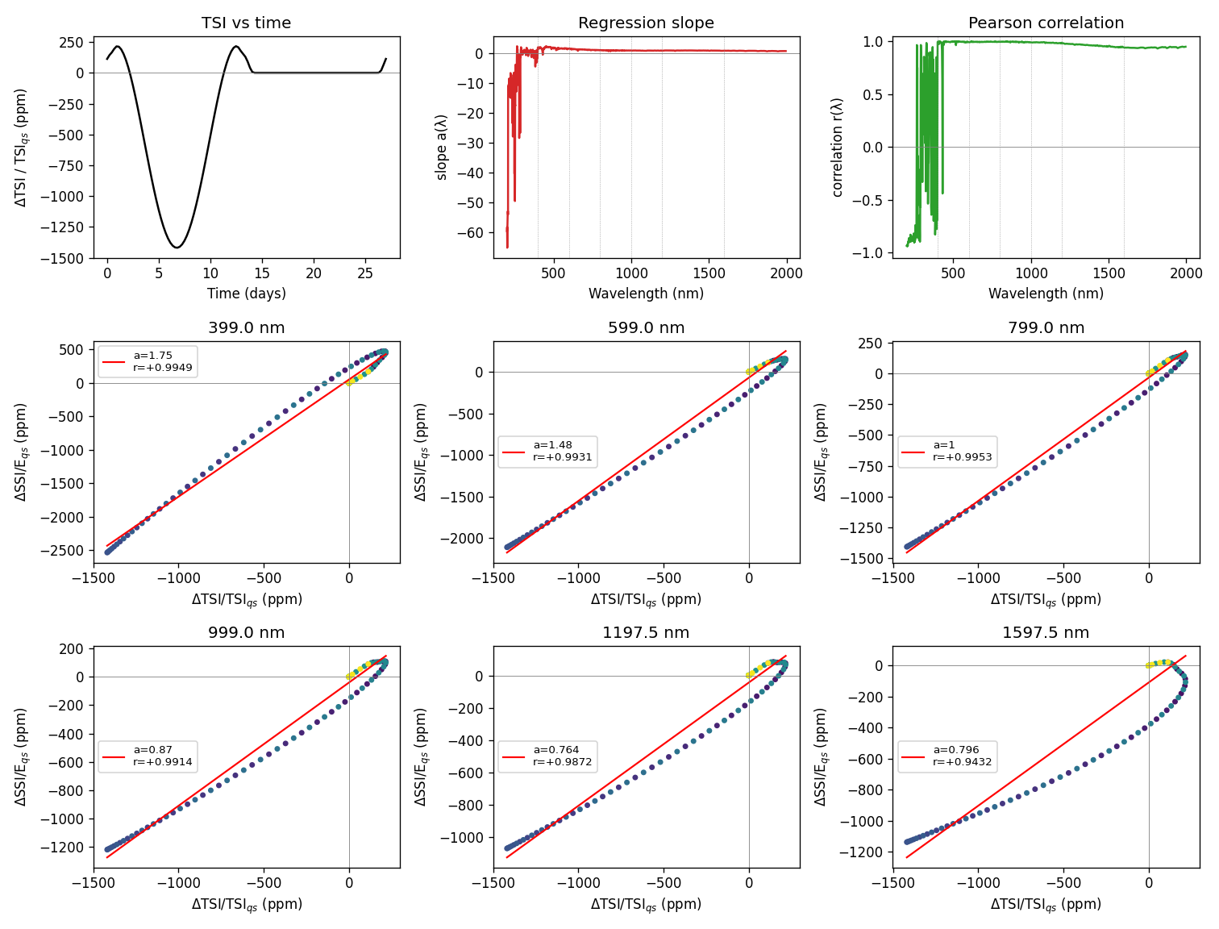
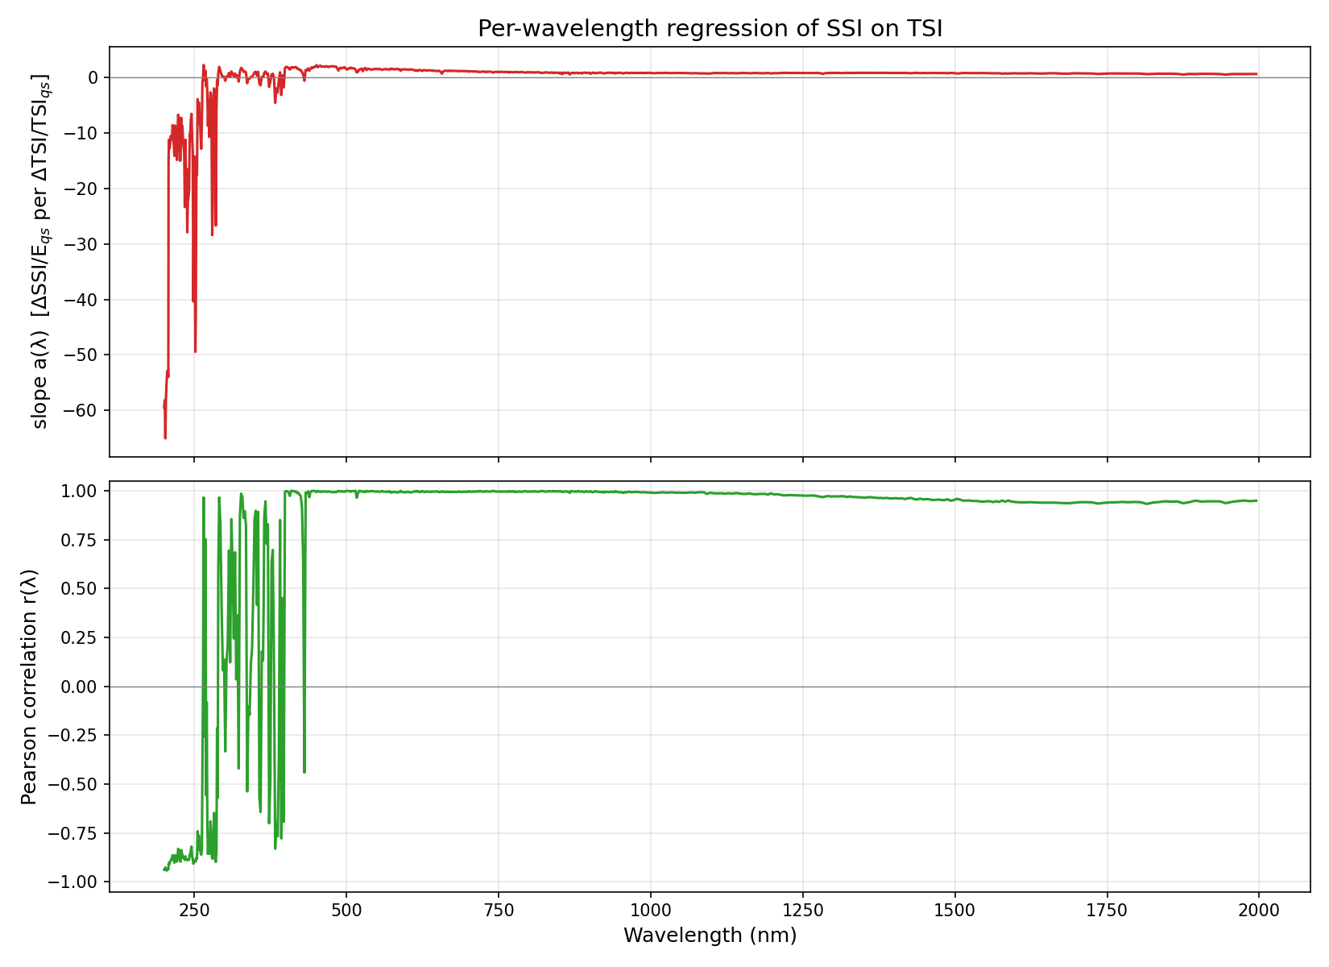
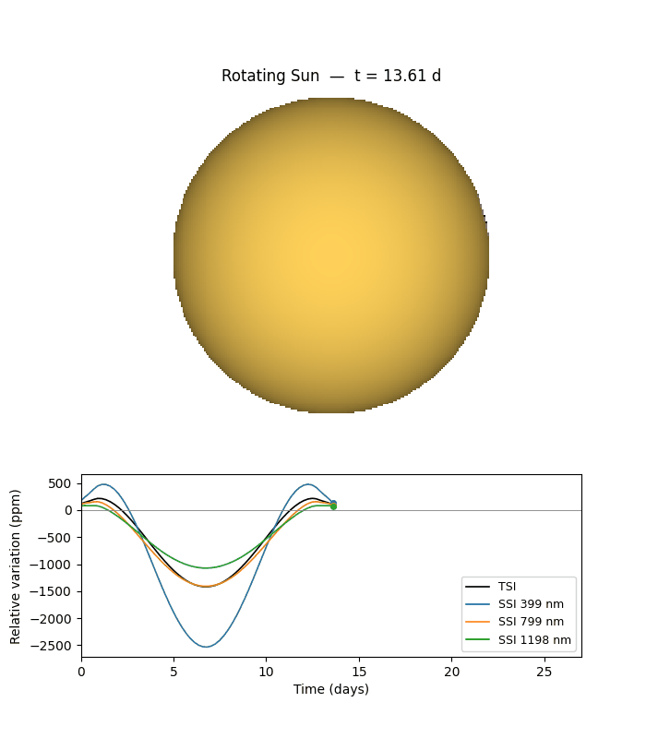
7. Concentric Ar
One concentric active region at (15°N, -90°): umbra(2°)⊂penumbra(5°)⊂faculae(10°).
Diagnostic: TSI, a(λ), r(λ), per-λ scatter with fit
Animation: 07_concentric_AR/animation.gif (middle frame shown; open the .gif in a browser or Quick Look to play)
Main result: regression slope a(λ) and correlation r(λ)

Slide 9
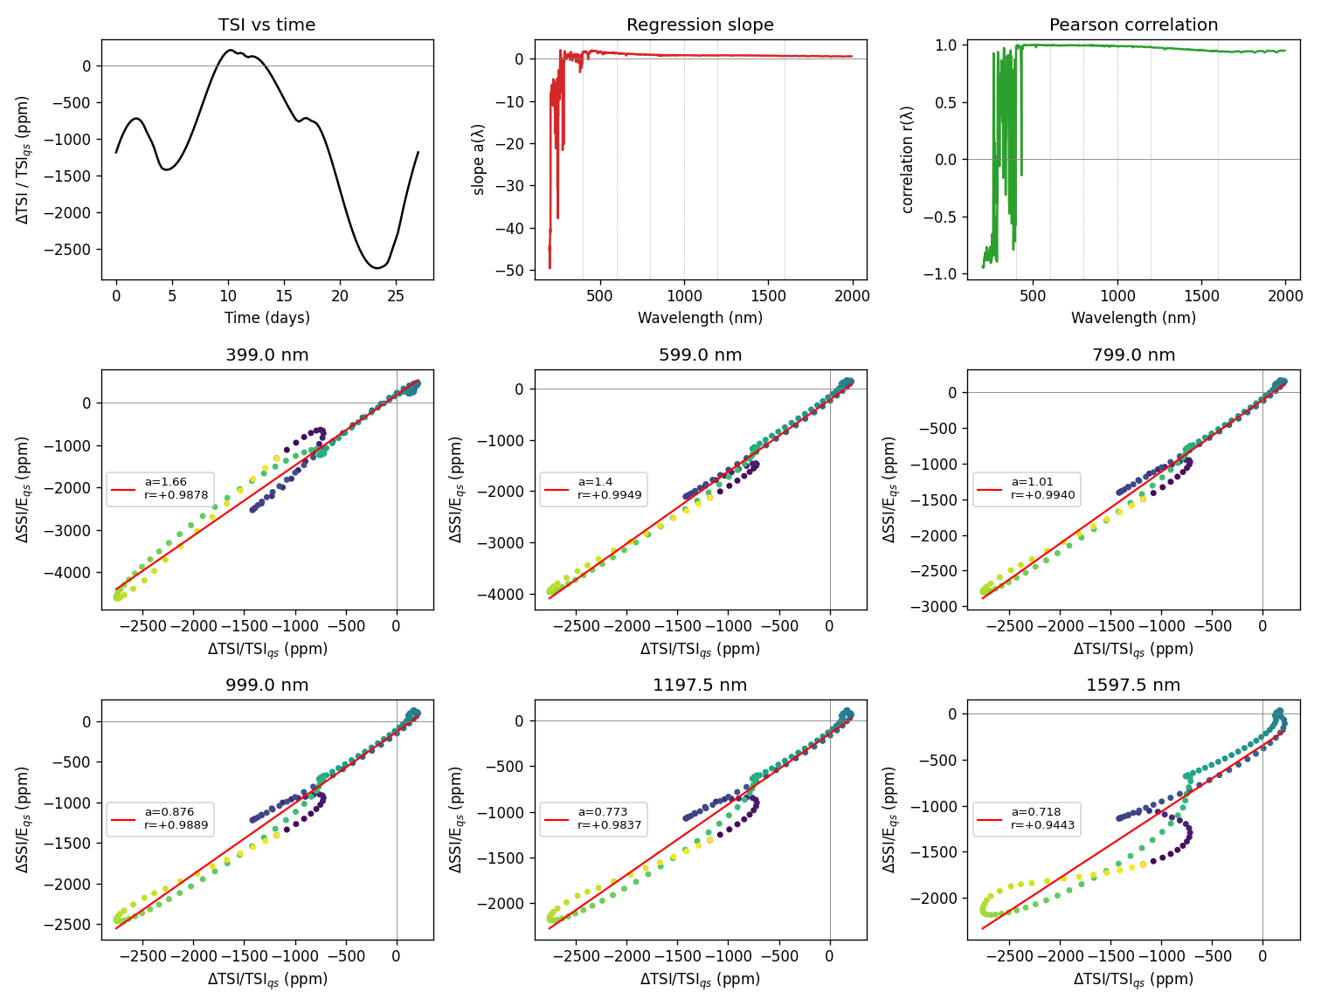
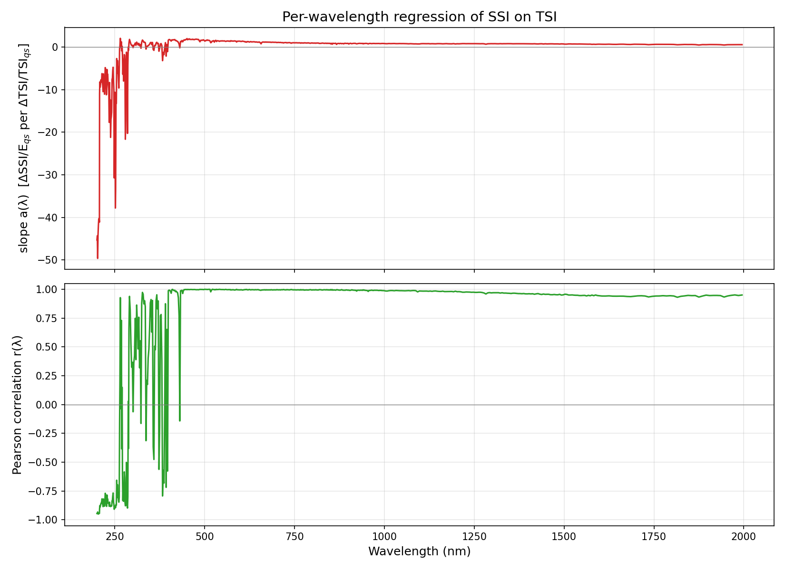
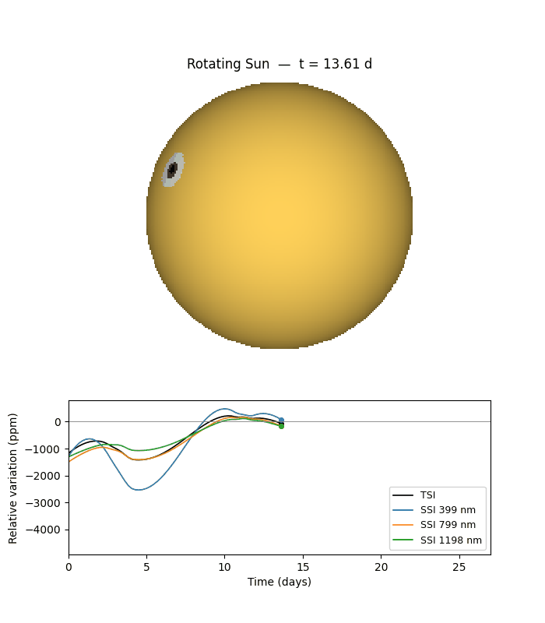
8. Multi Concentric
Three concentric active regions at different positions; realistic spot+faculae complexes.
Diagnostic: TSI, a(λ), r(λ), per-λ scatter with fit
Animation: 08_multi_concentric/animation.gif (middle frame shown; open the .gif in a browser or Quick Look to play)
Main result: regression slope a(λ) and correlation r(λ)

Slide 10
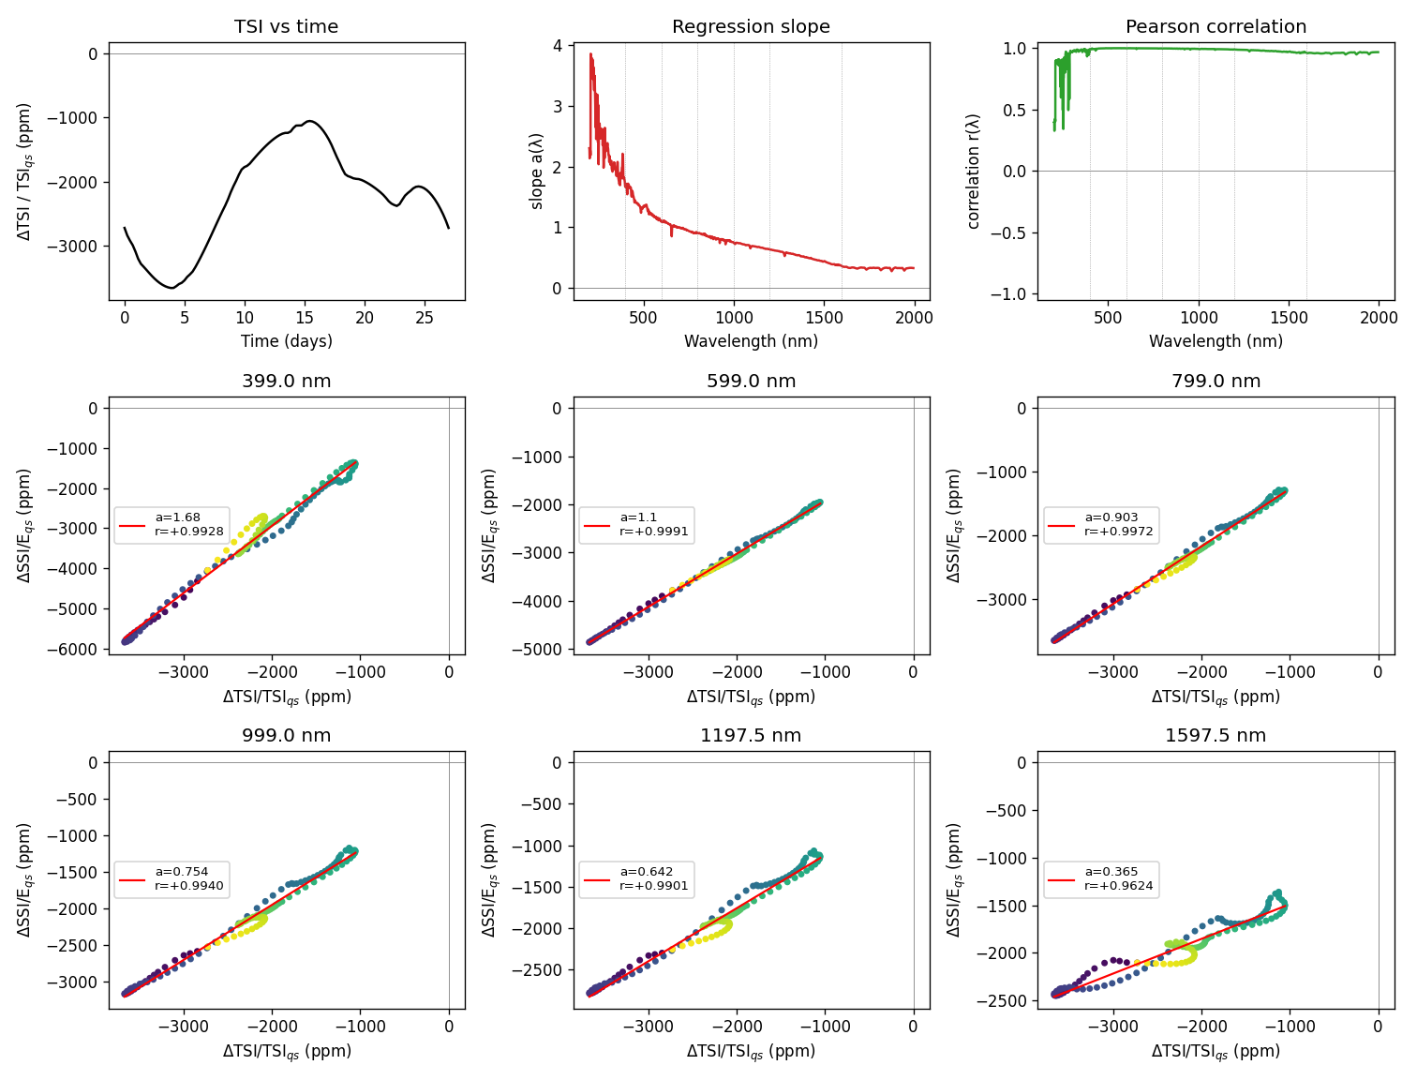
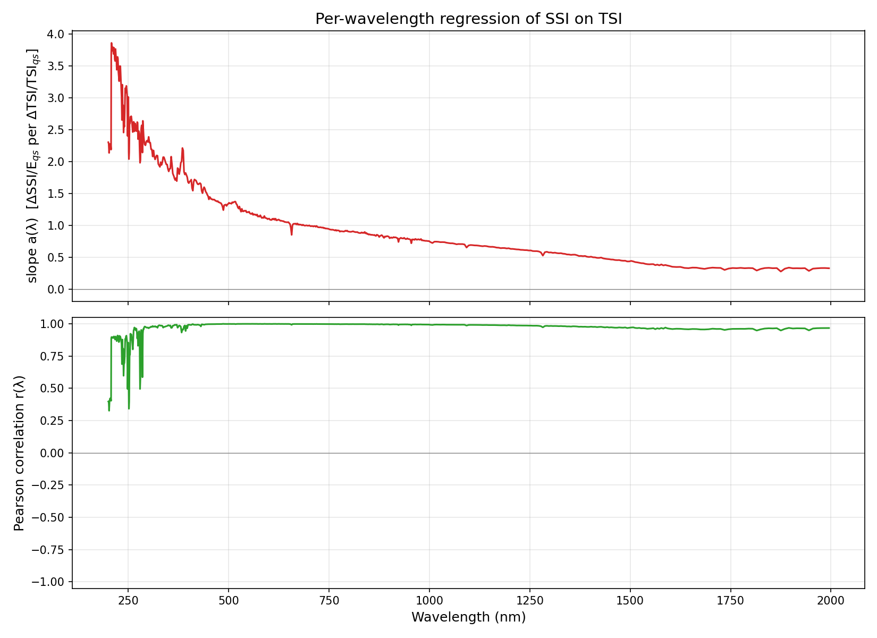
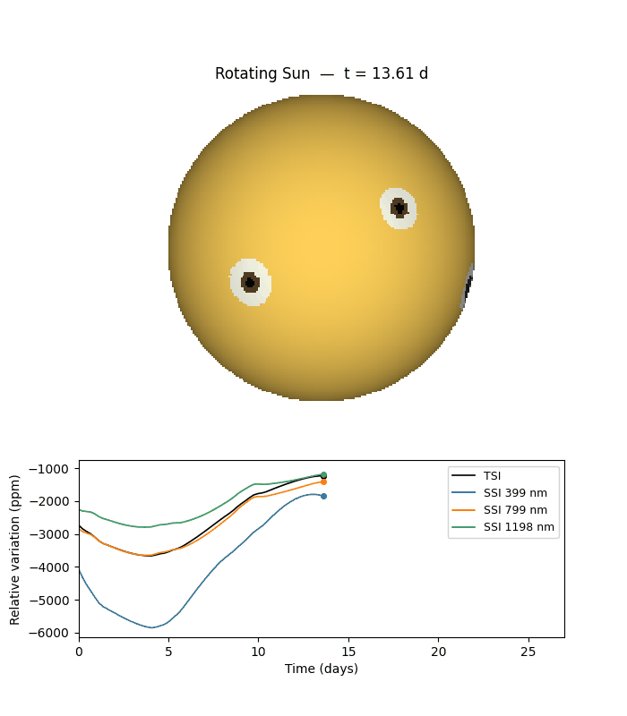
9. Activity Belts
Butterfly-like two-belt activity at ±15°: 6 concentric active regions distributed in longitude.
Diagnostic: TSI, a(λ), r(λ), per-λ scatter with fit
Animation: 09_activity_belts/animation.gif (middle frame shown; open the .gif in a browser or Quick Look to play)
Main result: regression slope a(λ) and correlation r(λ)

Slide 11
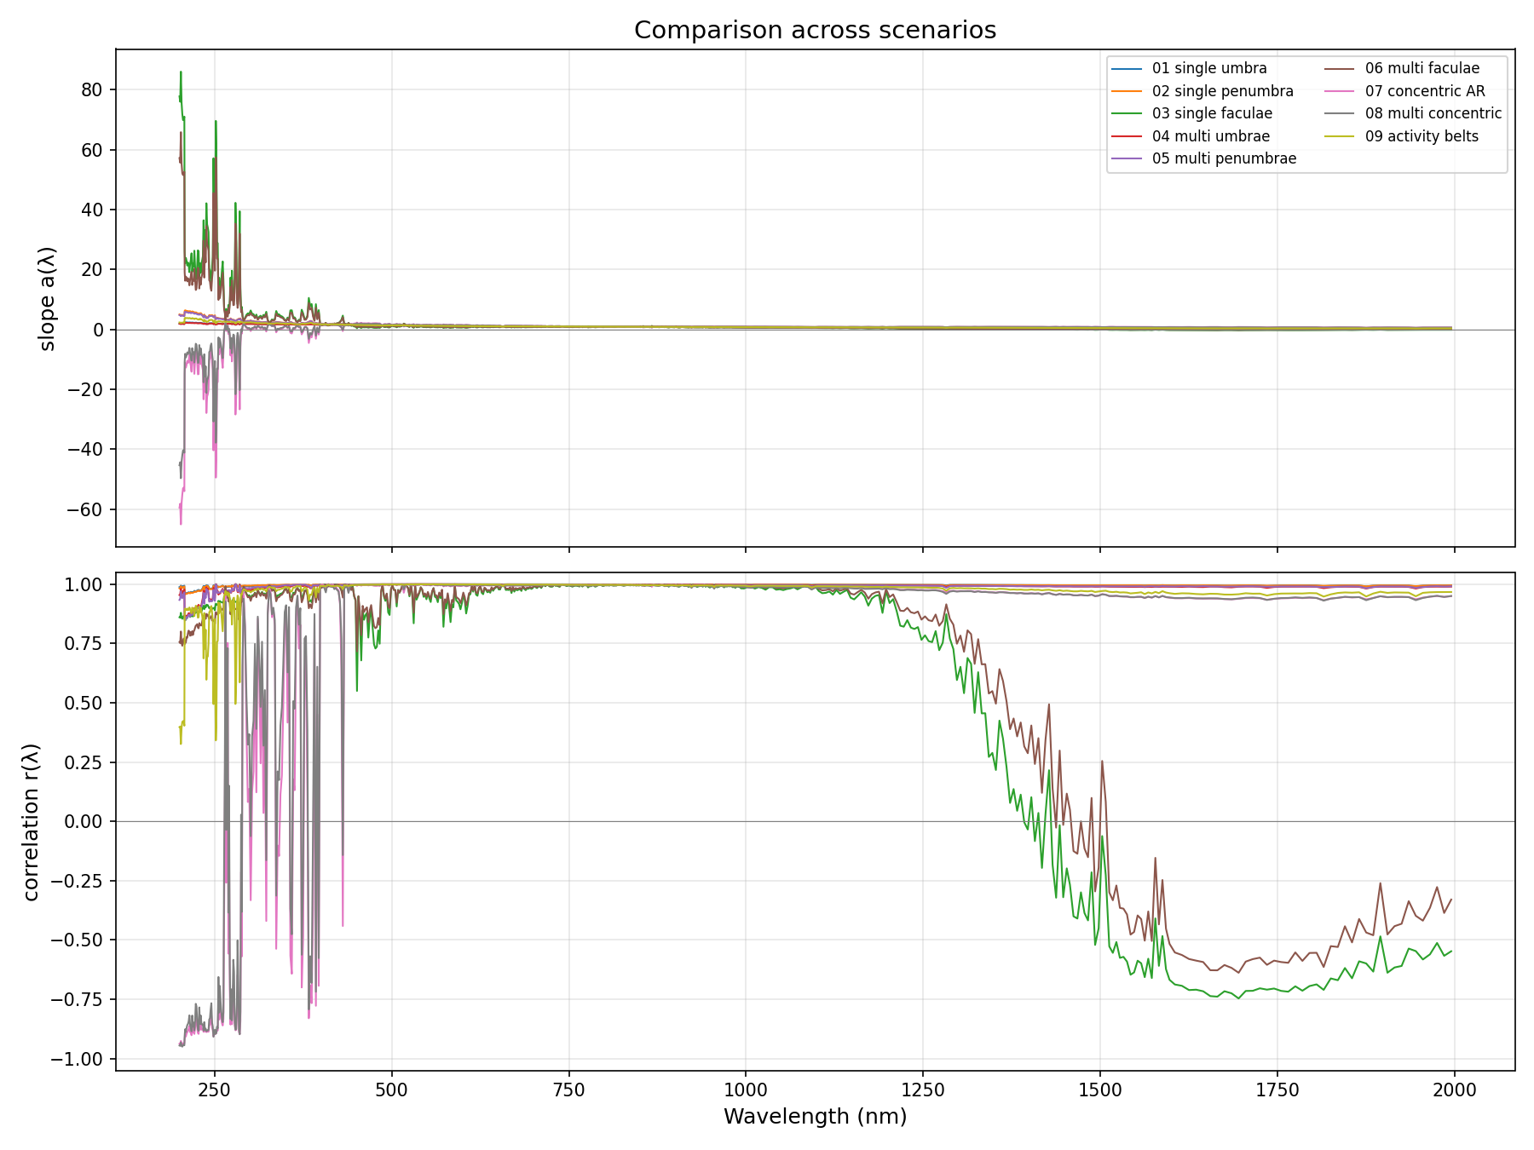
Comparison across all scenarios
Regression slope a(λ) and correlation r(λ) overlaid for all 9 scenarios (200–2000 nm).
Takeaway: pure-spot scenarios flip a(λ) sign in the mid-UV; faculae-dominated and mixed-feature scenarios keep a(λ) > 0 across the visible.

Slide 12
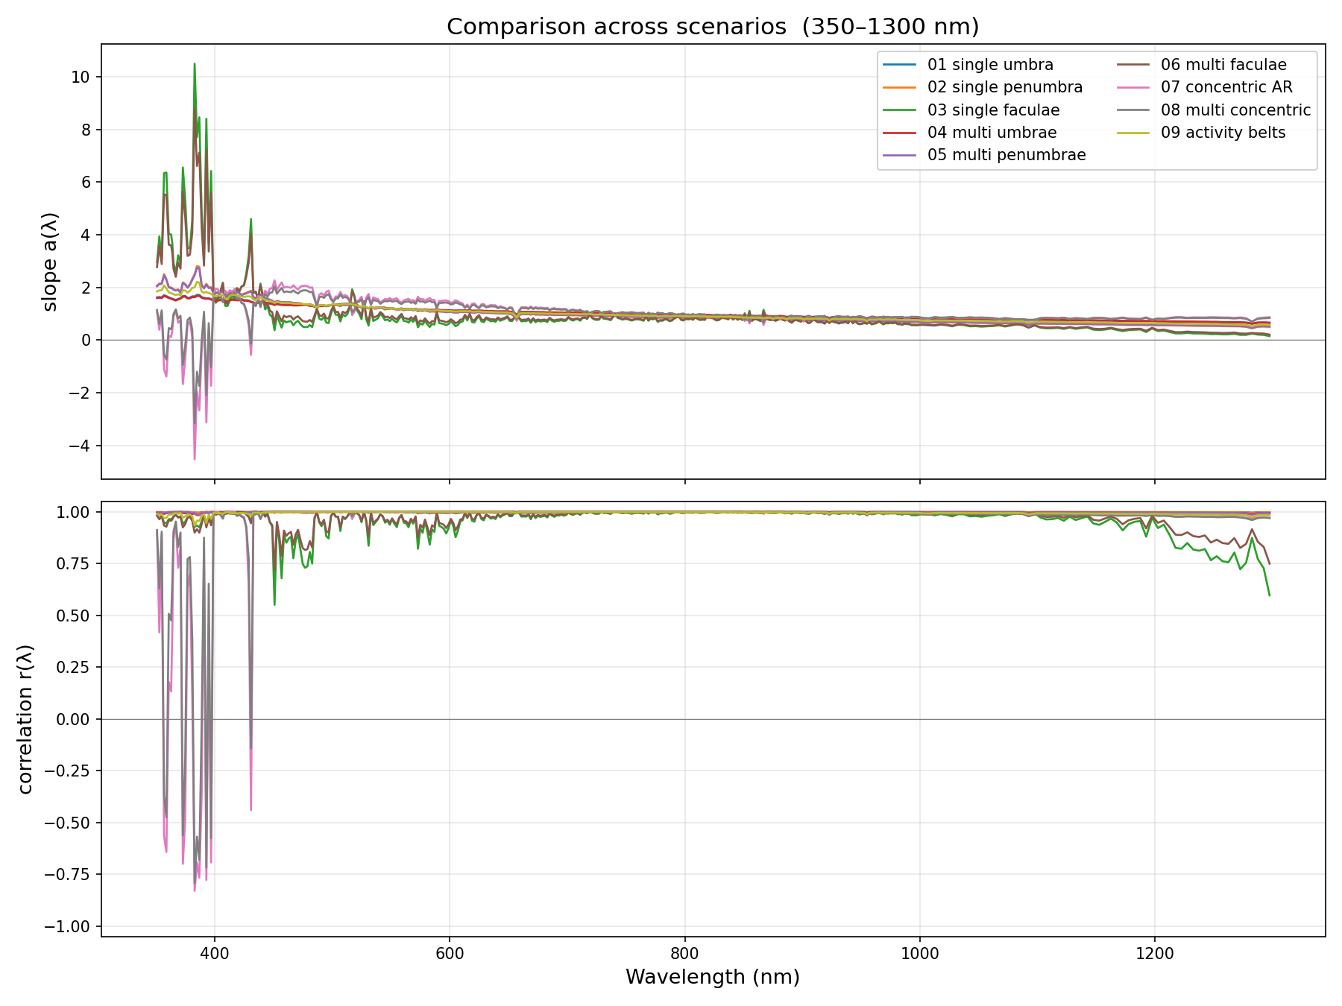
Comparison across scenarios — zoomed (350–1300 nm)
Same overlay restricted to 350–1300 nm for readability; the UV noise compressed the full-range scale.
Spot-only scenarios have a(λ) near or below zero; faculae and mixed scenarios have a(λ) ≈ 1–2 peaking in the blue.

