Slide 1

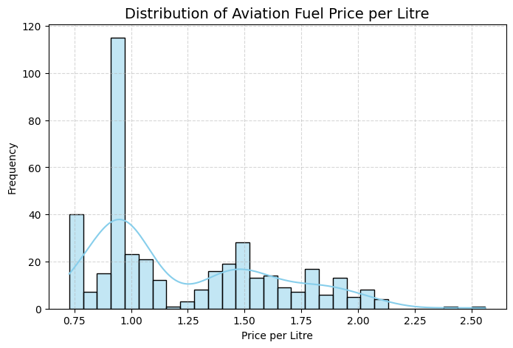

Monthly Aircraft Fuel Consumption and Cost For Canadian Fleets
Alexandra Breygina
Pace University, Seidenberg School of CSIS
GitHub
Abstract
Dataset
Evaluation
Conclusion
Fuel is one of the largest expenses in aviation, accounting for 20–40% of an airline’s operating costs (IATA, 2023). In Canada, these costs continue to rise, with operating expenses reaching $32.9 billion in 2023 and consuming over 91% of airline revenue (Statistics Canada, 2024). Because fuel prices significantly influence profitability, ticket pricing, and planning—and aviation contributes 2–3% of global CO₂ emissions—understanding regional fuel price variations is essential for improving budgeting, refueling strategies, and sustainability efforts (ICAO, 2024).
Research Question
How does the price of aviation fuel vary across different regions or cities in Canada?
Related Work
Recent studies show significant advances in fuel consumption prediction through machine learning and data-driven methods. Fang et al. (2024) achieved a low 1.1% error using neural networks and SVMs, while Panigrahi (2025) found Gradient Boosting models most accurate for estimating take-off mass. Uzun et al. (2021) improved reliability in underrepresented flight regimes by integrating physics-based loss functions, and Li et al. (2021) used LSTMs to more accurately predict contingency fuel for China Airlines. Kühn (2023) compared multiple estimation techniques across 50 aircraft types, noting modern aircraft typically consume 0.02–0.025 kg of fuel per km per seat and identifying the strengths and limitations of current methods.
The dataset used is “Aircraft Fleet: Monthly Fuel Consumption, by Region or Group,” and comes from the Government of Canada. This dataset provides detailed records of aviation fuel purchases made across Canada, which is collected from the Government of Canada’s open data portal. It contains 406 entries covering aircraft fuel transactions from various regions and cities. Each record includes information about the aircraft identifier, location of purchase, fuel supplier, payment method, fuel volume (in liters), price per liter (in CAD), and total cost.
Methodology
I used descriptive statistics, visualizations such as heatmaps and boxplots, feature engineering, and regression models, such as linear regression and decision tree regression.
Both the Linear Regression and Decision Tree models performed similarly in predicting fuel price per litre. The Linear Regression model achieved an R² of 0.69, meaning it explains about 69% of the variation in fuel prices, with the remaining 31% likely due to outside factors such as global crude oil fluctuations or general noise in the data. Its RMSE of 0.2056 indicates that predictions are off by about 20.5 cents per litre on average. The Decision Tree Regressor performed slightly worse, with an R² of 0.67 and an RMSE of 0.212, showing that it explains 67% of the variability and has an average prediction error of about 21.2 cents per litre. Overall, Linear Regression provided marginally better accuracy.
Results
The analysis shows that fuel prices are usually low, with a common peak around $1.00 per litre, but some regions—especially in western and coastal areas—consistently pay more. Shell is the leading supplier by a wide margin. Larger purchases tend to have lower prices, while British Columbia often appears in the high-price range. Price trends rise early, fluctuate, and then stabilize. Correlation results confirm that fuel volume strongly drives total cost, while other relationships are only moderate or weak.
Overall, this analysis demonstrates that aviation fuel prices in Canada vary notably across regions, with western and coastal areas showing consistently higher and more volatile costs than central and eastern locations. Exploratory data analysis highlighted clear pricing patterns, such as the common $1.00 per litre benchmark and the inverse relationship between purchase size and price, while also revealing that certain suppliers, particularly Shell, dominate the fuel market. The machine learning models further supported these findings: both Linear Regression and Decision Tree Regressor captured the majority of price variation, though approximately one-third of pricing remains driven by external factors such as global market conditions. Together, these results underscore the importance of understanding regional cost dynamics to improve refueling strategies, enhance operational planning, and support both financial and sustainability goals within the aviation sector.
Bibliography
Statistics Canada. (2025, January 17). Daily—Civil aviation: operating revenues and expenses, North American and international, Canadian air carriers, 2023 [Online]. Government of Canada. https://www150.statcan.gc.ca/n1/daily-quotidien/250117/dq250117c-eng.htm
International Civil Aviation Organization. (n.d.). Aircraft Engine Emissions. ICAO. Retrieved from https://www.icao.int/environmental-protection/pages/aircraft-engine-emissions.aspx
IATA. (n.d.). Jet Fuel Price Monitor. International Air Transport Association. https://www.iata.org/en/publications/economics/fuel-monitor/
https://open.canada.ca/data/en/dataset/2142e30d-9275-424d-be43-f5cc7ec91916/resource/958ae878-72c6-42d8-b59a-f63a6a161b5f#additional-info
Uzun, M., Demirezen, M. U., & Inalhan, G. (2021). Physics Guided Deep Learning for Data-Driven Aircraft Fuel Consumption Modeling. Aerospace, 8(2), 44. https://doi.org/10.3390/aerospace8020044
Shengyou Fang et al, , 2024, Prediction of aircraft fuel consumption based on machine learning algorithm, . Phys.: Conf. Ser. 2882 012043.
Panigrahi, Somnath. (2025). Inference of the Actual Take-Off Mass from ADS-B data using Machine Learning.
Li, L., Yuan, S., Teng, Y., & Shao, J. (2021). A Study on Sustainable Consumption of Fuel—An Estimation Method of Aircraft. Energies, 14(22), 7559. https://doi.org/10.3390/en14227559
Kühn, M. (2023, September 11). Fuel Consumption of the 50 Most Used Passenger Aircraft (Project report). Hamburg University of Applied Sciences, Department of Automotive and Aeronautical Engineering. https://www.fzt.haw-hamburg.de/pers/Scholz/arbeiten/TextKuehn.pdf

