Slide 1

E-Voting
Rasha flores
Muhammed hamza

Slide 2
Adopting Blockchain technology to build decentralized voting system to: - Improve the efficiency of the electoral process. - Reduce processing time of collecting & counting votes - Increase voter privacy by using their private keys - Eliminate fraudulent - Maximize transparency & security
Hypothesis of the project
Core message

Slide 3
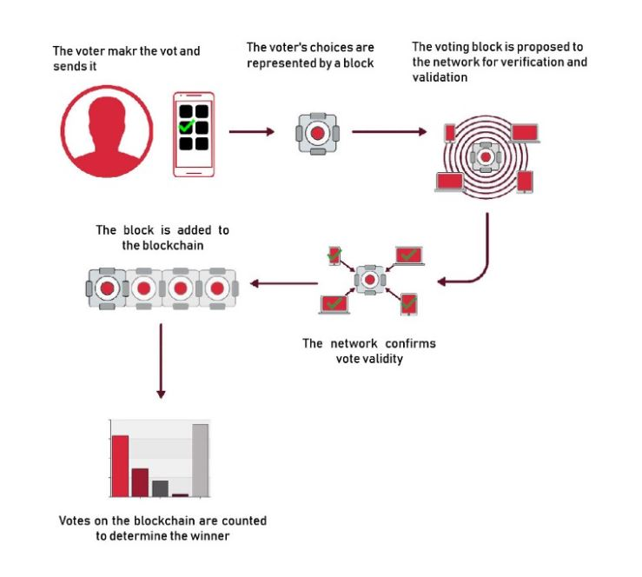
Adopting Blockchain technology to build decentralized voting system to: - Improve the efficiency of the electoral process. - Reduce processing time of collecting & counting votes - Increase voter privacy by using their private keys - Eliminate fraudulent - Maximize transparency & security
Hypothesis of the project
Core message

