Slide 1

EZVote
Rasha flores
Muhammed Perak

Slide 2
Adopting Blockchain technology to build decentralized voting system to: - Improve the efficiency of the electoral process. - Reduce processing time of collecting & counting votes - Eliminate fraudulent - Maximize transparency & security
Hypothesis of the project
Core message

Slide 3
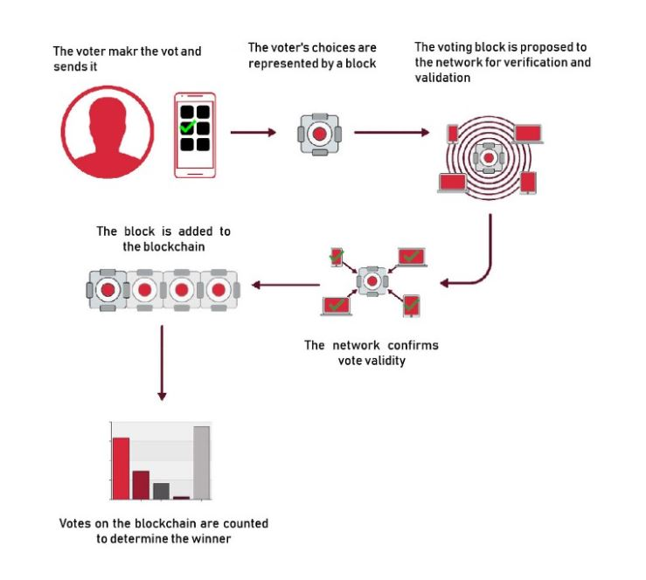
Adopting Blockchain technology to build decentralized voting system to: - Improve the efficiency of the electoral process. - Reduce processing time of collecting & counting votes - Increase voter privacy by using their private keys - Eliminate fraudulent - Maximize transparency & security
Hypothesis of the project
Core message

Slide 4
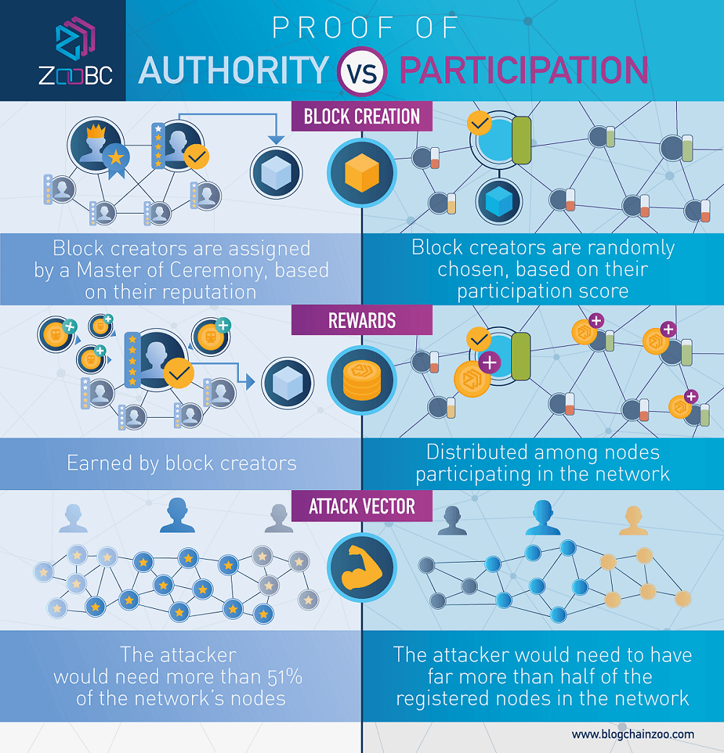
POA Consensus Algorithm
Votes and blocks are validated by approved accounts known as Validators.
Pre-assigned entities so no one can interfere with election results.
Validators put their identity & reputation at stake.
Smart contracts are trackable
irreversible applications that
execute in a decentralized
Environment.

