Slide 1
Time series analysis & forecasting of International Airline Activity
Data Exploration & Forecasting for International passengers, freight and mail data for Australia
Presented By: Sasha, Rich, Bharat
12/12/2019

Slide 2
Agenda
Problem Statement
Time Series Dataset Used
Data Exploration
STL Decomposition
Holt Winters Model
ARIMA Model
Prophet
Results & Conclusion
Future Work/Improvements

Slide 3
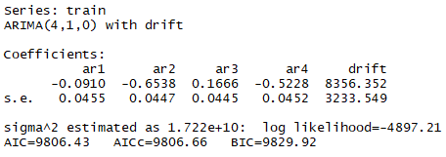
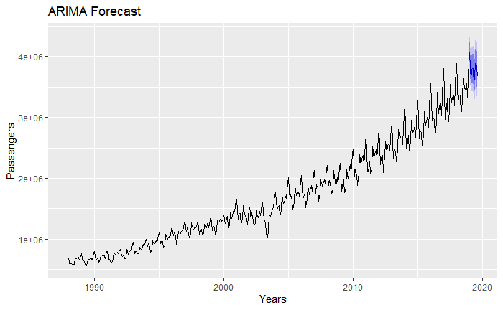
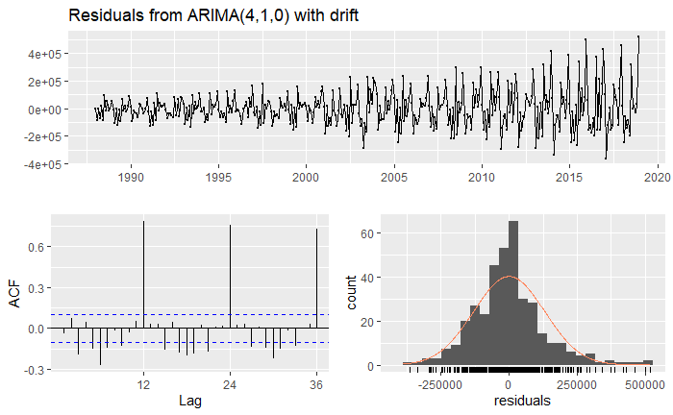
Passenger ARIMA
ARIMA (4,1,0) model returned from auto.arima with seasonal set to FALSE
Not a great fit for our data because there is seasonality
P-value 0.4423 of box test shows residuals not autocorrelated
sMAPE 0.0807 higher than other models

Slide 4
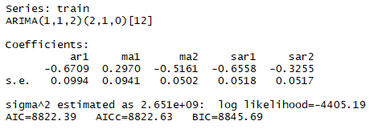
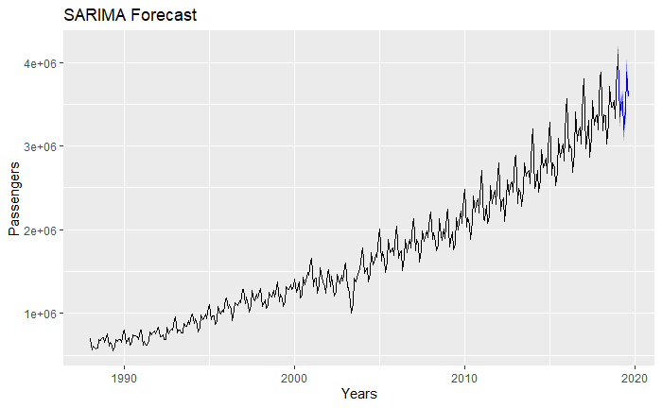
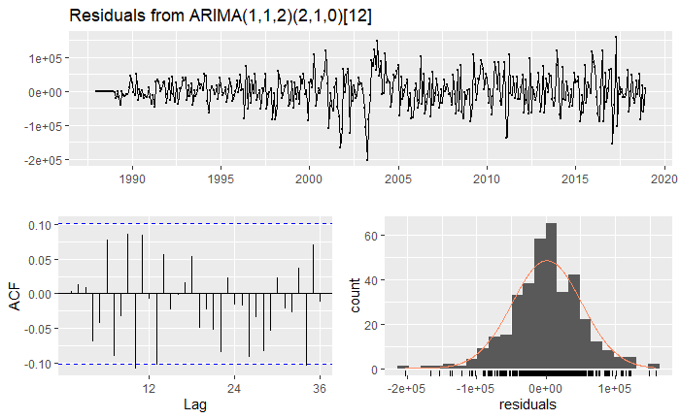
Passenger SARIMA
ACF/PCAF suggests SARIMA model could be best candidate
P-value 0.949 of box test shows residuals not autocorrelated
sMAPE 0.0222 lower than ARIMA

Slide 5
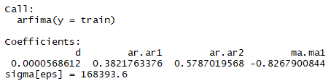
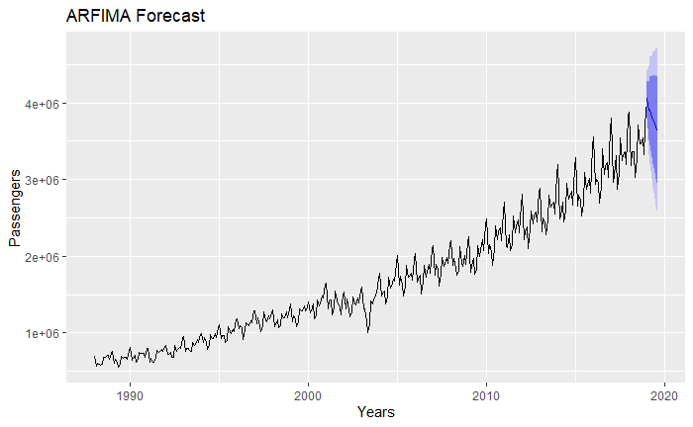
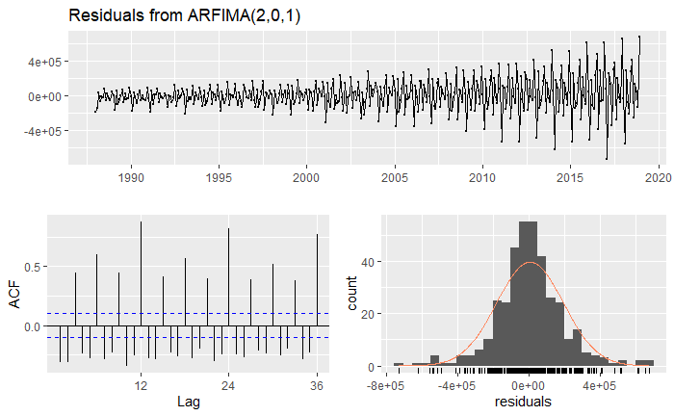
Passenger ARFIMA
ACF does not have a tapering/decaying pattern – suggests this is wrong model for data
P-value 1.869e-09 of box test shows residuals are autocorrelated
sMAPE .0941 much higher than other ARIMA models

Slide 6
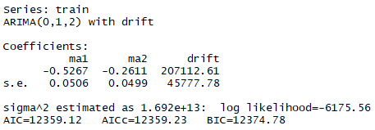
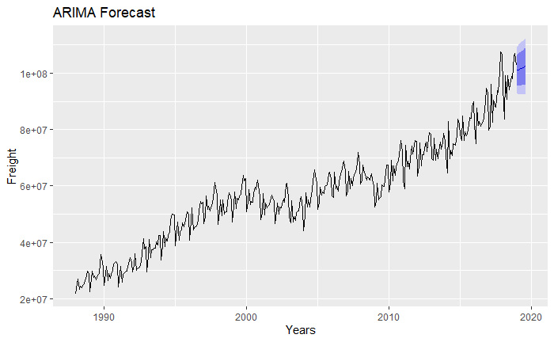
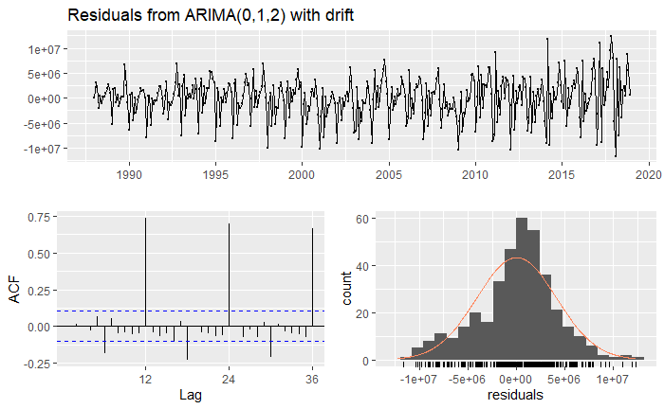
Freight ARIMA
P-value 0.979 of box test shows residuals are not autocorrelated
sMAPE 0.1361 higher than SARIMA

Slide 7
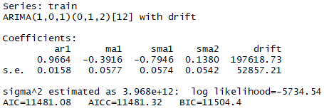
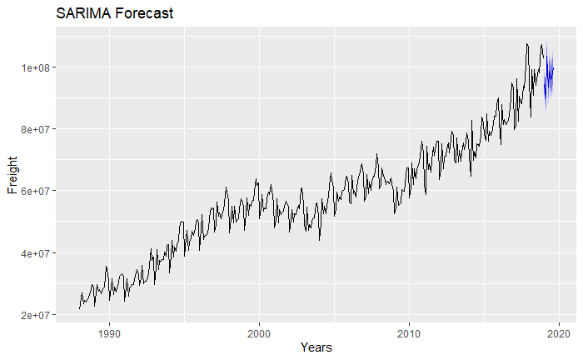
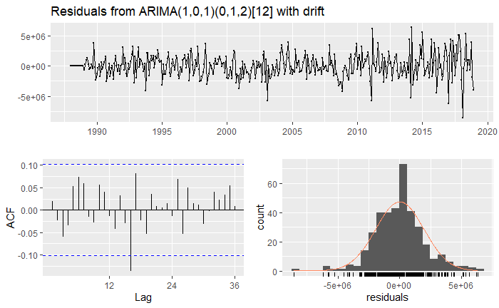
Freight SARIMA
P-value 0.7018 of box test shows residuals are not autocorrelated
sMAPE 0.0828 lower than ARIMA

Slide 8
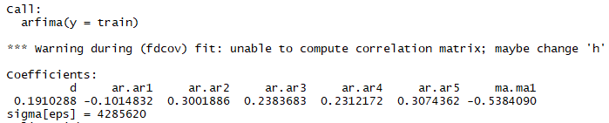
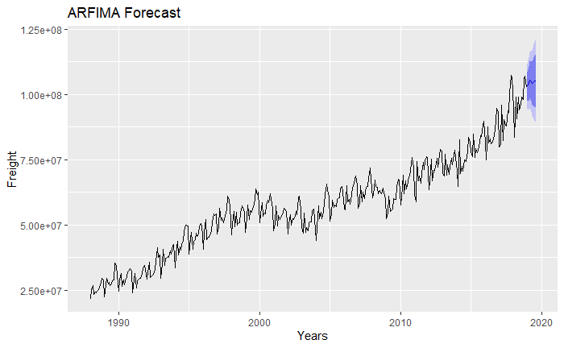
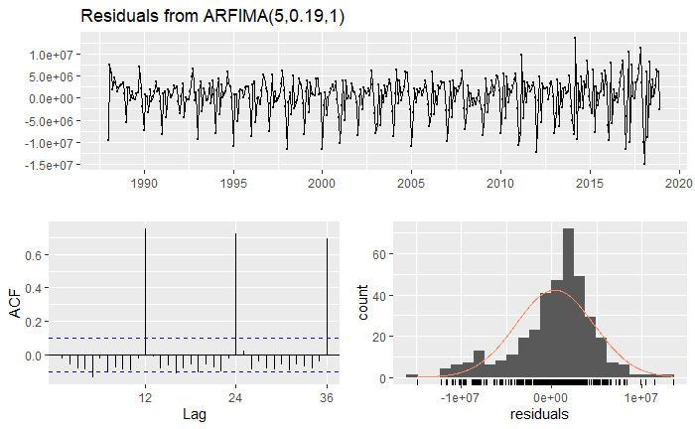
Freight ARFIMA
P-value 0.6884 of box test shows residuals are not autocorrelated
sMAPE 0.1647 is higher than other models

Slide 9
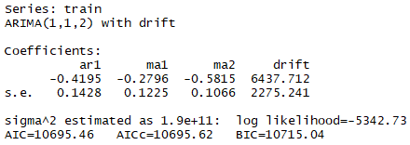
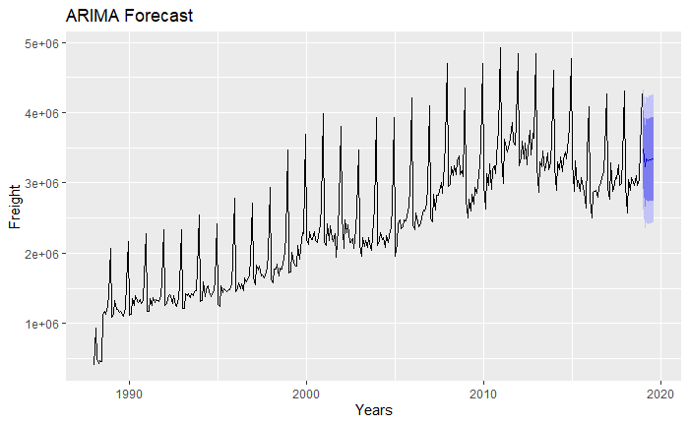
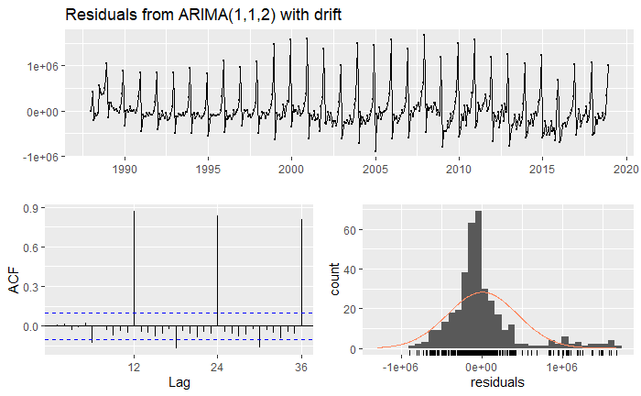
Mail ARIMA
P-value 0.8651 of box test shows residuals are not autocorrelated
sMAPE 0.0881 higher than other models

Slide 10
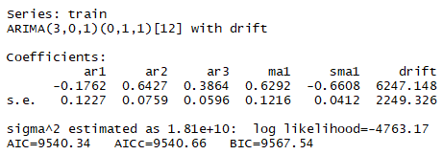
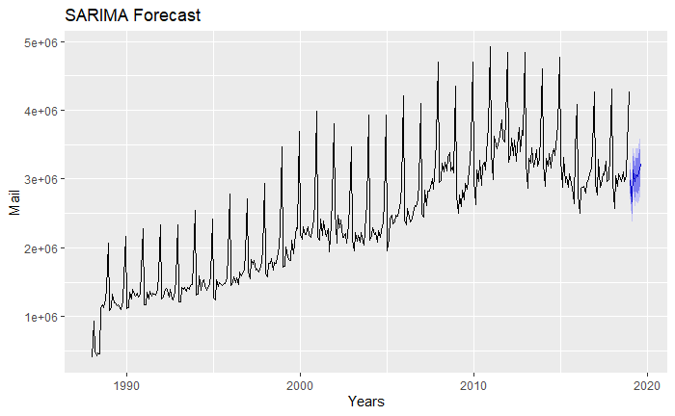
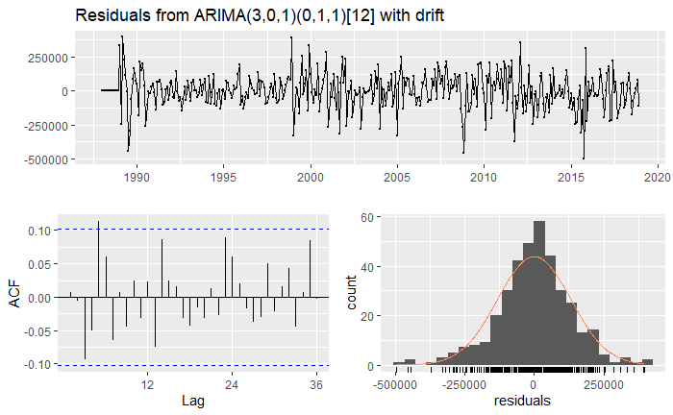
Mail SARIMA
P-value 0.9008 of box test shows residuals are not autocorrelated
sMAPE 0.0199 lower than ARIMA

Slide 11
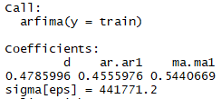
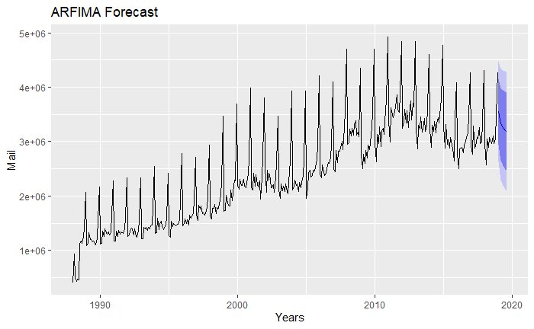
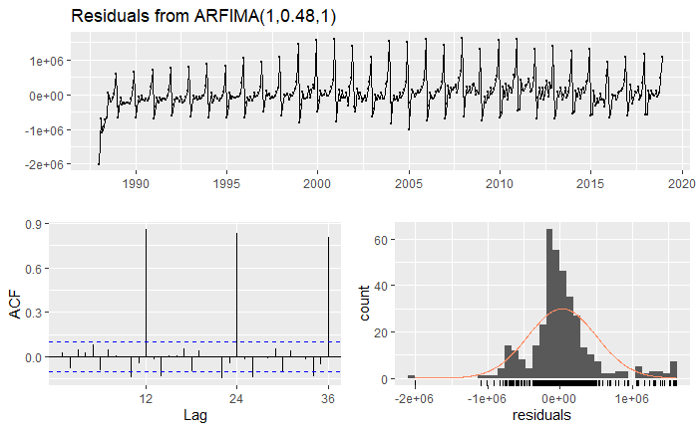
Mail ARFIMA
P-value 0.6189 of box test shows residuals are not autocorrelated
sMAPE 0.0849 higher than other models

